Slide 1
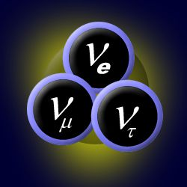
NEUTRINOS A NEW WINDOW TO THE UNIVERSE
C. Spiering
Yerevan, 30.5.2013

Slide 2
Postulate and discovery of neutrinos

Slide 3
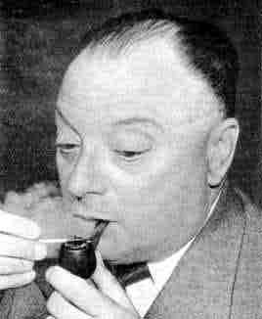
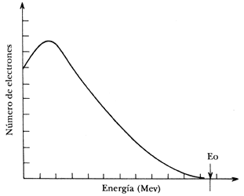
The postulate of the Neutrino
energy spectrum
of electrons from
β - decay
Expected for 2-particle final state
n → p + e⁻
Wolfgang Pauli, 1930

Slide 4
The postulate of the Neutrino
energy spectrum
of electrons from
β - decay
n → p + e⁻ + ν
Wolfgang Pauli, 1930

Slide 5
The postulate of the Neutrino
energy spectrum
of electrons from
β - decay
n → p + e⁻ + ν_{e}
Wolfgang Pauli, 1930

Slide 6
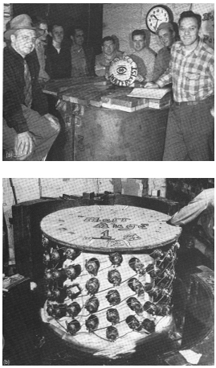
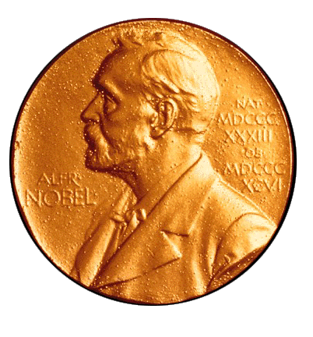
Discovery 1956
Cowan und Reines
Nobel prize 1995

Slide 7
1962: Discovery of the muon neutrino (ν_{μ})
Bruno Pontecorvo
Lederman,
Schwarz,
Steinberger
Nobel prize 1988
p
π
μ
ν_{μ}
Target
μ-Absorber
π-decay:
π → μ ν_{μ}
Accelerator
Neutrino beam

Slide 8
1962: Discovery of the muon neutrino (ν_{μ})
p + Target → π + …..
→ μ + ν_{μ}
p
π
μ
ν_{μ}
Target
μ-Absorber
π-decay:
π → μ ν_{μ}
Accelerator
Neutrino beam

Slide 9
neutrinos as messengers challenges and benefits

Slide 10
The challenge
Weak interactions: σ_{νN} ~ 10⁻³⁸ × E_{ν}/GeV cm²
Interaction probability when crossing the full Earth
solar neutrinos (keV/MeV range): ~ 10⁻¹⁰
1 TeV neutrinos: ~ 10⁻²
100 TeV neutrinos: ~ 0.8
need huge detectors

Slide 11
The benefits
Neutrinos ...
... can escape dense celestial bodies
the Sun
fresh neutrons star
dense regions close to black holes
interior of the Earth
core of nuclear reactors
... are not absorbed on their journey
... travel straight

Slide 12
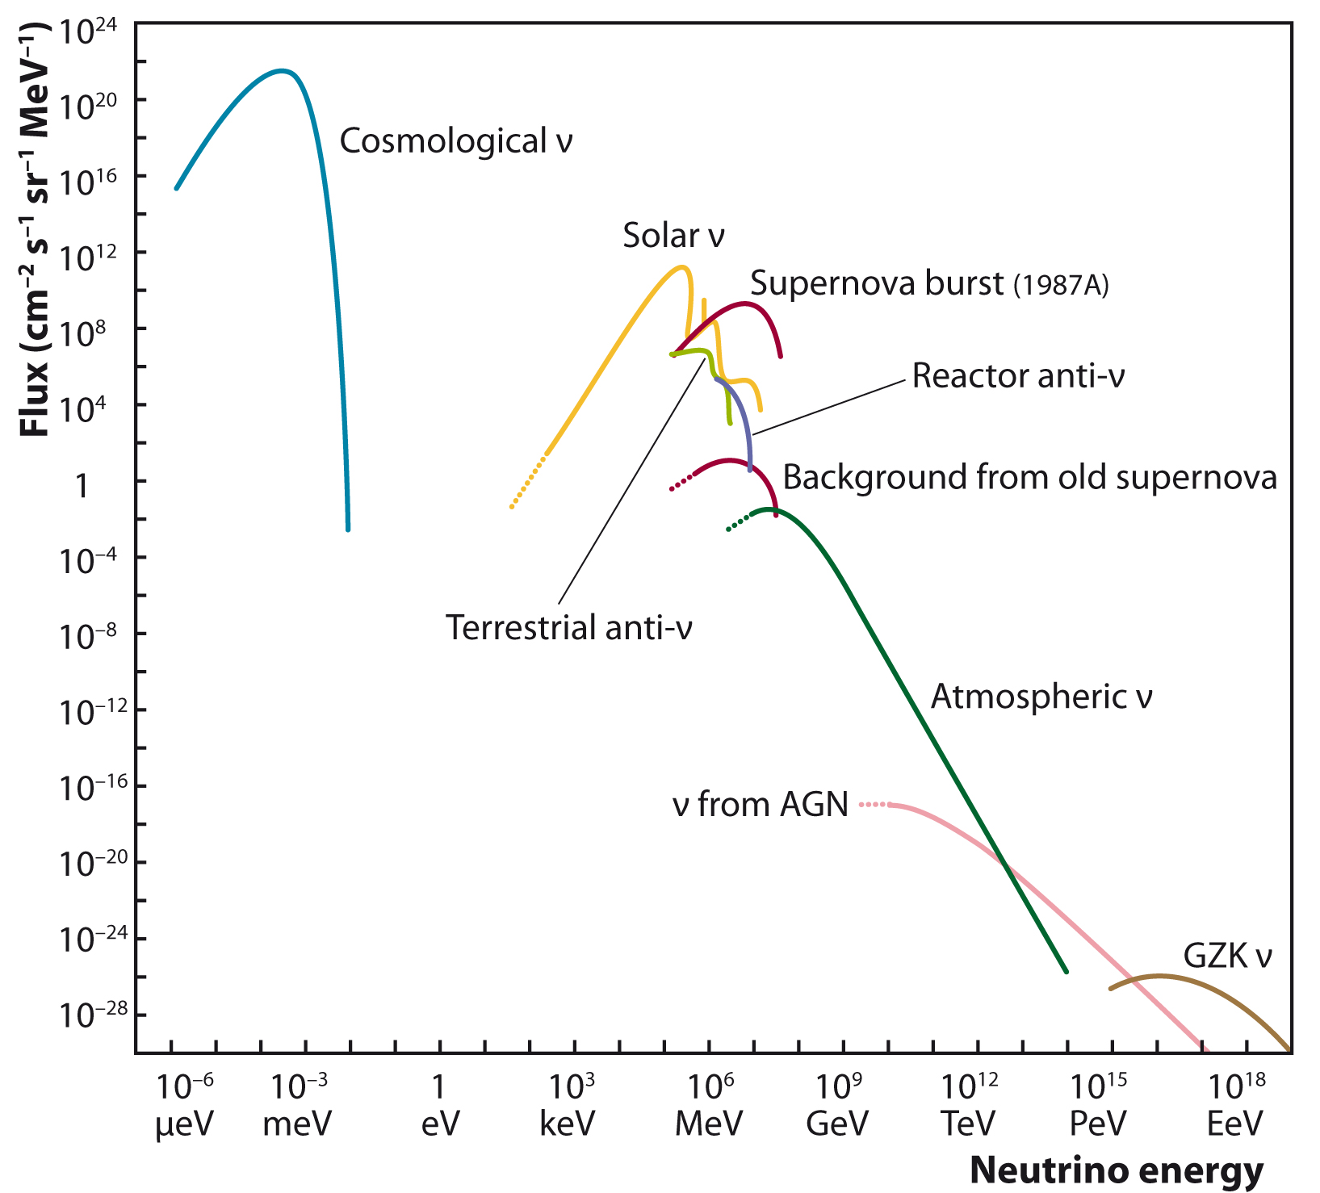
Neutrinos are everywhere

Slide 13
Supernova 1987A The birth of neutrino astronomy

Slide 14
Supernova 1987A
in the Large Magellanic Cloud
23.2.1987

Slide 15
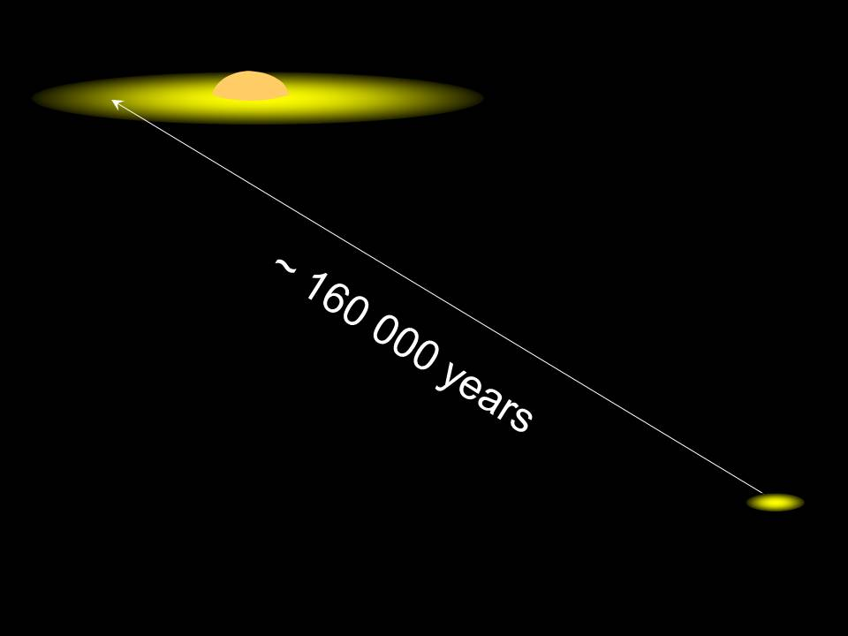

Slide 16
What happened?
Star exhausts its nuclear fission power and collapses to a neutron star, ∅ ~ 30 km
proton + e⁻ → neutron + ν_{e}
Short pulse of electron neutrinos (~ 10 msec)
Neutron star cools down over ~10 sec (99% of the energy emission via neutrinos!)

Slide 17
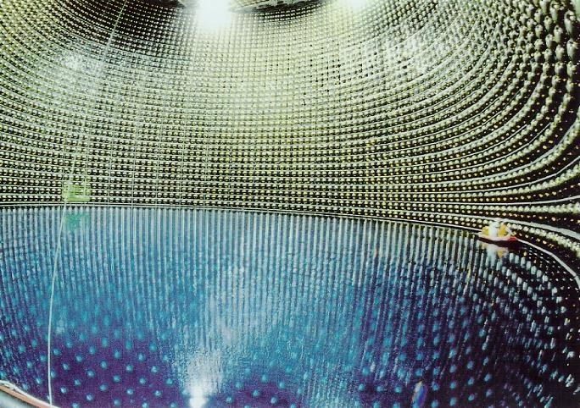
Super-Kamiokande
Japan

Slide 18
Neutrinos in Kamiokande
ν_{e}
e⁺

Slide 19
Neutrino Signal from SN-1987A
in Kamiokande
SN 1987A
Noise

Slide 20
What have we learned?
12 events in Kamiokande, 8 in IMB (Ohio), 3 in Baksan (Russia)
Temperature in the fresh neutron star: 30-50 billion Kelvin
Mass of neutrinos < 20 eV
... plus many other conclusions
SN 1987A
Noise

Slide 21
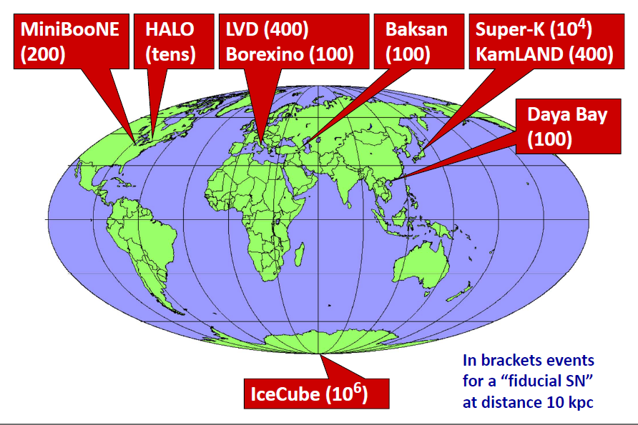
Experiments ready to detect a Supernova today
SNO+
(800)
commissioning
phase

Slide 22
Solar neutrinos what fuels the Sun?

Slide 23
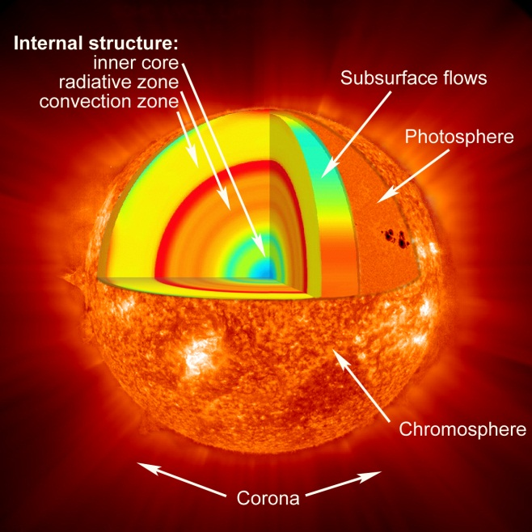

Slide 24
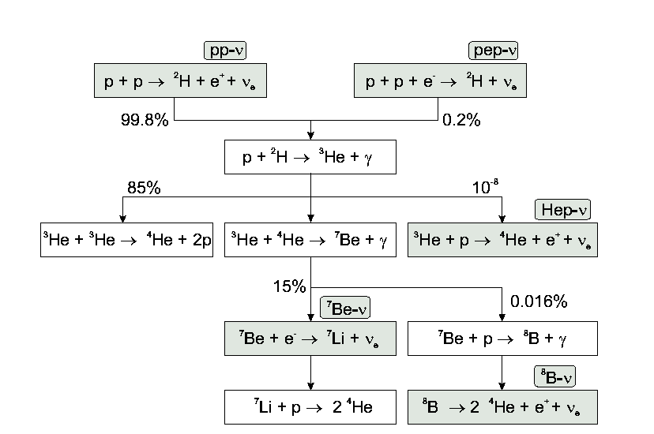
The proton-proton chain

Slide 25
The proton-proton chain

Slide 26
The proton-proton chain
1991
2012
2009
1969

Slide 27
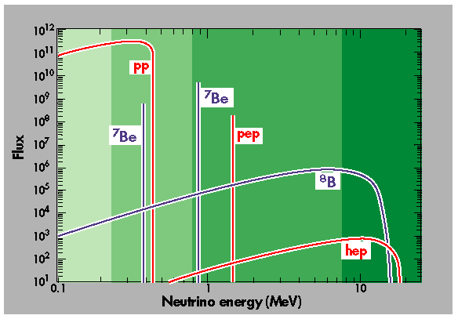

Slide 28
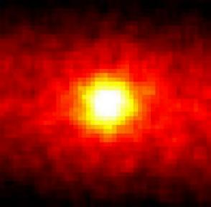
The Sun in Neutrinos

Slide 29
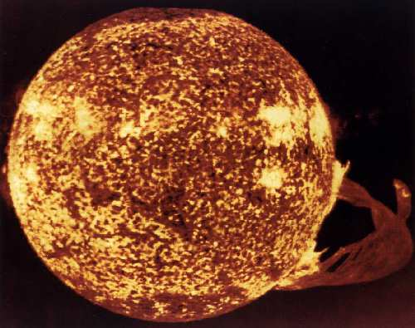
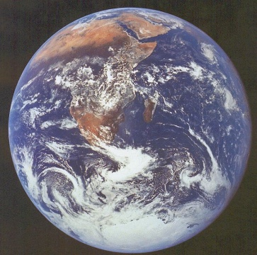
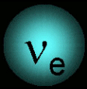
What have we learned?
The basic mechanism of the Sun is confirmed with a few percent accuracy
Neutrinos change their identity on their way to Earth („oscillations“)
neutrinos change
their identity on
their way to Earth
→ neutrinos have a mass

Slide 30
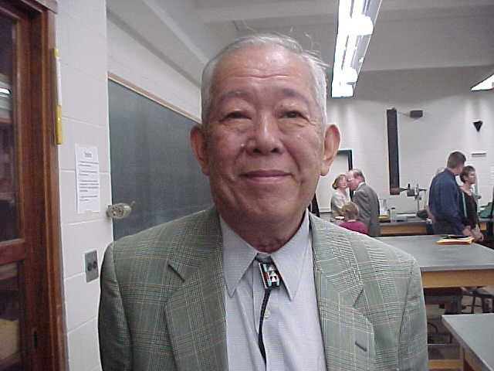
Solar and Supernova Neutrinos:
2002
„… for opening a new observational window
to the Universe“
Raymond Davis jr. Masatoshi Koshiba

Slide 31
Icecube and the high-energy universe

Slide 32
A century ago: discovery of cosmic rays
Victor Hess 1912
Nobel Prize 1936

Slide 33
What do we know about cosmic rays?
What do we know?
Composition: Protons and light and heavy nuclei
Spectrum: Energies up to 10 million of that of the Large Hadron Collider in Geneva (10²⁰ eV)!
Contribute substantially to the energy budget of our Galaxy.
What don‘t we know?
What are the sources? How do they work?
Suspected sources: shock fronts of Supernova remnants, environment of black holes, ...

Slide 34
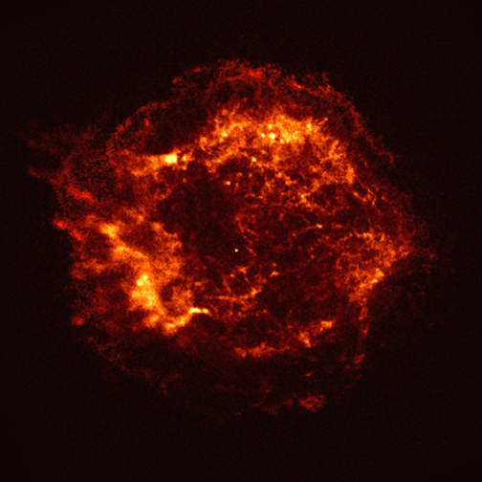
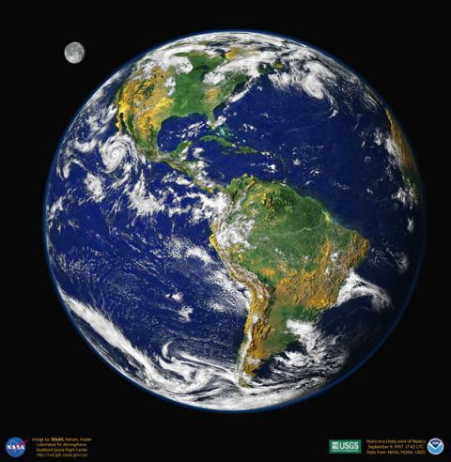
Charged cosmic rays vs. gamma rays vs. neutrinos
Charged particles
γ,ν
ν

Slide 35
Detection principle (1)

Slide 36
Detection principle (2)
⟨θ_{νμ} ⟩ ~ 1°/√E (TeV)
μ
ν_{μ}

Slide 37
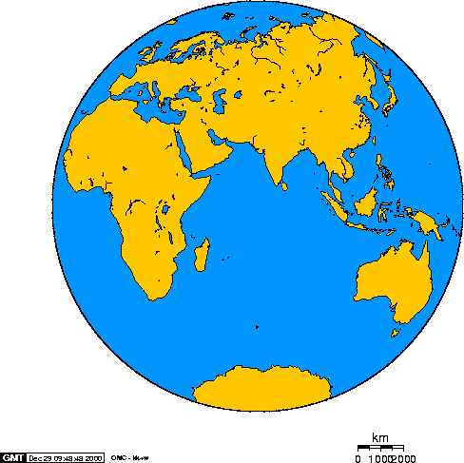
High-energy neutrino telescopes
Baikal
Antares
GVD
KM3NeT
Amanda
IceCube

Slide 39
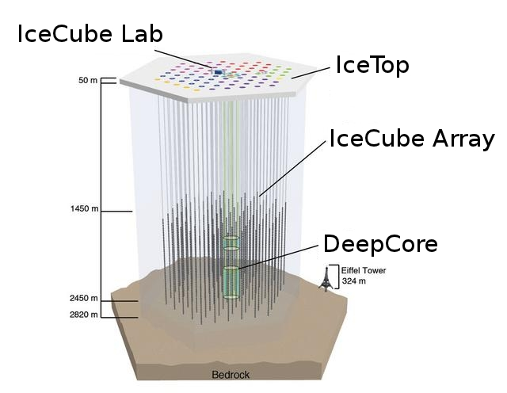
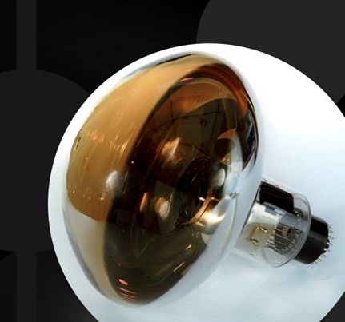
The IceCube Neutrino Observatory
5160 optical sensors
buried deep in the
Antarctic ice
A full km³ of ice
instrumented!
10´´ photo-multiplier

Slide 40
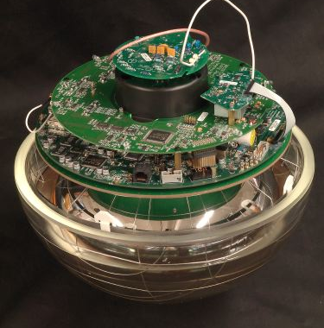
The IceCube Neutrino Observatory
5160 optical sensors
buried deep in the
Antarctic ice
A full km³ of ice
instrumented!

Slide 41
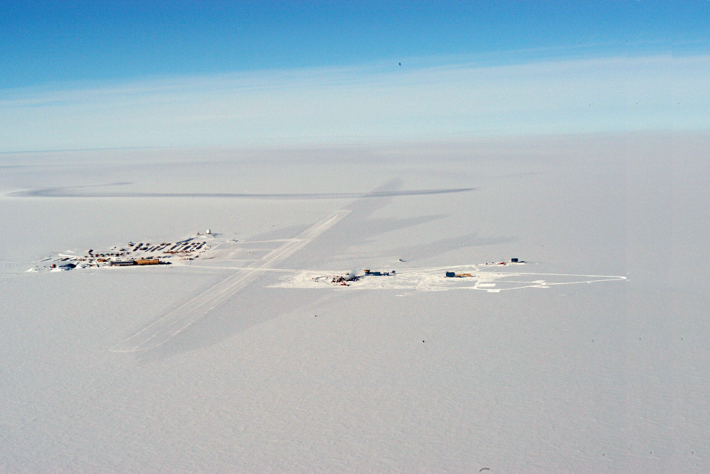
The Amundsen-Scott Station
South Pole Station Building Astronomy Sector
IceCube
AMANDA
skiway

Slide 42
Drill Camp
- 5 MW power
- 16 m³ Kerosine
per hole

Slide 43
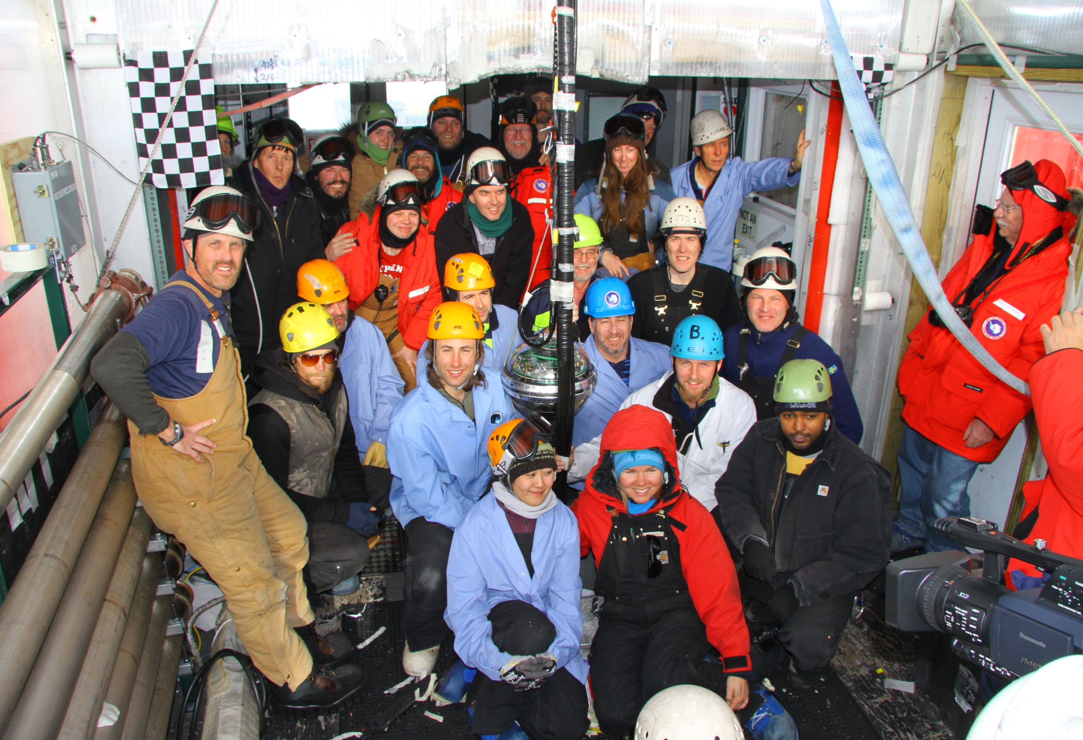
Besseres Bild
Dec.18, 2010: the last string

Slide 44
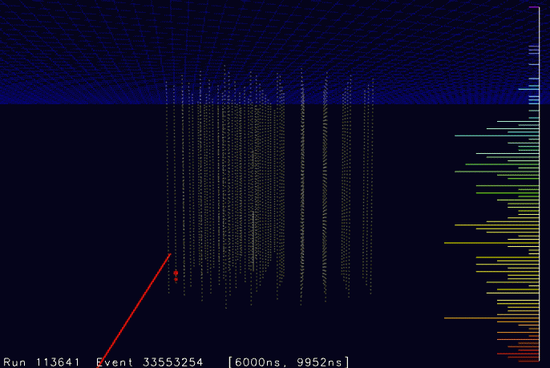

Slide 45
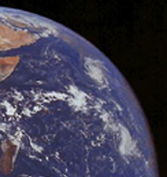
Atmospheric Neutrinos
π⁺
μ⁺
e⁺
ν_{μ}
ν_{e}
ν_{μ}
≈15 km

Slide 46
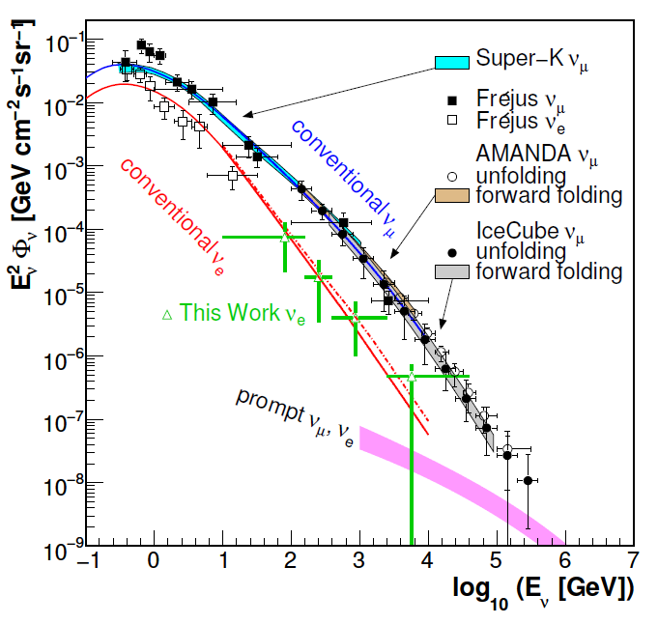
Atmospheric Neutrinos
proton
c,(b)
prompt
e,μ
νe,μ
π
μ
νμ
e
νμ
νe
conventional

Slide 47
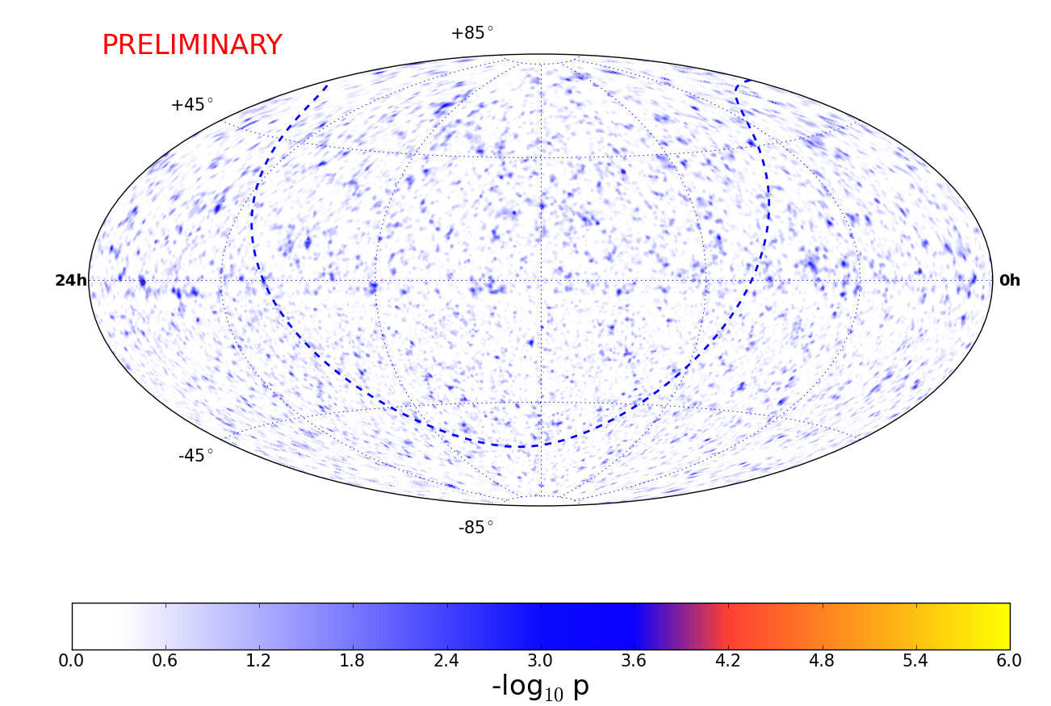
IceCube Neutrino Sky-Map

Slide 48
Last 12 years: a factor 1000 !
Amanda
2000
Antares 800 days
IceCube 40+59+79
IceCube
2012

Slide 49
Point Source Summary
Giant leap: have improved the sensitivity to point sources by a factor 1000 compared to 12 years ago
No point sources (yet) identified
Another factor 10 to come within the next few years.
Entering region with very high discovery potential

Slide 50
However ...

Slide 51
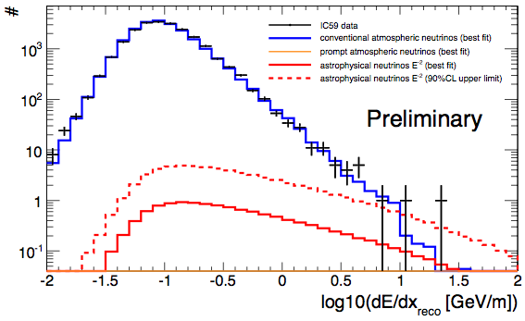
Tantalizing excesses at high energies
A 200 TeV muon crossing IceCube
(the highest energy muon we have detected)
2.1σ excess

Slide 52
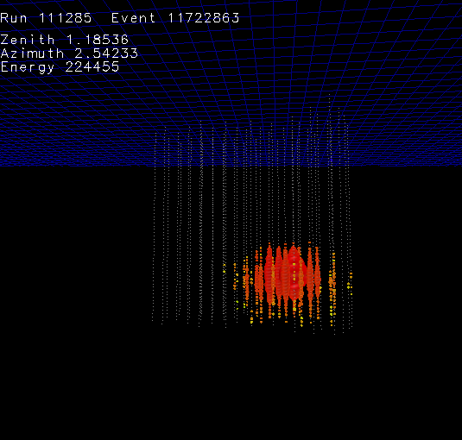
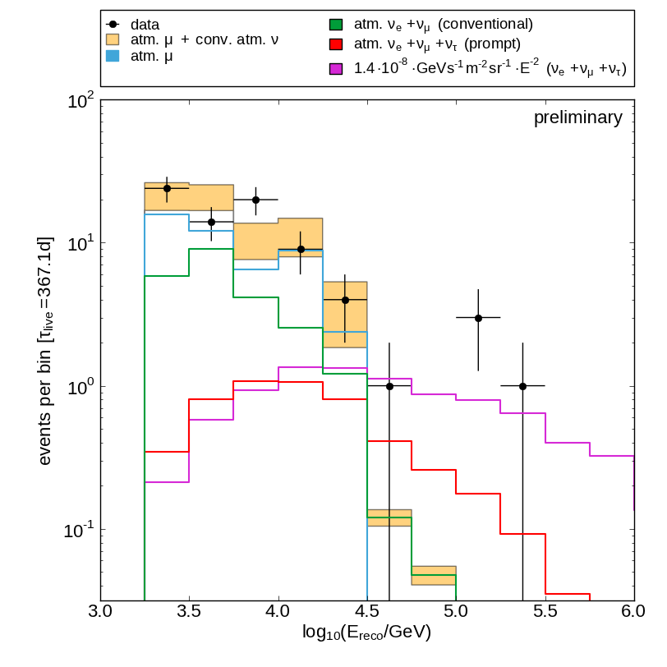
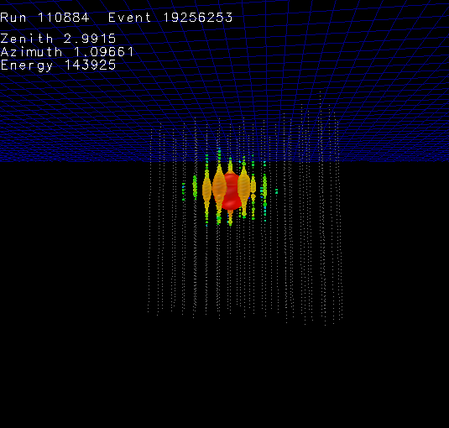
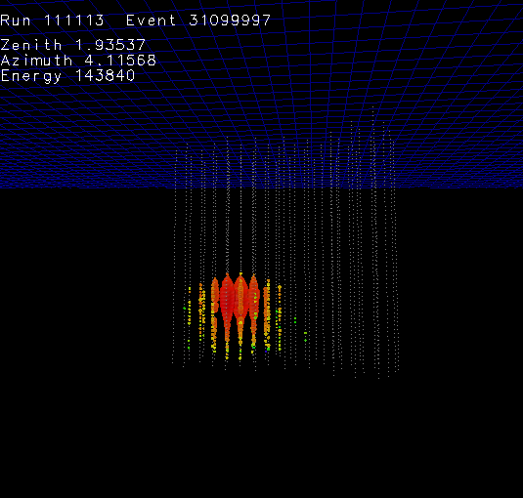
Tantalizing excesses at high energies
3 cascade events with IC-40 2.3σ excess
~ 220 TeV
~ 140 TeV
~ 140 TeV

Slide 53
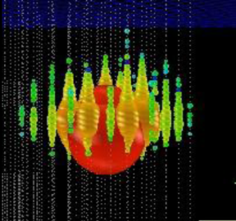
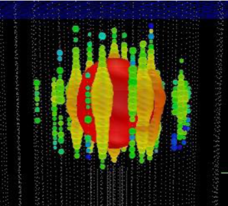
Tantalizing excesses at high energies
Ernie Bert
~1.1 PeV ~ 1.3 PeV
Atmospheric neutrinos from charm decay („prompt neutrinos“) or extraterrestrial neutrinos ??
2.6 σ excess

Slide 54
The break-through?
26 more events („starting track analysis“)
Significance of all 28 events 4.3 σ
More data to be analyzed
Expect > 5σ at end 2013
Systematics! (Charm, Energy scale, ...)
Ernie and Bert

Slide 55
Other physics / Astrophysics

Slide 56
Myon Astronomy?

Slide 57
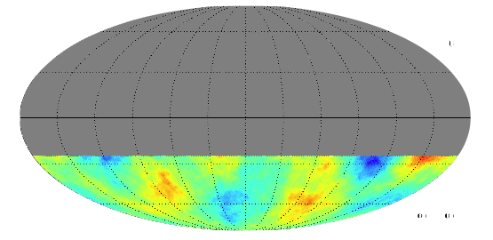
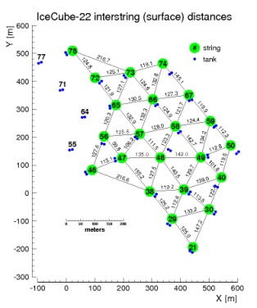
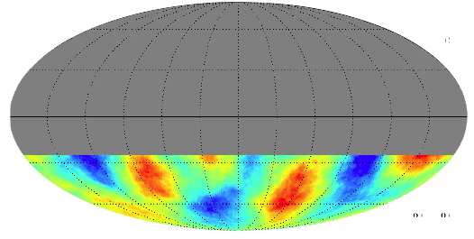
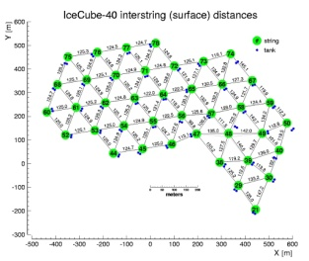
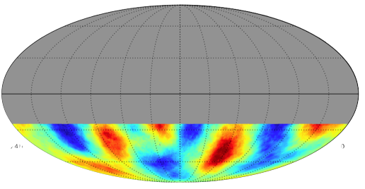
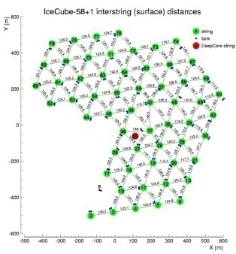
IC22
IC40
IC59

Slide 58
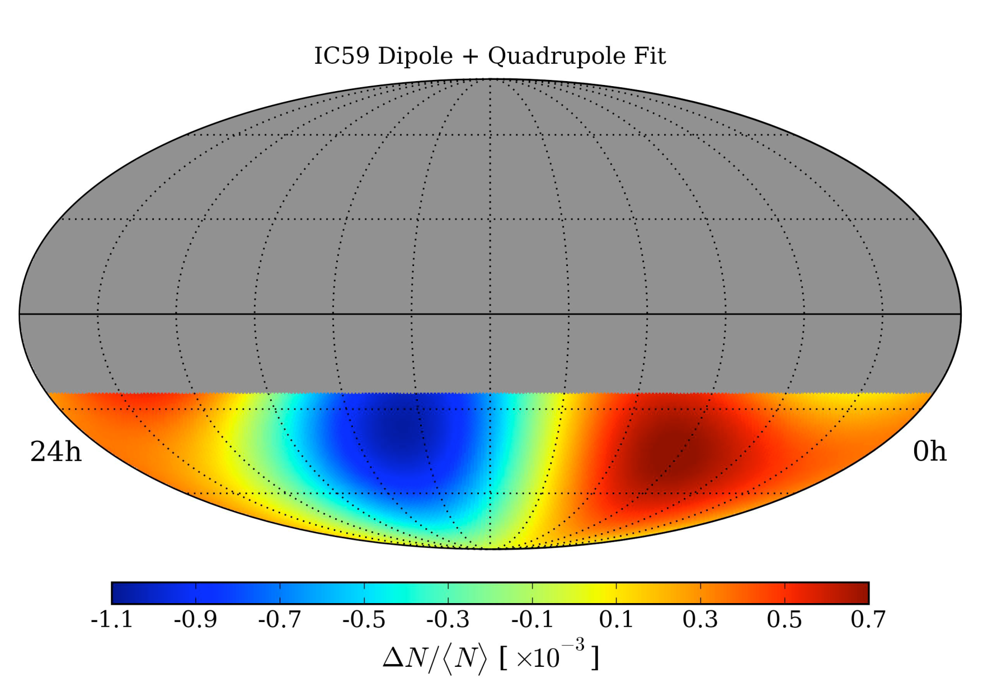

Slide 59
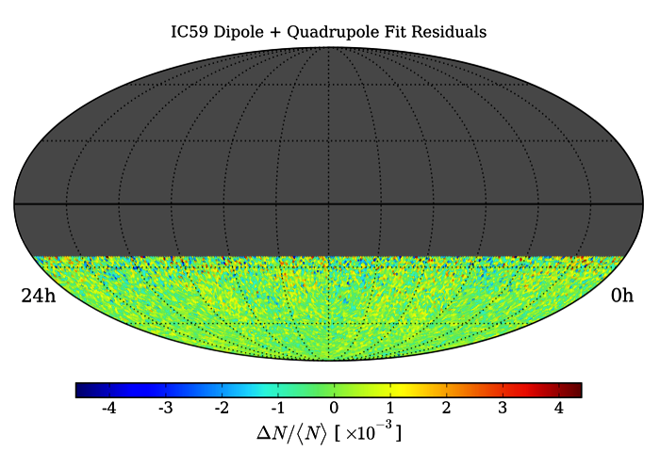
Small scale anisotropies not immediately visible (smoothing needed)

Slide 60
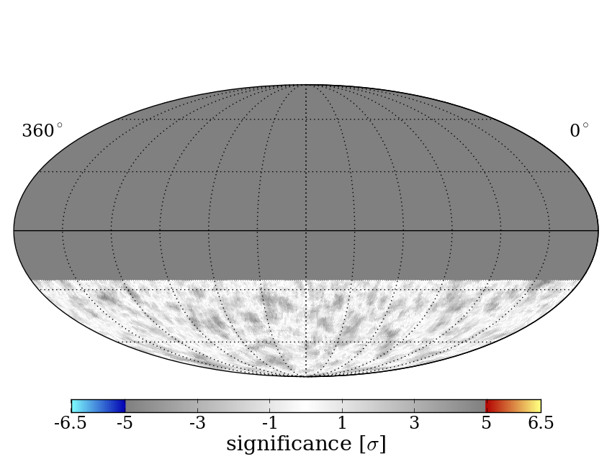
Map smoothing scan
Scan from 1 - 30° in smoothing
Different regions have different optimal smoothings
Significances are pre-trial
3° smoothing

Slide 61
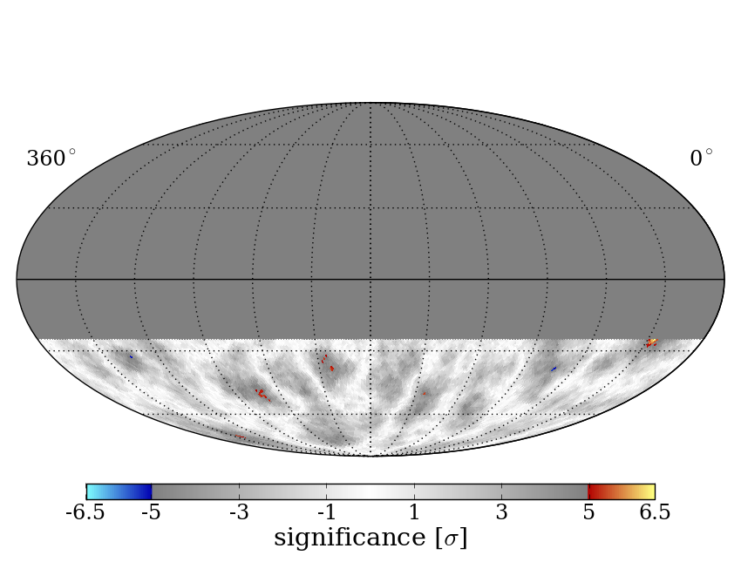
Map smoothing scan
Scan from 1 - 30° in smoothing
Different regions have different optimal smoothings
Significances are pre-trial
6° smoothing

Slide 62
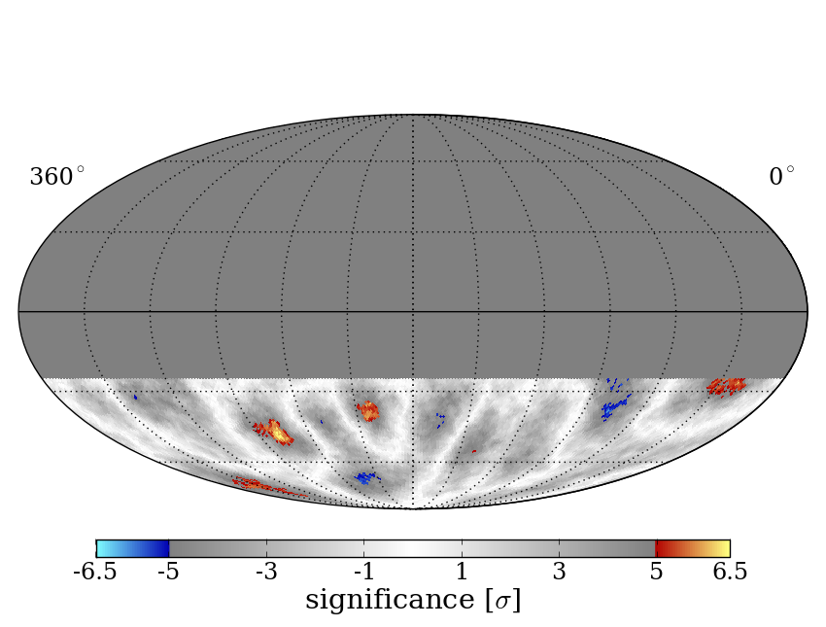
Map smoothing scan
Scan from 1 - 30° in smoothing
Different regions have different optimal smoothings
Significances are pre-trial
9° smoothing

Slide 63
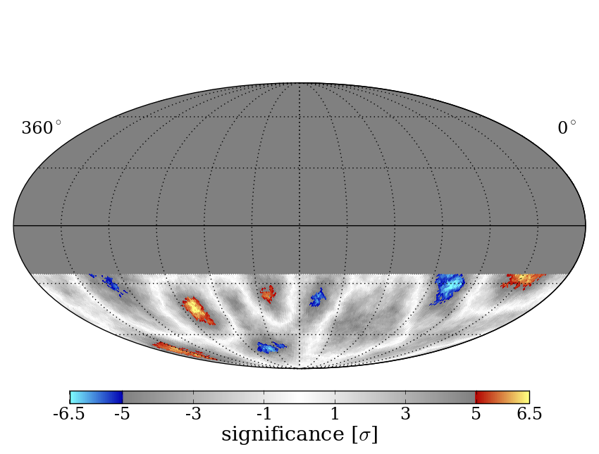
Map smoothing scan
Scan from 1 - 30° in smoothing
Different regions have different optimal smoothings
Significances are pre-trial
12° smoothing

Slide 64
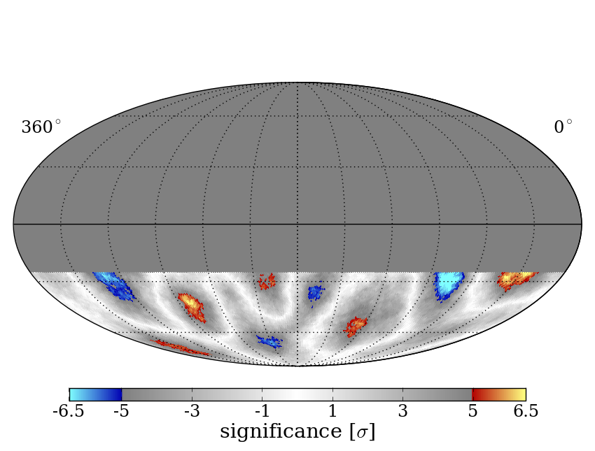
Map smoothing scan
Scan from 1 - 30° in smoothing
Different regions have different optimal smoothings
Significances are pre-trial
15° smoothing

Slide 65
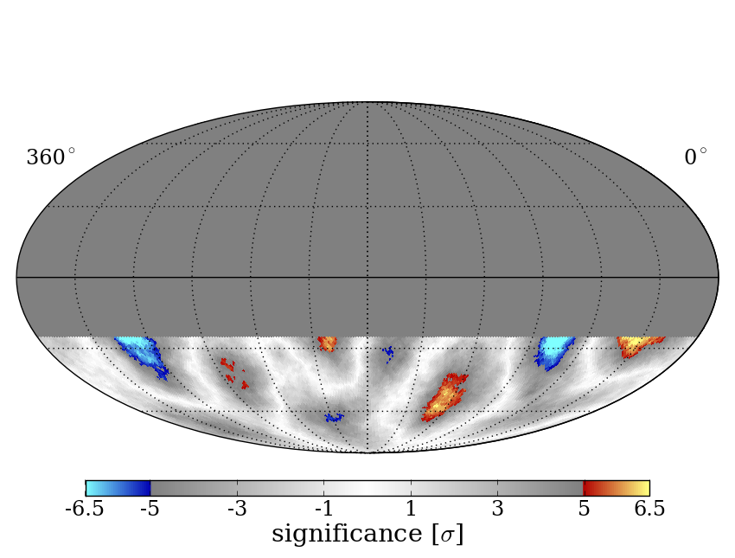
Map smoothing scan
Scan from 1 - 30° in smoothing
Different regions have different optimal smoothings
Significances are pre-trial
18° smoothing

Slide 66
Map smoothing scan
Scan from 1 - 30° in smoothing
Different regions have different optimal smoothings
Significances are pre-trial
21° smoothing

Slide 67
Map smoothing scan
Scan from 1 - 30° in smoothing
Different regions have different optimal smoothings
Significances are pre-trial
24° smoothing

Slide 68
Map smoothing scan
Scan from 1 - 30° in smoothing
Different regions have different optimal smoothings
Significances are pre-trial
27° smoothing

Slide 69
Map smoothing scan
Scan from 1 - 30° in smoothing
Different regions have different optimal smoothings
Significances are pre-trial
30° smoothing

Slide 70
Energy dependence
IceCube-59: 20 TeV
Change
of polarity
IceCube-59: 400 TeV
IceTop-59: PeV-range

Slide 71
North and South
Anisotropies of cosmic rays/muons seen on the Northern hemisphere (Tibet, Milagro/Super-K) are also seen via IceCube muons from the Southern hemisphere.

Slide 72
Possible reasons for anisotropies
Dipole:
Discrete spatial distribution of PeV cosmic ray sources?
Compton-Getting effect (movement of solar system against the plasma of cosmic rays)?
Smaller structures:
Special magnetic field configurations (channeling)?
Turbulent propagation of cosmic rays in galactic magnetic fields?
Heliospheric effects ???? (not at >> TeV)
Nearby sources??

Slide 73
Indirect dark matter search and neutrino oscillations

Slide 74
WIMP detection
, e⁺, p

Slide 75
Indirect Dark Matter Search

Slide 76
Indirect Dark Matter Search

Slide 77
Oscillations of atmospheric neutrinos
Muon neutrino survival probability
Vertically
upward
cosmic ray
ANTARES/DeepCore
ν
Earth
L
θ
Horizontal

Slide 78
Oscillations of atmospheric neutrinos
Muon neutrino survival probability
Vertically
upward
ANTARES/DeepCore
Horizontal

Slide 79
Oscillations of atmospheric neutrinos
Muon neutrino survival probability
Vertically
upward
ANTARES/DeepCore
Horizontal

Slide 80
Future mega-projects

Slide 81
LENA, GLACIER Europe
LBNE USA, Hyper-K Japan
Daya-Bay2 China , Hano-Hano, USA
KM3NeT Med-Terr. Sea
GVD Lake Baikal
IceCube++ South Pole
PINGU
South Pole
ARA, ARIANNA
Antarctica

Slide 82
summary

Slide 83
Neutrinos are unique cosmic messengers.
Rich legacy of gold-plated discoveries: solar, supernova and geo-neutrinos.
Neutrino oscillations have been discovered using solar and atmospheric neutrinos.
IceCube seems to see first extraterrestrial high-energy neutrinos. Light at the end of the tunnel !
Much more powerful detectors promise deep understanding of Sun, Earth interior, Supernovae and the origin of cosmic rays.
There is a fascinating decade ahead!

Slide 84
end

Slide 85
The CNO cycle
Dominant in heavy stars
Contributes only 0.5% in the Sun
CNO neutrinos not yet detected
But:
Solar CNO neutrinos provide key information about heavy elements in the Sun („metallicity puzzle“) !

Slide 86
Geo-neutrinos understanding the interior of the earth

Slide 87
Structure of the Earth
Crust
Mantle
Core

Slide 88
Heat loss of the Earth: 42-48 TW

Slide 89
Contributions to heat loss
Expect 14-24 TW due to radioactive decay in crust and mantle
Missing
Measure anti-neutrinos from U and Th decays in order to determine, at least, the heat production in mantel and crust

Slide 90
Expected fluxes of geoneutrinos

Slide 91
First detection and future needs
Kamland (liquid scintillation detector in Japan): 2005
Borexino (liquid scintillation detector in Italy): 2010
Heat production by U and Th decays 20±9 TW
Need to distinguish U and Th separately, pushing the error below ±2 TW and scrutinizing Earth models
→ DayaBay-2 China 20 kt
→ LENA Europe 25-50 kt

Slide 92
Example: LENA
Electronics Hall dome of 15m height
Top Muon Veto
Water Cherenkov Veto 2000 PMTs
Egg-Shaped Cavern
Concrete Tank
32,000 12‘‘-PMTs coverage: 30%
Active volume 50kt of scintillator
Depth:
4 km water equivalent
Finnish mine

Slide 93
What do we not know yet?
Why do we see less „metals“ at the solar surface than suggested by the solar model („metallicity puzzle“)?
→ measure CNO neutrinos
Are there tiny time modulations of the neutrino flux?
Hints from satellite experiment SOHO
Present limits : < 10%. Could be ~1% or less.
→ build larger detectors which
collect larger statistics!

Slide 94
LENA Science Potential
Proton decay sensitivity 10 years p →νK 4×10³⁴ y
SN at 10 kpc ~16,000 events
Diffuse SN signal/background 10 years 60/10
Solar neutrinos events/years
⁷Be 3,600,000
pep 100,000
⁸B 30,000
CNO 70,000
Geoneutrinos events/year 1500
Test new class of SUSY models
Bonanza for astro- and particle physics
Understand past supernovas
Test Sun with % accuracy
Resolve remaining puzzles
(Will there be more?)
Understand the energy budget of our planet

Slide 95
Looking
deep into …
… the Sun
… the Earth
… a Supernova
… environment
of black holes
Crust
Mantle
Core

Slide 96
... and „tomorrow“
Several projects for huge detectors:
USA: LBNE detector at Homestake mine 10-34 kt liquid argon
Japan: Hyper-Kamiokande up to 500 kt water
Europe: LBNO 25-70 kt liquid argon
LENA 25-50 kt scintillator
- China: DayaBay 2 20 kt liquid scintillator
~10⁵ ν-events from SN in center of our Galaxy
Bonanza for particle physics and astroparticle physics !

