Slide 1

Seven years of Astroparticle Roadmapping x
Progress, Reality Check, Lessons
Christian Spiering

Slide 2
steady progess
The last 18 months:

Slide 3
θ₁₃

Slide 4
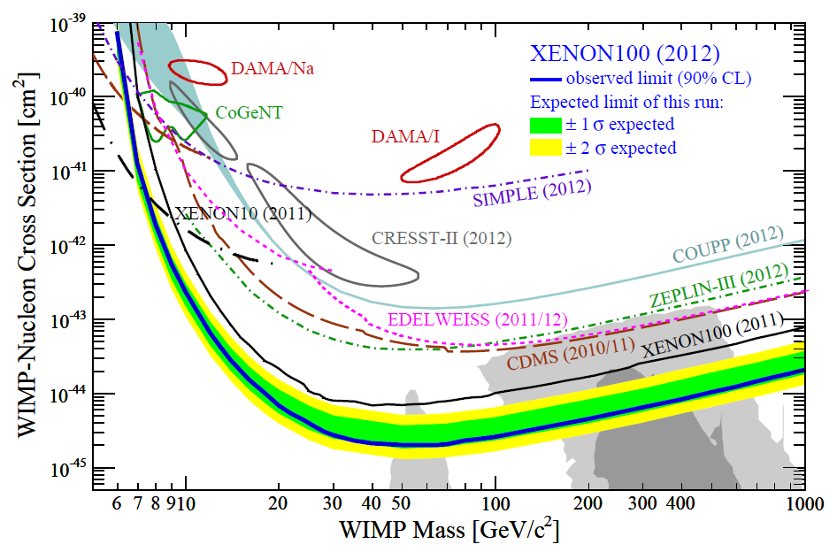

Slide 5
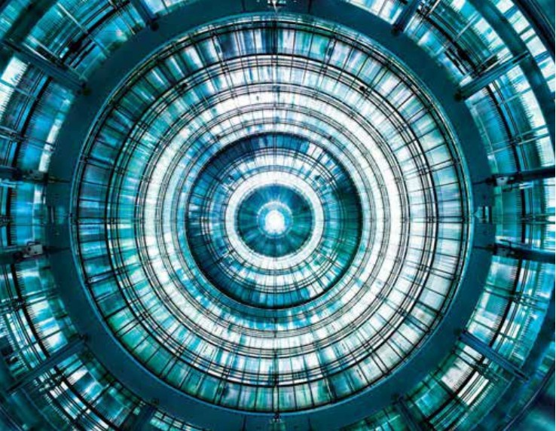
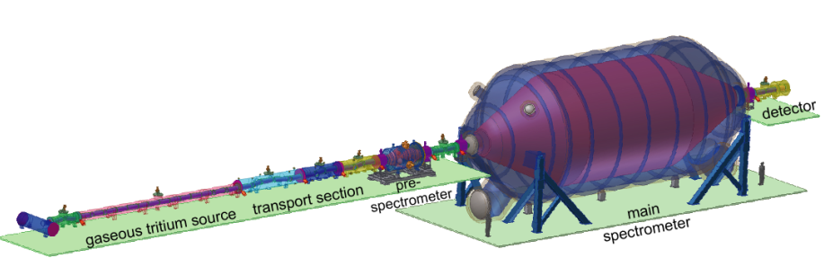
KATRIN Main Spectrometer
electrode sytem installed (Jan 2012)

Slide 6
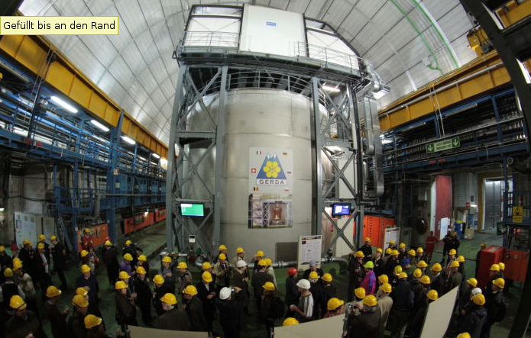
GERDA: taking data
Unblinding: Spring 2013

Slide 7
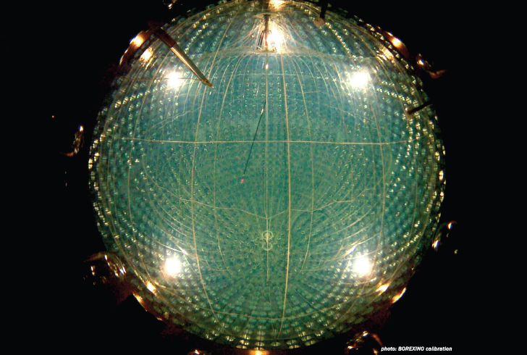
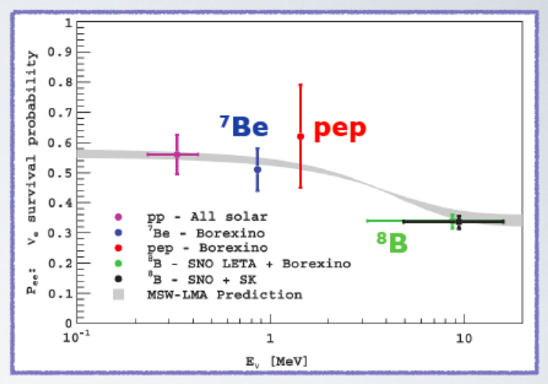
Borexino
Solar nu: ⁷Be, pep geo-neutrinos

Slide 8
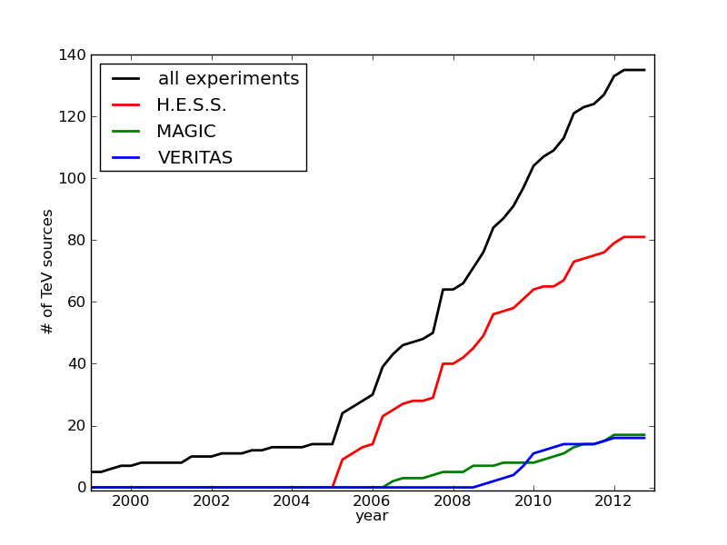
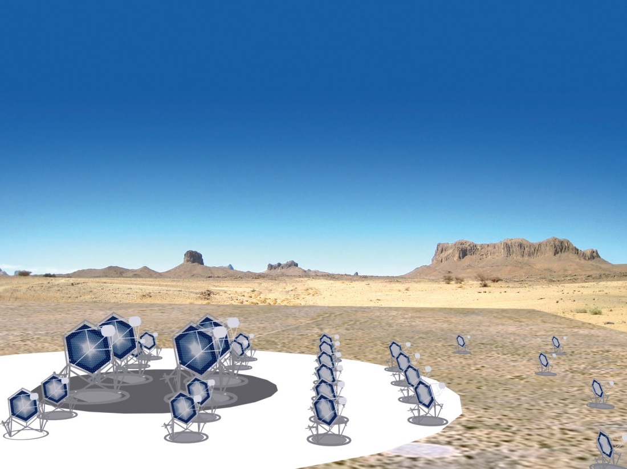

Gamma Rays
H.E.S.S., MAGIC, VERITAS Fermi, Agile
+ new technologies: FACT, HiSCORE
G-APD, La Palma
Timing Array, Siberia
10 fold sensitivity of current instruments
10 fold energy range
~1000 sources and
new phenomena expected
25 countries, 132 institutes,800 scientists

Slide 9
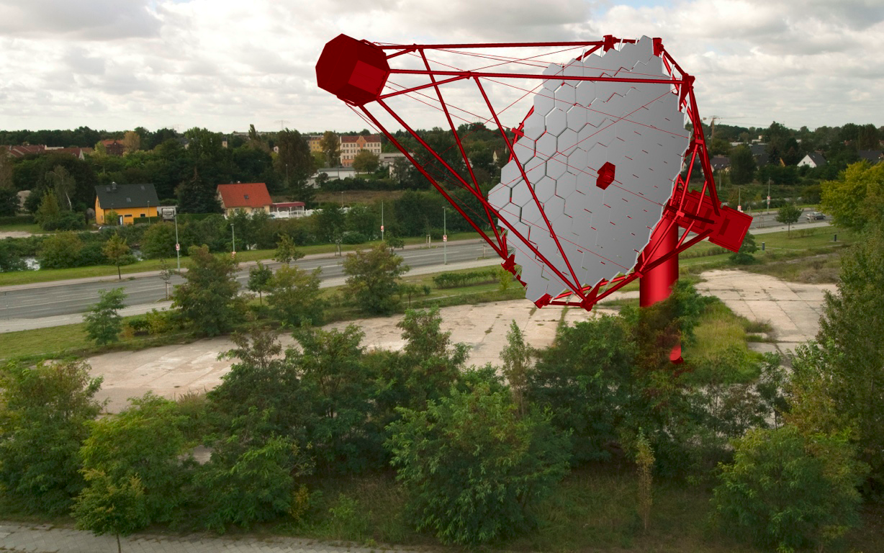
Prototype of Mid-Size Telescope CTA, Berlin (photoshop version)

Slide 10
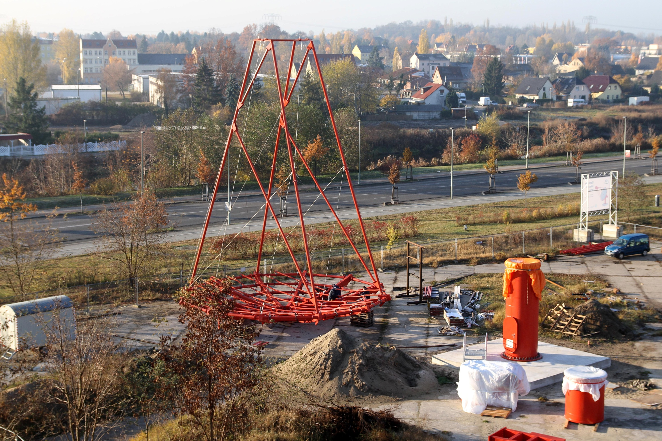

Slide 11
AUGER ↔ LHC

Slide 12

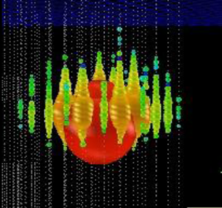
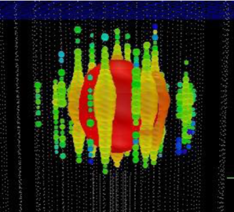
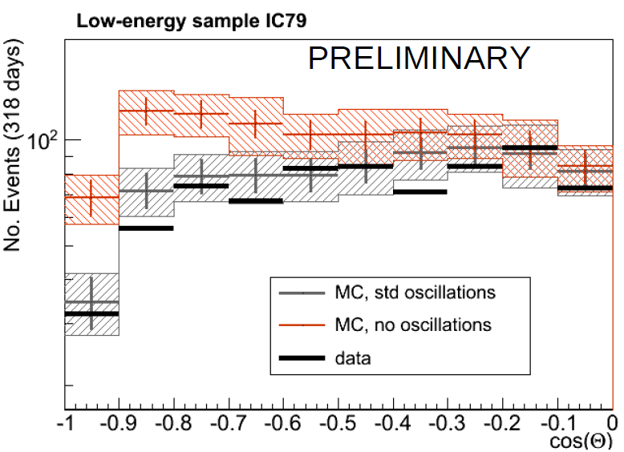
Ernie Bert
~1.1 PeV ~ 1.3 PeV
Excess at high energies?
Neutrino Oscillation in DeepCore and Antares
→ PINGU/ORCA & mass hierarchy?

Slide 13
2 (+2) Roadmaps

Slide 14
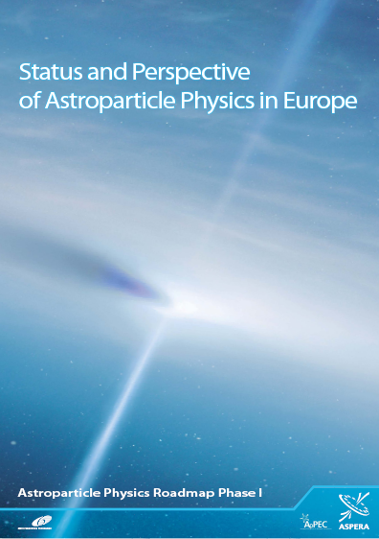

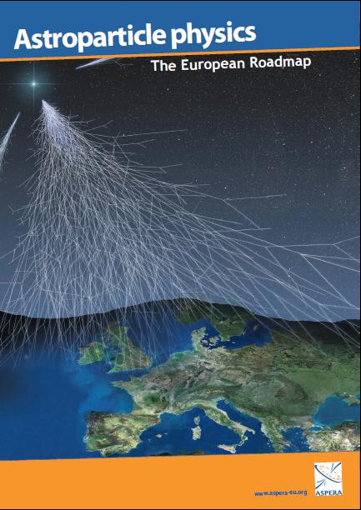
2007 2008 2011

Slide 15
S.K. coins „The Magnificent Seven“
(and notes that in the classic movie only 3 of them survive)
A.M. realizes the the Big Dipper looks better than the Pleiades
C.S. invents Alice, looking to the
Wonderland of Astroparticle Physics
2007 2008 2011

Slide 16
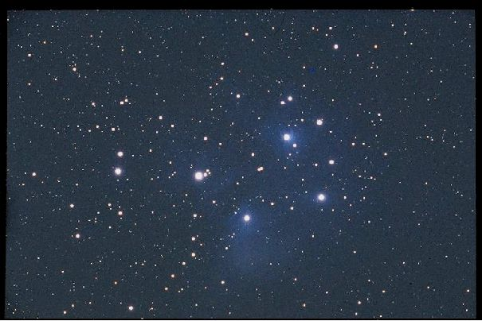
ApPEC′s Plejades (Siebengestirn)
Einstein Telescope
(LISA)
Ton-scale
Double Beta
Megaton
KM3NeT
CTA
Ton-scale
Dark Matter
Auger-Nord

Slide 17
2007 2008 2011

Slide 18
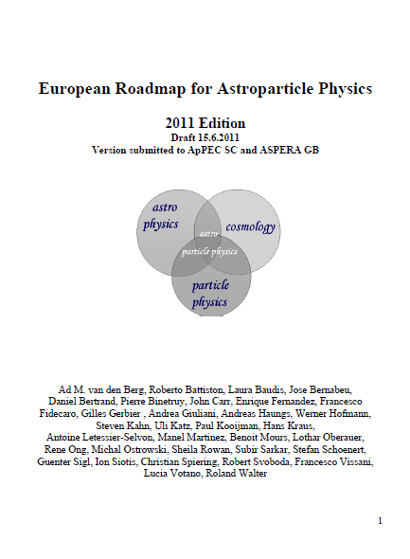
2007 2011
142-page document 87-page document

Slide 19
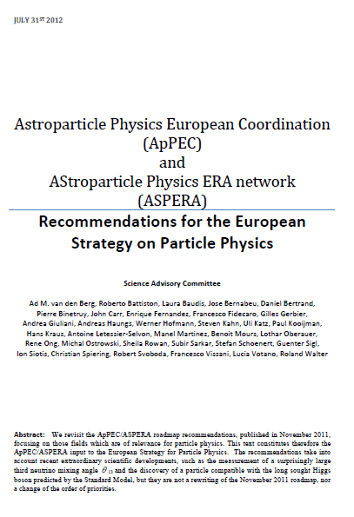
2007 2011
Input to the European Strategy
July 2012
142-page document 16-page document 87-page document

Slide 20
2005-6
Starting the process

Slide 21
Early 2005: ApPEC SC decides to order a roadmap
June 23/24 2005: ApPEC PRC sketches length (50-60 pages) and content of the Roadmap
First step: Questionnaire
First drafts from the WG scheduled for Nov. 2005

Slide 22
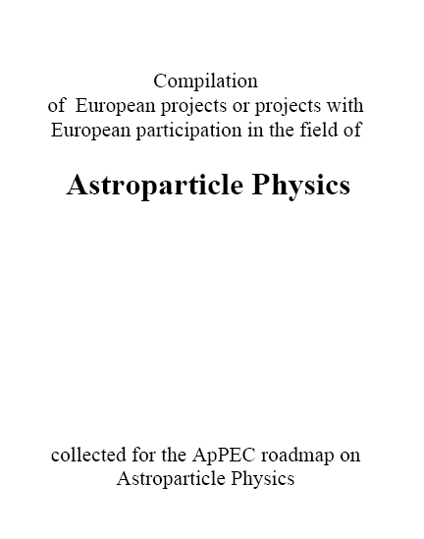
Dec. 2005: Compilation of all activities

Slide 23
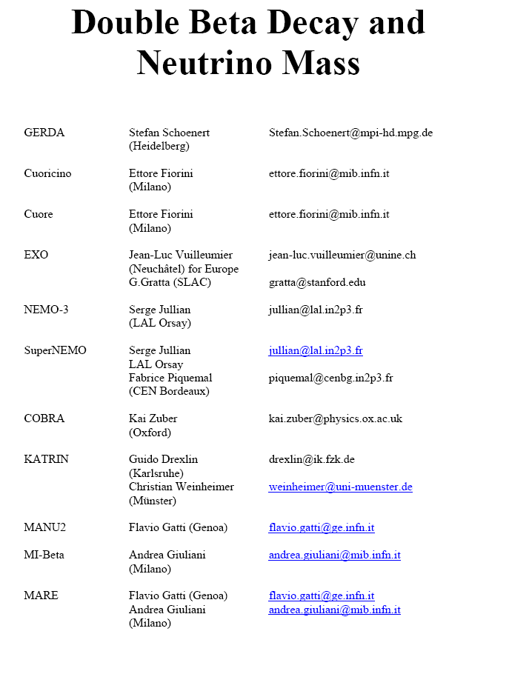
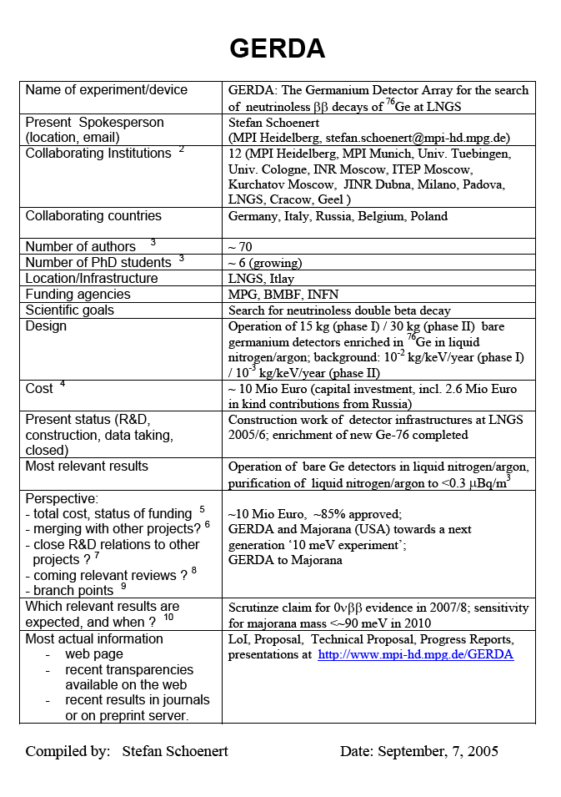

Slide 24
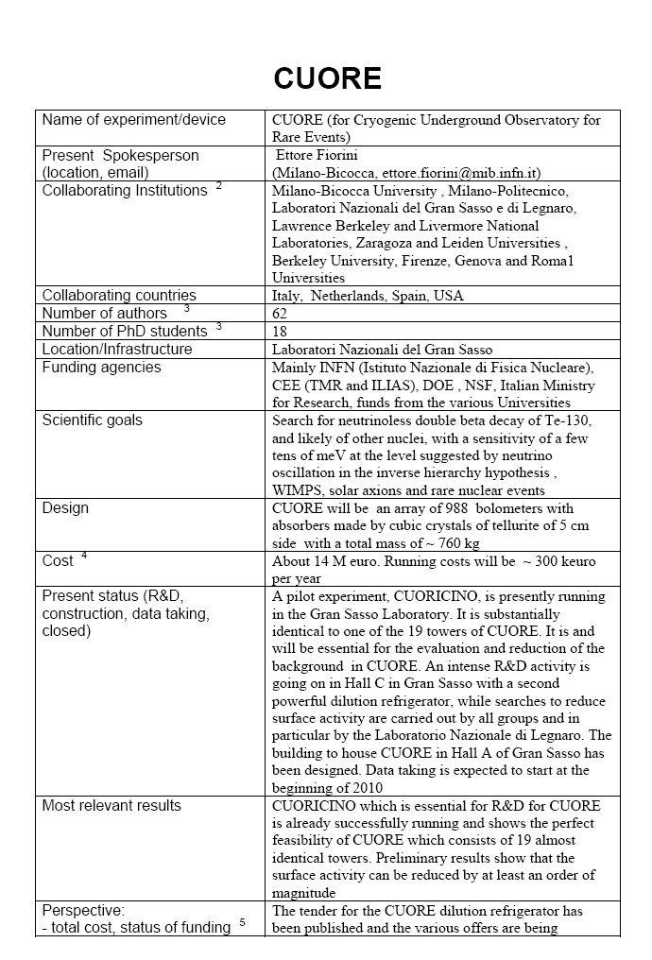
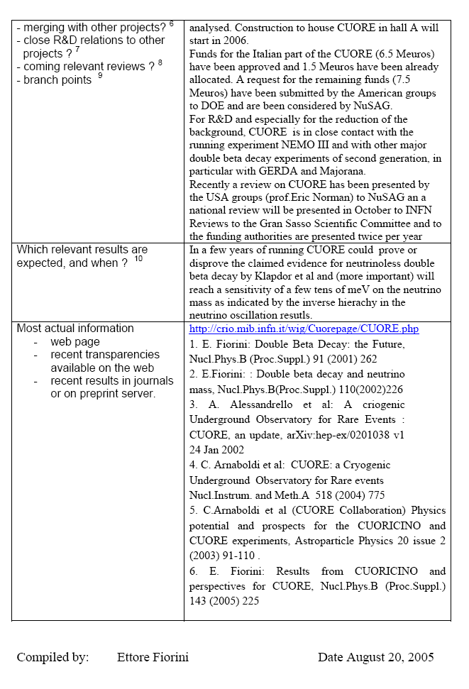

Slide 25
First fragment of ApPEC Roadmaqp
16.10.2005
This report provides a European roadmap for astroparticle physics. It describes status and perspective of this field in Europe and links it to the activities in other parts of the world. It aims to promote astroparticle physics in the member states of ApPEC, to stimulate coordination and cooperation within the European astroparticle community and to prepare future decisions on National and European level. The roadmap will cover the next ten years, with a focus to the next five.
The document has been worked out by the ApPEC roadmap committee (RC) on request of the ApPEC Steering Committee (SC). The roadmap committee consists of the ApPEC Peer Review Committee (PRC), extended by additional experts from ApPEC member states, USA and Russia.

Slide 26
Six Questions
What are the constituents of the Universe? In particular: What is dark matter?
Do protons have a finite life time?
What are the properties of neutrinos? What is their role in cosmic evolution?
What do neutrinos tell us about the interior of the Sun and the Earth, and about Supernova explosions?
What is the origin of cosmic rays ? What is the view of the sky at extreme energies ?
What will gravitational waves they tell us about violent cosmic processes and about the nature of gravity?

Slide 27
2005-2012
Projections vs. reality

Slide 28
Dark Matter

Slide 29
10⁻⁴
LHC
10⁻⁶
Cross section (pb)
10⁻⁸
Projection 2002 (R. Gaitskell)
Projection
2005 (C.S.)
Sensitivity to
WIMP-DM cross section
10⁻¹⁰
1980 1985 1990 1995 2000 2005 2010 2015

Slide 30
10⁻⁴
LHC
10 years after the projection of
Gaitskell we have a delay of 4-5
years w.r.t. to his estimate.
Likely, the dashed line down
to 10⁻¹⁰ pb is also too optimistic
10⁻⁶
Cross section (pb)
10⁻⁸
Projection 2002 (R. Gaitskell)
Sensitivity to
WIMP-DM cross section
10⁻¹⁰
1980 1985 1990 1995 2000 2005 2010 2015

Slide 31
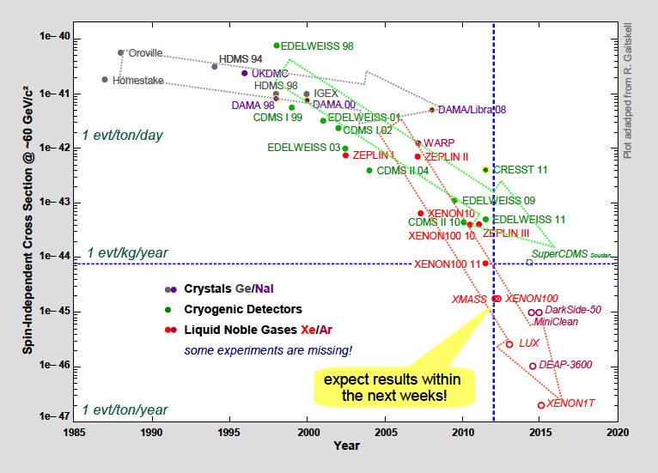

Slide 32
10⁻⁴
Projection C.S. from March 2007
(this is in the 2007 roadmap)
Stage 1:
Field in
Infancy
Stage 2:
Prepare the
instruments
10⁻⁶
Stage 3:
Maturity.
Rapid
progress
Cross section (pb)
10⁻⁸
Stage 4:
- Understand remaining
background.100 kg scale
Determine best method
for ton-scale detectors
Stage 5:
Build and operate
ton-scale detectors
10⁻¹⁰
1980 1985 1990 1995 2000 2005 2010 2015
LHC

Slide 33
Towards 2 large "zero-background" detectors
Now: 10 kg scale 2009/11: 100 kg scale 2012/14: ton scale
CRESST
EURECA
@ ton scale
EURECA-100
Edelweiss
LXe
LXe
Xe-100
Noble liquid
@ ton scale
LAr
Ar-100
LAr
Scheme from March 2007
…

Slide 34
Towards 2 large "zero-background" detectors
Now: 10 kg scale 2009/11: 100 kg scale 2012/14: ton scale
CRESST
EURECA
@ ton scale
EURECA-100
Edelweiss
PLUS > 3 YEARS
LXe
LXe
~ IN TIME
PLUS ~ 2-3 YEARS
Xe-100
Noble liquid
@ ton scale
LAr
Ar-100
LAr
DARKSIDE-50?
PLUS ~ 3 years
…

Slide 35
Résumé Dark Matter
Expectations have been too optimistic; we are now 5 years behind the projections from ten years ago.
In 2005, bolometric detectors were clearly favored; this changed only with XENON.
There is much less convergence than we hoped; worldwide, but even in Europe (and even in some countries!)

Slide 36
Double Beta

Slide 37
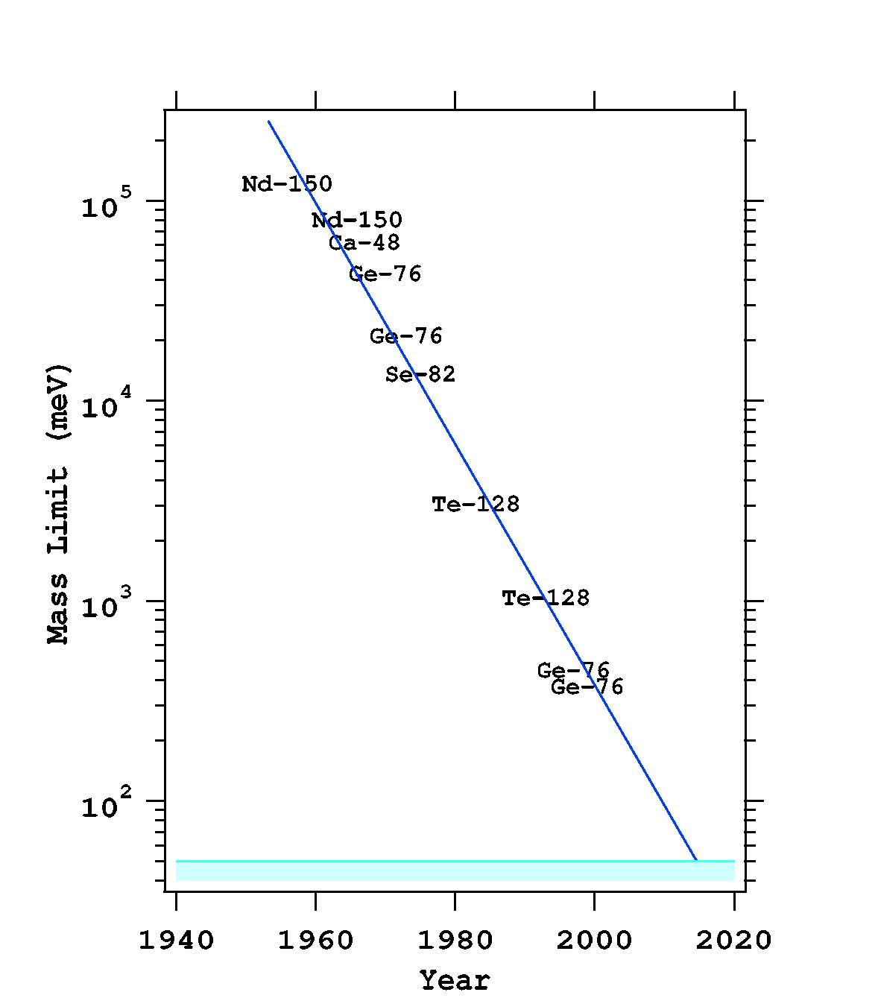
From the 2007 roadmap (picture already somewhat older)
Start next 5 years:
GERDA, Cuore,
Super-NEMO, EXO-200, ..
Following generation:
GERDA+Majorana,
Cuore-enr., EXO-1ton,
COBRA,. ..

Slide 38
From the 2007 roadmap (picture already somewhat older)
Start next 5 years:
GERDA, Cuore,
Super-NEMO, EXO-200, ..
Following generation:
GERDA+Majorana,
Cuore-enr., EXO-1ton,
COBRA,. ..
Gerda: PLUS ~3 years
Exo-200: PLUS ~2 years
Cuore: PLUS ~5 years
Super-NEMO:
PLUS ~5 years

Slide 39
DBD projects 0.1 eV scale
now
March 2007
2005
2006
2007
2008
2009
2010
2011
2012
2013
2014
2015
2016
operation
CUORICINO
operation
construction
CUORE
operation
NEMO-3
operation
design study
construction
Super-NEMO
operation
construction
GERDA
operation
design study
construction
EXO (USA)
(Projects running, under construction or with substantial R&D funding)

Slide 40
DBD projects 0.1 eV scale
now
2005
2006
2007
2008
2009
2010
2011
2012
2013
2014
2015
2016
operation
CUORICINO
operation
PLUS 4-6 years
construction
CUORE
operation
NEMO-3
operation
Super-NEMO
design study
construction
PLUS
3-5 years
operation
construction
GERDA
PLUS 3 years
operation
PLUS 1 year
design study
construction
EXO (USA)
(Projects running, under construction or with substantial R&D funding)

Slide 41
DBD projects 30 meV eV scale
now
2005
2006
2007
2008
2009
2010
2011
2012
2013
2014
2015
2016
operation
CUORICINO
operation
Converge
towards
2 large
European
Projects !
Start construction
2012-2015
construction
CUORE
operation
NEMO-3
operation
design study
construction
operation
construction
GERDA
operation
design study
construction
EXO (USA)

Slide 42
Résumé Neutrino Mass
Expectations for DBD have been too optimistic; we are now 4-6 years behind the projections from ten years ago.
New DBD players with much drive appeared on stage, e.g. KamlandZen, NEXT, SNO+, ...
Some DBD projects are since 2005 in R&D phase. Stamina or agony?
Not enough convergence (Gerda/Majorana has at least the right spirit)
KATRIN: also delayed by 4-6 years. Cost over-run.

Slide 43
H.E. Universe

Slide 44
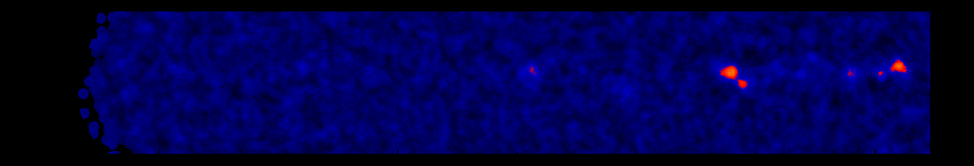
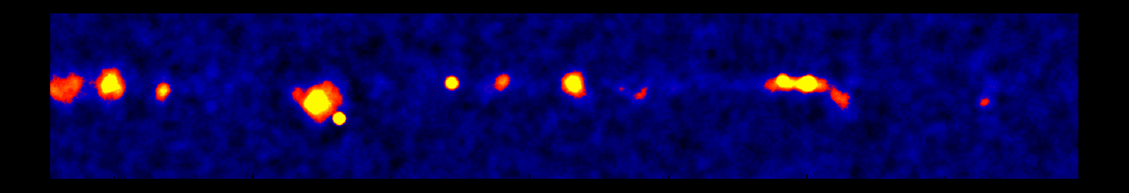
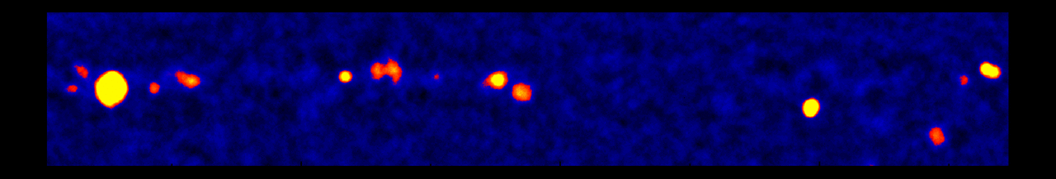
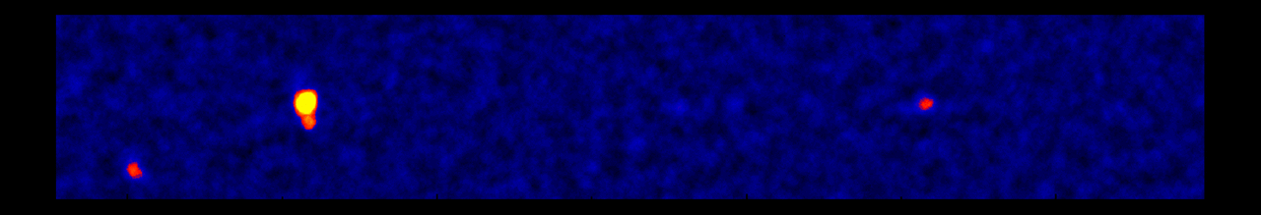
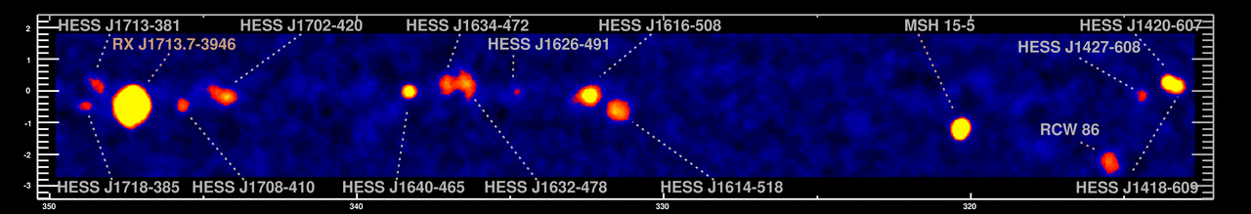
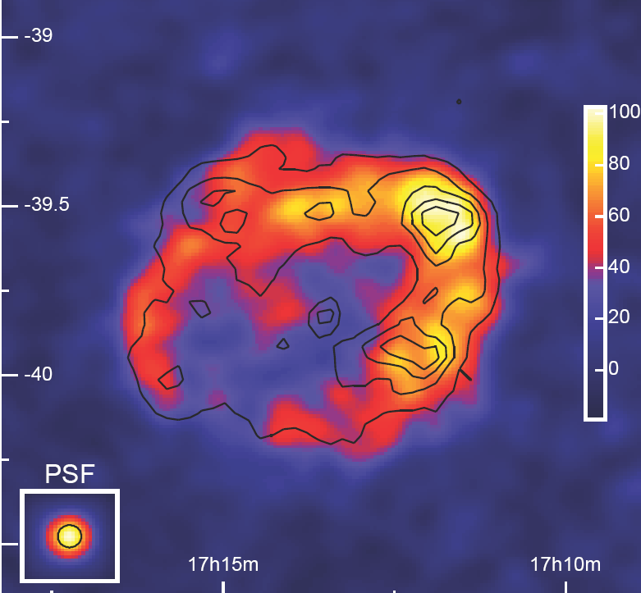
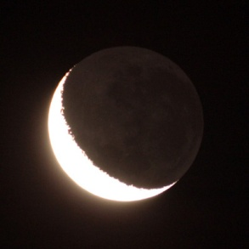
The Sky at TeV-Energies
H.E.S.S.-Scan of the galactic plane
0.5°
RX J1713.7-3946
1989: 1 Source
1996: 3 Sources
2005: 80 Sources
2012: 150 Sources
Moon

Slide 45
European IACT projects
now
March 2007
2005
2006
2007
2008
2009
2010
2011
2012
2013
2014
2015
2016
operation
H.E.S.S.
operation
construction
H.E.S.S.- II
operation
MAGIC-I
operation
construction
MAGIC- II
CTA
operation
design study
construction + operation

Slide 46
European IACT projects
now
March 2007
2005
2006
2007
2008
2009
2010
2011
2012
2013
2014
2015
2016
operation
H.E.S.S.
operation
construction
H.E.S.S.- II
PLUS 4 years
operation
MAGIC-I
operation
construction
MAGIC- II
PLUS 3 YEARS
PLUS 4 YEARS
CTA
operation
design study
construction + operation

Slide 47
now
HE Neutrino Telescopes
March 2007
2005
2006
2007
2008
2009
2010
2011
2012
2013
2014
2015
2016
operation
AMANDA
operation
IceCube
oonstruction + operation
operation
NT200, NT200+
?
GVD
operat
design study
construction + operation
operation
construction
c + o
ANTARES
R&D KM3
NESTOR, NEMO
KM3NeT
operat
FP6 Design Study
construction + operation

Slide 48
now
HE Neutrino Telescopes
March 2007
2005
2006
2007
2008
2009
2010
2011
2012
2013
2014
2015
2016
operation
AMANDA
IN TIME
operation
IceCube
oonstruction + operation
operation
NT200, NT200+
?
GVD
PLUS 3-4 years
operat
design study
construction + operation
operation
construction
c + o
ANTARES
R&D KM3
NESTOR, NEMO
KM3NeT
PLUS 3-4 years
operat
FP6 Design Study
construction + operation

Slide 49
now
HE Neutrino Telescopes
2005
2006
2007
2008
2009
2010
2011
2012
2013
2014
2015
2016
operation
AMANDA
operation
IceCube
oonstruction + operation
operation
GVD
NT200, NT200+
Recommendation: only
ONE large detector on
the Northern hemisphere.
Expect confirmation
of physics case from
Icecube and H.E.S.S.
operat
design study
construction + operation
operation
ANTARES
construction
c + o
R&D KM3
KM3NeT
NESTOR, NEMO
operat
construction + operation
FP6 Design Study

Slide 50
Flux * E² (GeV/ cm² sec sr)
2005
10⁻⁴
Rice AGASA
Rice GLUE
Anita, Auger
Dumand
Frejus Macro
Baikal/Amanda
IceCube/Km3
10⁻⁶
1 EeV
10⁻⁸
Present status corresponds to ~2008/9 in my 2005 projection
No KM3NeT yet
No competitive limits from new technologies in water or ice
Sensitivity to HE diffuse
neutrino fluxes
10-1000 TeV
10⁻¹⁰
1980 1985 1990 1995 2000 2005 2010 2015

Slide 51
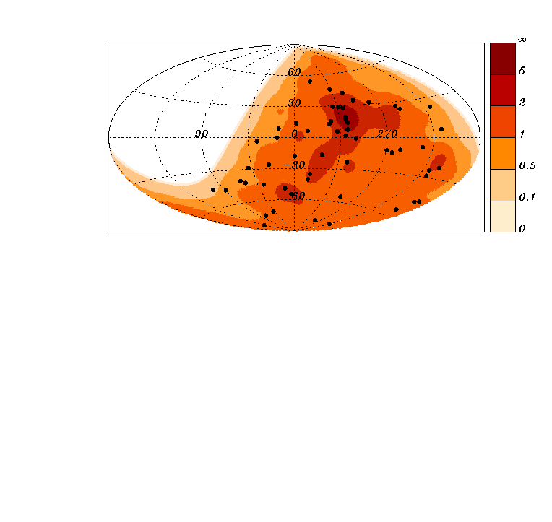
Auger 2009 →
2012:
no point sources yet
Dipole?
Cutoff (but is it GZK?)
Composition

Slide 52
Résumé H.E. Universe
Gamma Rays
  Fermi fantastic success
  IACTs fantastic scientific harvest : ~ 150 sources
  MAGIC-2, HESS-II , CTA delayed by 3-4 years
Neutrinos
  IceCube within time and cost schedule, works excellently
  KM3NeT delayed by 3-4 years. Troublesome convergence process. From single site to multi-site.
  Sensitivity improvement neutrinos ~ 3 years behind expectations.
  No point sources yet; tantalizing hints for H.E. diffuse excesses
Cosmic Rays
  Auger works excellently. Continuous succesfull upgrading.
  Composition, Cut-off – but no point sources (yet). CEN-A?
  Auger-North was not approved. New plans expected ~ 2015
  JEM-EUSO gained more interest
  New interest in Galactic CR (anisotropies, composition): IceTop, Tunka, LHHASO, ....

Slide 53
Cost projections
All but the first figures from the preparation of the 2008 „Glossy Paper“

Slide 54
2007
2008
2009
2010
2011
2012
2013
2014
2015
2016
2017
2018
Auger North
30 M€ (from 85)
CTA
> 2/3 from 100 + 50 M€
KM3NeT
250 M€
Megaton
400-800 M€
Grav Wave 3rd generation
300 M€
DM search 1 ton
60-100 M€
60-100 M€
50-200 M€
Double Beta 1 ton
March 2007
50-200 M€

Slide 55
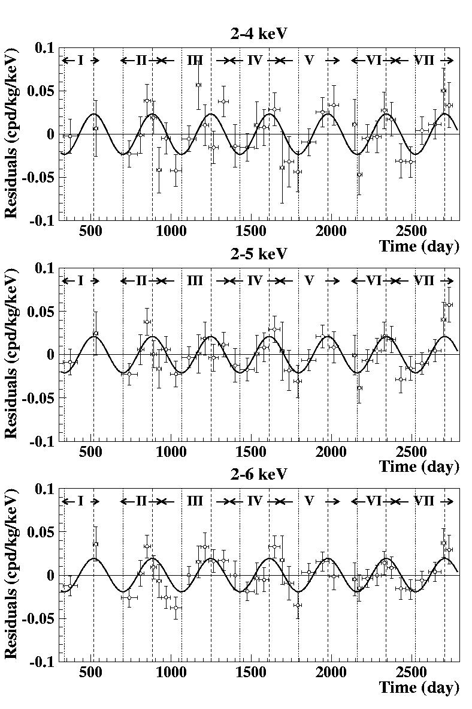
2007 Aspera WG requests European Dark Matter projects
Underground Infrastructure
EURECA
(bolometric)
ELIXIR
(liquid Xe)
DAMA-1ton

Slide 56
2007 Aspera WG requests European Dark Matter projects
convergence within
noble liquid community
still poor
Underground Infrastructure
LUX
EURECA
(bolometric)
XENON
DAMA-1ton

Slide 57
High Energy Cosmic Rays
Clear priority: Auger North
Summary: ASPERA sum 2008-2018
Auger North
Auger North planning at this point shifted by ~1 year compared to the figure

Slide 58
High Energy Gamma Telescopes
Clear priority: CTA
CTA
CTA planning at this point shifted by ~1 year compared to the figure

Slide 59
All Projects
Requests (here without DAMA-1 ton and Frejus new lab)

Slide 60
All Projects
without DAMA and new Frejus lab
all projects shifted according to realistic estimates
CTA: 1/3 from non-Europe
KM3NeT: 200 M€
Megaton: Europe only 200-300 M€
DM and DBD shared with US
keep 20% for R&D and new initiatives
can do it within a factor ~2 smooth increase over 8-10 years (investment)
personnel will increase by less
Auger-North
Neutrino Mass
E.T.
Megaton
Dark Matter
KM3NeT
CTA
Existing
R&D, new initiatives

Slide 61
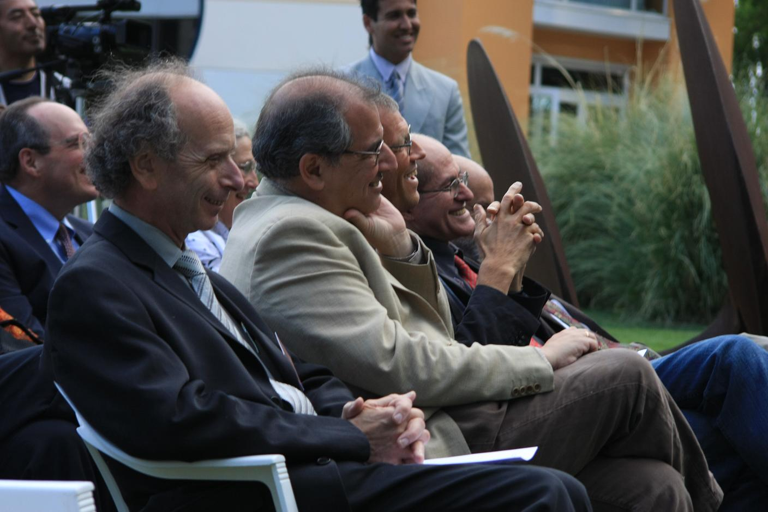
We should create
a factor-of-two pressure !

Slide 62
GREAT !

Slide 63
Hmm...

Slide 64

Autumn 2008:
The economic crisis

Slide 65


Slide 66
What about a flat funding scenario?
further reduce CTA
further shift and reduce Megaton
further shift E.T.
somewhat reduce new initiatives
Must not reduce Auger
and KM3NeT. Either
you build it huge or you
do not build it at all !
KM3NeT
ET
Megaton
Auger
CTA
DBD
DM

Slide 67
What about a flat funding scenario?

Slide 68
ASPERA Common Calls

Slide 69
First call 2008
  CTA F, DE, PL, ES, HE 2.7 M€
  DARWIN IT, F, NL, HE 0.6 M€
  EURECA FR, ES 0.6 M€
Second call 2009 (10?)
  AugerNEXT DE, NL, PL, F, PT, ES, IT, RO 1.8 M€
  ISOTTA F, IT, PL 0.5 M€
  SILENT IT, PL, HE 0.6 M€
Third call 2012
  Low-energy neutrinos (PINGU/ORCA, LENA, r.a. source)
  Gravitational waves (community with a compelling worldwide coordination – GWIC!)

Slide 70
The ASPERA Calls have been (and are) very important for community building
The calls promote convergence tendencies
The convergence is in some conflict with the competition principle (which one has, e.g., in EU design studies)
Future:
  Keep convergence character but add some competition?
  Support should correlate with the number of groups behind the project (also within the individual countries)

Slide 71
... And, at the very end:

Slide 72
Low-energy neutrinos
and proton decay

Slide 73
Gained enormous momentum after measurement of θ₁₃ due to the interest of the accelerator community (Fermilab, CERN, Japan)
Liquid Argon is prioritized by most of this community due to its (principally) superior features w.r.t. oscillation physics.
Europe: LAGUNA-LBNO
  GLACIER (LAr) LENA (LSc) MEMPHYS (water)
USA: LBNE (LAr)
Japan:
  Hyper-K (water) Okinoshima-Project (LAr)

Slide 74
Science on the Megaton scale
Proton decay: improve sensitivity by > factor 10 and test a new class of Supersymmetry models
Galactic Supernova: 10⁴- 10⁵ events Incredibly detailed information on the early SN phase
Diffuse flux from past SN: probe cosmological star formation rate
Solar neutrinos: details of the Standard Solar Model determined with percent accuracy. CNO cycle. Time variations.
Atmospheric neutrinos: high statistics would improve knowledge neutrino mixing and provide information on the neutrino mass hierarchy
Geo-neutrinos: improve understanding of the Earth interior
Indirect WIMP search
Neutrinos from accelerators: neutrino properties !

Slide 75
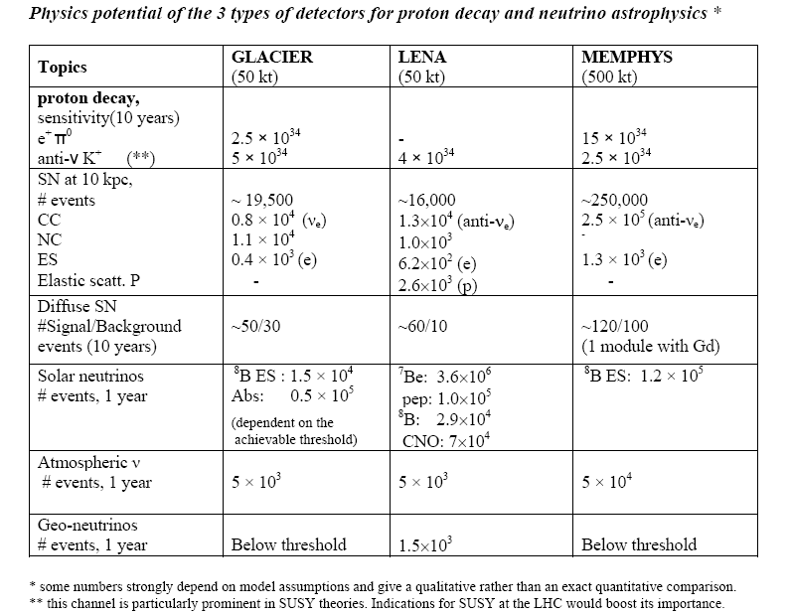

Slide 76
Low energy!

Slide 77
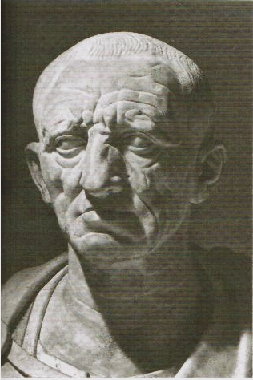
Cato the elder:
„Ceterum censeo: Carthaginem delendam esse.”

Slide 78
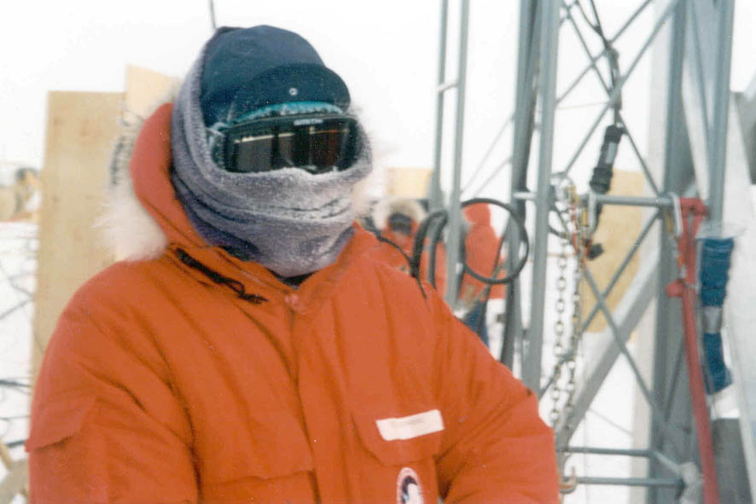
C.S.:
„Ceterum censeo: We need a large scintillation neutrino detector.“

Slide 79
Résumé on low-energy neutrino detectors (1)
Exciting symbiosis of
  tackling fundamental questions in particle physics,
  accessing new cosmic landscapes,
  high-precision measurement of known cosmic phenomena .
Common program on
  accelerator based neutrino physics
  astroparticle physics
  that will have more impact than the sum of its parts.
Impact of PINGU?
Needs coherent international strategy

Slide 80
Résumé on low-energy neutrino detectors (2)
LAr vs LSc: Geo-neutrinos and high-statistics solar neutrinos only with LSc
Its YOUR star !
Its YOUR planet !
Its more than getting errors down by a factor 2 or 20.
Need both: LAr and LSc

Slide 81
Résumé on low-energy neutrino detectors (2)
LAr vs LSc: Geo-neutrinos and high-statistics solar neutrinos only with LSc
Its OUR star !
Its OUR planet !
Its more than getting errors down by a factor 2 or 20.
Need both: LAr and LSc

Slide 82
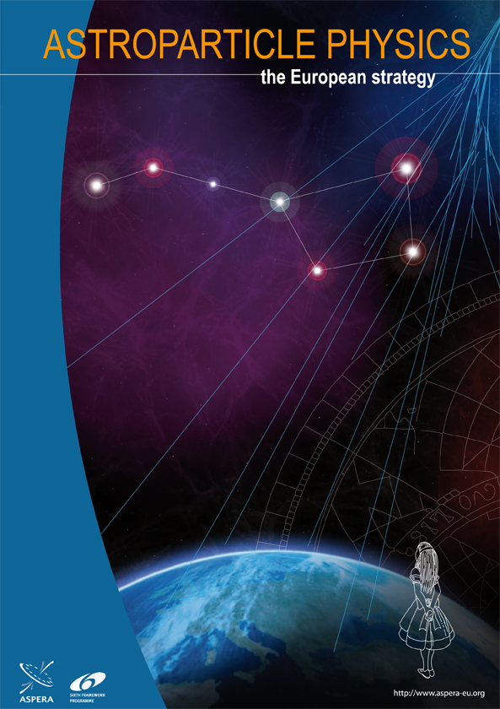
Lessons

Slide 83
Problems
Experimenters must have visions & be optimistic – but with a reasonable sense for reality ...
The reality check shows that nearly all projects were and are substantially delayed compared to the collaboration plans.
They are even delayed to the schedule after „massaging“ the collaboration plans in the roadmap process.
Reasons:
  Technology and background rejection
  Not enough convergence
  Not enough money
  Political conflicts (formal status, site decisions)

Slide 84
Lessons
Fold the experience of our roadmapping into future projections
Force more convergence
Promote a mixture of high-risk explorations and projects with guaranteed (lathough in detail unknown) harvest
Follow physics and not necessarily the road of the largest crowd
More independent committees? Swarm intelligence?
Avoid strategies relying on the „who dies first“ principle

Slide 85
Scientific Successes
Break-throughs:
  neutrinos from Sun and Supernova
  neutrino oscillations
  gamma-ray astronomy
Many fields approaching sensitivity with high discovery potential for fundamental questions:
  gravitational waves
  dark matter
  neutrino mass & double beta decay
Tantalizing hints:
  UHE cosmic rays
  high energy neutrinos
  sterile neutrinos ???

Slide 86



We‘ve got a lot
of work to do !
ApPEC has

Slide 87
The best is yet
to come !

