Slide 1

Particle Physics with Neutrino Telescopes
Christian Spiering
QUARKS-2012
Yaroslavl, June 2012

Slide 2
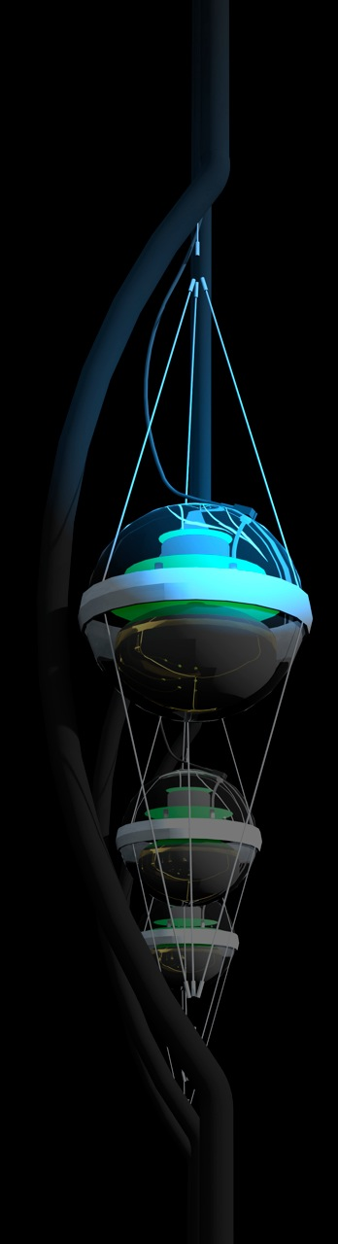
Neutrino Telescopes

Slide 3
High energy particles deep underground/water

Slide 4
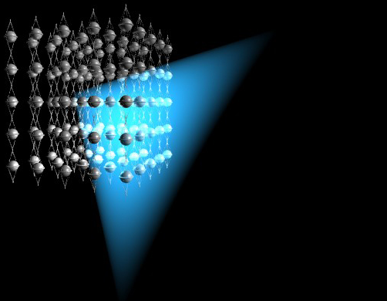
range of muons in
water or ice up to
kilometers …
detector
muon
neutrino

Slide 5

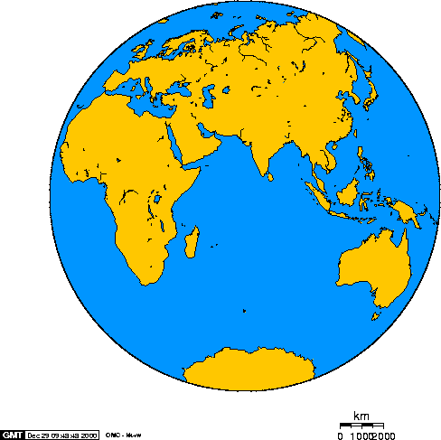
Baikal
Antares
IceCube

Slide 6
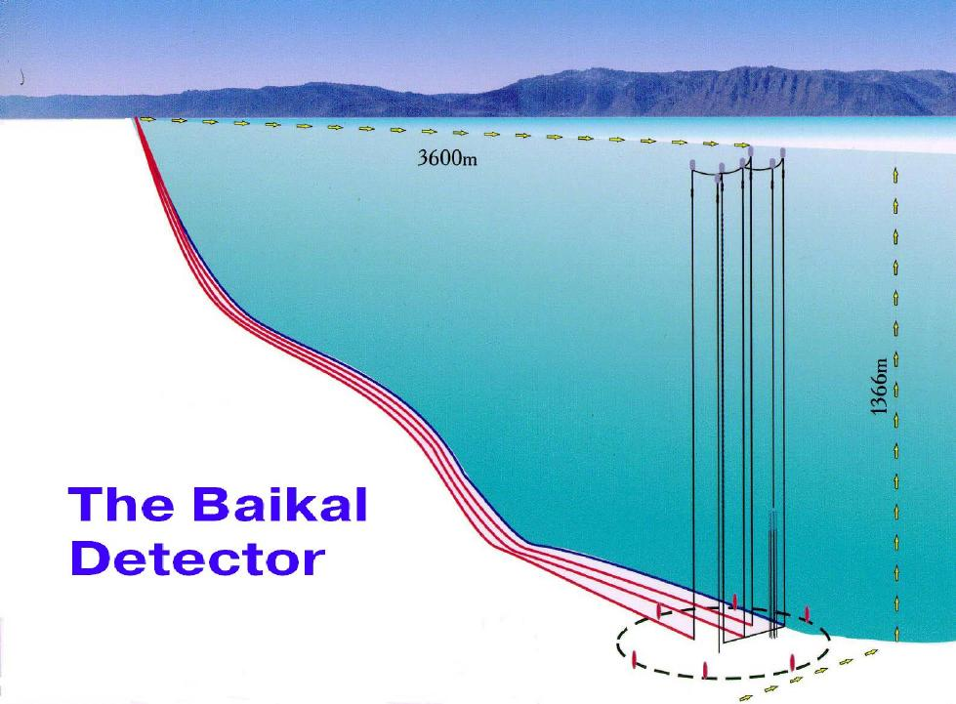
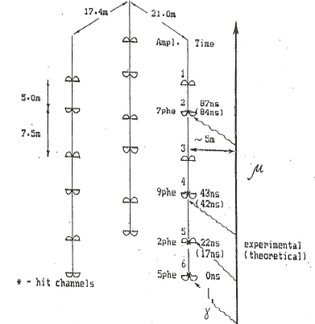
3600 m
1994:
The first „Underwater Neutrino“
1366 m
μ

Slide 7
NT200+
3600 m
1366 m

Slide 8
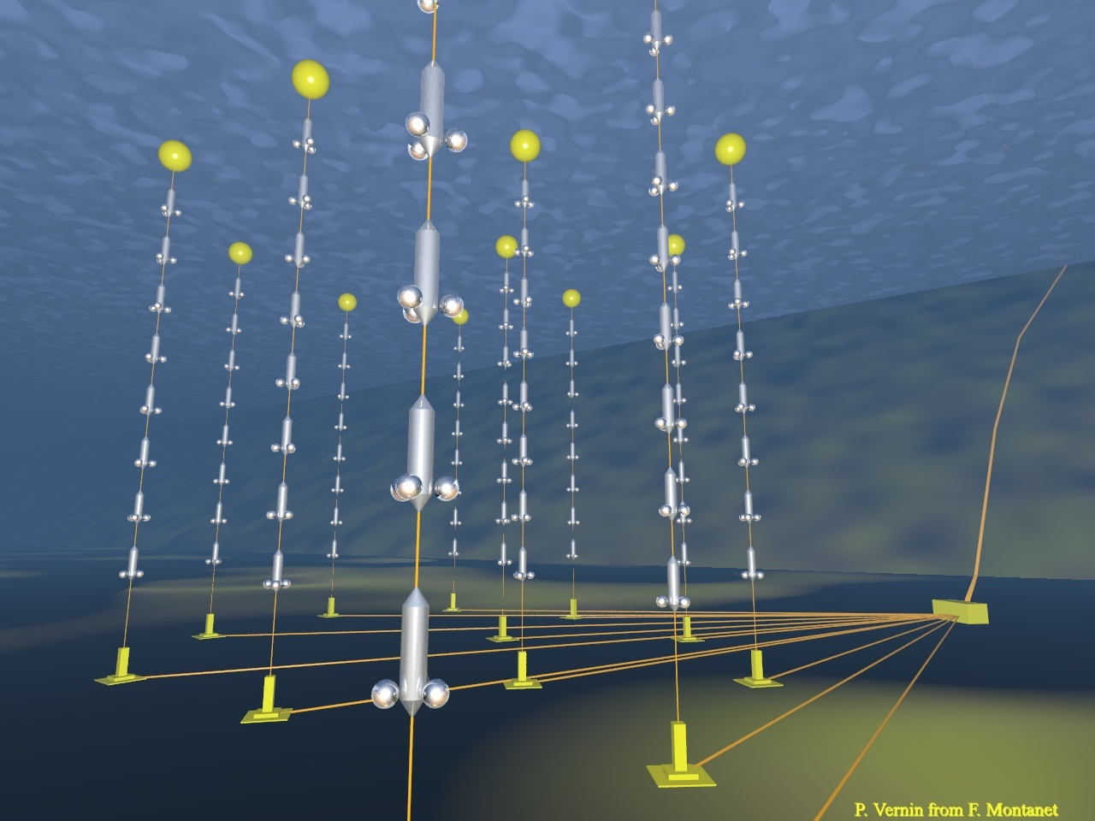
ANTARES
2500m
885 PMTs
12 strings
450 m
70 m

Slide 9
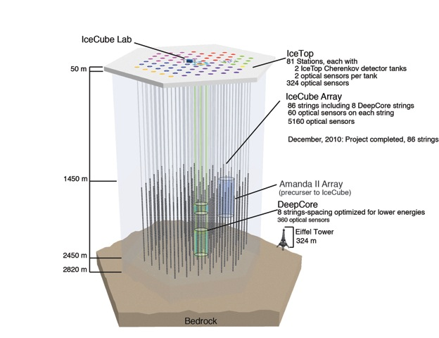
IceCube
~220 ν/day
Threshold:
- IceCube ~ 100 GeV
- DeepCore ~10 GeV

Slide 10
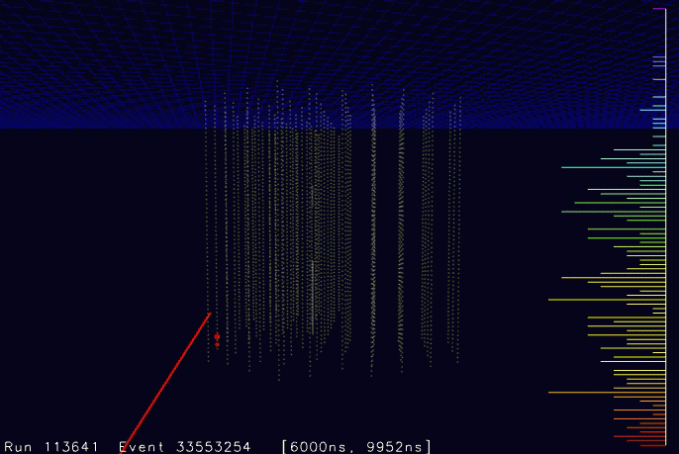

Slide 11
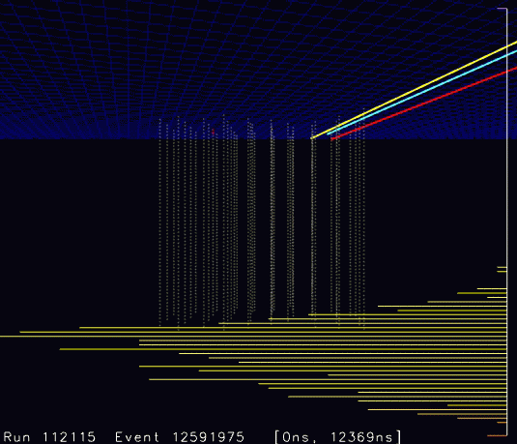

Slide 12

ANTARES

Slide 13
Why do we build
Neutrino Telescopes ?

Slide 14
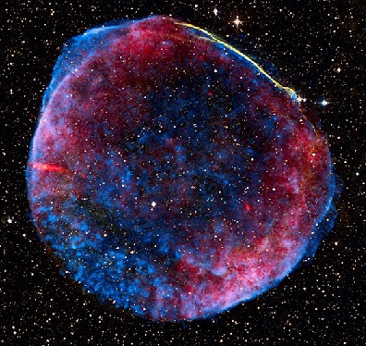
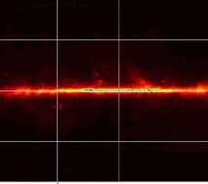
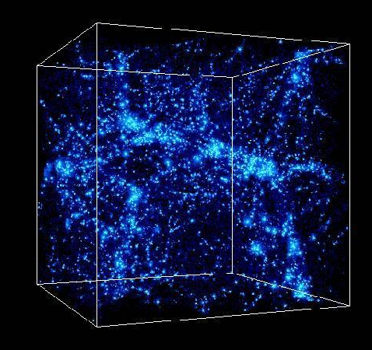
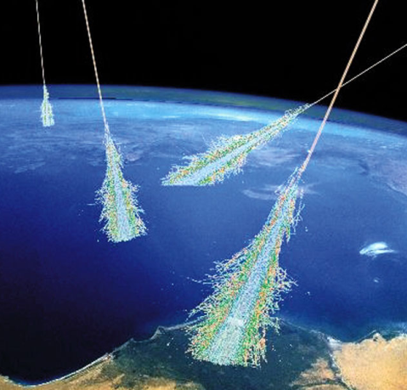

Physics with neutrino telescopes
Cosmic accelerators
Diffuse fluxes
Dark Matter &
Exotic Physics
Point-like sources
(SNRs, binaries ...)
Extended sources
(SNRs, molecular clouds ...)
Transients (GRBs, AGN flares ...)
All-sky fluxes
(e.g. cosmogenic)
Galactic plane
Extended structures
Indirect DM search (Sun, Galactic halo)
Magnetic monopoles, Q-balls, . . .
Lorentz invariance violation
ν faster than light?
Cosmic rays
Supernova explosions
Neutrino Properties &
Particle Physics
Anisotropy
Galactic CR: spectrum and composition
Galactic/LMC SNe
Phases
Neutrino hierarchy
Neutrino oscillations
Heavy flavors
in showers
K/π ratio in showers
Cross sections at
very high energies

Slide 15
Physics with neutrino telescopes
Cosmic accelerators
Diffuse fluxes
Dark Matter &
Exotic Physics
Point-like sources
(SNRs, binaries ...)
Extended sources
(SNRs, molecular clouds ...)
Transients (GRBs, AGN flares ...)
All-sky fluxes
(e.g. cosmogenic)
Galactic plane
Extended structures
Indirect DM search (Sun, Galactic halo)
Magnetic monopoles, Q-balls, . . .
Lorentz invariance violation
ν faster than light?
Cosmic rays
Supernova explosions
Neutrino Properties &
Particle Physics
Anisotropy
Galactic CR: spectrum and composition
Galactic/LMC SNe
Phases
Neutrino hierarchy
Neutrino oscillations
Heavy flavors
in showers
K/π ratio in showers
Cross sections at
very high energies

Slide 16
Search for
neutrino point sources

Slide 17
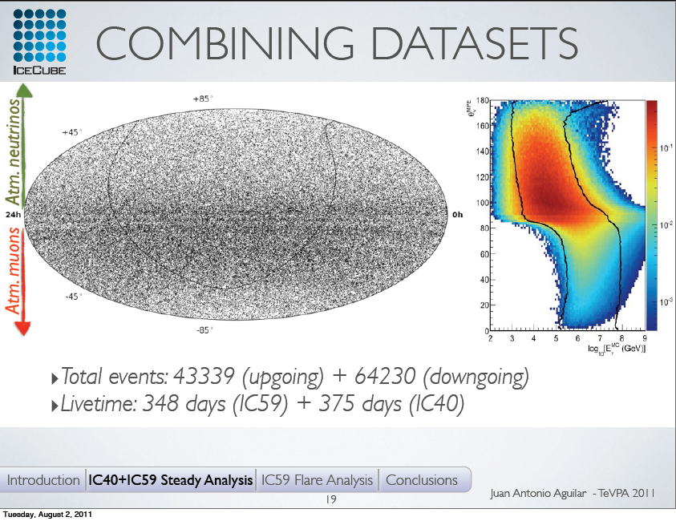
Point Source Search IceCube 40 strings
1PeV 1TeV 1EeV
Upward
Horizontal
Downward

Slide 18
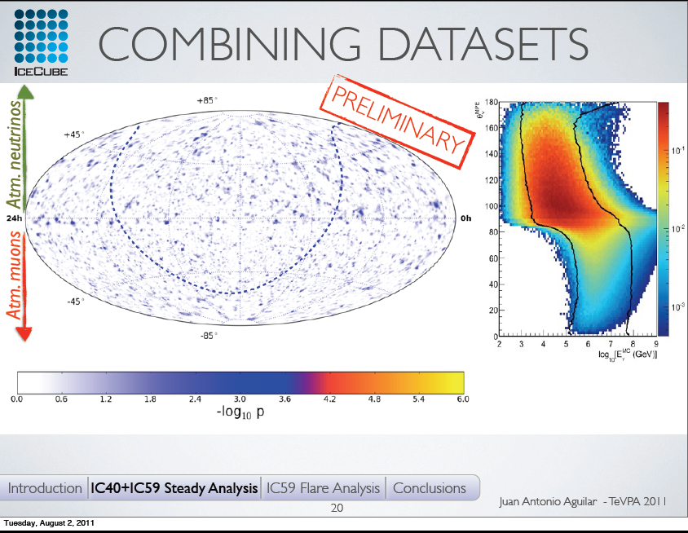
Point Source Search IceCube 40 strings

Slide 19
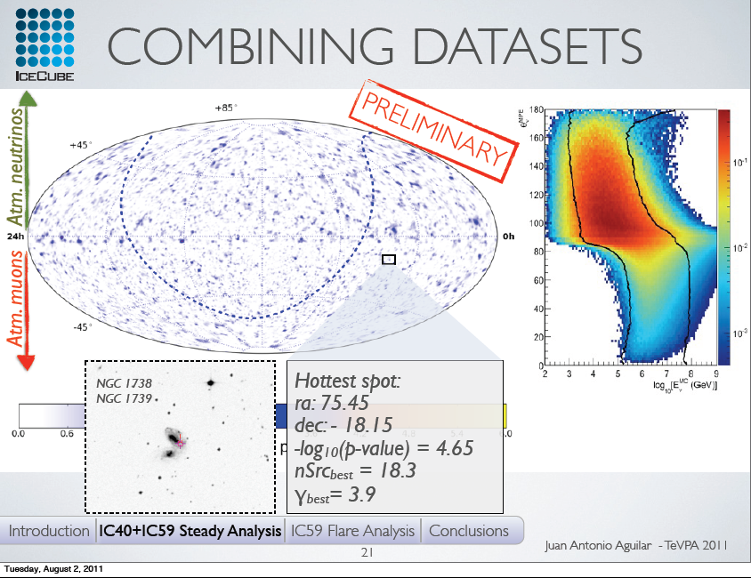
Point Source Search IceCube 40 strings

Slide 20
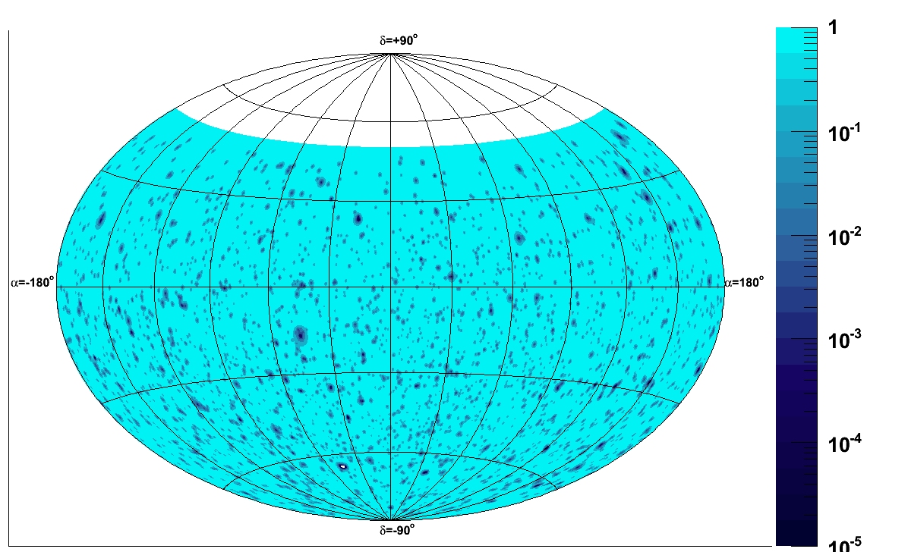
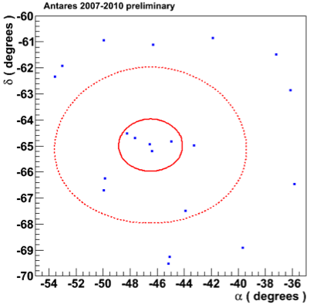
Point source Search ANTARES (2007-2010)
(Talk Paschal Coyle, Nu 2012)
Sky map in equatorial coordinates
Most significant
cluster at:
RA= ‒46.5°,
δ= ‒65.0°
N_{sig} = 5
p-value = 0.026
Significance = 2.2 σ
3⁰
1⁰
Result compatible with the background hypothesis

Slide 21
Point sources: factor 1000 in 12 years
Amanda
2000
ANTARES, 813 days
IceCube
2012

Slide 22
Atmospheric neutrinos

Slide 23
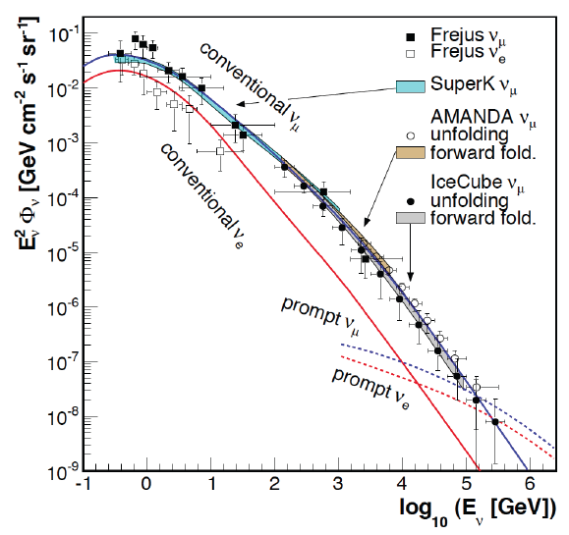
Energy spectrum of atm. muon neutrinos
Frejus, Super-K, Amanda, IceCube
IC-40: ~18,000 ν_{µ} CC events
θ= 180°-97°
Compatible with Bartol/Honda predictions
Close to constrain estimates for prompt neutrinos
Glashow: tachyonic neutrinos would lead to a depletion at high energies !
23

Slide 24
Search for diffuse
extraterrestrial neutrino fluxes

Slide 25
Diffuse Fluxes: a factor 1000 w.r.t. underground detectors

Slide 26
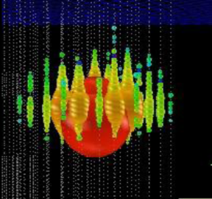
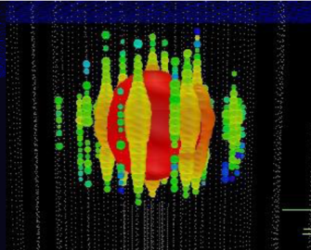
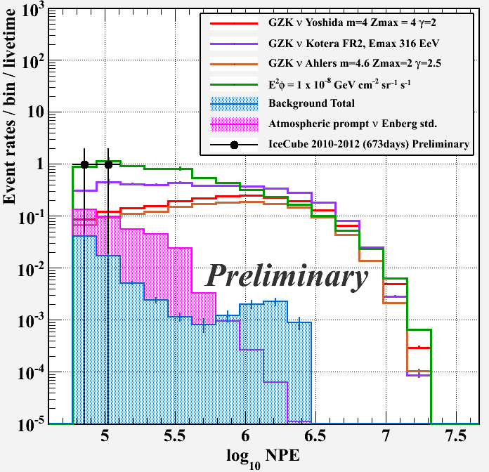
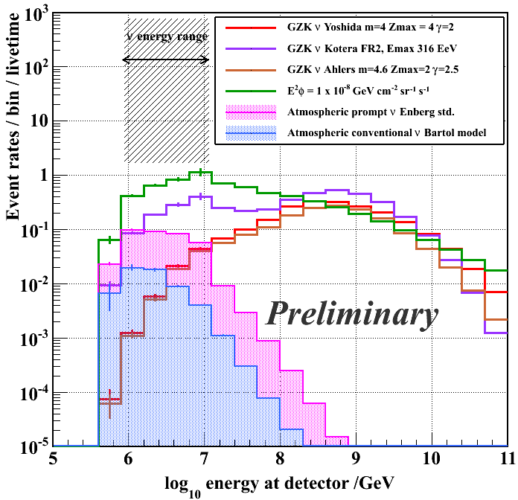
Search for extremely high energy events
IceCube May 31, 2010 - May 14, 2012

Slide 27
Peering into the EeV region
IceCube
May 2010-May 2012
(preliminary)

Slide 28
Neutrino Oscillations:
Standard Oscillations

Slide 29
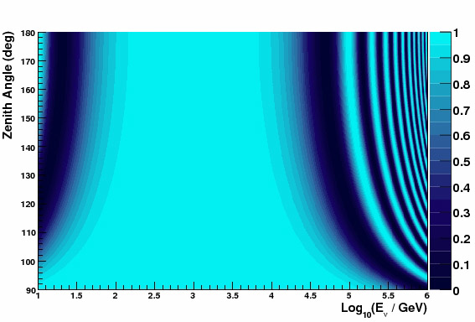
Oscillations of atmospheric neutrinos
Muon neutrino survival probability
Vertically upward
ANTARES/DeepCore
Horizontal

Slide 30
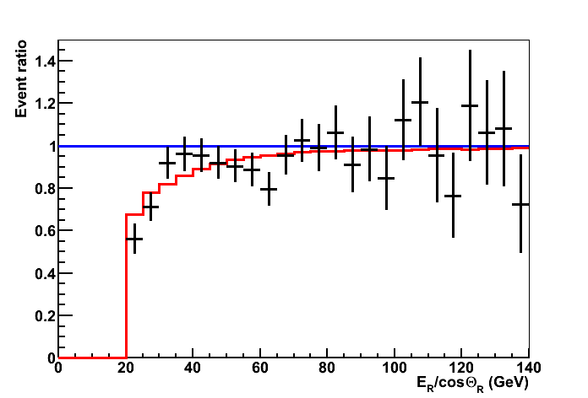
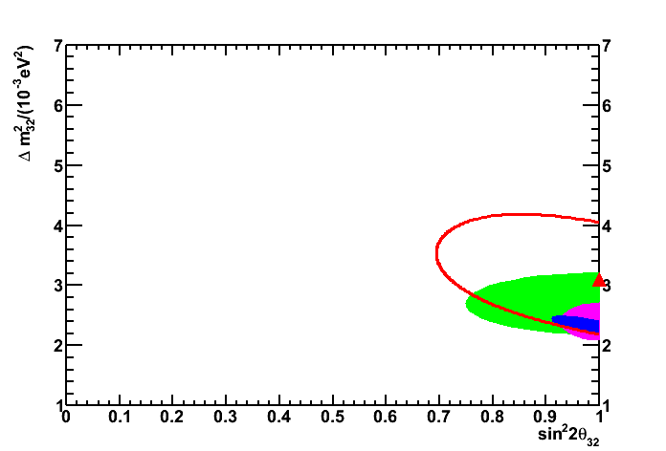
ANTARES 2007-2010
(talk Paschal Coyle Nu 2012)
2008-2010 data (863 days):
No oscillation: χ²/NDF = 40/24 (2.1%)
Best fit: χ²/NDF = 17.1/21
Δm² = 3.1 ⋅ 10⁻³ eV²
sin²2θ =1.00
Systematics:
(Absolute normalisation free)
Absorption length: ±10%
Detector efficiency: ±10%
Spectral index of ν flux: ±0.03
OM angular acceptance
ANTARES preliminary
ANTARES preliminary
no osc
68%CL contours
ANTARES
K2K
Super-K
MINOS
best osc
Assuming maximal mixing: Δm²=(3.1±0.9) 10⁻³ eV²

Slide 31
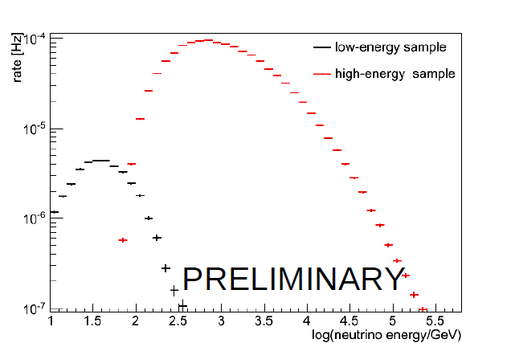
IceCube/DeepCore (79 strings)
VERY PRELIMINARY
Simple cuts and reconstruction in Deep Core to extend sample to low energies and look for consistency with standard neutrino oscillations.
Is not optimized for DeepCore efficiency, angular resolution,…
Ongoing Work: more “sophisticated” analysis for measurement of oscillation parameters

Slide 32
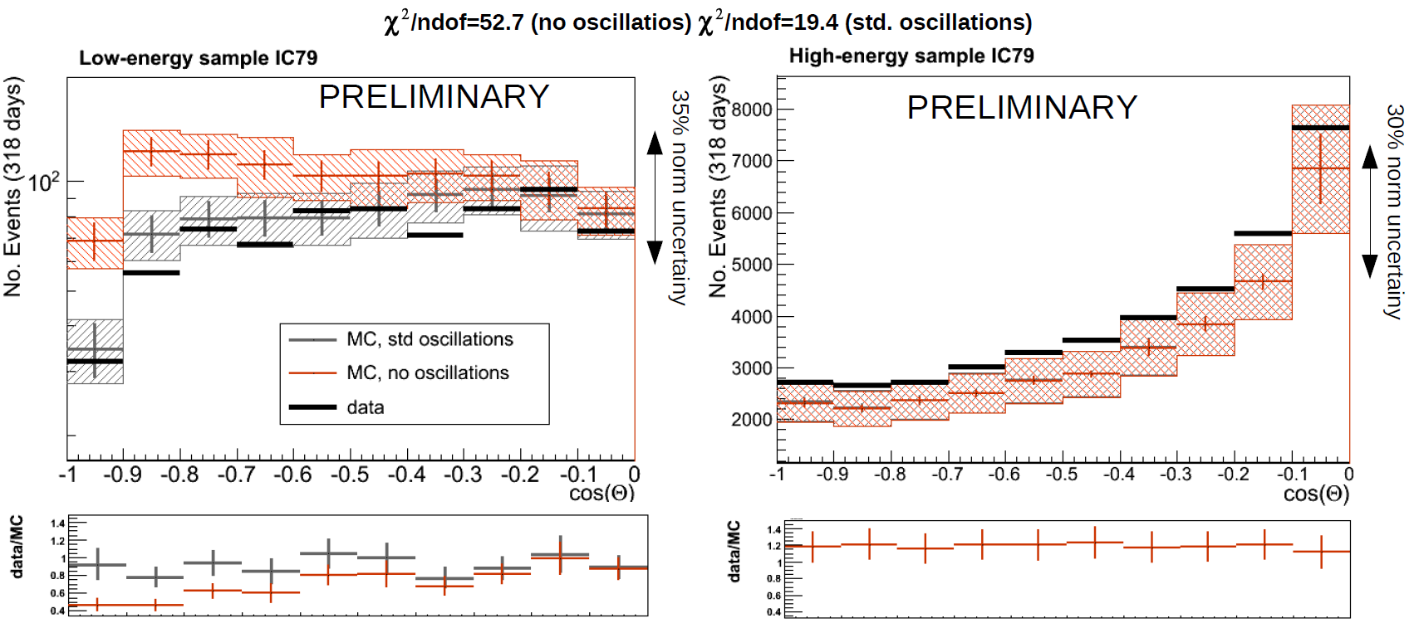
IceCube/DeepCore (79 strings)
delta chi-square = 33.3, p-value = 1 x 10⁻⁸
More sophisticated analyses are under work.
Expect determination of osc. parameters in some months

Slide 33
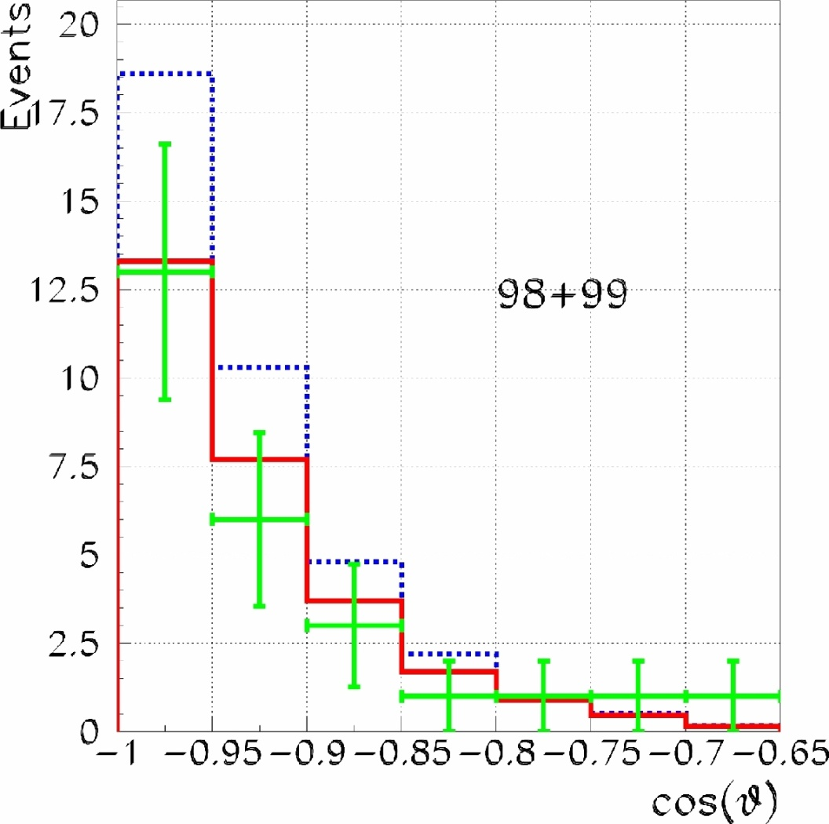
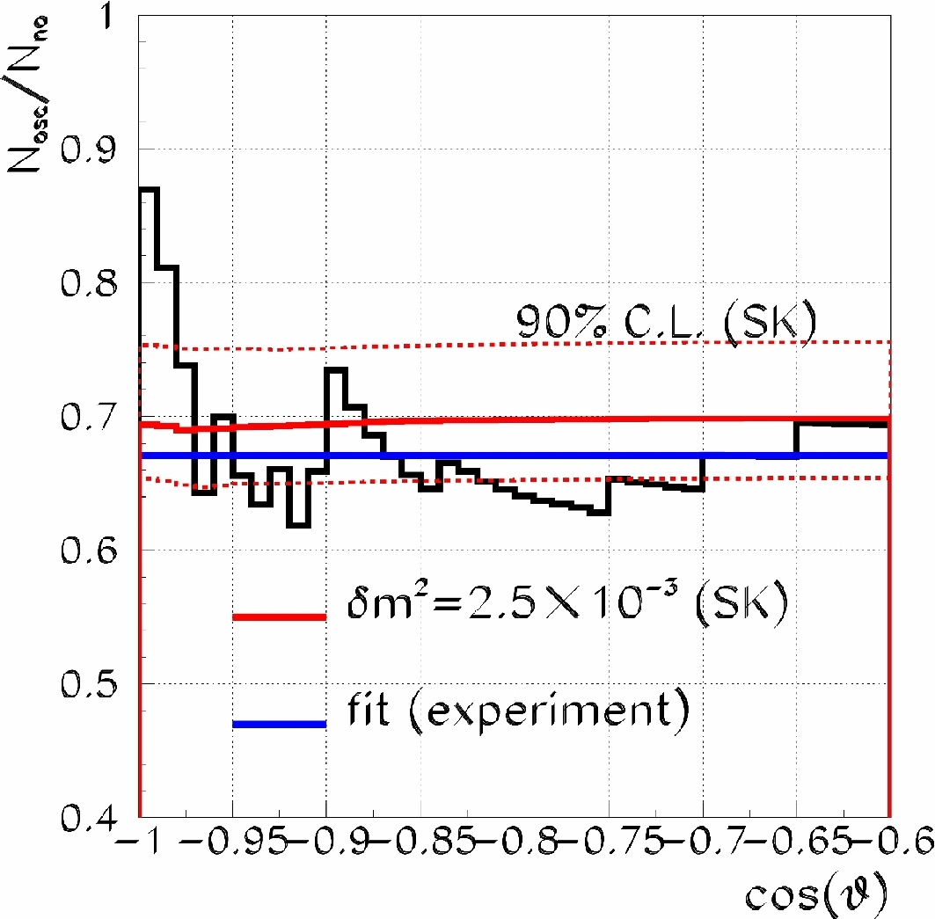
Remember: Baikal-NT200
(but only around opposite zenith, no angular dependence towards horizon!)

Slide 34
Neutrino Oscillations:
b) MSW effect & Mass Hierarchy

Slide 35
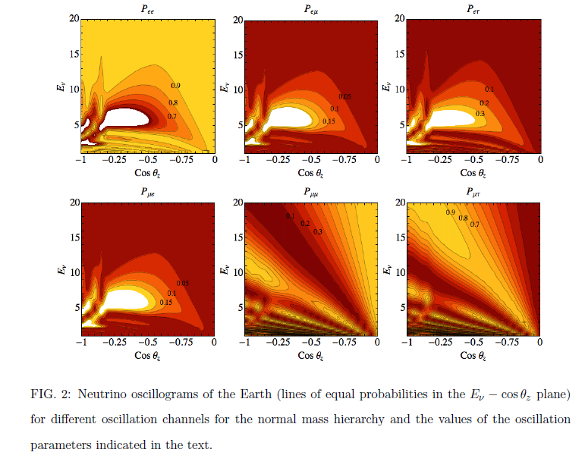
Matter Effects
Akhmedov, Razzaque, Smirnov
arXiv:1205.7071 (May 31) [hep-ph]

Slide 36
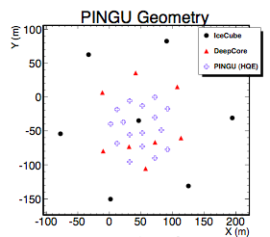
PINGU
PINGU is a concept for an even higher density infill to DeepCore that lowers the energy range of to a few GeV, with a few Megatons effective volume

Slide 37
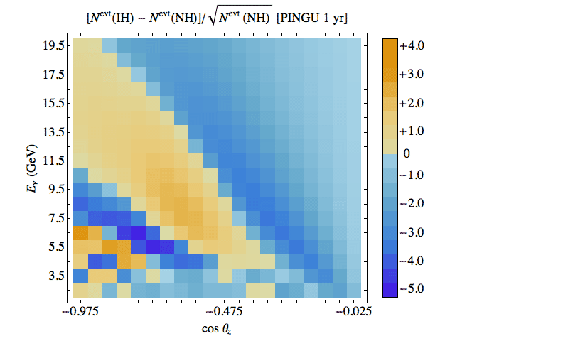
Mass hierarchy with PINGU?
Akhmedov, Razzaque, Smirnov
arXiv:1205.7071 (May 31) [hep-ph]
IceCube coll. is currently studying the feasibility of reaching the needed requirements.
Statistical significance of Normal versus Inverted Mass Hierarchy.
Sets PINGU requirements on:
Energy Resolution
Angular Resolution
Particle ID, Background
Systematic Errors

Slide 38
Neutrino Oscillations:
c) Oscillations due to
Violation of Lorentz
Invariance (VLI)

Slide 39
Exotic Oscillations
“νμ disappearance” in atmospheric neutrinos
  Violation of Lorentz Invariance
  Quantum Decoherence
  (both effects in Quantum Gravity)
Muon neutrino survival probability
VLI oscillations,
δc/c = 10⁻²⁷
a case for DeepCore
Parameters:
VLI: δc/c, sin 2ξ, Phase η
QD: D₃ und D₈, D₆ und D₇
Different to standard
oscillations (~ 1/E),
QG Oscillations go like
~ E (or even E²)
Conventional
oscillations

Slide 40
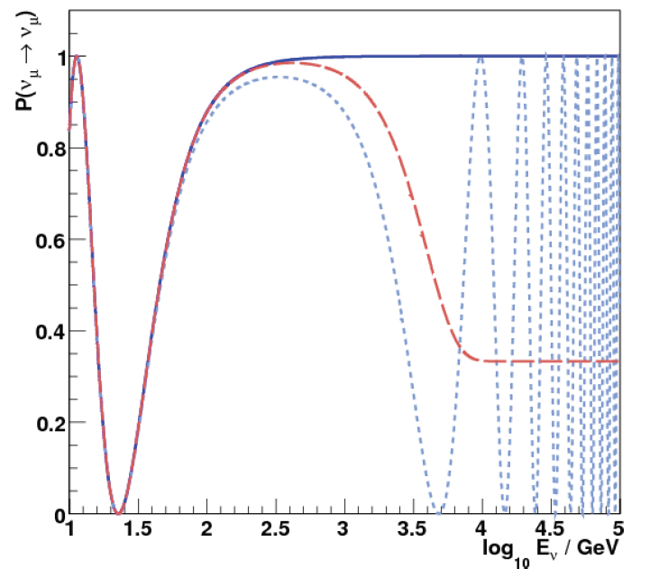
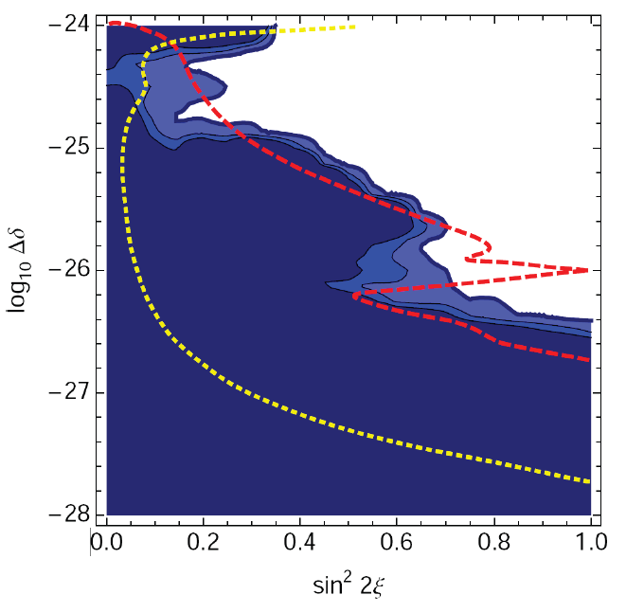
Exotic Oscillations
VLI (Δδ=10⁻²⁶, max mixing)
conventional
VLI
AMANDA
90%, 95%, 99%
SK + K2K
90%
QD
(n=2, D_{i} = 10⁻³⁰ GeV⁻¹)
IceCube
10y, 90%

Slide 41
Neutrino Oscillations:
d) Sterile Neutrinos

Slide 42


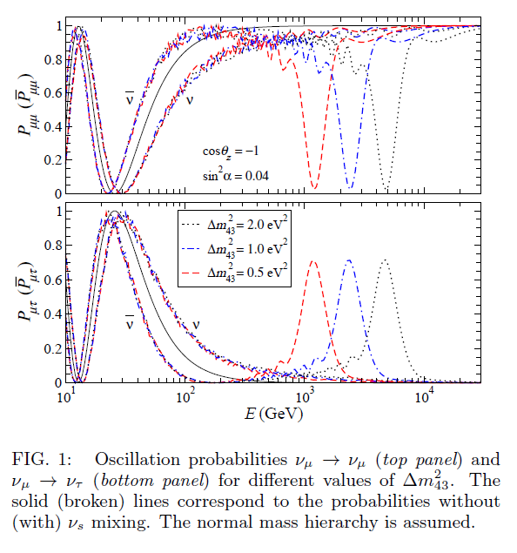
Visible as distortion of standard pattern with DeepCore
Visible as distortion of angular spectrum in the standard Icecube energy range

Slide 43
Indirect Dark Matter Search

Slide 44
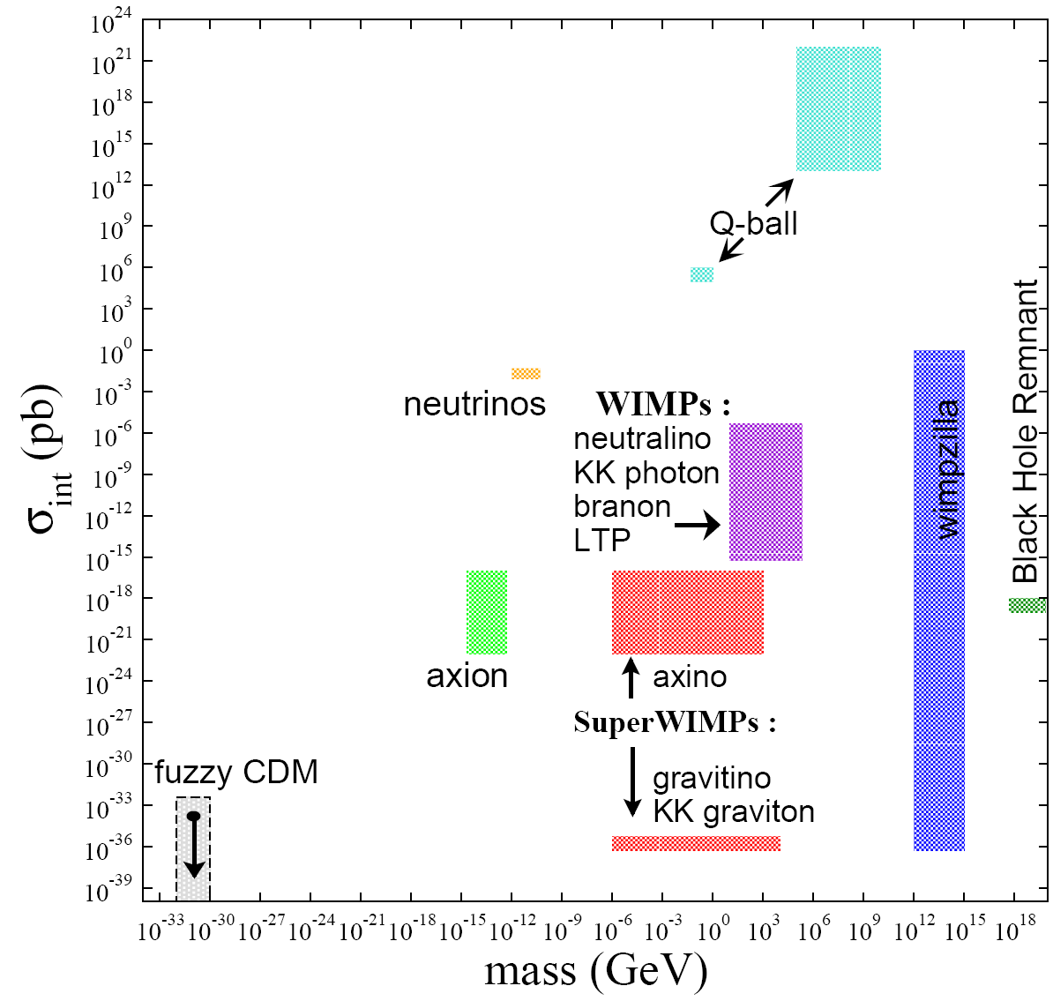
Dark Matter Candidates

Slide 45
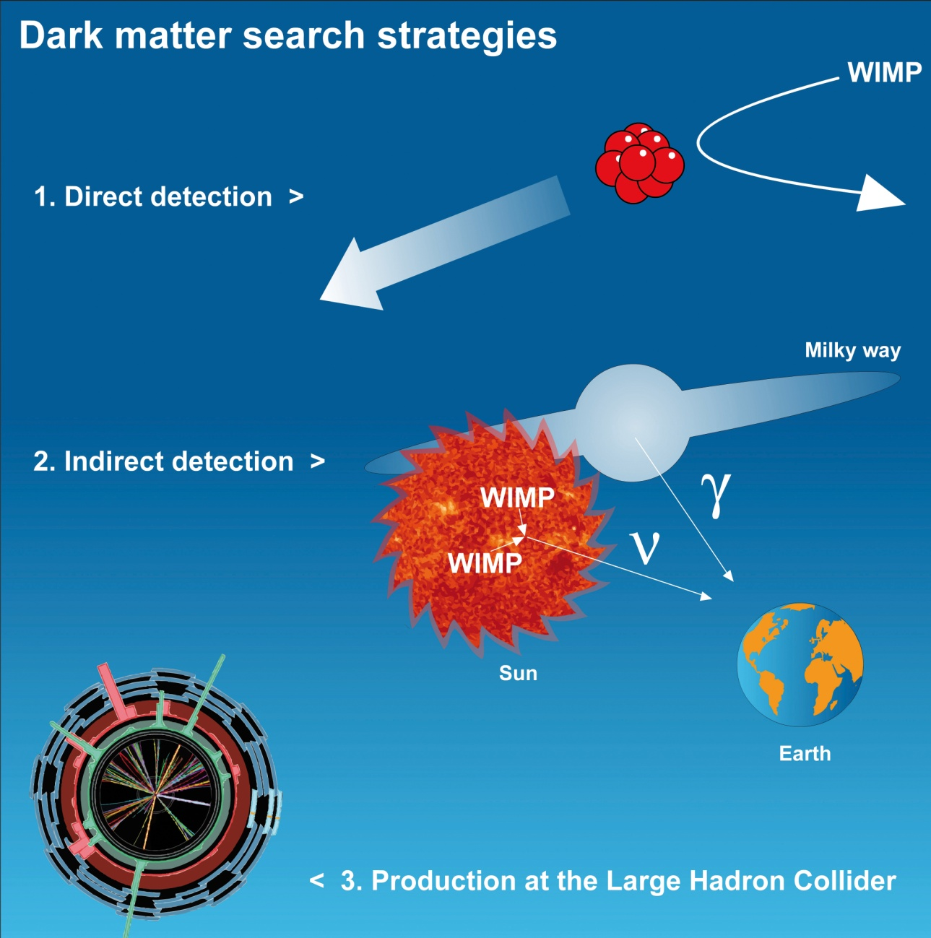
Indirect Dark Matter Search
WIMPs
  Neutralinos
  Kaluza-Klein particles
  …
Axions
Super-WIMPs
Axinos
Sterile neutrinos
Q-balls
WIMPzillas
Elementary BHs
…
, e⁺, p

Slide 46
Indirect Dark Matter Search
WIMPs
  Neutralinos
  Kaluza-Klein particles
  …
Axions
Super-WIMPs
Axinos
Sterile neutrinos
Q-balls
WIMPzillas
Elementary BHs
…
AMANDA skymap
around Sun
, e⁺, p

Slide 47
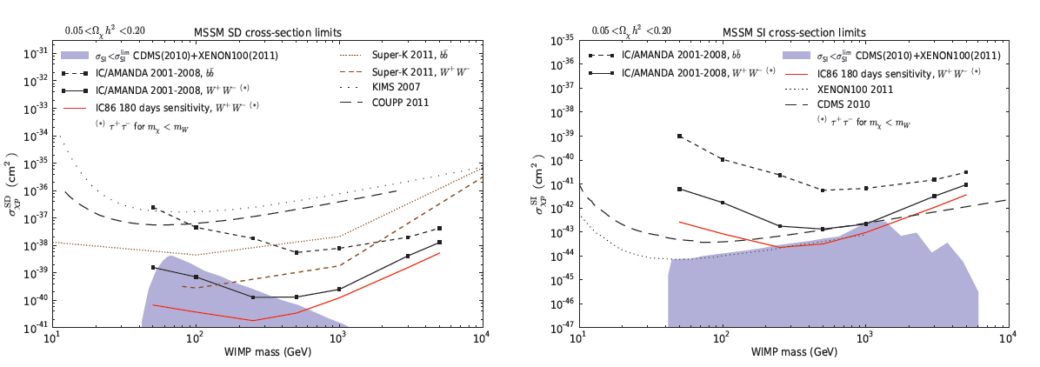
Indirect Dark Matter Search

Slide 48
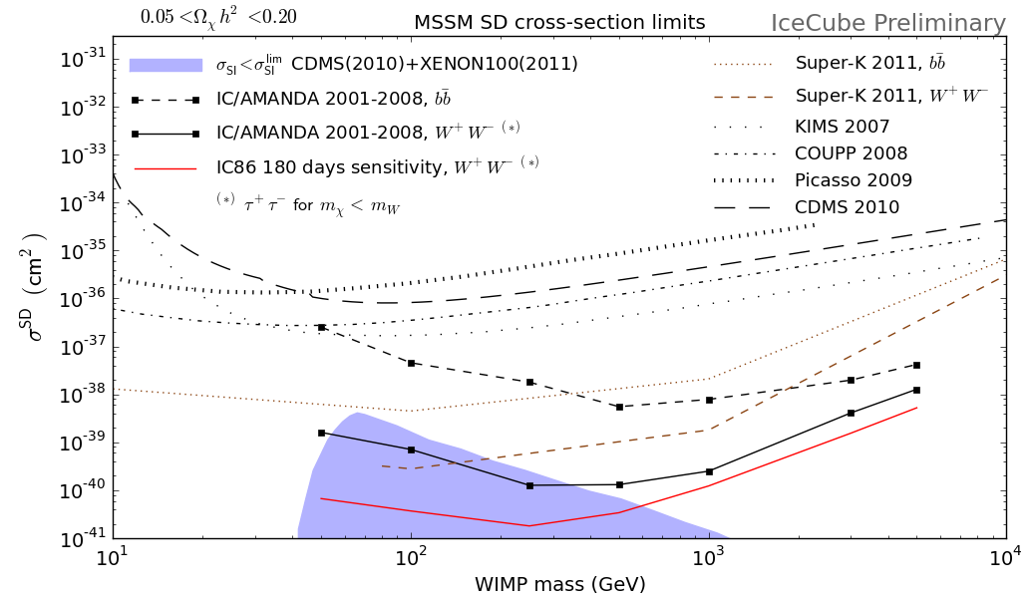
Indirect Dark Matter Search

Slide 49
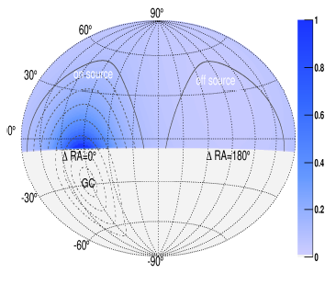
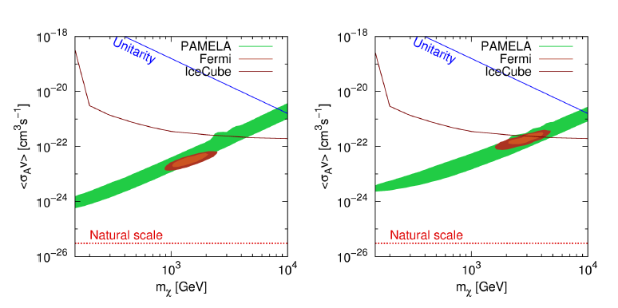
Search for DM from Galactic Halo
(IceCube-22)
90% CL upper limits on DM self-annihilation
cross section assuming the Einasto profile and
annihilation into μμ (left) and ττ (right)

Slide 50
Search for relativistic magnetic
Monopoles

Slide 51
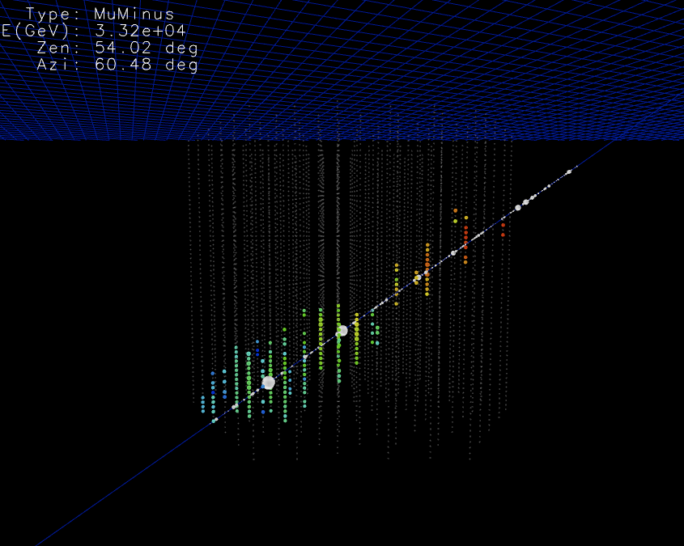
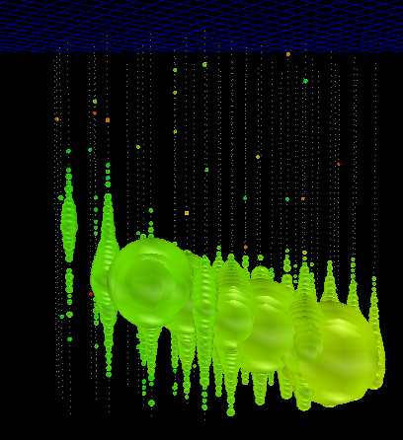
Relativistic Magnetic Monopoles
10⁷
muon
monopole
Cherenkov Light ∝
n²·(g/e)²
10⁵
δ
photons/cm
n = 1.33
(g/e) = ¹³⁷/₂
magnetic
monopole
10³
bare
muon
10¹
≈ 8300
0.4 0.6 0.8 1.0
β

Slide 52
Relativistic Magnetic Monopoles
2006
2008
2010
2011

Slide 53
Search for GUT magnetic
monopoles and other
extremely heavy, slowly moving
particles

Slide 54
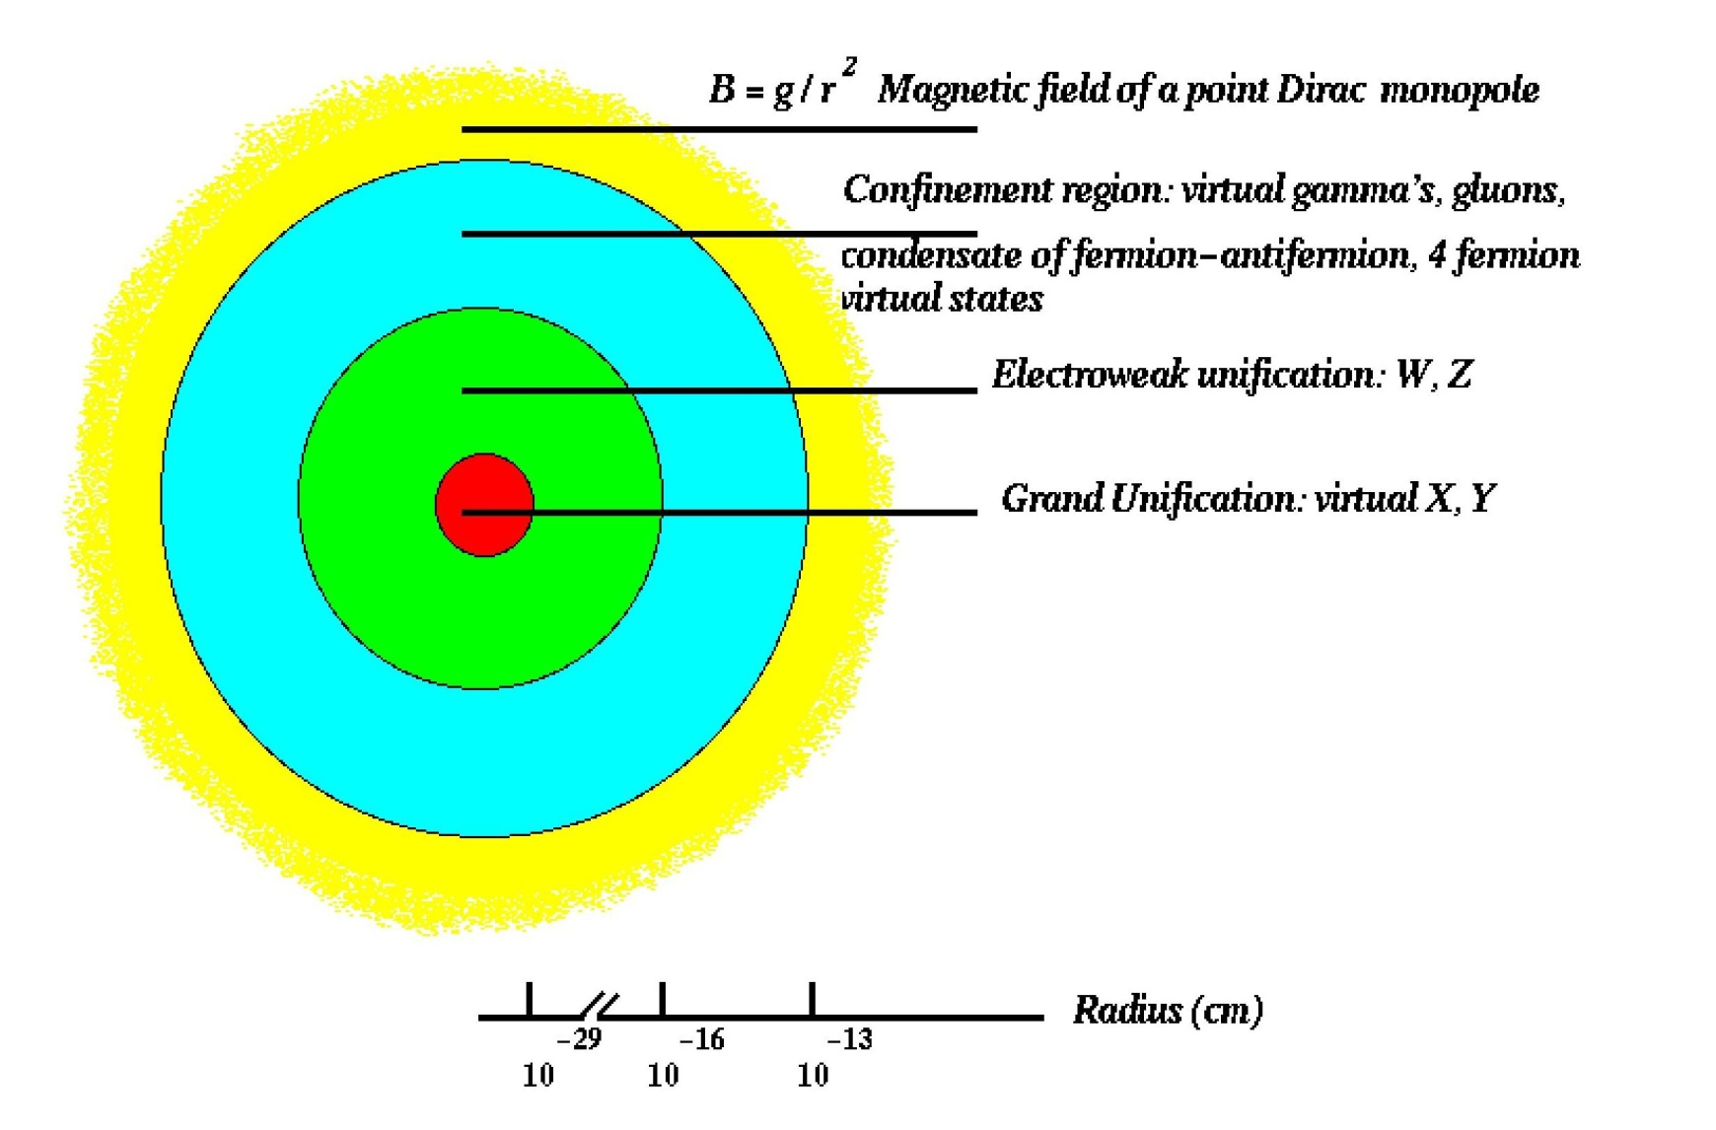
GUT Magnetic Monopoles
Mass 10¹⁶⁻¹⁷ GeV/c² Velocity β ~ 10⁻³
M + p → M + e⁺ + π⁰
May catalyze proton decay with σ ≈ σ₀ / β²
bright track from Cherenkov radiation from
proton decay products in water detectors (Rubakov)

Slide 55
NUCLEARITES (Strange Quark Matter+electrons)
Aggregates of u, d, s quarks + electrons
Stable for baryon number ∼300 < A < 10⁵⁷
ρ_{N} ∼ 3.5 × 10¹⁴ g cm⁻³ (ρ_{nuclei} ∼ 10¹⁴ g cm⁻³)
Produced in Early Universe, candidates for sub-dominant dark matter
May be produced also in neutron stars
Light generation via Planck radiation
Virial velocities
Supersymmetric Q-balls
Coherent states of squarks, sleptons and Higgs fields
10⁸ < M_{Q} 10²⁵ GeV
Produced in Early Universe, candidates for (sub-dominant) dark matter
Light generation via ionization (SECS) or catalysis of proton decay
(SENS)
Virial velocities

Slide 56
Flux upper limits for Magnetic Monopoles
IMB 1986-91
Kamiokande 1985
σ₀ = 10⁻²⁹ cm²
σ₀ = 10⁻²⁸ cm²
Baikal
1993
1986-89
Direct detection via
Ionization: MACRO
-4

Slide 57
Flux upper limits for Magnetic Monopoles
IMB 1986-91
Kamiokande 1985
σ₀ = 10⁻²⁹ cm²
σ₀ = 10⁻²⁸ cm²
Baikal
1993
1986-89
-4
IceCube sensitivity 1 year, σ₀ = 10⁻²⁷ cm² : ~10⁻¹⁸ cm⁻² s⁻¹ sr⁻¹

Slide 58
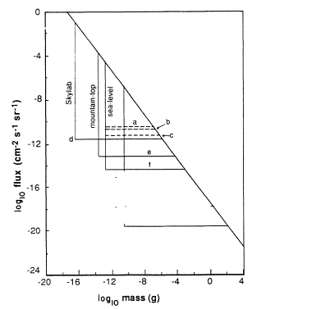

Nuclearites
Fluxes above this line
excluded by Galactic
dark matter limit
IceCube
after 1 yr
Macro
Herrin and Teplitz
“6-ton” event
ancient mica
IceCube
after 5 yr
following Buford Price

Slide 59
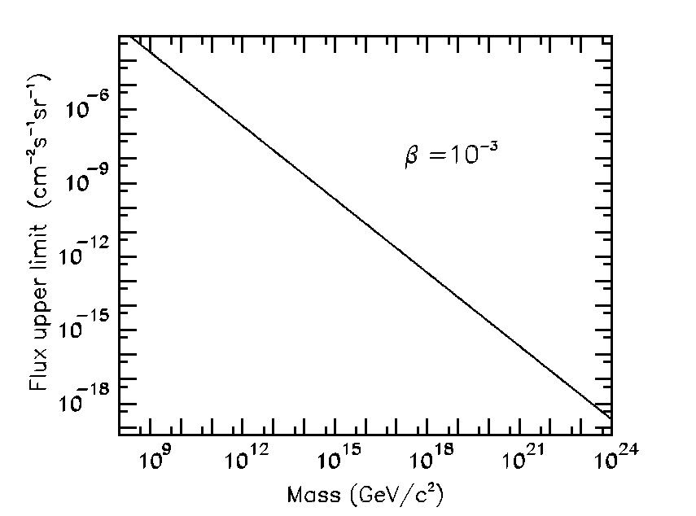
Neutral Q-Balls
Dark Matter Flux Limit
Baikal limit (Girlyanda 86)
Macro
Q-balls
stable
5 yr IceCube sensitivity
following Buford Price

Slide 60
Summary
High-energy neutrino astronomy: we may be close to first discoveries.
Record limits on LVI effects, dark matter cross sections and monopole fluxes
Neutrino telescopes demonstrate their capability to measure „standard oscillations“.
Neutrino telescopes are sensitive to certain sterile-neutrino scenarios.
Neutrino telescope may be capable to determine the neutrino mass hierarchy.
Not discussed in this talk: superluminal neutrinos, heavy flavor production (via prompt neutrinos), neutrino cross section at highest energy, ....

Slide 61
Do neutrinos move with v > c?
OPERA: after 730 km, neutrinos seem to arrive 60 ns earlier than light would arrive.
6 sigma effect, if wrong then likely through systematics.
Independent prove with the same method: MINOS (also 730 km), will have similar error only at end of 2013. Possibly T2K.
Conflict with SN1987A (neutrinos arrived only 2 hours earlier (due to emission start!). If OPERA result would be independent of energy and flavor, neutrinos should have arrived >1 year earlier!
  On flavor effects, see previous slides
  Effect could be strongly energy dependent
Can we search for v>c with IceCube? *
* See also Montaruli/Ronga arXiv:1109.6238

Slide 62
Searching for superluminal
neutrinos with IceCube?
Air shower
Energetic atmospheric
neutrinos
Energetic
atm. neutrinos
150-200 km to
generation point
delay of muon
up to 20 nsec
IceTop
muon
IceCube
neutrino
muon

Slide 63
Searching for superluminal
neutrinos with IceCube ?
T-zero from IceTop
Can one distinguish
the 2 muons and
measure time
differences ?
OPERA → time
delays of 1-2 nsec
Let be E_{ν} > 14 TeV (factor 1000
more than OPERA). If the effect
depends strongly on E, it could
be many ns or even μs.
- Muon stops in IceCube
- Neutrino interacts in DeepCore

Slide 64
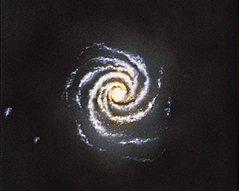
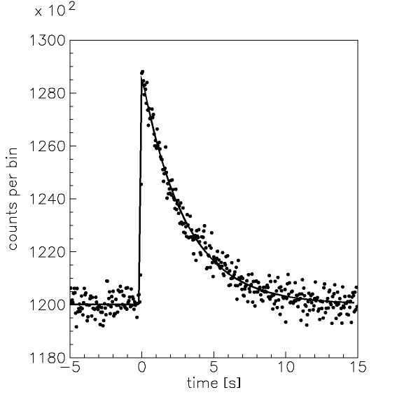
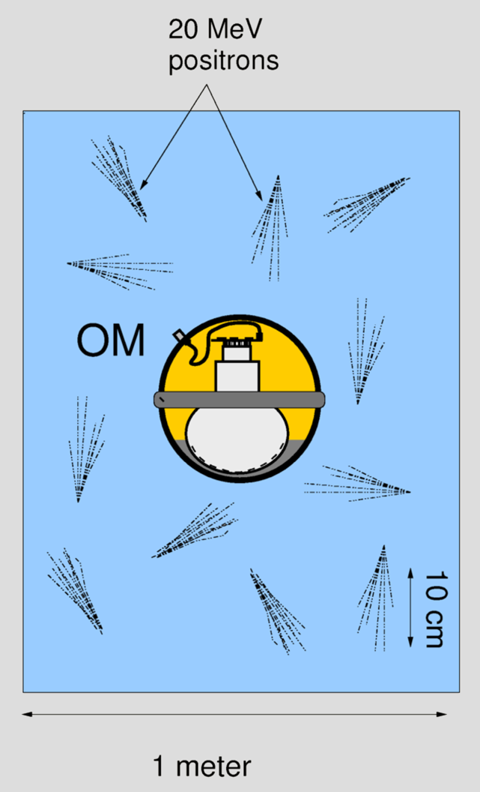
Supernova in IceCube
Close by objects
Detection via
enhanced
PMT noise rates
Sun
Dark noise (1PE) in IceCube
photomultipliers
only ~ 320 Hz !
Magellanic
Clouds
Count rates
Signal for SN in GC, 10⁶ counts
0 5 10 sec

Slide 65


Slide 66
DeepCore
6 DeepCore strings with 50 of the 60 DOMs in clearest ice
Plus 2 „remaining“ strings from the IceCube corner
Threshold ~ 10 GeV

