Slide 1
Determining the neutrino mass hierarchy with detectors in water and ice
C. Spiering, Prague, May 24, 2013

Slide 2
Content
Present detectors: Antares, IceCube/DeepCore
Oscillations in Antares and DeepCore
Measuring the mass hierarchy with PINGU and ORCA
Status and plans for PINGU
Protvino → ORCA (J. Brunner, Marseille)

Slide 3
Present detectors: - IceCube/DeepCore - ANTARES

Slide 4
IceCube
~220 ν/day
Threshold
- IceCube ~ 100 GeV
- DeepCore ~10 GeV

Slide 5
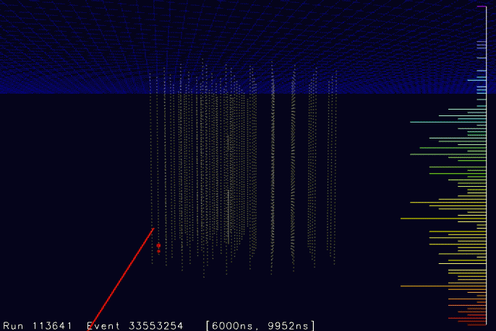

Slide 6
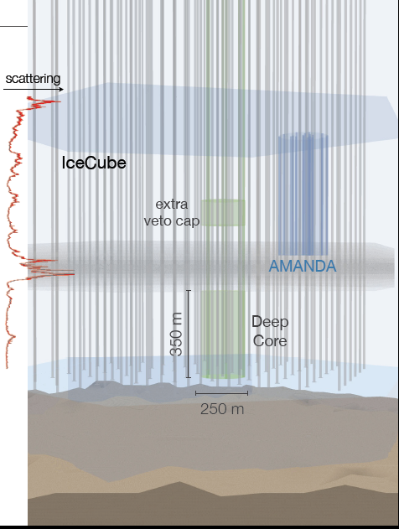
DeepCore
More densily instrumented than IceCube
8 special strings + 12 nearest standard strings
Spacing 45 -72 m (IceCube 125 m)
Clearest ice (λ_{eff} ~ 45-50 m)
High QE PMT (35%)
Taken alltogether: 5 times better photon collection than standard IceCube

Slide 7
DeepCore
More densily instrumented than IceCube
8 special strings + 7 nearest standard strings
Spacing 45 -72 m (IceCube 125 m)
Clearest ice (λ_{eff} ~ 45-50 m)
High QE PMT (35%)
Taken alltogether: 5 times better photon collection than standard IceCube

Slide 8
DeepCore
More densily instrumented than IceCube
8 special strings + 7 nearest standard strings
Spacing 45 -72 m (IceCube 125 m)
Clearest ice (λ_{eff} ~ 45-50 m)
High QE PMT (35%)
Taken alltogether: 5 times better photon collection than standard IceCube

Slide 9
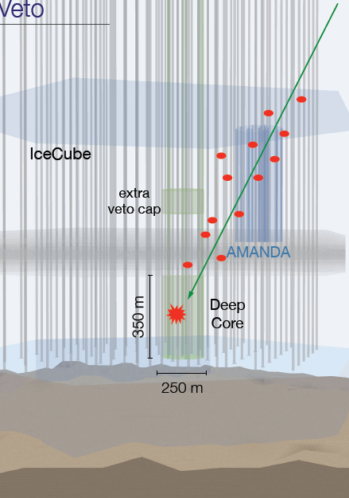
DeepCore
Depth 2.5 km.w.e.
Cosmic ray background ~ 10^{5.5} of atmospheric neutrinos
Top and outer layers provide a muon shield
→ effective depth w.r.t. muon background much deeper
Vetoing algorithms surpass 10⁶ rejection level
Threshold 10-20 GeV

Slide 10
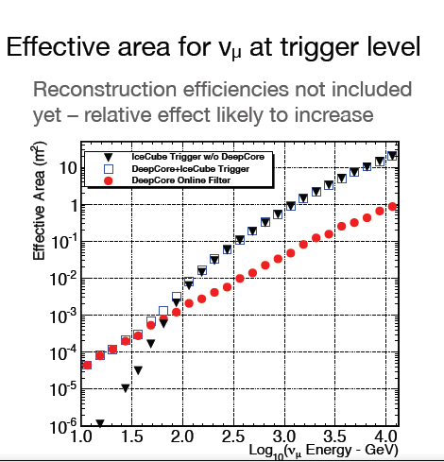
DeepCore
Depth 2.5 km.w.e.
Cosmic ray background ~ 10^{5.5} of atmospheric neutrinos
Top and outer layers provide a muon shield
→ effective depth w.r.t. muon background much deeper
Vetoing algorithms surpass 10⁶ rejection level
Threshold 10-20 GeV

Slide 11
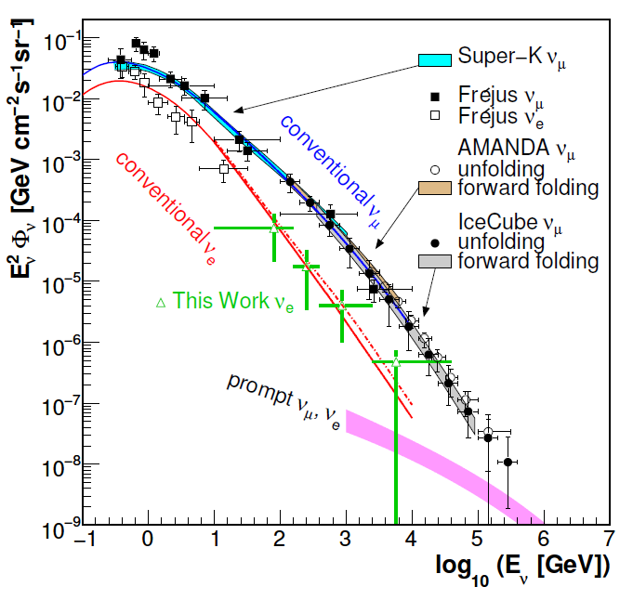
Atmospheric neutrinos in IceCube

Slide 12
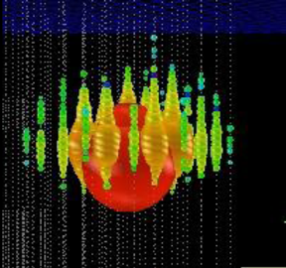
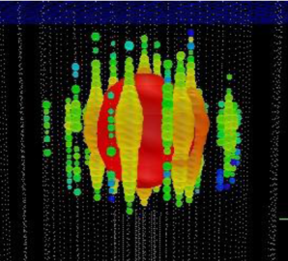
Recent IceCube results at the HE frontier
Ernie Bert
~1.1 PeV ~ 1.3 PeV
Until last week:
Two ~ PeV events
PLUS excesses in the 100-200 TeV range
Left: muon with ~ 200 TeV
Also 3 cascade events 140 -200 GeV
Atmospheric neutrinos from charm decay („prompt neutrinos“) or extraterrestrial neutrinos ??

Slide 13
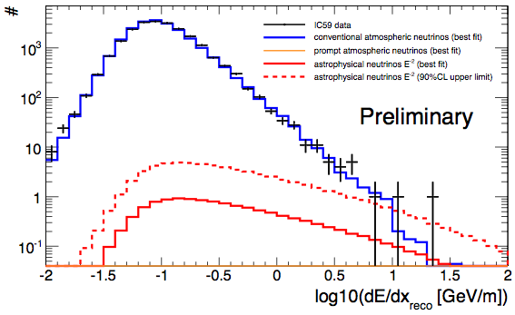
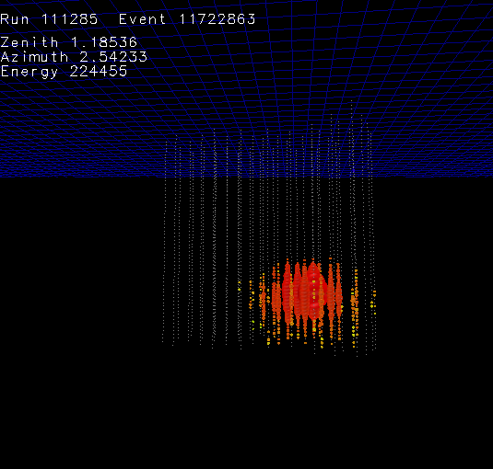
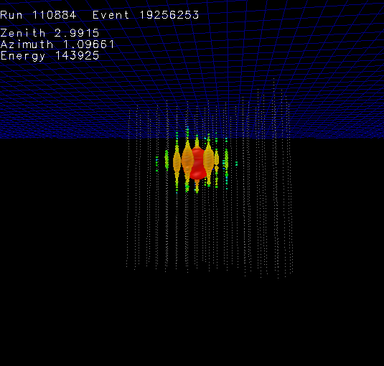
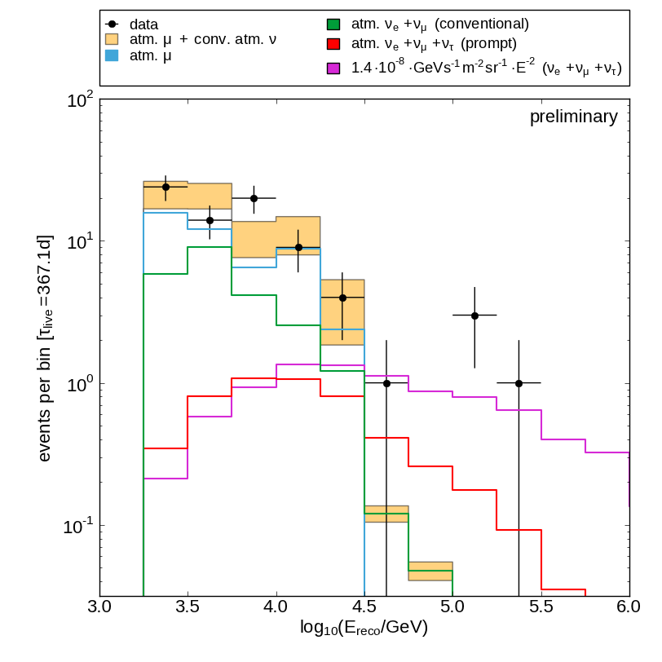
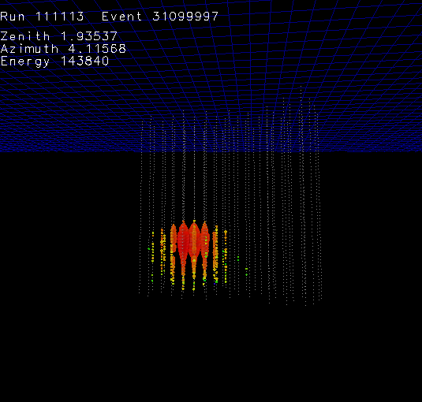
Recent IceCube results at the HE frontier
~ 220 TeV
Top: the excess of the 200 TeV muon events
Right: the 3 cascade events
~ 140 TeV
~ 140 TeV

Slide 14
Recent IceCube results at the HE frontier
At present:
26 more events („starting track analysis“)
Significance of all 28 events 4.3 σ
More data to be analyzed
Expect > 5σ at end 2013
Systematics! (Charm, Energy scale, ...)
Ernie and Bert

Slide 15
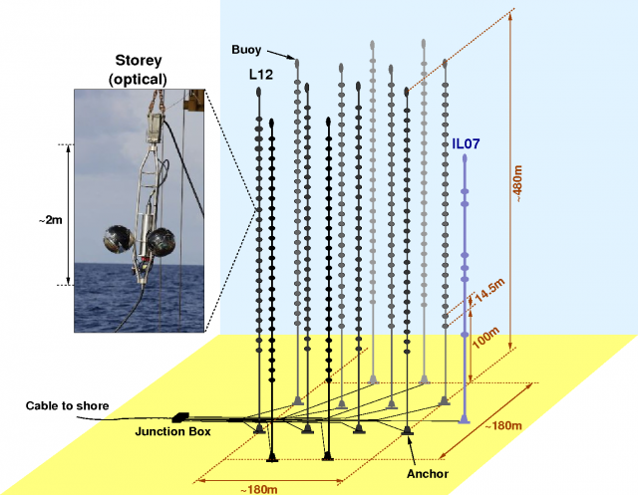
ANTARES
Mediterranean Sea close to Toulon
Depth ~2475 km
Volume ~0.01 km³
12 strings, each with 25 PMT triplets
Operating in final configuration since 2008

Slide 16
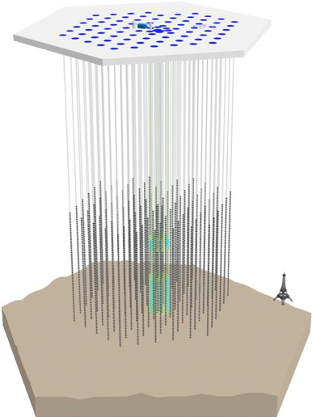
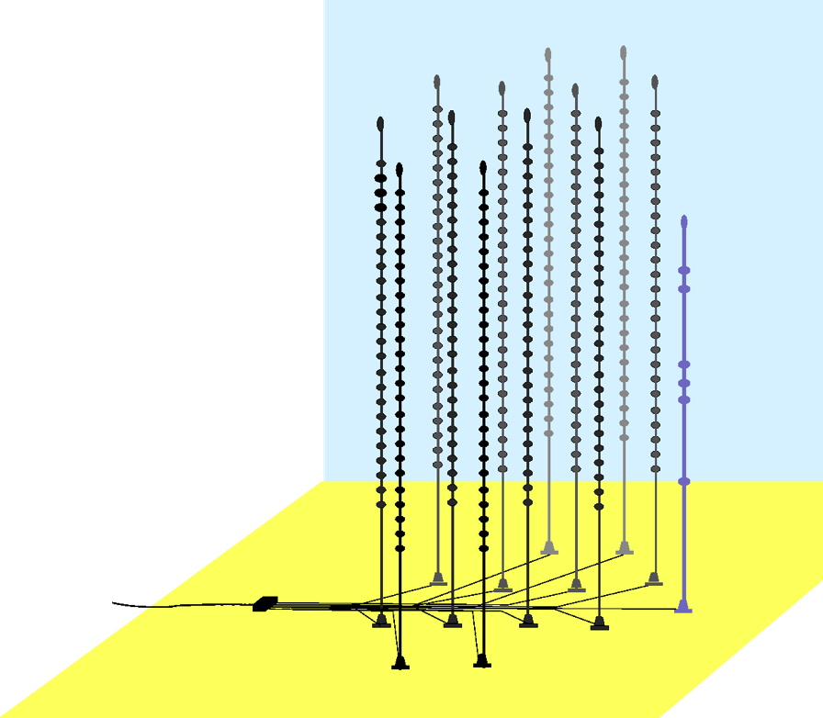
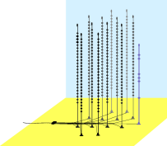
Scales
IceCube
ANTARES
DeepCore

Slide 17
Oscillations in antares and DeepCore

Slide 18
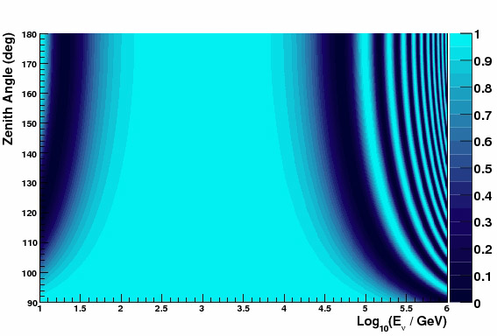
Oscillations of atmospheric neutrinos
Muon neutrino survival probability
Vertically upward
cosmic ray
ANTARES/DeepCore
ν
Earth
L
θ
Horizontal

Slide 19
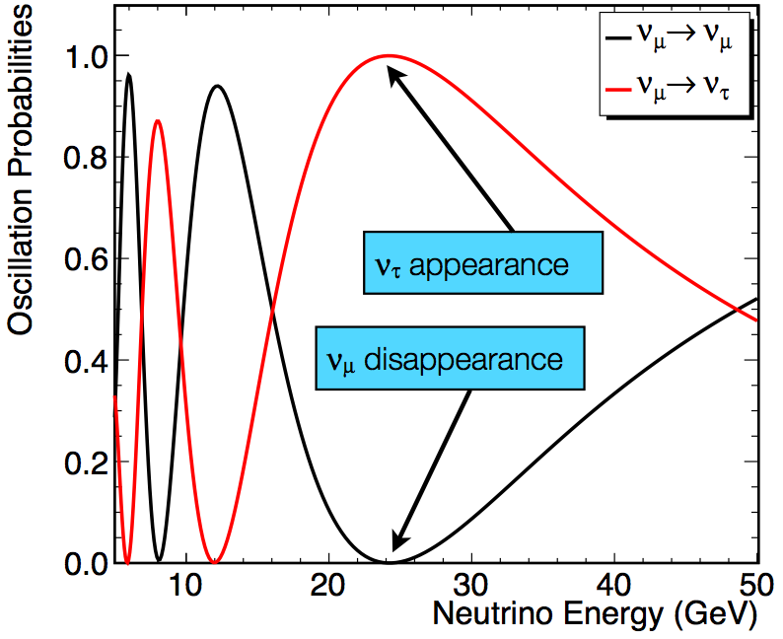
Oscillations of atmospheric neutrinos
Muon neutrino survival probability
Vertically upward
Mena et al. PR D78 2008
cosmic ray
ANTARES/DeepCore
ν
Earth
L
θ
Horizontal

Slide 20
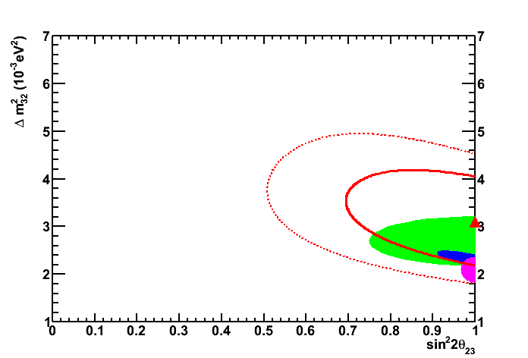
Oscillations of atmospheric neutrinos
Muon neutrino survival probability
Vertically upward
ANTARES
PL B714 (2012)
cosmic ray
ANTARES/DeepCore
2σ
ν
Earth
1σ
ANTARES
K2K
MINOS
SuperK
L
θ
Horizontal

Slide 21
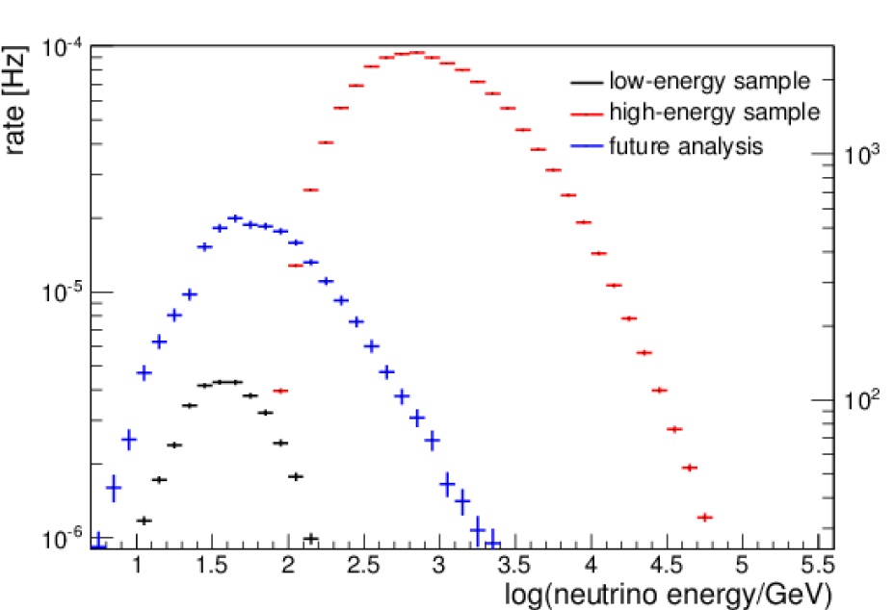
DeepCore result (IC79)
Low energy sample: DeepCore
High Energy sample: full IceCube (control sample which should not reveal any effect of oscillation)

Slide 22
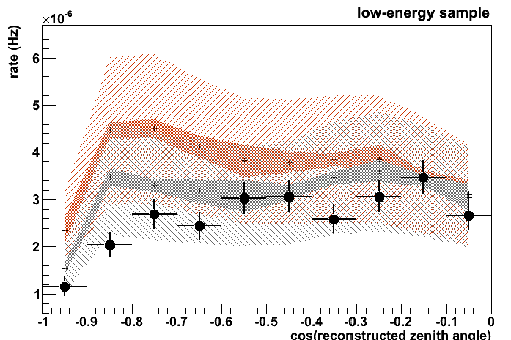
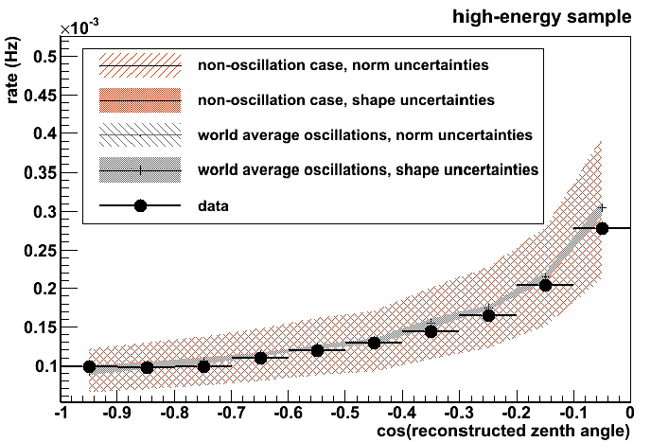
DeepCore result (IC79)
PRELIMINARY

Slide 23
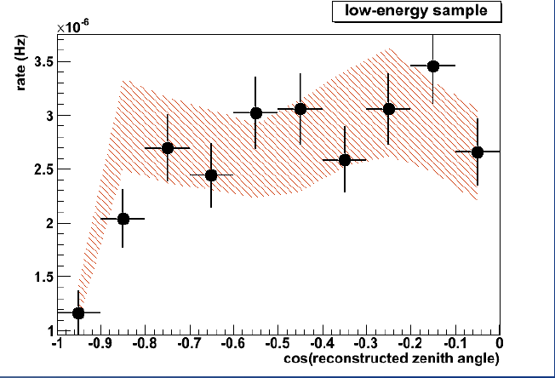
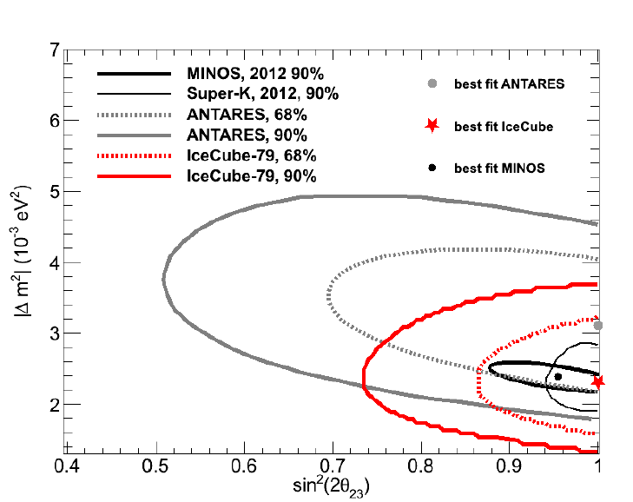
DeepCore result (IC79)
PRELIMINARY
Submitted to Journal
Can do precicsion measurements with DeepCore
DeepCore, 86-string data being analyzed
Improved reconstruction methods
Expect considerably tighter constraints to osc. parameters very soon

Slide 24
PINGU and orca

Slide 25
The Neutrino Detector Spectrum
NOνA
Accelerator
OPERA
K2K, T2K
MINOS
Energy ↔ Volume
10 MeV
100 MeV
1 GeV
10 GeV
100 GeV
1 TeV
10 TeV
1 EeV
Solar/Reactor
Atmospheric
Atmospheric/Astrophysical
Gap
Borexino/KamLand/Daya Bay/Double Chooz/SNO/SuperK
AMANDA/ANTARES/IceCube/KM3Net/
ANITA/RICE/Auger/ARIANNA
Dark
Matter
ντ
Appearance
Non-accelerator based
νμ
Disappearance
(Neutrino
Mass Hierarchy)
* boxes select primary detector physics energy regimes and are not absolute limits

Slide 26
The Neutrino Detector Spectrum
NOνA
Accelerator
OPERA
K2K, T2K
MINOS
Energy ↔ Volume
10 MeV
100 MeV
1 GeV
10 GeV
100 GeV
1 TeV
10 TeV
1 EeV
Solar/Reactor
Atmospheric
Atmospheric/Astrophysical
DeepCore
Borexino/KamLand/Daya Bay/Double Chooz/SNO/SuperK
AMANDA/ANTARES/IceCube/KM3Net/
ANITA/RICE/Auger/ARIANNA
Non-accelerator based
* boxes select primary detector physics energy regimes and are not absolute limits

Slide 27
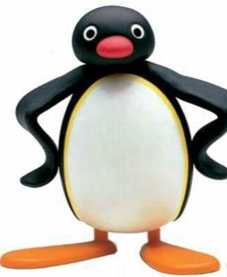
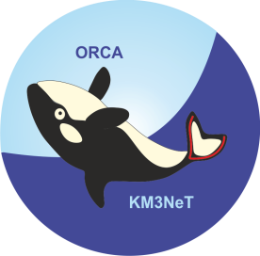
The Neutrino Detector Spectrum
PINGU (Precision IceCube Next Generation Upgrade)
NOνA
Accelerator
OPERA
K2K, T2K
MINOS
Energy ↔ Volume
LBNE
10 MeV
100 MeV
1 GeV
10 GeV
100 GeV
1 TeV
10 TeV
1 EeV
Solar/Reactor
Atmospheric
Atmospheric/Astrophysical
DeepCore
Borexino/KamLand/Daya Bay/Double Chooz/SNO/SuperK
PINGU
ORCA
AMANDA/ANTRES/IceCube/KM3Net/
ANITA/RICE/Auger/ARIANNA
ORCA (Oscillation Research with Cosmics in the Abyss)
Notes:
and so I introduce our future plan- the upgrade detectors for which I have now accepted the role of lead scientist towards their development

Slide 28
Future: Matter Oscillations and Mass Hierarchy
P(νμ → νμ) for θ=130º
1
Akhmedov et al., arXiv:1205.7071
IH
NH
0.5
P (νx → νμ)
νμ
νe
0
1
5
10
Eν [GeV]
Maximum difference NH ↔ IH for θ = 130° at 7 GeV
For anti-ν, NH and IH are approximately swapped → effect cancels if ν and anti-ν have equal fluxes and cross sections and if the detector cannot distinguish μ⁺ and μ⁻
However: flux of atm.ν ~ 1.3 × flux of atm. anti -ν
and σ(ν) ~ 2 × σ(anti-ν) at low energies
→ Count N_{μ}(θ, E) from ν_{μ} + N →μ + X and compare with NH/IH predictions

Slide 29
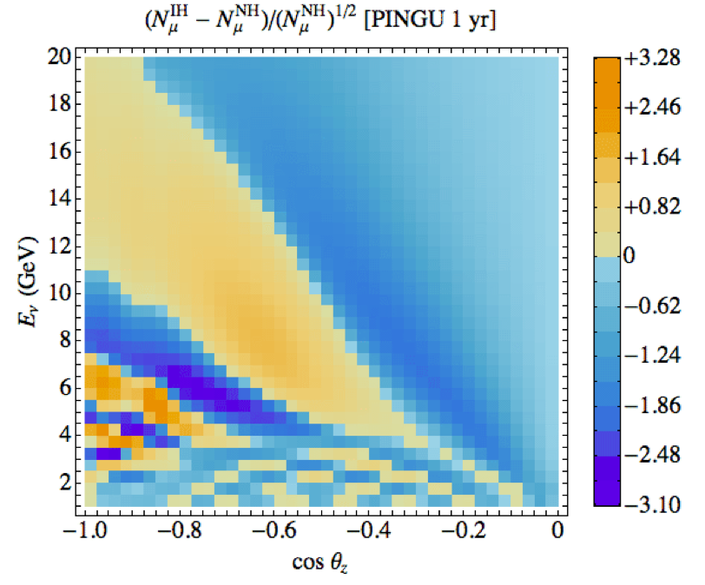
Pattern from matter oscillations
ΔN(IH‑NH) / √N(NH) [PINGU 1 yr, 10% sys.]
Perfect resolution
Akhmedov et al., arXiv:1205.7071

Slide 30
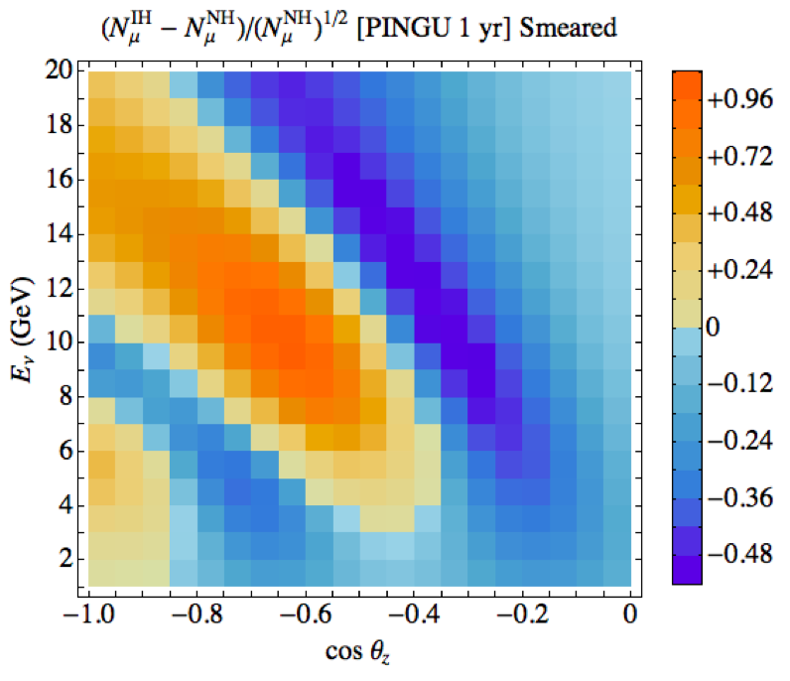
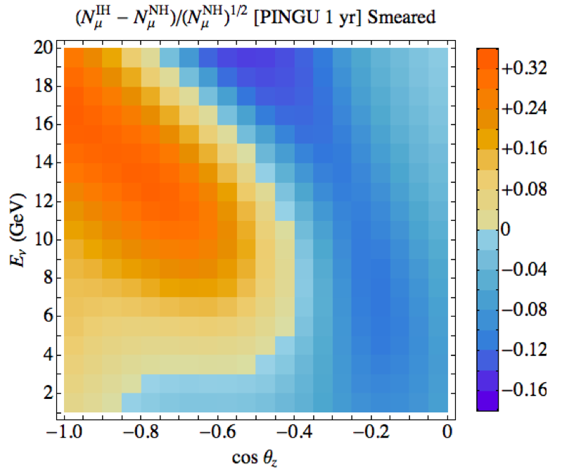
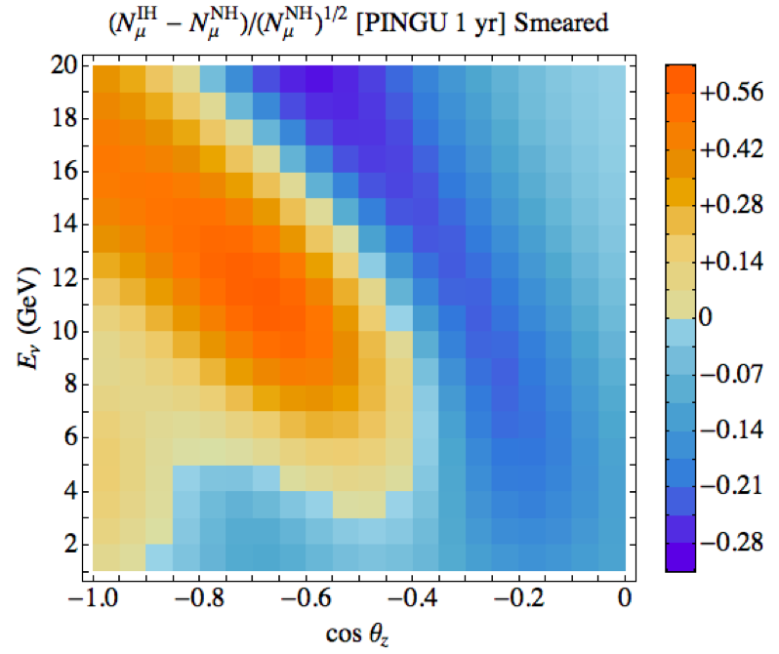
Importance of resolution and systematics
ΔN(IH‑NH) / √N(NH) [PINGU 1 yr, 10% sys.]
σθ = 11º σE = 2 GeV → Σ=7σ
σθ = 23º σE = 4 GeV → Σ=3σ
σθ = 15º σE = 3 GeV → Σ=5σ
Perfect resolution
Feasibility depends on
Angular resolution
Energy resolution
Particle ID
Systematic effects
Akhmedov et al., arXiv:1205.7071

Slide 31
PINGU
Goals: - Determine neutrino mass hierarchy - low mass WIMP search - improved sensitivity to SN burst neutrinos
→ must reach energy threshold of < 5 GeV
Add infill strings to DeepCore
More optical modules per string
Improve veto capabilities
Co-deploy calibration devices optimized for low energy
Simplify optical modules
Improve quality of refrozen hole ice
PINGU I
DeepCore
IceCube
PINGU II

Slide 32
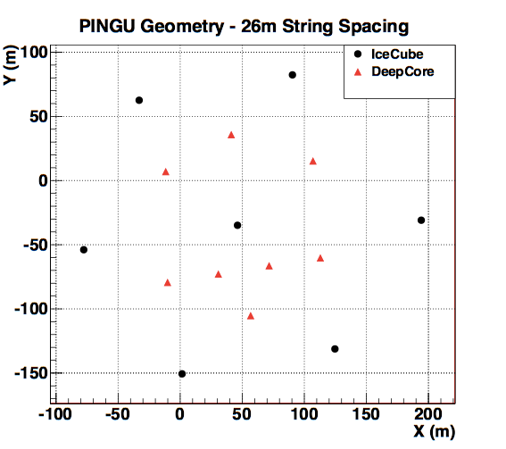
Configurations
DeepCore

Slide 33
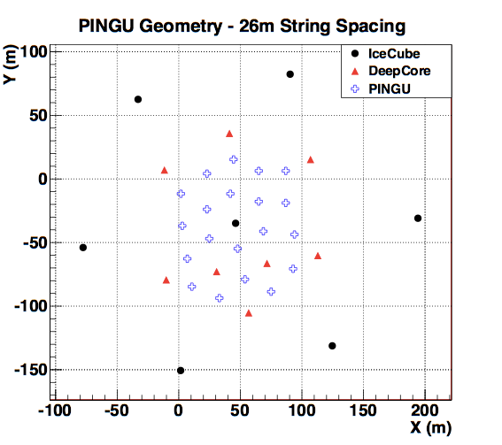
Configurations
PINGU
Minimal option
20 more strings
26 m spacing
60 DOMs per string
5 m spacing
Need 2 seasons to deploy

Slide 34
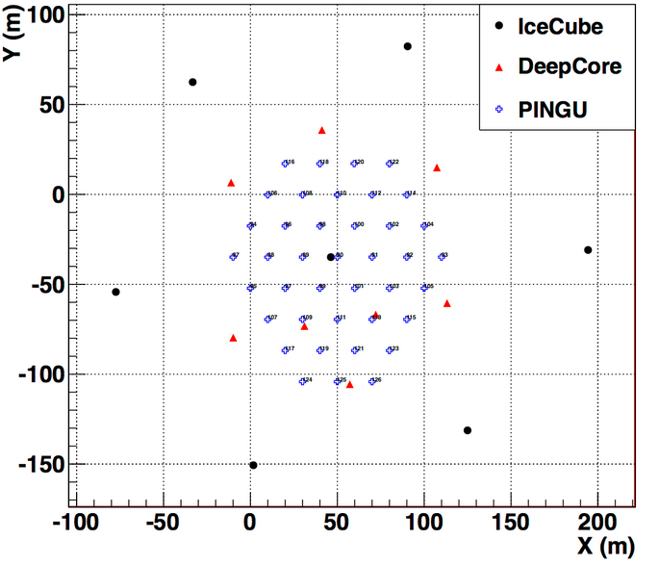
Configurations
PINGU
Medium option
40 more strings
20 m spacing
60-120 DOMs per string
2.5-5 m spacing
Need 3 seasons to deploy

Slide 35
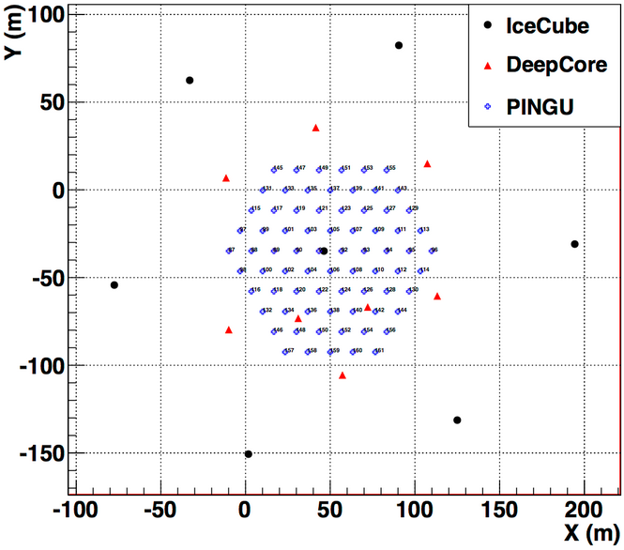
Configurations
PINGU
Maximum (?) option
75 more strings
13 m spacing
60-120 DOMs per string
2.5-5 m spacing
Need 4 seasons to deploy

Slide 36
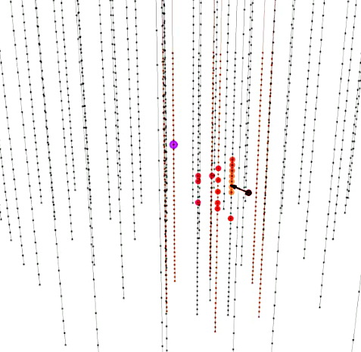
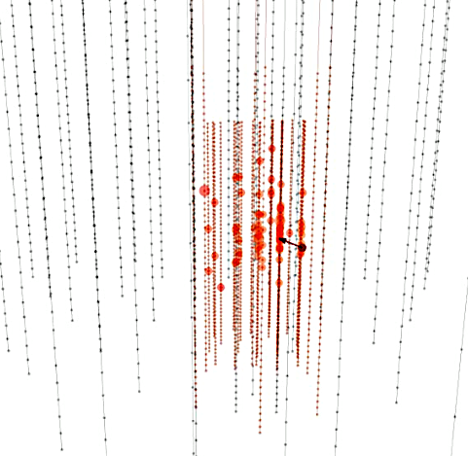
A 9-GeV neutrino event (PINGU 20 strings)
DeepCore
DeepCore + PINGU
Neutrino energy: 9.3 GeV Muon energy: 4.8 GeV Cascade energy: 4.5 GeV
Hit modules: 20 (DC) → ~50 (DC + PINGU)

Slide 37
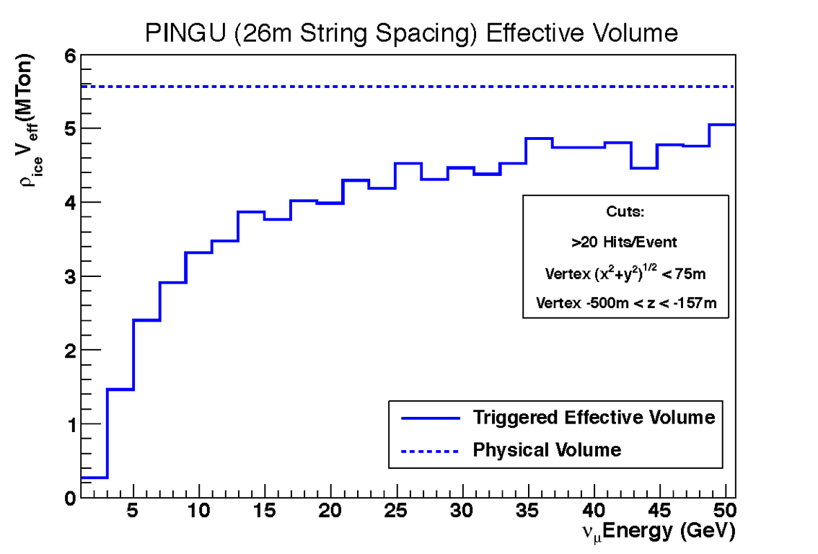
Effective volume
preliminary
For „maximum configuration“ the effective (> 20 hits) volume at 3-4 GeV increases by more than a factor 2
This does not mean that we will have sufficiently good angular and energy resolution and flavor identification. These aspects are under investigation. They will lead to a substantial reduction of the real effective volume

Slide 38
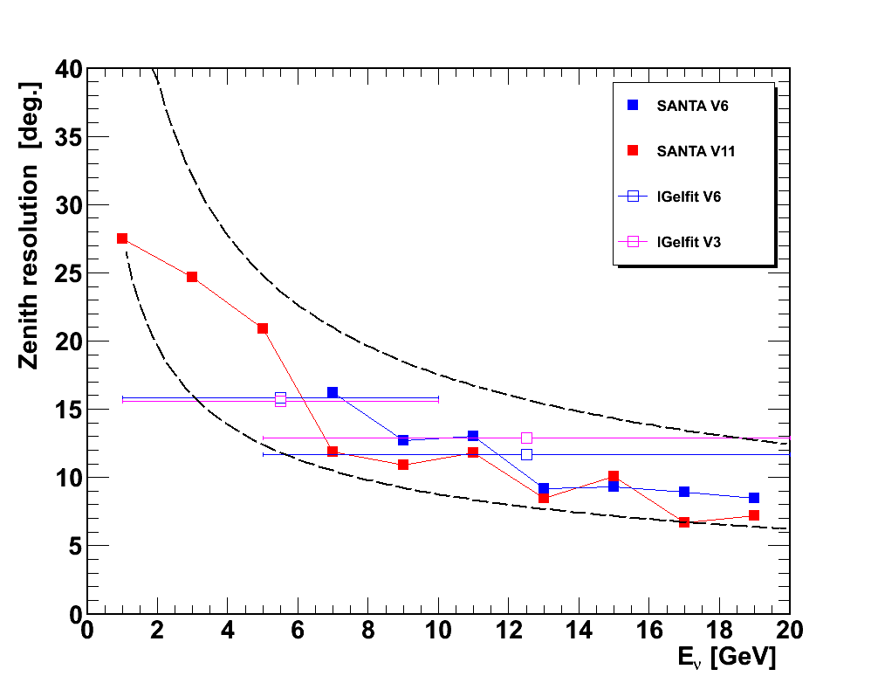
Angular resolution
Trying different algorithms
using only non-scattered photons (SANTA)
LLH fit with grid-search strategy (Igelfit)
Reco of CC events with 8 parameters (interaction vertex and time, direction, length and cascade energy)
Figure: examples for different configurations and fit-algorithms
Resolution in relevant energy range~ 10 degree
(m_{p}/E)^{1/2}
preliminary
(1/2)x (m_{p}/E)^{1/2}

Slide 39
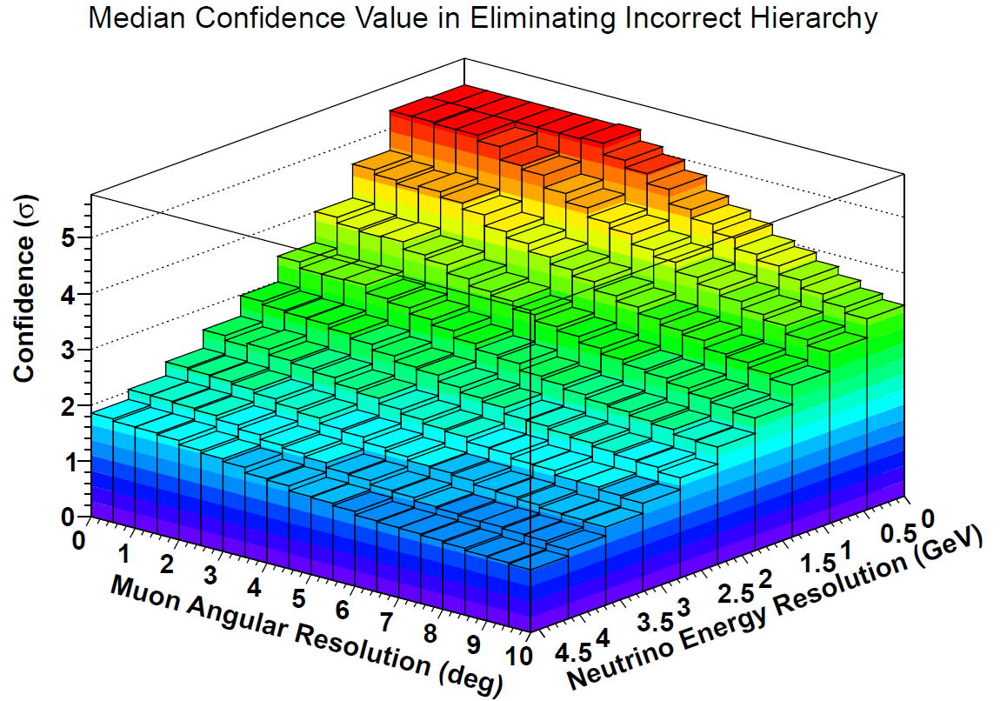
Statistical analysis for the NMH sensitivity
PINGU configuration
with 20 strings
(60 DOM/string)
1 year of data
and N_{hit}>20
PINGU preliminary

Slide 40
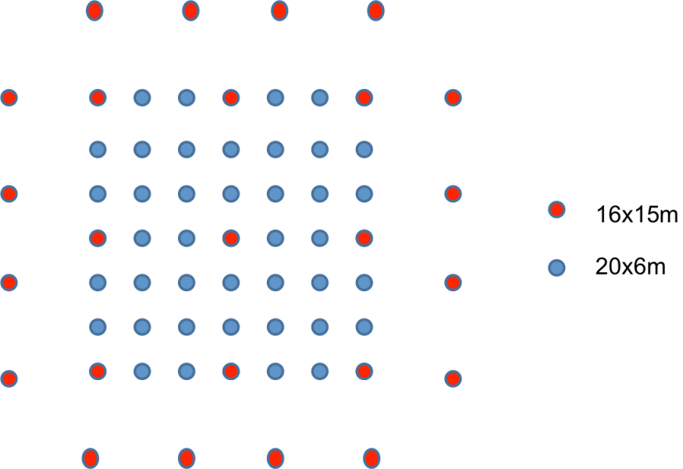
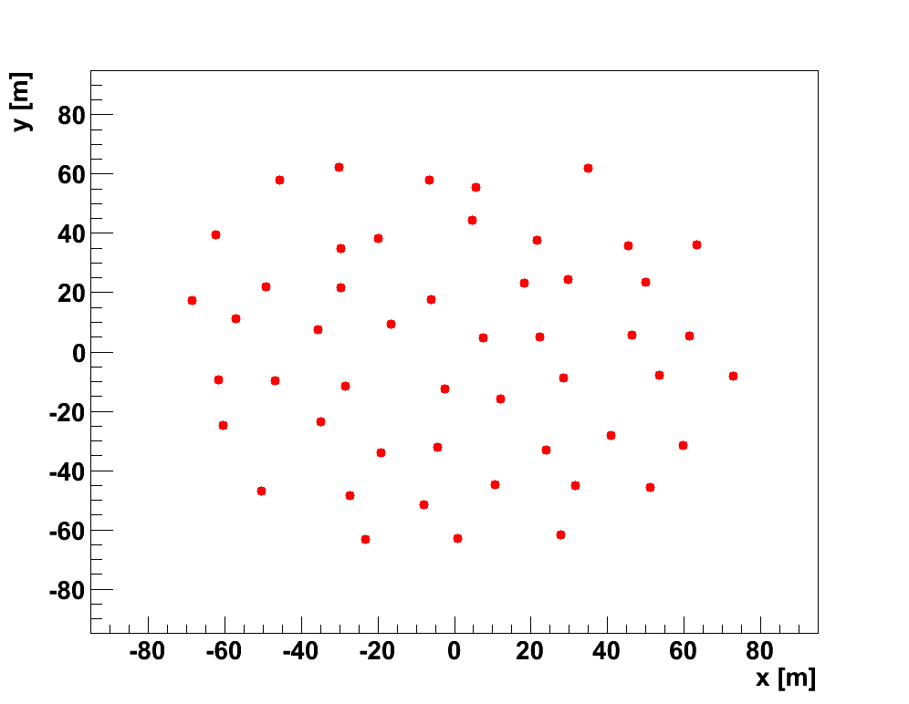
ORCA
Shown are 2 example configurations, for instance
50 strings, 20 OMs each
KM3NeT design: 31 3-inch PMTs / OM
20 m horizontal distance
6 m vertical distance
instrumented volume: 1.75 Mton water
ORCA
150 m
Height 120 m

Slide 41
Status and plans for pingu

Slide 42
First of all:
Confirm feasibility (DeepCore as test bed, MC studies, improve reconstruction) !
Which energy resolution can be achieved?
Which angular resolution can be achieved?
How well works flavor identification?
Are there non-understood systematic effects?

Slide 43
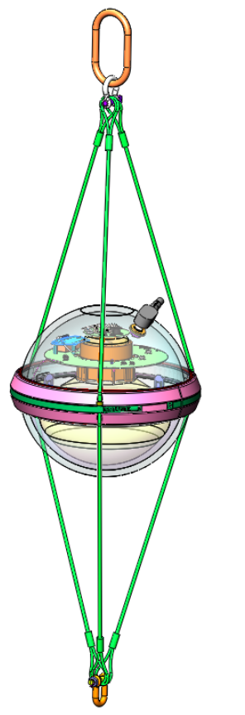
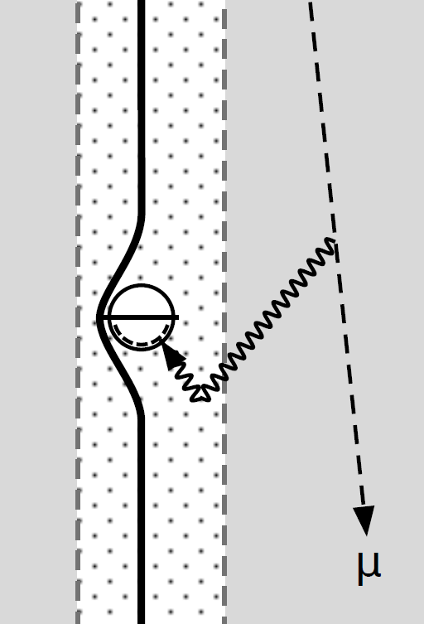
Optical Module and hole ice
Reduced ADC time window
Reduced dynamical range
Simplified control circuity
Simplified support solution
Modified coincidence circuitry
hole ice
hole ice
Upgrade drilling system
Cleanliness – Filter water, Replace hose
Minimize Bubbles – Circulate de-gassed water at hole bottom
Crack Free – limit refreeze pressure

Slide 44
Timeline (the optimist´s view)
April 18, 2013: advanced LoI for SAC Meeting at UW Madison
October 2013: proposal to US finding agencies (NSF)
If proposal approved in March/April 2013: ← ???
Summer 2014: start construction project
2014-16: design, manufacture and test hardware
Season 2015/16: drill preparation
2016: first cables/DOMs shipped to Antarctica
Season 2016/17: first deployment
Season 2017/18: second deployment

Slide 45
Summary on PINGU
PINGU offers a fast, low cost solution to determine the mass hierarchy with atmospheric neutrinos
PINGU feasibility remains still to be demonstrated
PINGU construction cost including drilling: 40-50 M$
PINGU start data taking
approval Spring 2014, 20 strings: 2018
approval late 2014 or 2015, 40 strings: 2020

Slide 46
References
O. Mena, I. Mocioiu, S. Razzaque, Phys. Rev. D78(2008), 093003 [arXiv:0803.3044]
Neutrino mass hierarchy extraction using atmospheric neutrinos in ice
First calculation for DeepCore, assuming sin²(2Q₁₃) =0.1, d=0
E.Kh. Akhmedov, S.Razzaque and A.Yu. Smirnov, JHEP 1302(2013),082 [arXiv:1205.7071]
Mass hierarchy, 2-3 mixing and CP-phase with Huge Atmospheric Neutrino Detectors
S. K. Agarwalla, T. Li, O. Mena, and S. Palomares-Ruiz, arXiv:1212.2238
Exploring the Earth matter effect with atmospheric neutrinos in ice
M.Ribordy and A. Yu. Smirnov, arXiv:1303.0758
Improving the neutrino mass hierarchy identification with inelasticity measurement
in PINGU and ORCA
T. Ohlsson, H. Zhang and S. Zhou, arXiv: 1303.6130
Effects of non-standard neutrino interactions at PINGU
D.Franco et al., arXiv: 1301.4332
Mass hierarchy discrimination with atmospheric neutrinos
in large volume ice/water Cherenkov detectors

Slide 47
Beam physics with underwater detectors
Jürgen Brunner, Marseille
See: J. Brunner „ Counting Electrons to
Measure the Neutrino Mass Hierarchy “
arXiv:1304.6213
Slides based on a talk of J. Brunner at APC

Slide 48
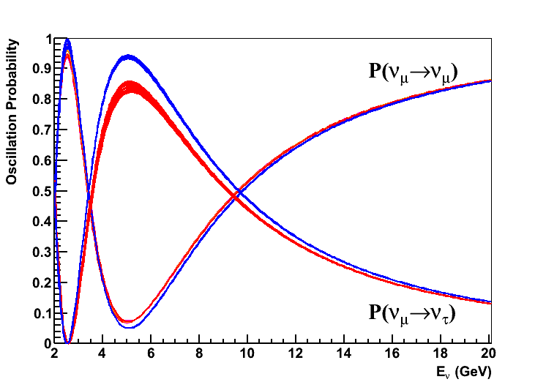
Oscillation Probabilities
GLOBES for Baseline of 2600km (neutrinos)
CP phase in steps of 30 degree
Full 3-flavor treatment
red: NH, blue: IH
NH/IH = 5/1

Slide 49
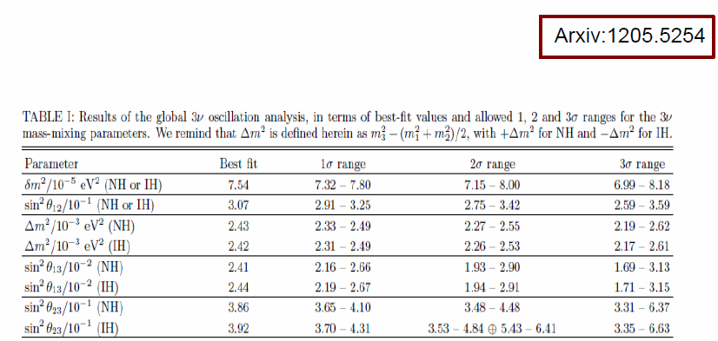
Oscillation parameters
Taken from Global Fit (Fogli et al.) for both hierarchy options
CP phase left free

Slide 50
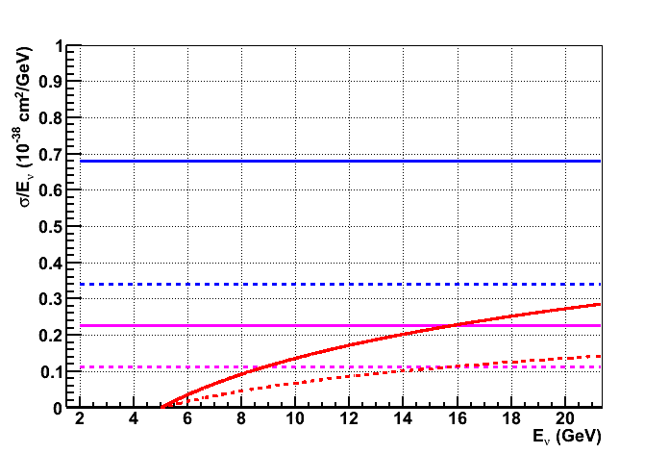
Neutrino cross sections
Simple parton scaling assumed (Quasi-el. & Res. ignored)
Flavor universality
NC, CC: ν_{e} ν_{µ} ν_{τ}
Solid : neutrino , dashed : antineutrino

Slide 51
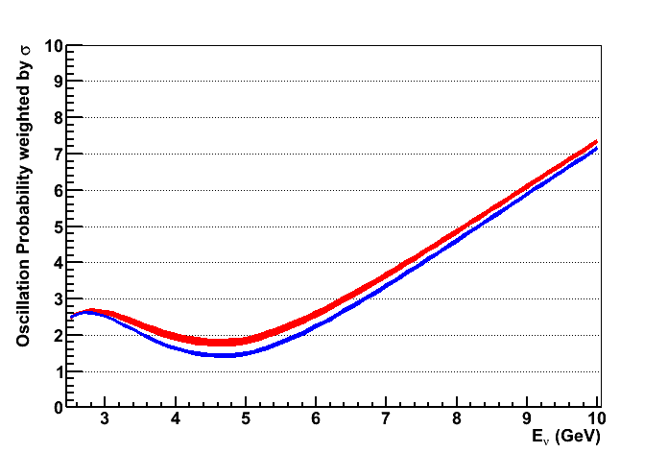
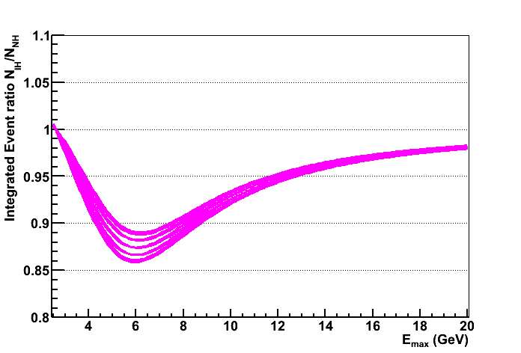
Cross Section Weighted P_{osc}
Allows to find optimal energy range for MH determination
No flavour tagging or CC/NC separation used
Kinematical suppression of ν_{τ} exploited
NH / IH
Ratio of Integrals IH/NH
(2.5 GeV - E_{max})

Slide 52
Cross Section Weighted P_{osc}
Optimal energy range for “event counting” 4-7 GeV
11-14% suppression of IH w.r.t. NH
Ratio of Integrals IH/NH
(2.5 GeV - E_{max})

Slide 53
U-70 and neutrino beam in Protvino
Shielding
p
target
Decay pipe
55m
focus
140m
270m

Slide 54
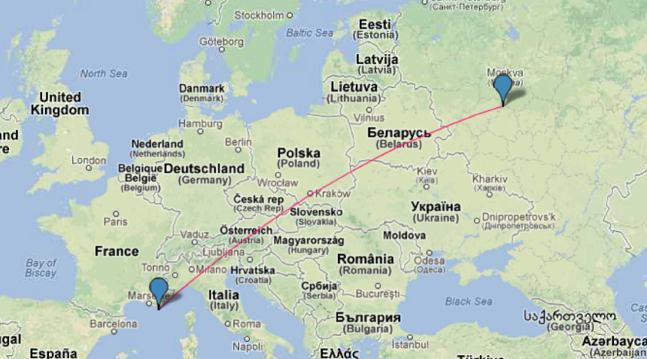
Protvino - Toulon
Baseline 2588km ; beam inclination : 11.7˚ (cosθ = 0.2)
Similar distance to Fréjus : 2400km
Deepest point 134 km : 3.3 g/cm³
With upgrade 10²¹ p.o.t. in 3 years might be feasible

Slide 55
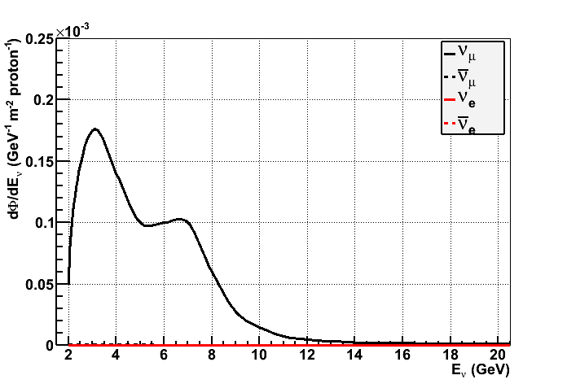
Beam parametrisation (1988)
Scaling to ANTARES site (0.245/2600)²
Neutrino Focus
Anti-Neutrino Focus
Very clean ν_{µ} beam
< 1% contaminations
from other flavors
Most neutrinos @ 1-8 GeV
Z. Phys. C 40 (1988) 487

Slide 56
ORCA Effective Mass, event simulation
From study of A. Trovato for “default” ORCA detector
Vertex in instrumented volume
Reconstruction Quality cut
beam direction known, no background from atmospherics
Same function used for all CC interactions
Same light output for ν_{µ} and ν_{e}
Conservative for ν_{τ} due to escaping neutrinos
NC evaluated at E/2

Slide 57
Flavour identification
Misidentification probability :
assume same for both directions
50% at 2 GeV → random ; 20% at 5 GeV ; 10% at 10 GeV

Slide 58
Event rates, flavor specific
Event numbers for 1.5 10²¹ pots
NH : 1621 +/- 255 (CP-phase variations)
IH : 497 +/- 100 (CP-phase variations)
20 sigma statistical separation of both Mass Hierarchy hypotheses from signal
10000 muon events for beam normalisation
No oscil
ν_{µ} CC
NH
ν_{e} CC
IH

Slide 59
Event rates, topology specific
Event numbers for 1.5 10²¹ pots
9-18% difference for NH/IH
7 sigma statistical separation of MH hypotheses
With 3-4% syst. uncertainty still 3 sigma for MH test
No assumption on energy reconstruction !
Background largely independent from MH (& CP)

Slide 60
Event rates, topology specific
Event numbers for 1.5 10²¹ pots
9-18% difference for NH/IH
7 sigma statistical separation of MH hypotheses
With 3-4% syst. uncertainty still 3 sigma for MH test
No assumption on energy reconstruction !
Background largely independent from MH (& CP)
Tracks
Cascades
Total Evt
Total Bg
NC
Total Evt
Total Bg
NC

Slide 61
Systematic Uncertainties
Detector Response
Water parameters
Extensively studied in ANTARES
Neutrino flux
Can be monitored with muon events
Neutrino Cross Section
Ongoing and planned short baseline Experiments
Oscillation parameters
ORCA with atmospheric neutrinos

Slide 62
Summary on Protovino-ORCA
Upgraded proton accelerator at Protvino well suited for LBL towards Mediterranean Sea.
Beam with 10²¹ pot realistic in a short time?
Complementary to measurement with atmospheric neutrinos. Much less uncertainties due to known direction, small background and better defined energy band. 3-4% systematical error realistic?
Preliminary performance figures of ORCA encouraging: High significance determination of Mass Hierarchy after few years of data taking
Cost: HL beam (~ X(?)00 M€) + detector (30-40 M€)
However: ORCA not the priority option of KM3NeT collaboration
→ No time line

Slide 63
end

