Slide 1
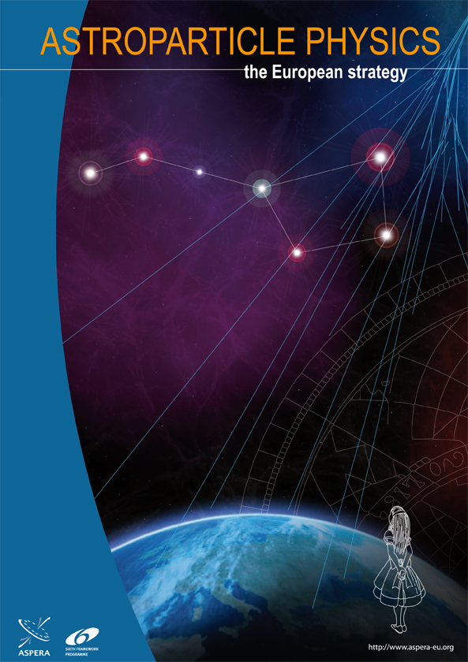
European Astroparticle Physics
Status and Vision
Christian Spiering, DESY
Open Symposium
European Strategy Preparatory Group
Krakow, Sept. 11, 2012

Slide 2
Overview ASPERA Roadmap
Large underground detectors
Dark matter searches
    WIMPs
    Axions
Mass and nature of neutrinos: 0νββ
Cosmic ray physics and the LHC

Slide 3
1
Overview ASPERA Roadmap
Three categories:
Medium scale, ongoing/extension
Large scale (few hundred M€), mid of decade
Very large scale (several hundred M€ to G€), end of decade

Slide 4
Medium scale
Advanced detectors for gravitational waves
    discovery in next 5 years highly probable
    Entirely new window to Universe
Dark Matter → see below
Neutrino properties → see below
Support Underground Labs (urgent: LSM extension!)
A few to several tens of sources per year
Adv Virgo/ Adv LIGO
Virgo/LIGO
“We prioritize these projects for immediate funding, and urge agencies to join their forces for an effective, substantial support”
  impressing momentum which needs to be maintained;
  enter a region with high discovery potential;
  hand in hand with LHC physics;
  technologically ready and worldwide community

Slide 5
Large scale, mid of decade
TeV gamma-ray astrophysics: CTA
  worldwide priority project of gamma astronomy
  ~200M€, 2 sites (N/S), start construction 2014
High energy neutrinos: KM3NeT
  See the talk on oscillations and IceCube/PINGU & KM3NeT/ORCA
High energy cosmic rays: 30,000 km² ground based array
  Closely related to fixed target and LHC physics, see below
    Low energy neutrinos & p-decay: LAGUNA
        → see below
        Somewhere between category 2 and 3

Slide 6
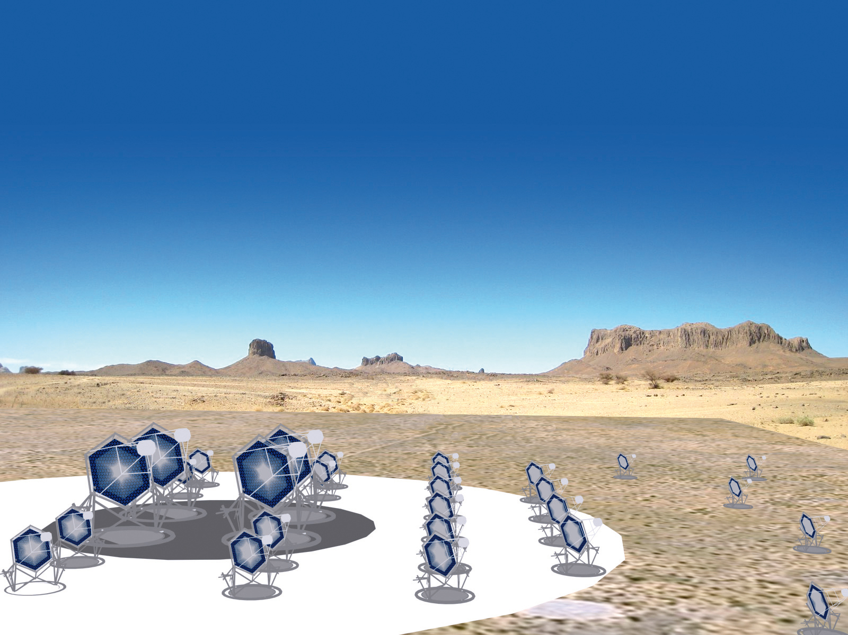

Large scale, mid of decade
TeV gamma-ray astrophysics: CTA
  worldwide priority project of gamma astronomy
  ~200M€, 2 sites (N/S), start construction 2014
High energy neutrinos: KM3NeT
  See the talk on oscillations and IceCube/PINGU & KM3NeT/ORCA
High energy cosmic rays: 30,000 km² ground based array
  Closely related to fixed target and LHC physics, see below
    Low energy neutrinos & p-decay: LAGUNA
        → see below
        Somewhere between category 2 and 3
10 fold sensitivity of current instruments
10 fold energy range
~1000 sources and
new phenomena expected
25 countries, 132 institutes,800 scientists

Slide 7
Large scale, mid of decade
TeV gamma-ray astrophysics: CTA
  worldwide priority project of gamma astronomy
  ~200M€, 2 sites (N/S), start construction 2014
High energy neutrinos: KM3NeT
  See the talk on oscillations and IceCube/PINGU & KM3NeT/ORCA
High energy cosmic rays: 30,000 km² ground based array
  Closely related to fixed target and LHC physics, see below
    Low energy neutrinos & p-decay: LAGUNA
        → see below
        Somewhere between category 2 and 3

Slide 8
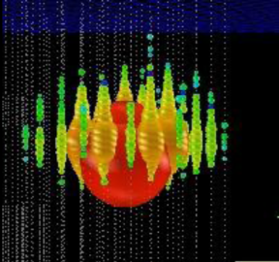
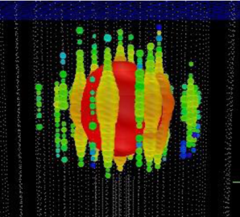
Large scale, mid of decade
TeV gamma-ray astrophysics: CTA
  worldwide priority project of gamma astronomy
  ~200M€, 2 sites (N/S), start construction 2014
High energy neutrinos: KM3NeT
  See the talk on oscillations and IceCube/PINGU & KM3NeT/ORCA
High energy cosmic rays: 30,000 km² ground based array
  Closely related to fixed target and LHC physics, see below
    Low energy neutrinos & p-decay: LAGUNA
        → see below
        Somewhere between category 2 and 3
IceCube providing data with unprecedented quality and statistics!
2 events with 1-2 PeV energy
First extraterrestrial high-energy neutrinos?
Strong scientific case for a Northern detector, but with substantially larger sensitivity than IceCube.
Pool resources in single design for a large research infrastructure. ~250 M€
Start of construction in 2014 (~40 M€ available).
IceCube, ANTARES /KM3NeT, GVD-Baikal → future Global Neutrino Observatory.

Slide 9
Large scale, mid of decade
TeV gamma-ray astrophysics: CTA
  worldwide priority project of gamma astronomy
  ~200M€, 2 sites (N/S), start construction 2014
High energy neutrinos: KM3NeT
  See the talk on oscillations and IceCube/PINGU & KM3NeT/ORCA
High energy cosmic rays: 30,000 km² ground based array
  Closely related to fixed target and LHC physics, see below
    Low energy neutrinos & p-decay: LAGUNA
        → see below
        Somewhere between category 2 and 3
Understanding the high-energy Universe
Sources of cosmic rays
Indirect dark matter search
Exotic particle physics
Test basic physics principles

Slide 10
Very large scale, 2020 horizon
Cost scale of a billion
LAGUNA-type infrastructure including beam would fall in this category
(see the talks of next session)
Next generation Dark Energy surveys
  LSST at ground
  EUCLID in space
Next generation graviational wave antennas
  Einstein Telescope ET underground
  eLISA/NGO in space

Slide 11
2
Neutrino Astrophysics, Neutrino Physics and Search for Proton Decay with Deep Underground Detectors

Slide 12
Physics case
Proton decay
  Test further classes of SUSY models with tenfold sensitivity
Galactic Supernova
  Bonanza for astrophysics and particle physics
  Incredibly detailed information on early SN phase and explosion mechanism
Solar neutrinos: details of solar model with percent accuracy
  Metallicity problem ← ν from CNO cycle → burning of heavy stars
  Time variations on the 10⁻³ level
  Transition vacuum/matter oscillations
Geoneutrinos
  What generates the heat of the Earth (about 30-50% due to U/Th decays).
  How much U, how much Th? Crust, mantel? (Reactor inside Earth?)
Diffuse background of past Supernova
  „average“ SN spectrum, star formation rate, „failed“ supernova
Indirect dark matter search
Oscillation physics: see talks of Hernandez, Zito and Hagner, …

Slide 13
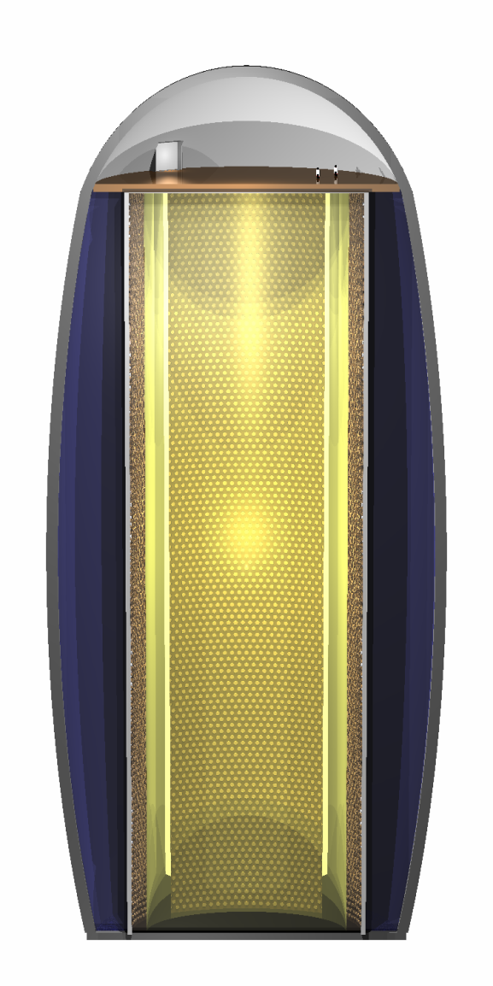
LAGUNA
MEMPHYS
600 kton water
LENA
50 kt scintillator
50 m
GLACIER
100 kton liquid argon

Slide 14
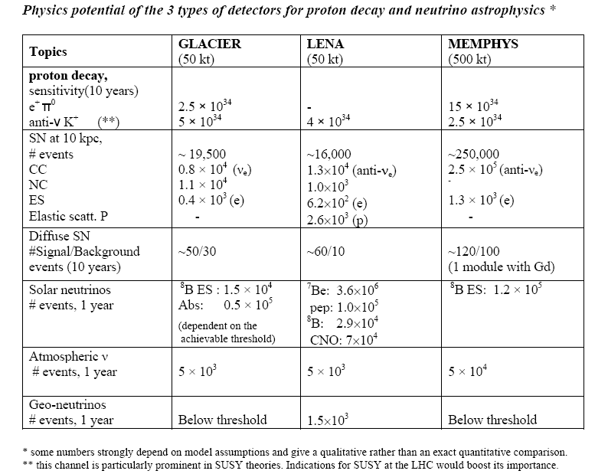

Slide 15
Low energy!

Slide 16
Recommendation: large underground detectors
The SAC notes the high costs for the creation of underground laboratories on the one hand, and the unique capabilities of large neutrino detectors in particle physics (proton decay) and astroparticle physics (supernova, solar neutrinos, dark matter, geo-neutrinos) on the other hand. The SAC concludes that the program with neutrino beams must be flanked by a strong astroparticle program to justify the high investment. It is important to note that the astroparticle physics topics will be the decision driver for a good part of the community and that therefore the astroparticle physics potential of different options should be considered when examining the overall coherence of a global program. There is an opportunity for a common program on both accelerator based neutrino physics and astro-particle physics that will have more impact than the sum of its parts. We recommend therefore that:
CERN and the national agencies, as well as ApPEC, should support a vigorous R&D program on neutrino detectors (e.g. liquid argon) and beam design studies (e.g. a neutrino beam to Pyhäsalmi), in anticipation of a critical decision in 2015.
ApPEC supports the astroparticle physics program that will profit from the synergy with the accelerator-based program (e.g. a liquid scintillation detector in Pyhäsalmi) as well as medium scale astroparticle physics detectors (including feasibility studies for high-density infills of high-energy neutrino telescopes) which can in principle determine the neutrino mass hierarchy and other neutrino parameters.
Given the obvious worldwide interest and the high project costs, it is recommended that CERN, together with key European agencies and ApPEC, enter into discussions with their US and Asian counterparts in order to develop a coherent international strategy for this field, including relevant astroparticle physics issues.

Slide 17
Large Underground Neutrino Detectors:
Community Input
#11 Conclusions of NUTURN Workshop, May 2012
# 24: Realistic next-generation nucleon decay and neutrino expt. Capable to probe leptonic CP violation
# 45: Neutrino and Astroparticle Physics Program of JINR and Russian Institutes : Baksan LSc 5-50 kt
  5 kt option: geo-neutrinos, solar neutrinos, SN neutrinos
  50 kt option: full LENA program
#70: LENA
#74 LAGUNA-LBNO: CN2PY (Cern to Pyhäsalmi): an opportunity of particle and astroparticle neutrino and GUT physics
#86 Hyper-Kamiokande
Veto region
Target 5 kt
2 m
22.5 m

Slide 18
3
Dark Matter Searches

Slide 19
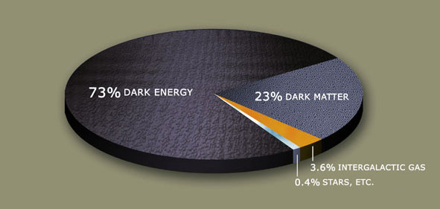
Physics case

Slide 20
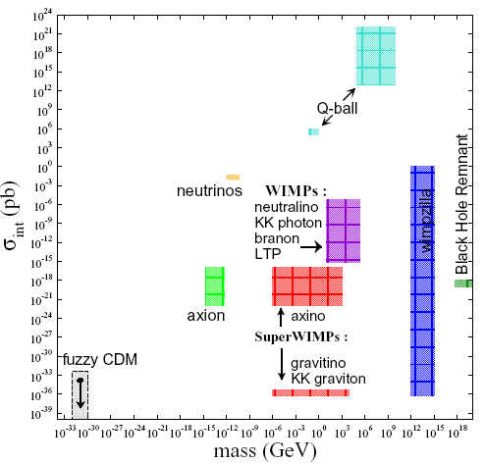
Particle Candidates

Slide 21
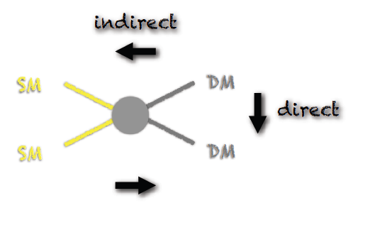
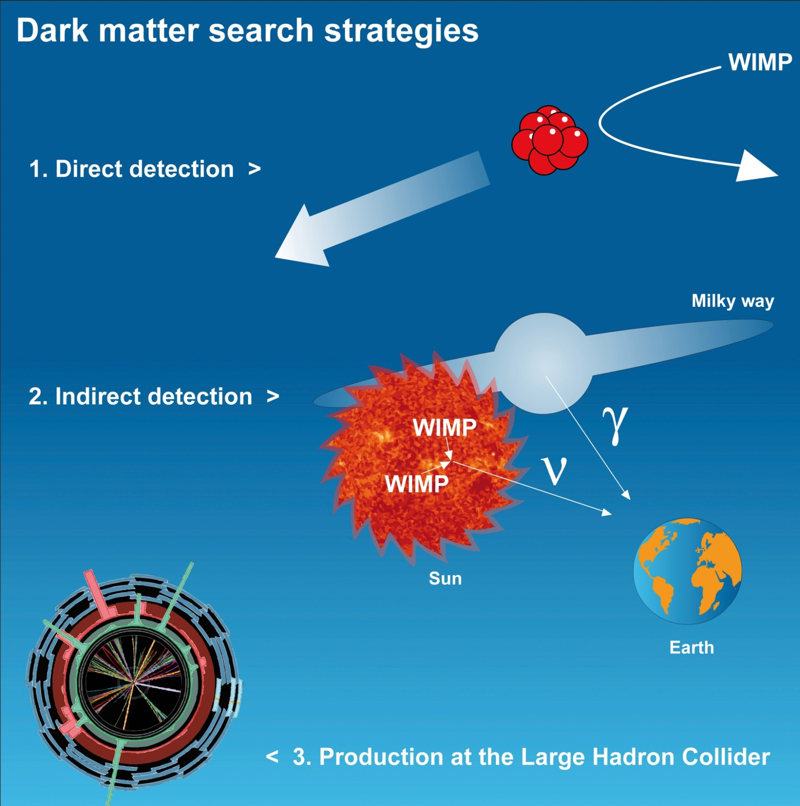
Methods to search for (SUSY) WIMPs
indirect
direct
LHC
ν IceCube, Antares
γ HESS/MAGIC/VERITAS
Agile, Fermi
e/p balloon exp.s, Pamela,
Fermi, AMS
e⁺/p

Slide 22
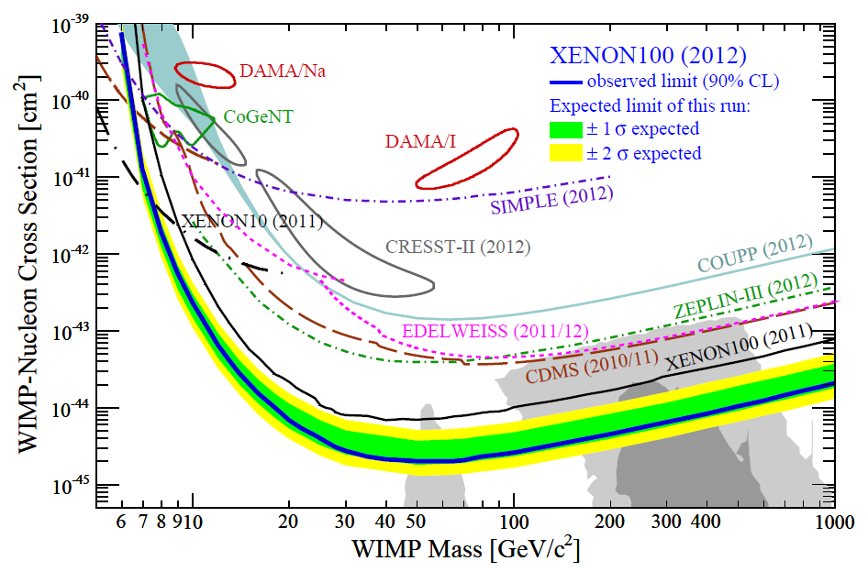
Snapshot Summer 2012

Slide 23
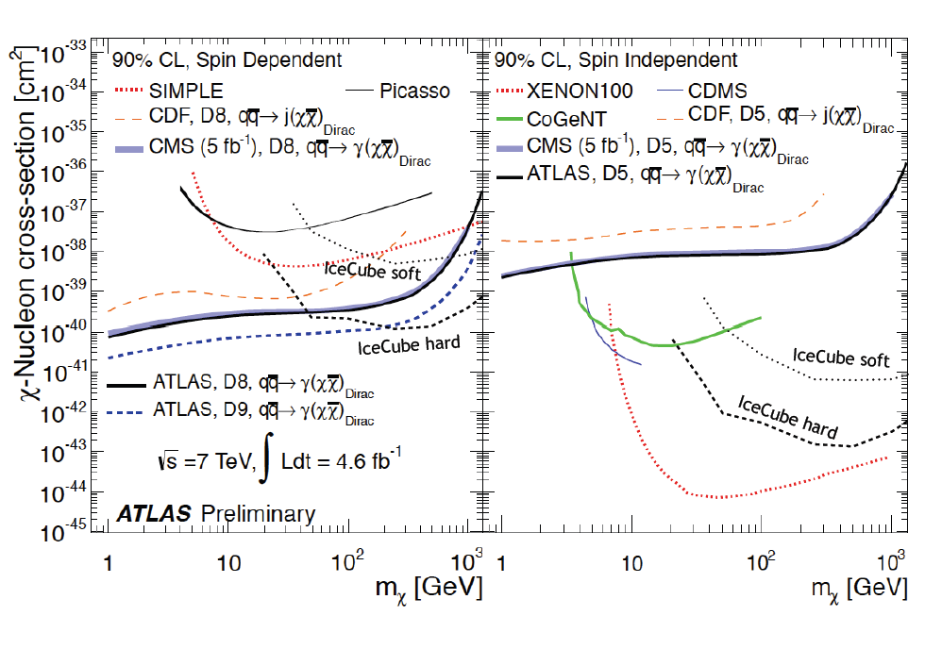
Synergy of direct, indirect and LHC searches
Direct searches will improve sensitivity by a factor of 100 over the next 5-7 years
Indirect searches with IceCube will improve sensitivity by a factor 10-20
AMS results: looking forward to data release end of the year!
LHC 7 → LHC 14: factor 300-1000

Slide 24
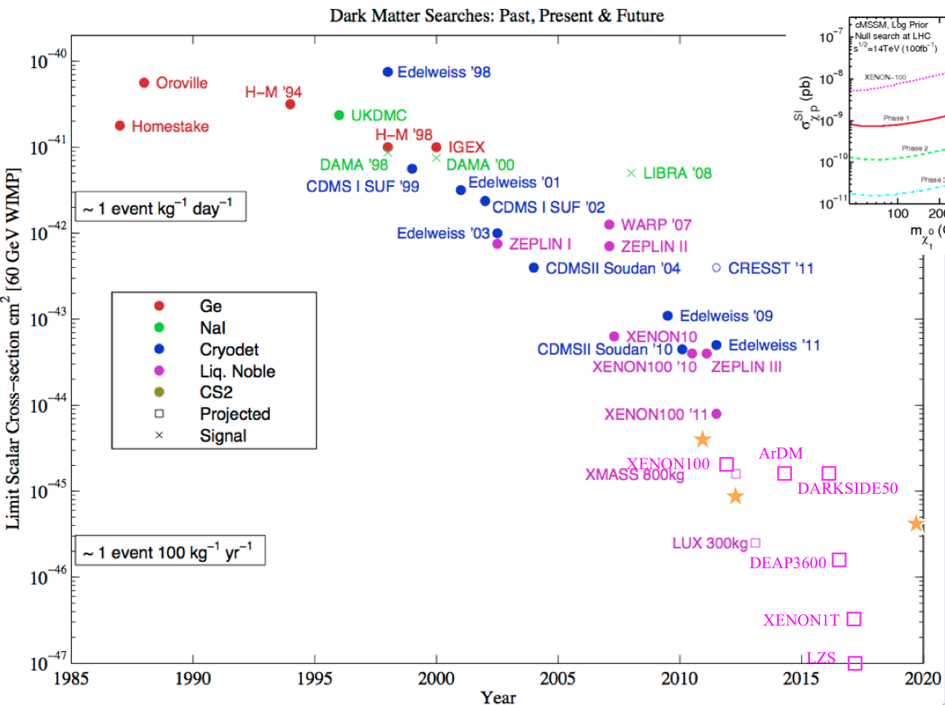
Synergy of direct, indirect and LHC searches
Taken from
Gaitskill 2011
Direct searches will improve sensitivity by a factor of 100 over the next 5-7 years
Indirect searches with IceCube will improve sensitivity by a factor 10-20
AMS results: looking forward to data release end of the year!
LHC 7 → LHC 14: factor 300-1000

Slide 25
Synergy of direct, indirect and LHC searches
Direct searches will improve sensitivity by a factor of 100 over the next 5-7 years
Indirect searches with IceCube will improve sensitivity by a factor 10-20
AMS results: looking forward to data release end of the year!
LHC 7 → LHC 14: factor 500-1000

Slide 26
Recommendations WIMP Dark Matter
With the advent of the LHC and thanks to a new generation of astroparticle experiments using direct and indirect detection methods, the SUSY -WIMP dark matter hypothesis will be proven or disproven within the next 5-10 years.
Stormy progress of LXe technology. XENON100 with record limits. XENON1T under construction.
LAr technology attracts new interest using argon depleted in ³⁹Ar. Potential of technology will be demonstrated by DarkSide-50 (50 kt, LNGS, end 2012).
SAC recommends that DARWIN (target mass of noble liquids up to 10-20 tons) is pursued and supported. Choice of double-target options after demonstration of LAr capabilities. Other potential capabilities of DARWIN: solar ν in real time, 0νββ decay with ¹³⁶ Xe.
Bolometric approach remained (nearly) competitive with noble liquids in sensitivity. EDELWEISS (Ge), CRESST (CaWO₄ ). CDMS in US. Need cross-check of possible signals in noble liquids!
SAC supports development of EURECA (~1 ton sensitive mass) and the on-going cooperation with the CDMS follow-up projects.
SAC supports R&D on directional detection, as a confirmation of the galactic character of potential positive detection by high-density target detectors
SAC supports improving DAMA/LIBRA w.r.t. lower threshold and lower background to better understand the modulation. Fully independent experiment of same/similar technology is crucial.

Slide 27
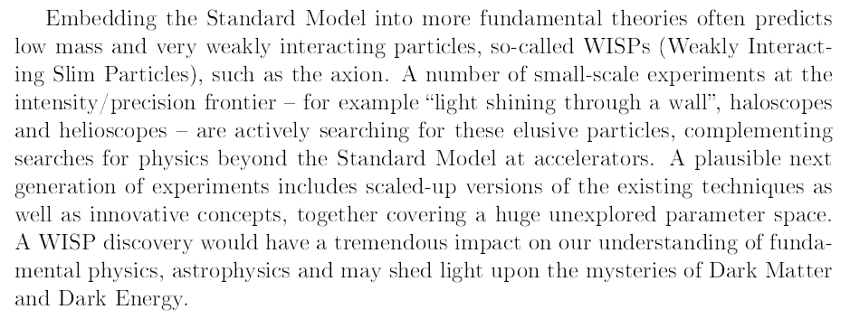
Axions
SAC recommendations: Although not all approaches in this field are strictly related to dark matter, all have the potential for revealing new physics. A CAST follow-up is discussed as part of CERN‘s physics landscape (new magnets, new cryogenic and X-ray devices). SAC supports R&D on this followp up, as well as smaller ongoing activities on the search for axions and axion-like particles.
Input from the community: Fundmental physics at low energies – the quest for axions and other new light particles

Slide 28
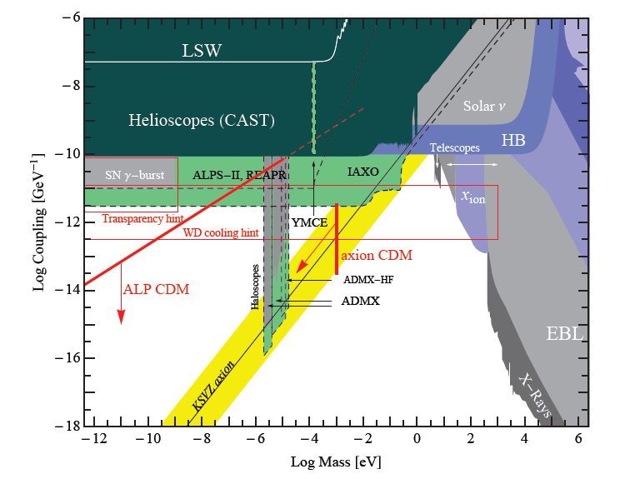
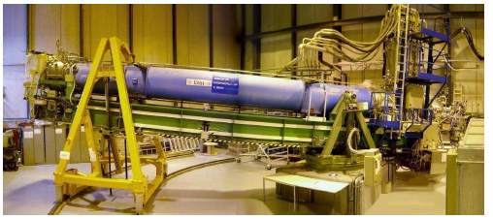
Axions
Parameter space for axions or axion-like particles
Experimentally excluded
Astronomy constraints
Cosmology constraints
Sensitivity of planned experiments
CAST
IAXO: CAST follow-up
10T magnets, 16m
low-BG/threshold X-ray detectors
50-100 M€

Slide 29
Further community Input Dark Matter Search
Super-WIMPs
#127 Boyarsky, Ruchayskiy, Shaposhnikov: „Searching for Dark Matter“
  no sign of WIMPs from LHC and direct detection
  Super-weakly interacting DM candidates (Super-WIMPs)
  Detectable via decays → sharp X-ray line
  Need X-ray spectrometer with ΔE/E ≤ 10⁻³, limited imaging capabilities
  Such a mission will not materialize within the astrophysical community itself but requires strong support by particle physics community

Slide 30
4
Mass and Nature of the Neutrino
Here: Double-Beta decay.
Direct mass measurement:
see talk of Hamish Robertson

Slide 31
Physics case
Majorana vs Dirac
mass & mass hierarchy
Physics beyond SM
Essential for Leptogenesis

Slide 32
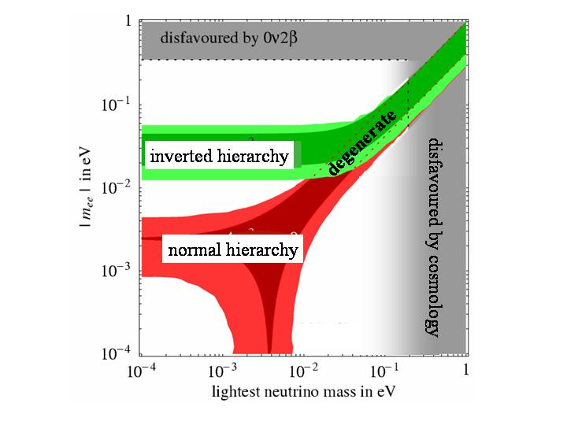
Physics case
Majorana vs Dirac
mass & mass hierarchy
KKGH claim
GERDA, EXO200, SNO+
CUORE, SuperNEMO
Ton-scale
Price tag for ton-scale 50-150 M€.

Slide 33
Recommendations 0νββ decay
Data taking of new generation 0νββ has started: Kamland-Zen (Japan), EXO (US), GERDA, Cuore-0 (Europe): Degenerate region
CUORE (start ≥2014) will probe part of Inverted Hierarchy region.
Discovery on degenerate level → path to precision measurement with 3 different nuclei and the unique capabilities provided by SuperNEMO.
GERDA/CUORE/SuperNEMO build on long experience and validation with precursors.
NEXT: new approach, steep time gradient. SAC encourages coll. To demonstrate all aspects of technology/physics capability and to move ahead toward NEXT-100 (see input paper on NEXT).
SAC recommends a phased experimental approach towards ton-scale masses with a sensitivity exploring fully the mass range predicted by oscillation experiments for the Inverted Hierarchy.
SAC supports R&D towards new promising technologies (scintillating bolometers, pixel detectors, ….) in view of final assessment of most effective approach towards ton-scale
SAC encourages companies and labs to continue R&D on new techniques for isotope separation.
High cost of ton-scale → realisation within worldwide collaborations, as e.g. pursued by GERDA and MAJORANA.

Slide 34
5
Cosmic Ray Physics and the LHC

Slide 35
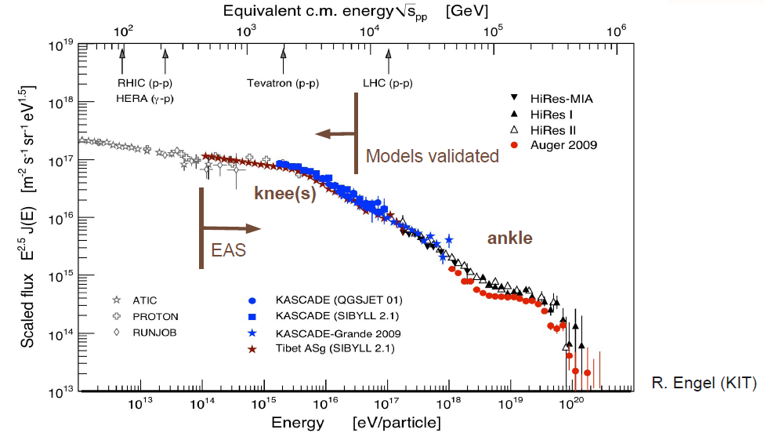
Cosmic Rays

Slide 36
Cosmic Rays and LHC
accelerators
satellites,
balloons
air shower
arrays
Auger

Slide 37
Cosmic Rays and LHC
LHC provides a significant
lever arm providing constraints
for UHECR simulations !
accelerators
Current models
tuned here
satellites,
balloons
air shower
arrays
Auger

Slide 38
Cosmic Rays and LHC
pp inel. cross section at sqrt(s)=57 TeV
Test Glauber model
Tune EAS simulations

Slide 39
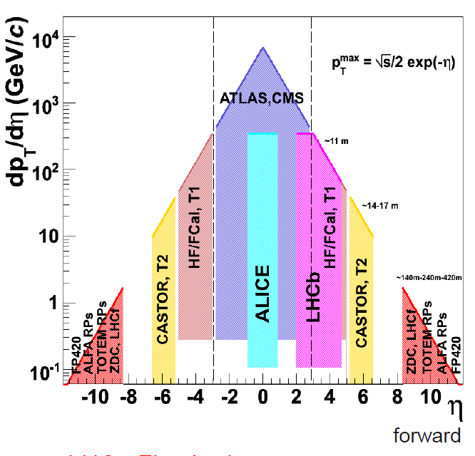
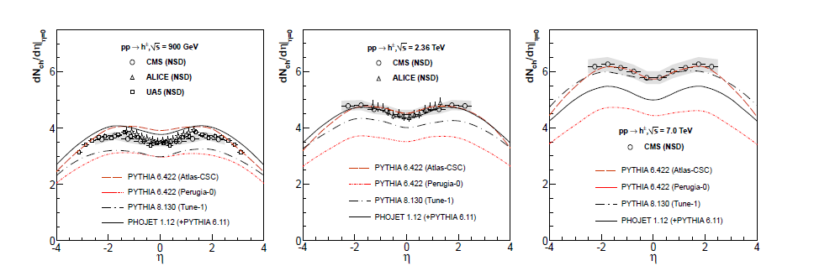
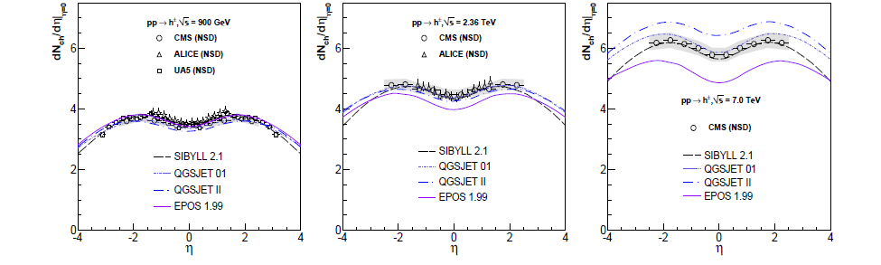
Models and data: rapidity distribution
LHC detectors cover all wide rapidity range
EAS models bracket accelerator data
no model perfect, but EAS models seem to do better than HEP models
HEP High Energy Physics models
EAS Extensive Air Shower models

Slide 40
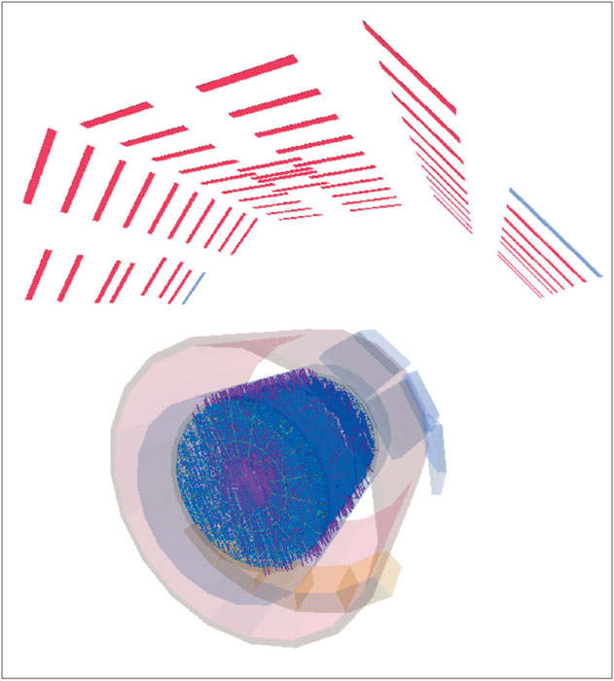
Another example
Extreme muon multiplicities
High-multiplicity cosmic event in ALICE →
  Density of ~18 muons/m² (within the TPC volume)
Similar enigmas in underground experiments
Muon numbers in EAS about 50-100% higher than MC predictions
→ Upgrade EAS experiments with muon counters
Fe EPOS
p QGSJet
N₁₉ ~ N_{μ}
Auger

Slide 41
Cosmic Rays and LHC: Summary
Cooperation of particle- and CR-physicists has been intensified over the last years.
This is extremely useful for understanding CR nature; accelerator data already helped improving shower models.
Tools of CR community may also help better understanding HE particle interactions: bulk LHC data are well described by EAS models, sometimes even better than by HEP models
Need common approach to understand muons in CR.
NA61/SHINE (SPS Heavy Ion and Neutrino Experiment): important input data for cosmic ray and neutrino experiments. Submitted paper #21 for plans beyond the approved program.
Establishing an „Astroparticle Physics Forum“ at CERN would intensify co-operation and synergies.

Slide 42
Summary
Dark Matter:
  close synergy “direct – indirect – LHC”
  Direct measurements: → … → DARWIN, EURECA
Double Beta Decay
  Cover inverted hierarchy region
  Phased approach to one-ton detector(s)
Nu astronomy and p-decay
  Combines fundamental discovery physics and precision physics
  Combines astro- and particle physics
High energy Universe
  LHC ↔ air showers
  Indirect dark matter search
  Test of fundamental principles
Need global approach (the higher the cost, the more urgent)
Install “Astroparticle Physics Forum” at CERN
Closer cooperation between CERN and ApPEC

