Slide 1
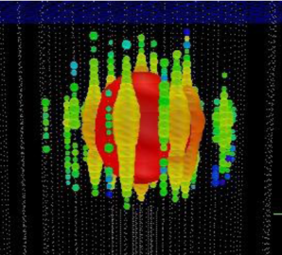


High-Energy Neutrino Astrophysics
Entering the promised land
In honor of Takaaki Kajita, Karlsruhe, Dec. 19, 2013
Christian Spiering

Slide 2
Marching since fourty years ...
1973, International Cosmic Ray Conference (ICRC)
F. Reines, J. Learned, H. Davis, P. Kotzer, M. Shapiro (all USA), G. Zatsepin (USSR) and S. Miyake (Japan) discuss a deep-water detector.
1978: DUMAND
First design of a cubic kilometer detector close to Hawaii

Slide 3
Physics Goals

Slide 4
Physics with neutrino telescopes
Search for the sources of high-energy cosmic rays
Dark Matter and Exotic Physics
  WIMPs
  Magnetic Monopoles and other superheavies
  Violation of Lorentz invariance
Neutrino and Particle Physics
  Neutrino oscillations (incl. mass hierachy)
  Charm physics
  Cross sections at highest energies
Supernova Collapse Physics
  MeV neutrinos in bursts → early SN phase, neutrino hierarchy, ...
Cosmic Ray Physics
  Spectrum, composition and anisotropies

Slide 5
Physics with neutrino telescopes
Search for the sources of high-energy cosmic rays
Dark Matter and Exotic Physics
  WIMPs
  Magnetic Monopoles and other superheavies
  Violation of Lorentz invariance
Neutrino and Particle Physics
  Neutrino oscillations (incl. mass hierachy)
  Charm physics
  Cross sections at highest energies
Supernova Collapse Physics
  MeV neutrinos in bursts → early SN phase, neutrino hierarchy, ...
Cosmic Ray Physics
  Spectrum, composition and anisotropies

Slide 6
p + target → π⁺ + …..
→ μ⁺ + ν_{μ}
→ e⁺ + ν_{e} + ν_{μ}
at source: ν_{e} : ν_{μ} : ν_{τ} = 1:2:0
at Earth: ν_{e} : ν_{μ} : ν_{τ} = 1:1:1
p
ν_{μ}
π
μ
ν_{e}
ν_{μ}
target
(gas cloud)
e
cosmic
accelerator
π-decay
µ-decay

Slide 7
Detection principle

Slide 8
Signal and Background
generic: E⁻² ~ E^{-3.7}

Slide 9
Detection Modes
Muon track from CC muon neutrino interactions
  Angular resolution < 1°
  dE/dx resolution factor 2-3
Cascade from CC electron/tau and NC all flavor interactions
  Angular resolution 10° at 100 TeV
  Energy resolution ~ 15%

Slide 10
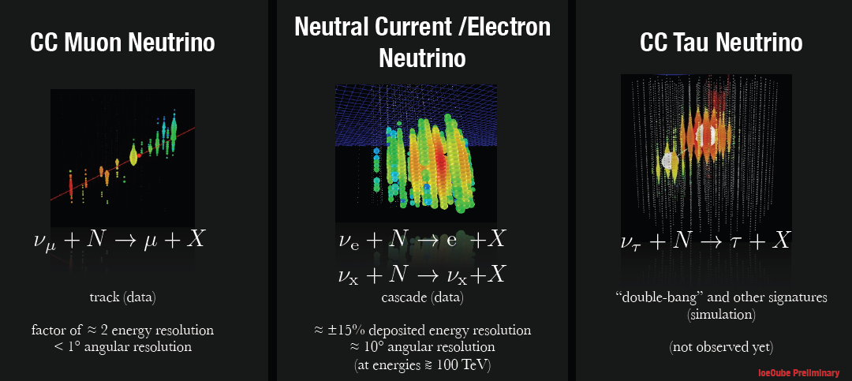
Detection Modes
Muon track from CC muon neutrino interactions
  Angular resolution < 1°
  dE/dx resolution factor 2-3
Cascade from CC electron and NC all flavor interactions
  Angular resolution 10° at 100 TeV
  Energy resolution ~ 15%

Slide 11
Present Devices

Slide 12

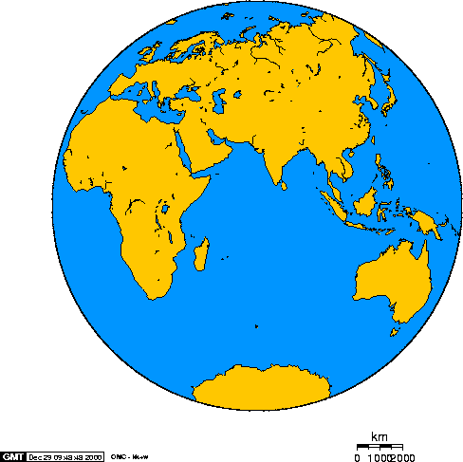
Baikal – Antares - IceCube
Baikal
Antares
AMANDA
IceCube

Slide 13
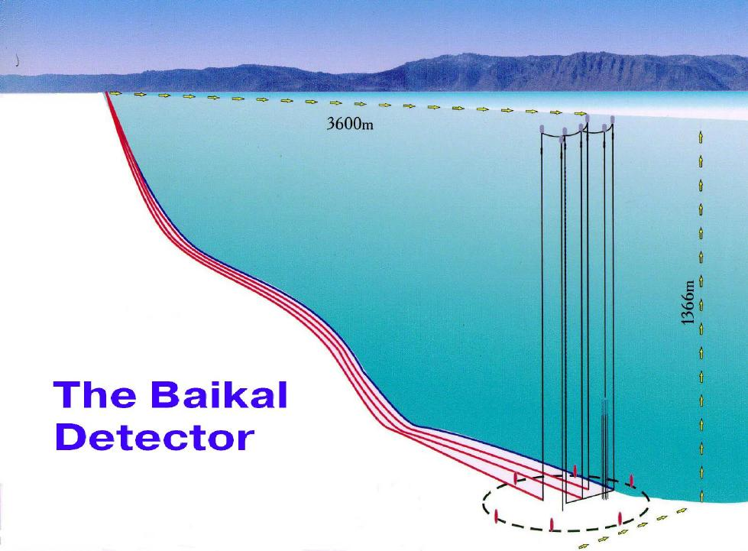
3600 m
Lake Baikal
1366 m
NT200
h = 70 m, ∅ = 42 m

Slide 14
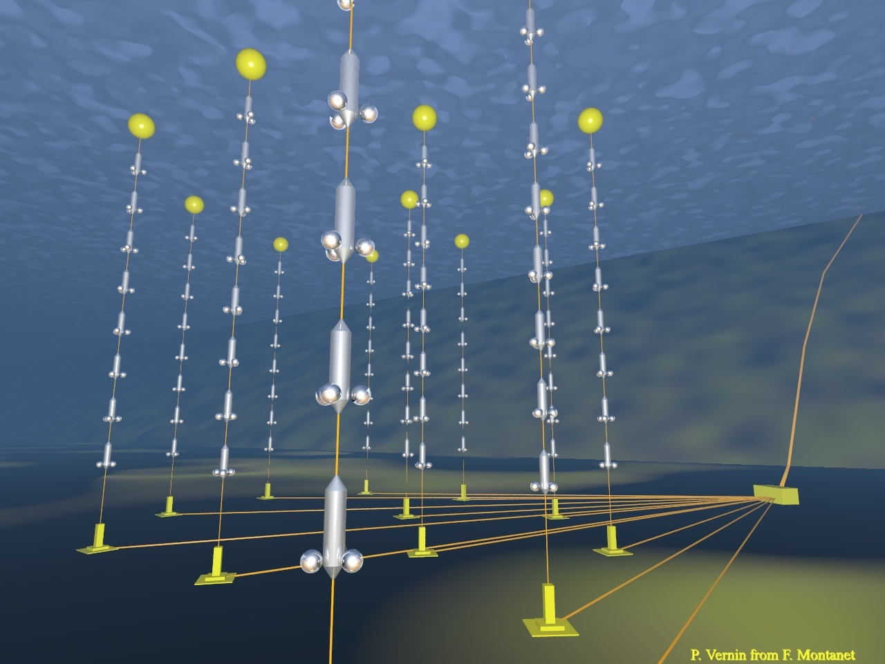
ANTARES
2500m
885 PMTs
12 strings
Operating in final
configuration
since 2008
450 m
70 m

Slide 15
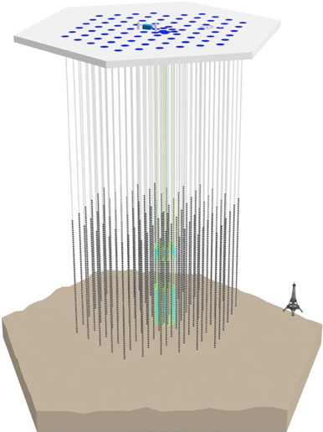
IceCube Neutrino Observatory
IceTop air shower detector
81 pairs of water Cherenkov tanks
IceCube
86 strings including 8 Deep Core strings
60 PMT per string
DeepCore
8 closely spaced strings
1450m
~220 ν/day
Threshold
- IceCube ~ 100 GeV
- DeepCore ~10 GeV
2450m
2820m

Slide 16
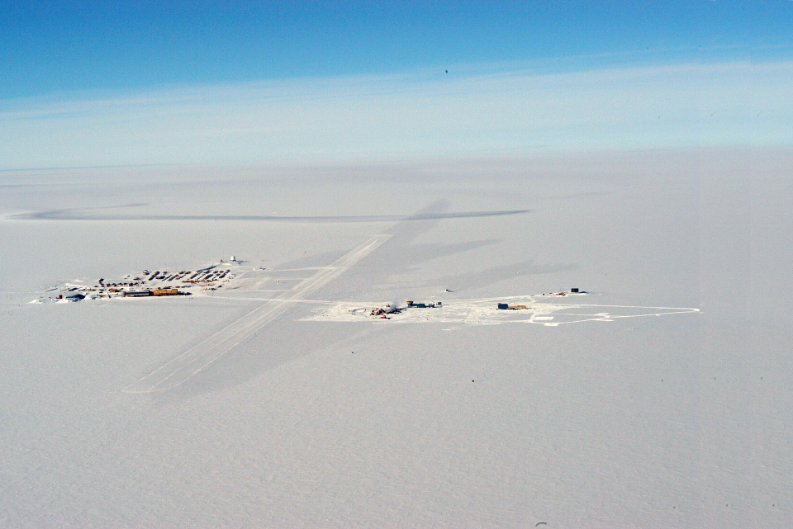
The Amundsen-Scott Station
South Pole Station Building Astronomy Sector
IceCube
AMANDA
skiway

Slide 17
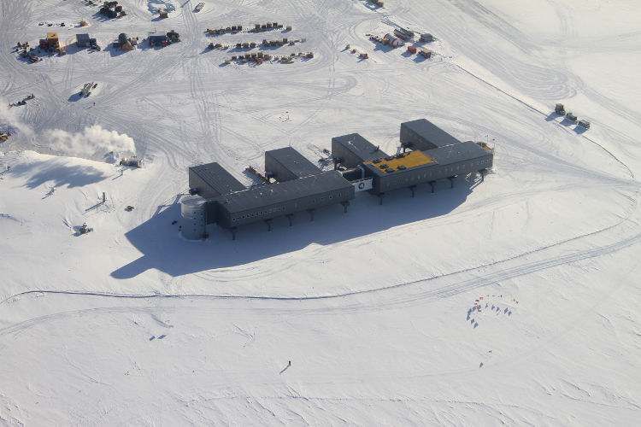
The South Pole Station

Slide 18
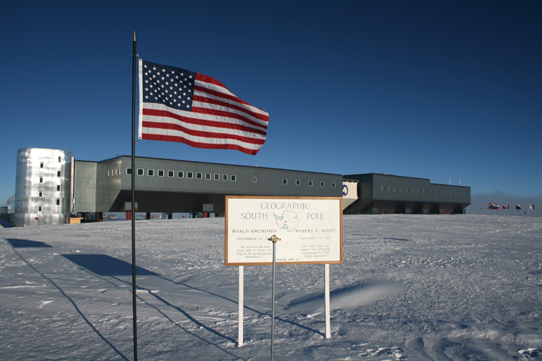
The South Pole Station

Slide 19
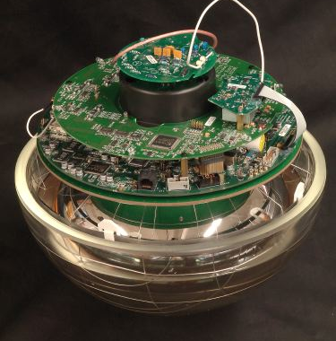
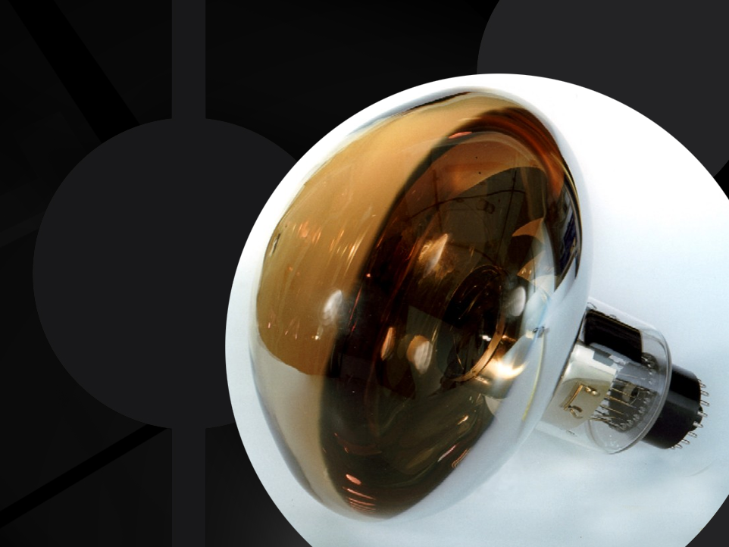
The DOM with the 10´´ Hamamatsu PMT

Slide 20
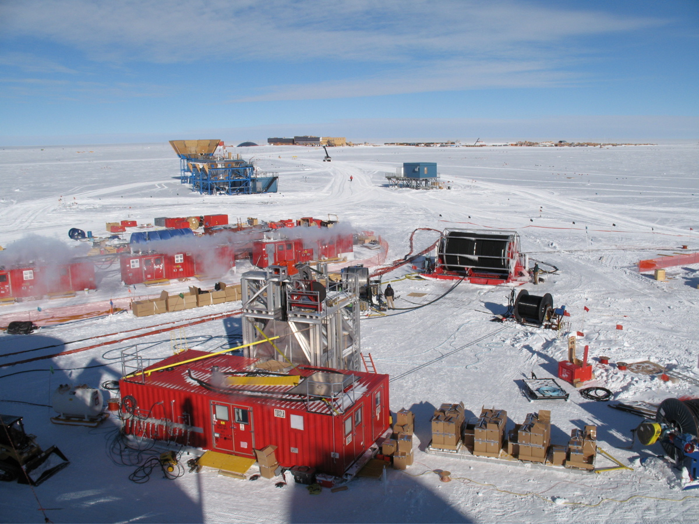
The Drill Camp
- 5 MW power
- 16 m³ kerosine
per hole

Slide 21
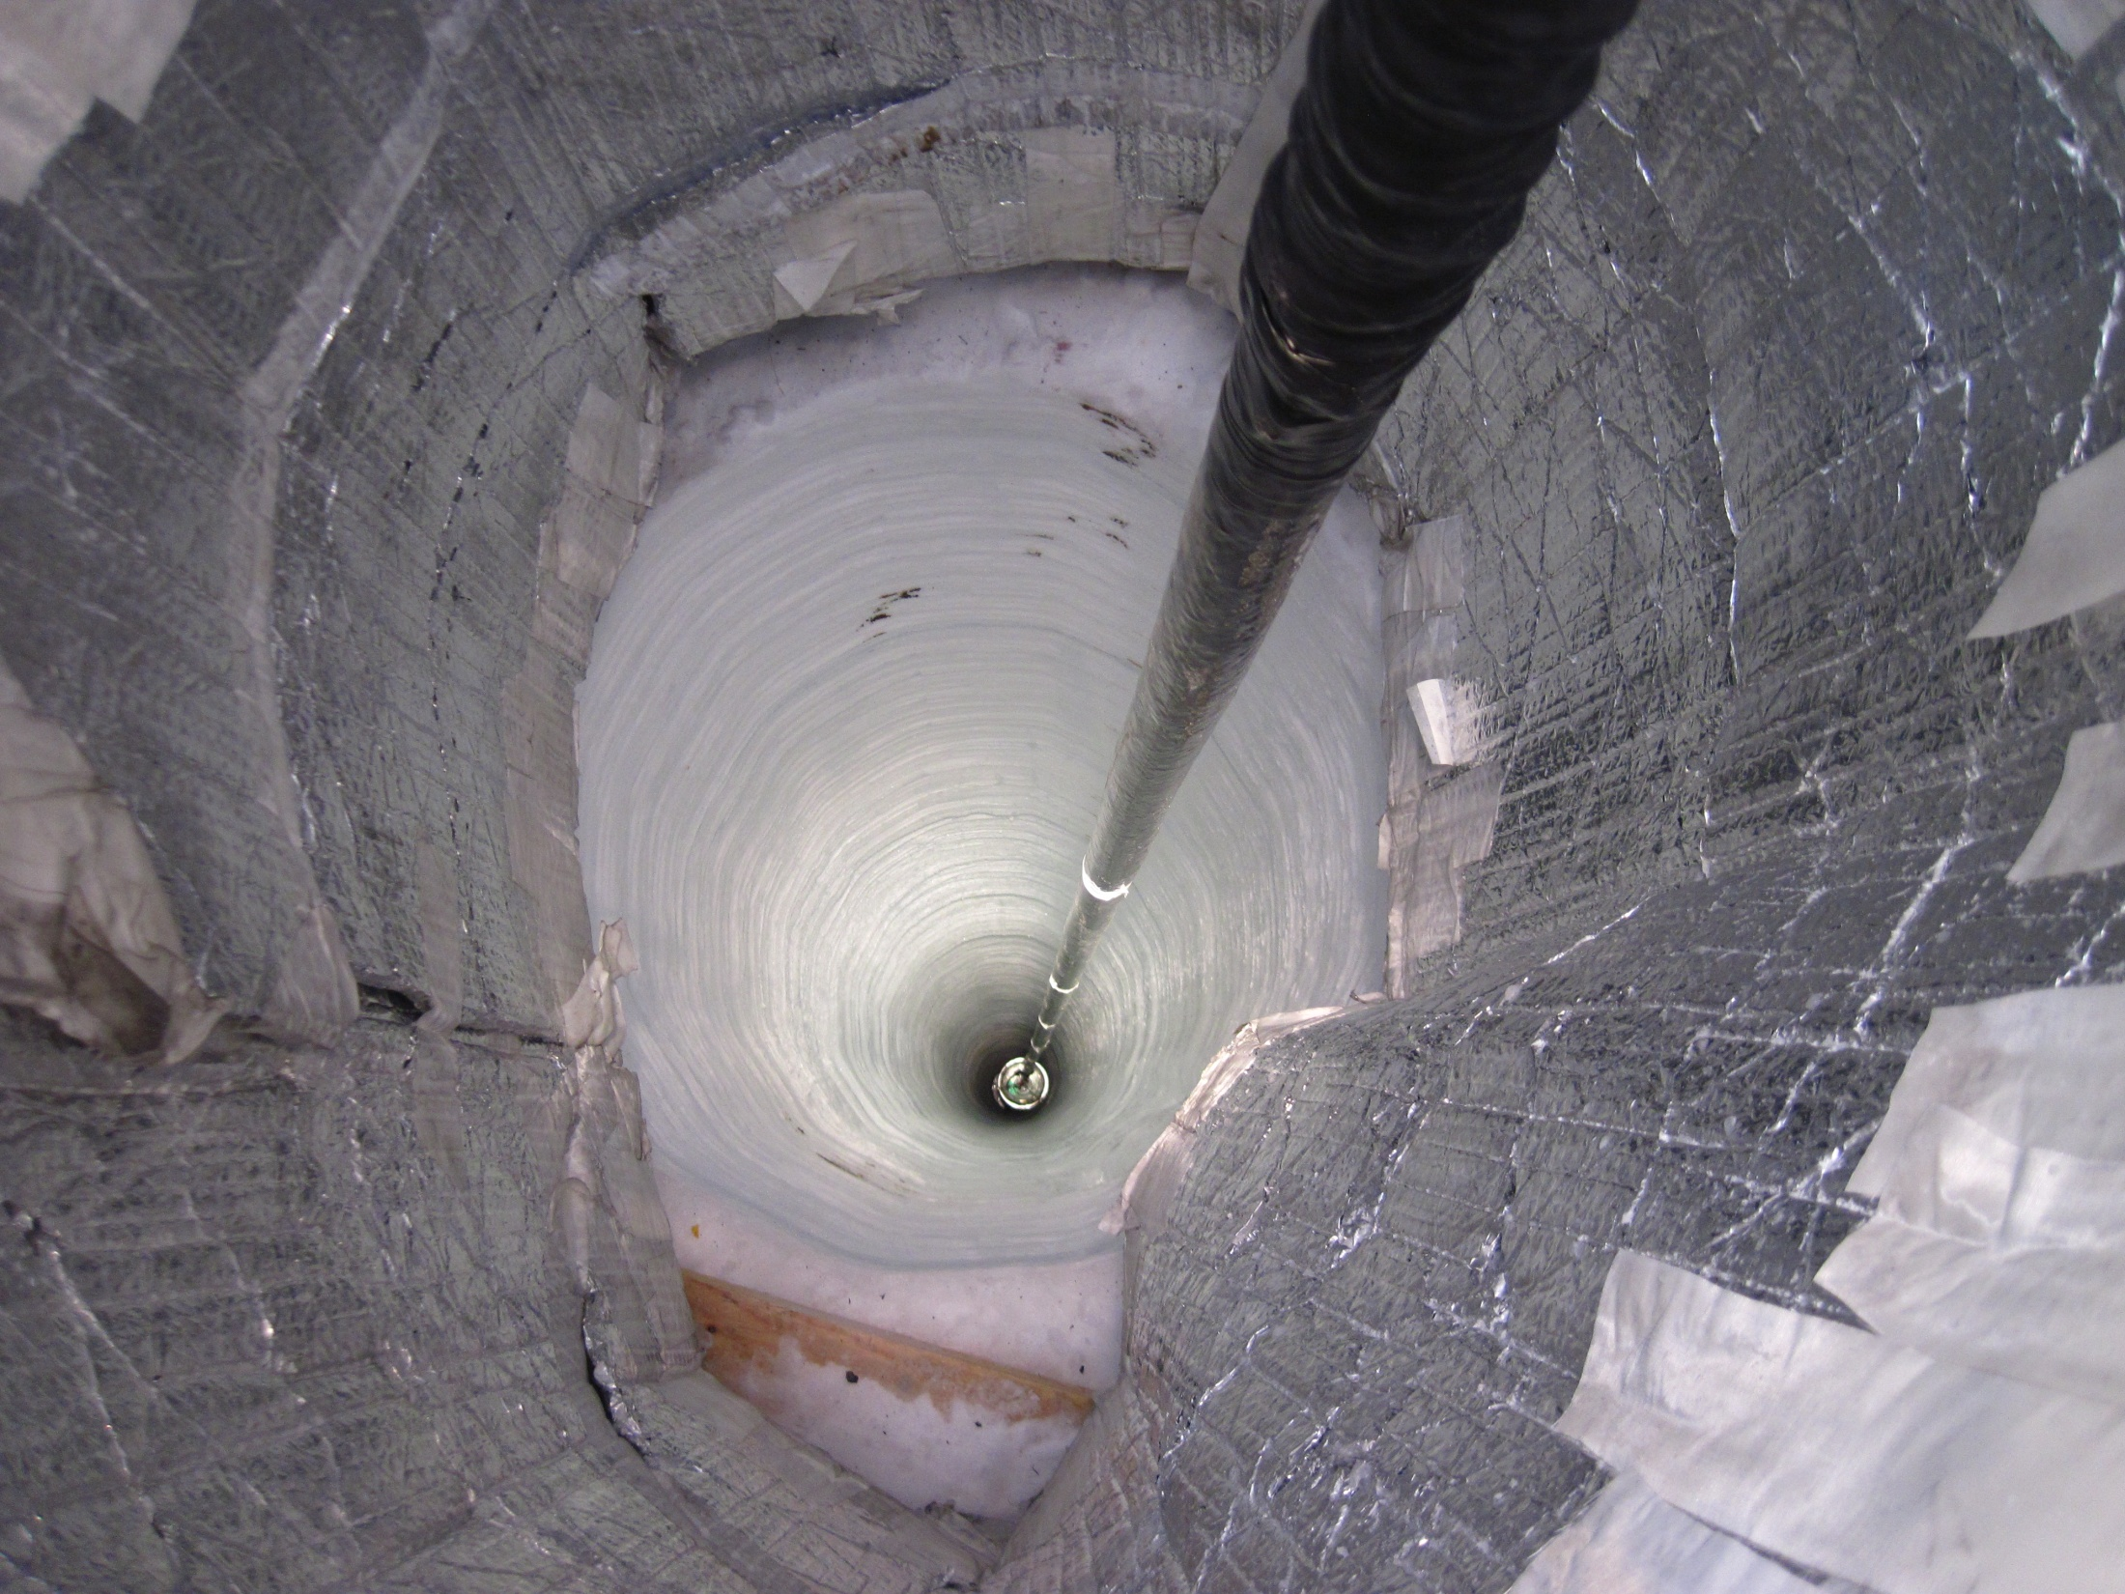

Slide 22
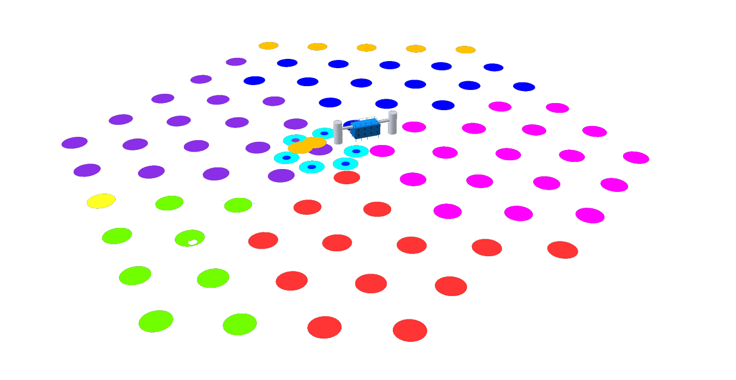
Completed December 18, 2010
IC-86
10-11 Season
IC-79
09-10 Season
IC-59
08-09 Season
IC-40
07-08 Season
IC-1
04-05 Season
IC-9
05-06 Season
IC-22
06-07 Season

Slide 23
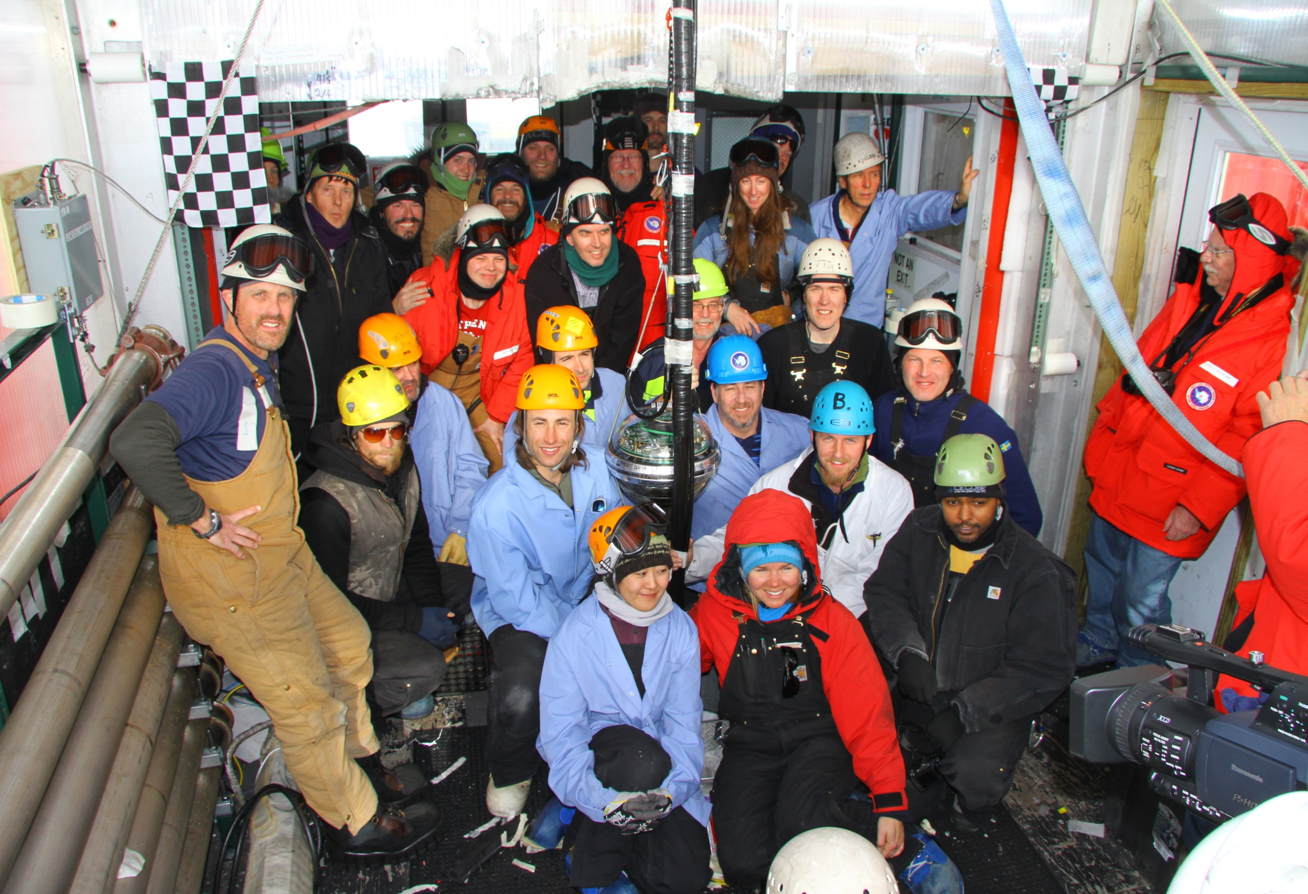
Besseres Bild
The last string, Dec.18, 2010

Slide 24
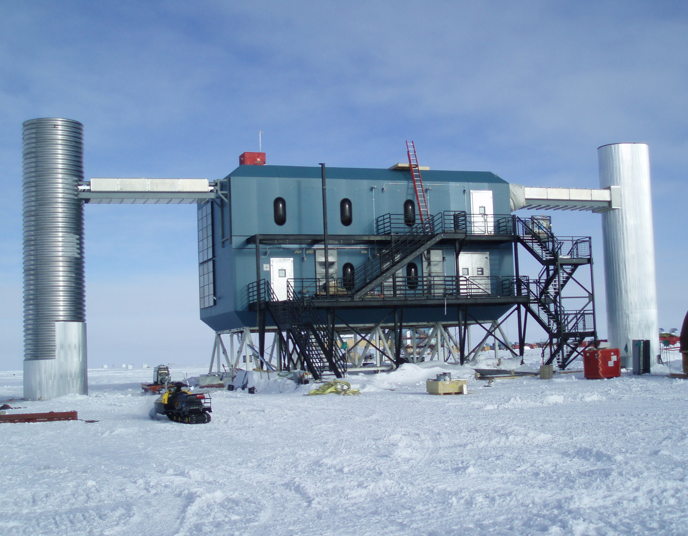
IceCube Laboratory and Data Center

Slide 25
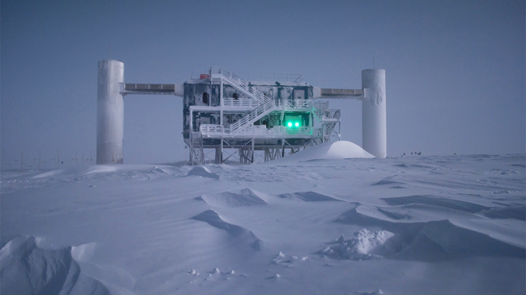
Winter is coming

Slide 26
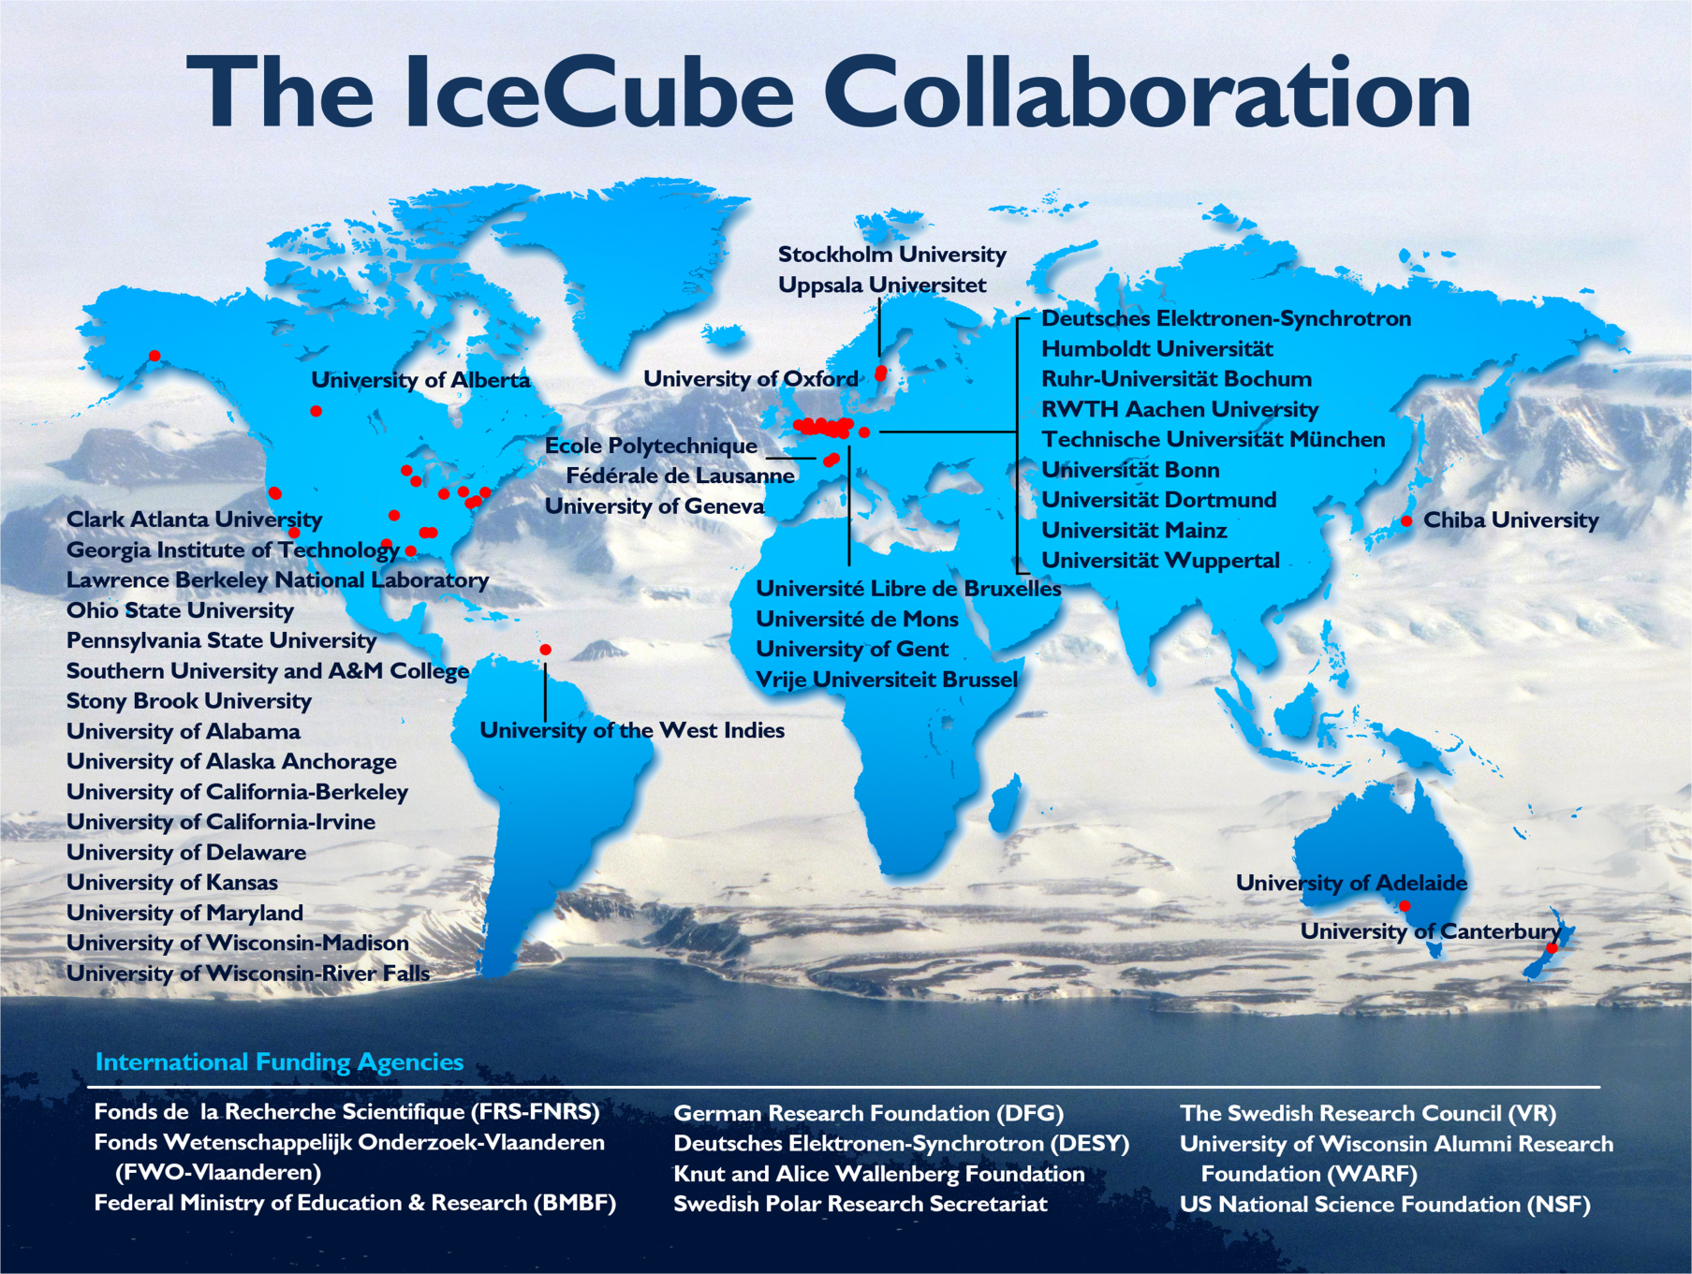

Slide 27
Study of atmospheric neutrinos
Baikal 1996
4-string stage (1996)

Slide 28
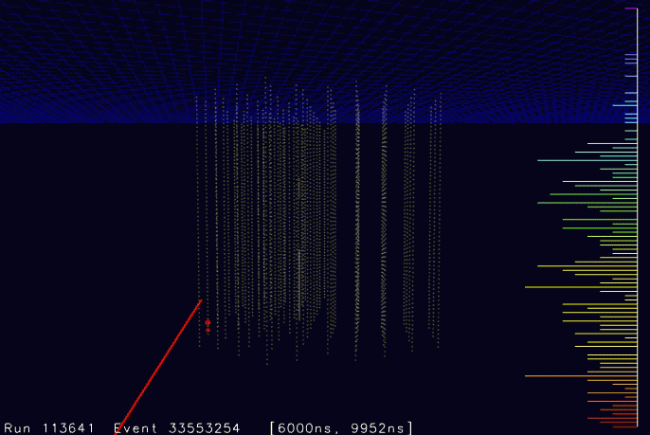
NT-96

Slide 29
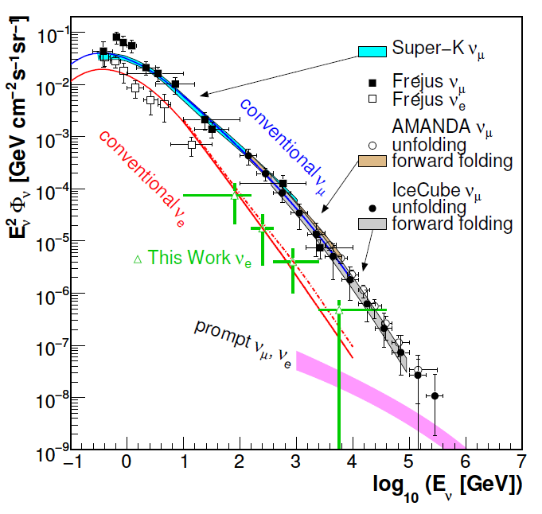
Atmospheric neutrinos in IceCube
proton
c,(b)
prompt
e,μ
νe,μ
π
μ
νμ
e
νμ
νe
conventional

Slide 30
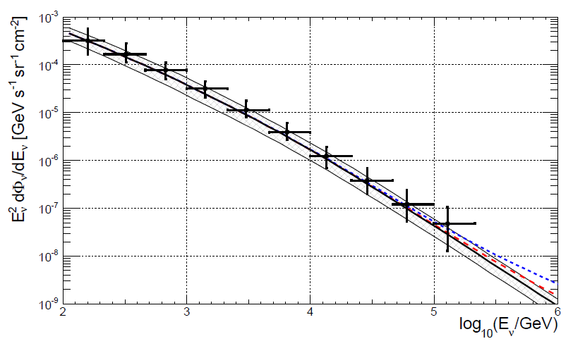
Atmospheric neutrinos in IceCube ...
.. and ANTARES
arXiv:1308.1599

Slide 31
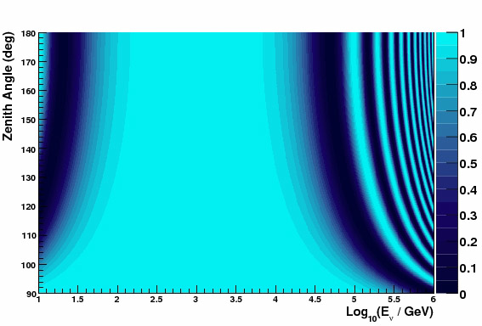
Oscillations of atmospheric neutrinos
Muon neutrino survival probability
Vertically upward
cosmic
ray
ANTARES/DeepCore
ν
Earth
L
θ
Horizontal

Slide 32
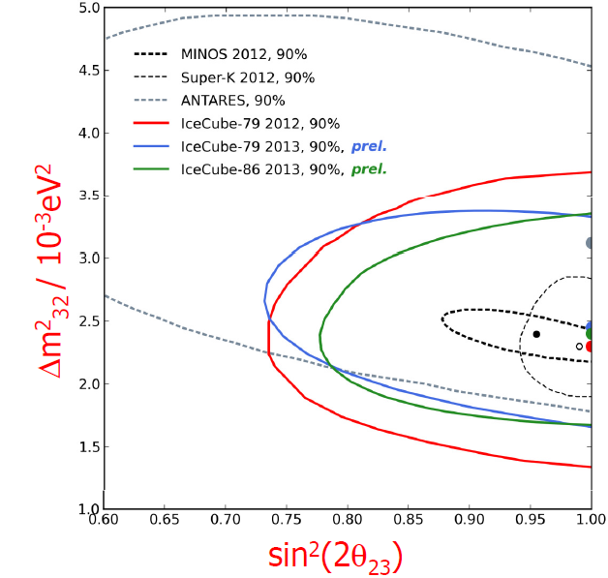
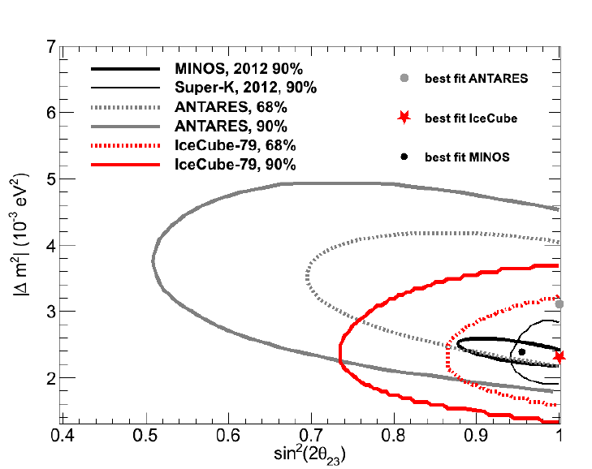
Oscillations of atmospheric neutrinos
Muon neutrino survival probability
Vertically upward
cosmic
ray
ANTARES/DeepCore
ν
Earth
L
θ
Horizontal

Slide 33
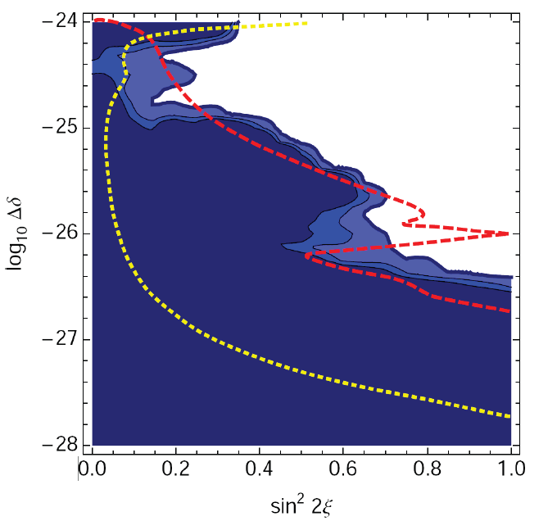
Oscillations of atmospheric neutrinos
Muon neutrino survival probability
Vertically upward
Oscillations
to sterile ν
Non-standard
oscillations due
to VLI
ANTARES/DeepCore
Standard
oscillations
VLI
AMANDA
90%, 95%, 99%
SK + K2K
90%
Horizontal
IceCube
10y, 90%

Slide 34
Search for extra-terrestrial neutrinos
• Steady point sources
• Transient sources: GRB
• Diffuse flux

Slide 35
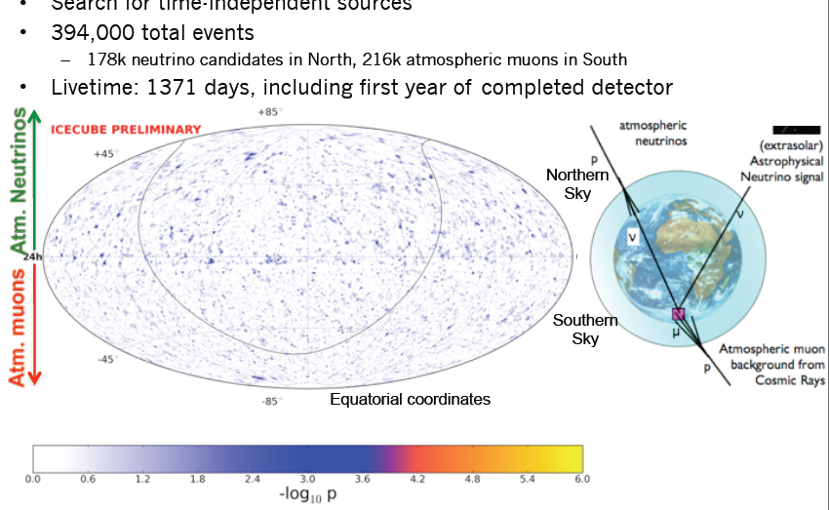
Point Source IceCube 4 years IC40/59/79/86
April 2011-March 2012
N o r t h
S o u t h

Slide 36
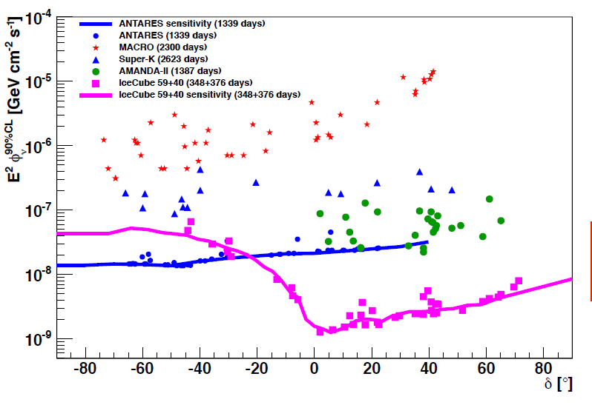
Limits for steady point sources
Factor 1000 in 12 years
No detections yet
ANTARES is best at Southern Sky IceCube sensitivity at Southern sky only for cut-off at >> PeV
Expect another factor 3 for IceCube in 2016
KM3NeT/GVD would give ~ factor 50 w.r.t. Antares
early Amanda limit
IceCube 4 years
preliminary
Southern Sky | Northern Sky

Slide 37
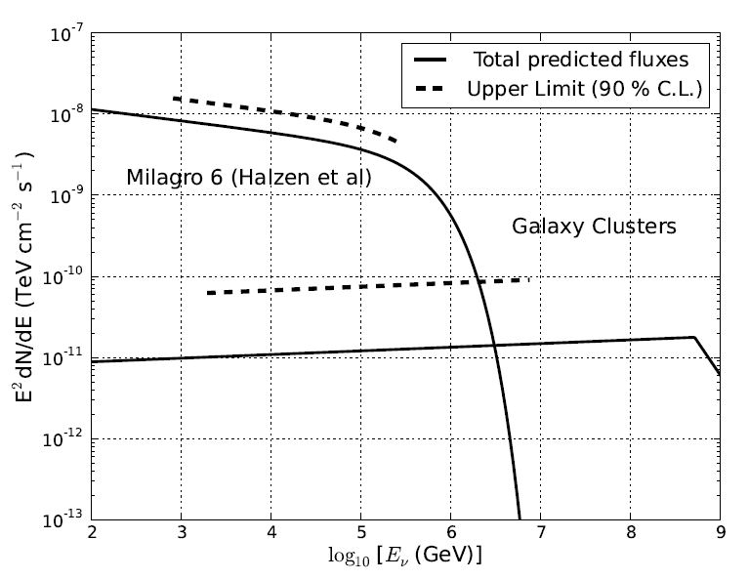
IceCube 3 years: upper limits and predictions

Slide 38
Transient Sources
GRB (second to minute scale)
AGN (Flares on hours to week scale)
→Various follow-up programs
Binary systems (periodic behaviour)
IceCube: SN burst trigger

Slide 39
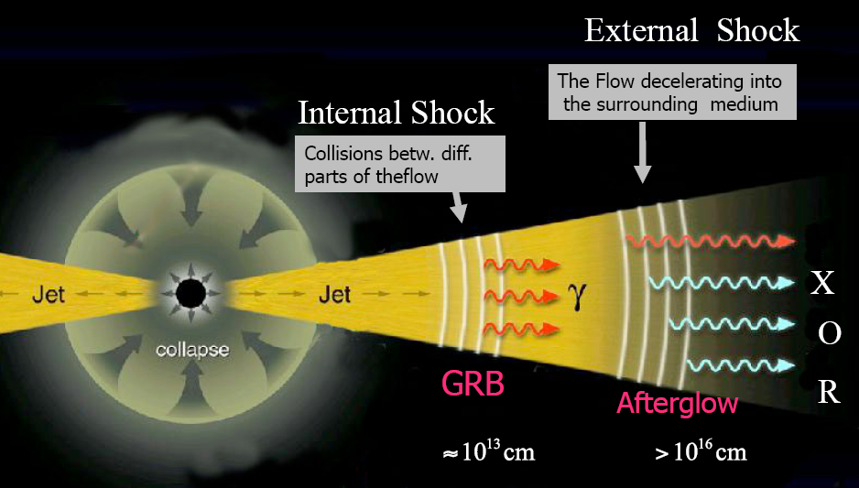
Transient Sources
GRB (second to minute scale)
AGN (Flares on hours to week scale)
→Various follow-up programs
Binary systems (periodic behaviour)
IceCube: SN burst trigger

Slide 40
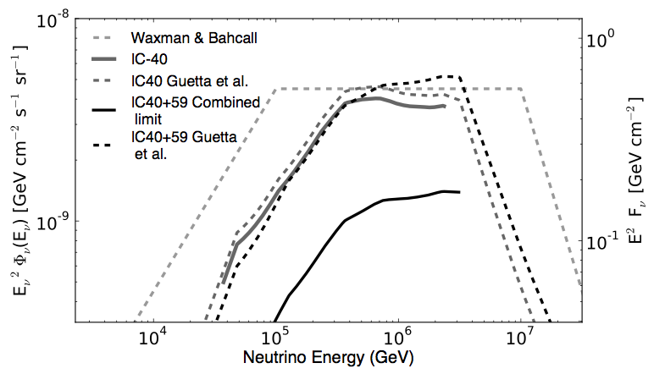
GRB Coincidence Search: IceCube
225 GRB at Northern sky (IC40 + IC59)
No IceCube event in time and direction coincidence
8.4 coincidences expected (Guetta et. al)
Standard fireball model à la Waxman or Guetta excluded with > 3σ (Nature 484 (2012) 351)
Winter et al. have modeled the fireball numerically, using more realistical particle energy distributions, and got fluences less by nearly one order of magnitude !

Slide 41
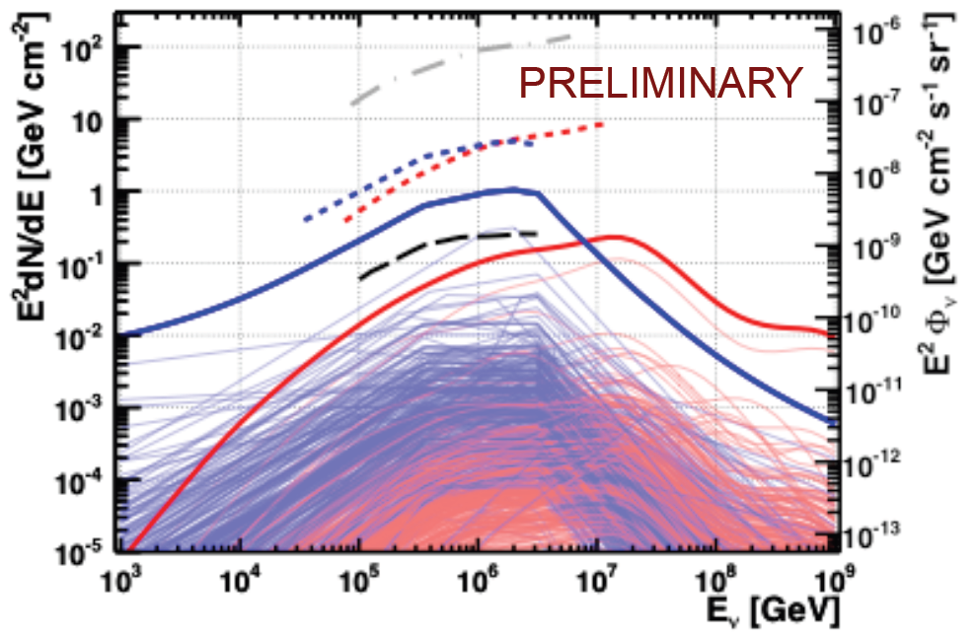
GRB Coincidence Search: ... and ANTARES
ANTARES 2007
ANTARES 2013
IceCube 2012

Slide 42
Diffuse extraterrestrial neutrino fluxes
ANTARES, Amanda, IceCube: Upward going muons
Amanda, IceCube: contained cascades
Baikal, IceCube: Extremely high energies
IceCube: galactic plane
ANTARES: Fermi bubbles

Slide 43
Diffuse extraterrestrial neutrino fluxes
IceCube:
Upward going muons
Contained cascades
Extremely high energies

Slide 44
Search for an extraterrestrial diffuse ν flux
proton
c,(b)
prompt
e,μ
νe,μ
π
μ
νμ
e
Extra-terrestrial
νμ
νe
conventional

Slide 45
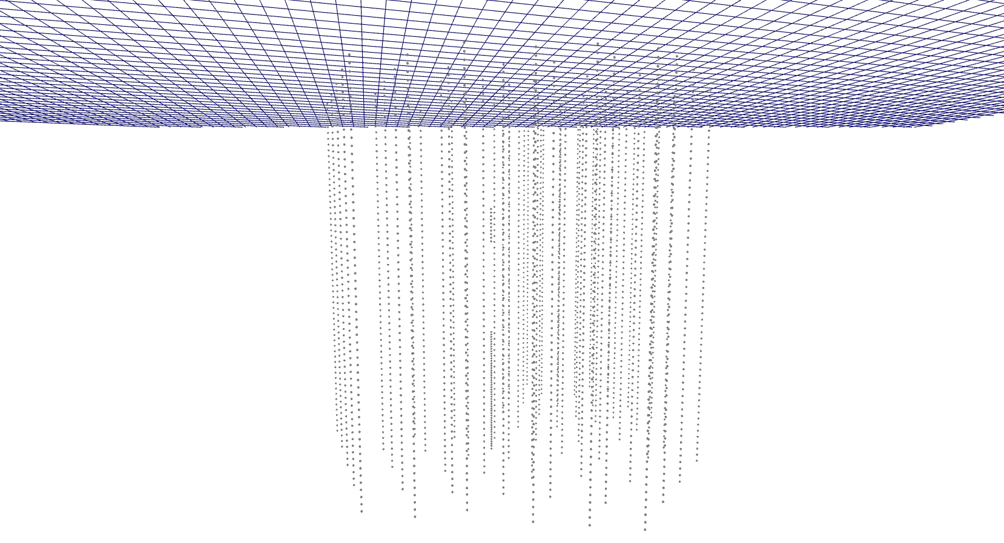
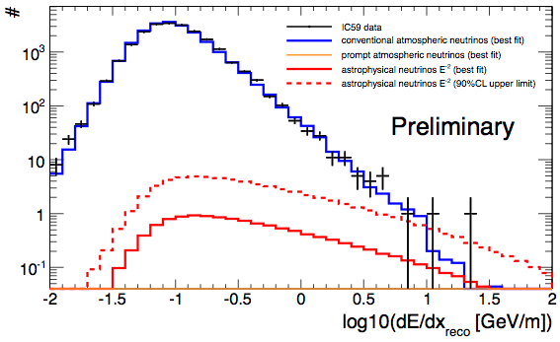
IceCube-59: upward muons
A 200 TeV muon crossing IceCube
The higest energy muon we have detected
1.8σ excess
IC-79 data: see below

Slide 46
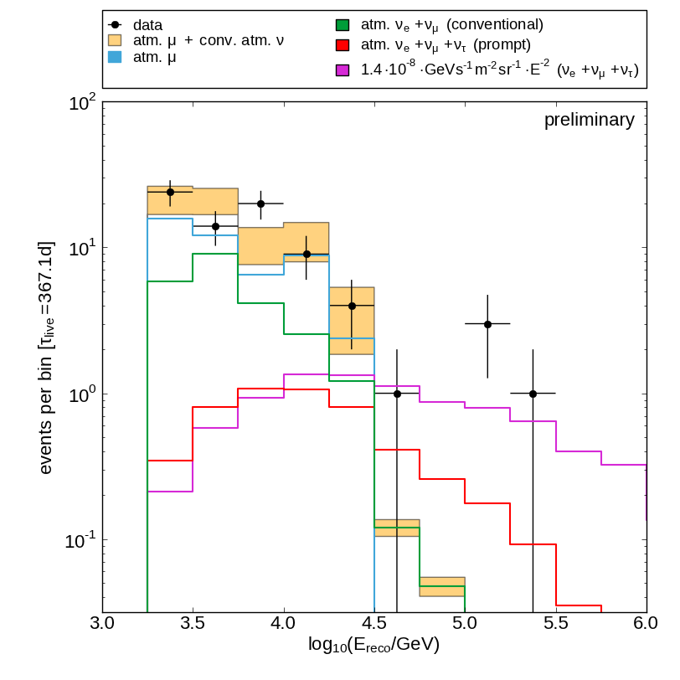
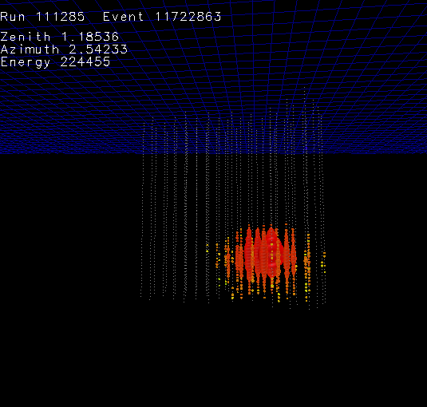
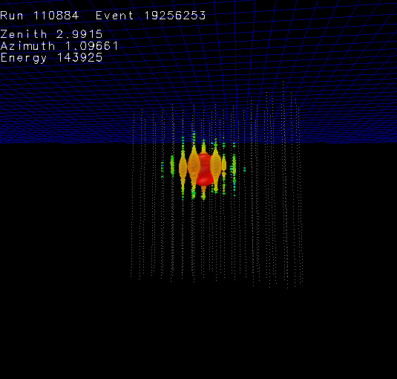
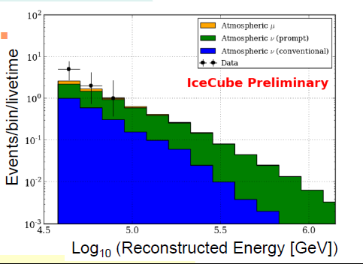
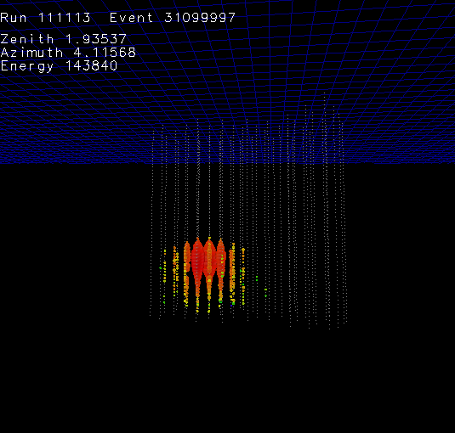
IceCube contained cascades
IceCube-40
3 cascade events 2.7 σ excess
IceCube-59
Mild excess over conventional atm. neutrinos
~ 220 TeV
~ 140 TeV
~ 140 TeV

Slide 47
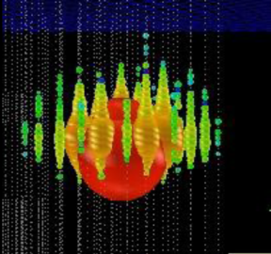
Special Search for cosmogenic ν (Berezinsky Zatsepin)
Ernie Bert
~1.2 PeV ~ 1.1 PeV
IC79/IC86
2.8 σ
Both downgoing
Unbroken E⁻² would have made 8-9 events at higher energy → cut-off

Slide 48
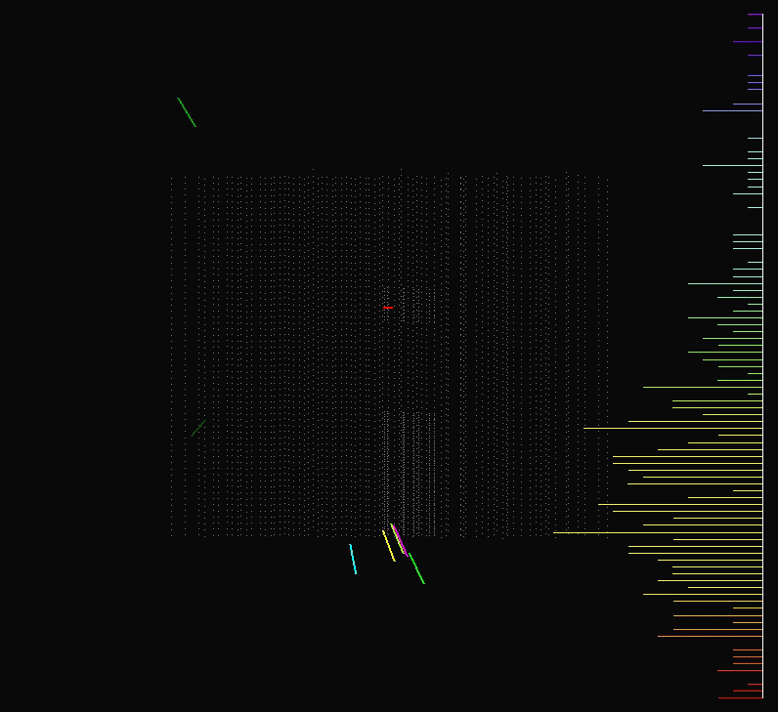

Slide 49
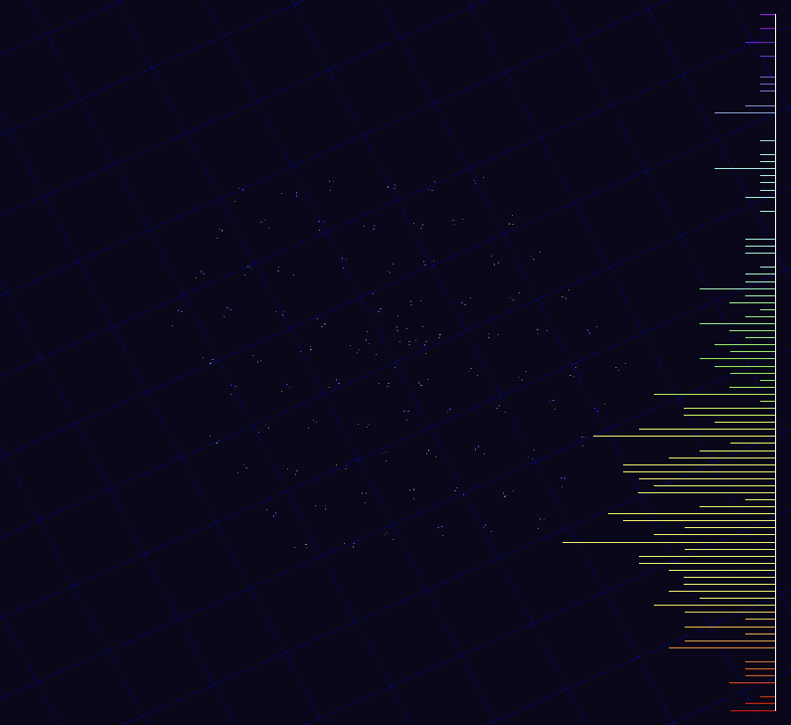

Slide 50
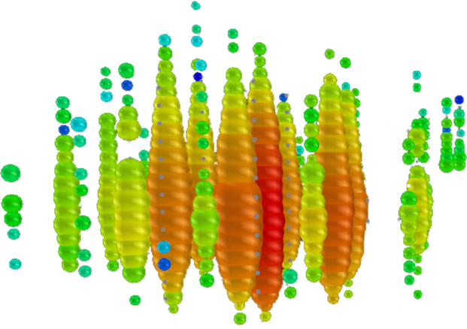
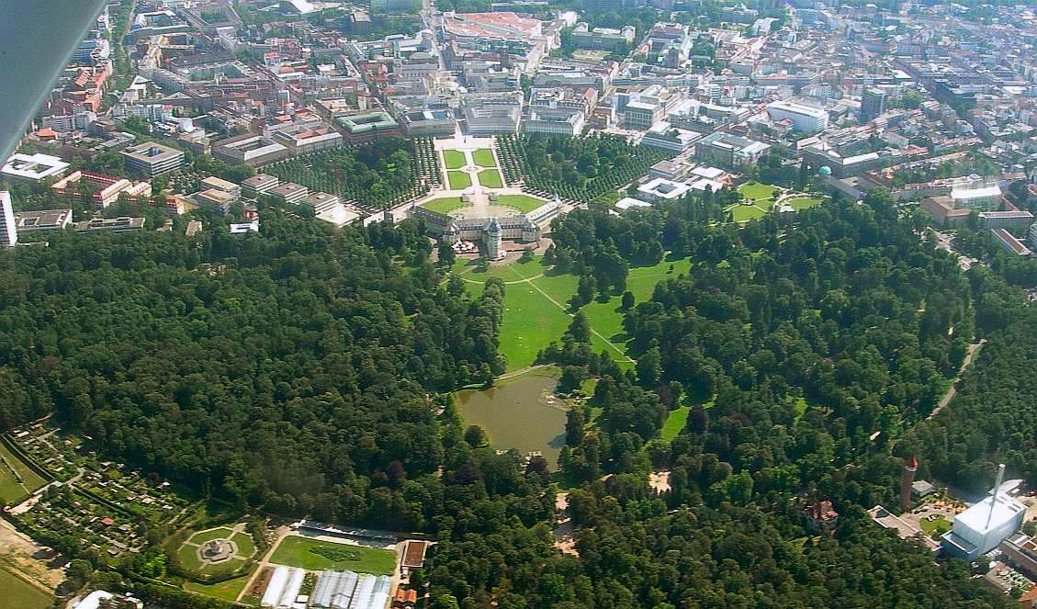
Karlsruhe, Schlosspark

Slide 51
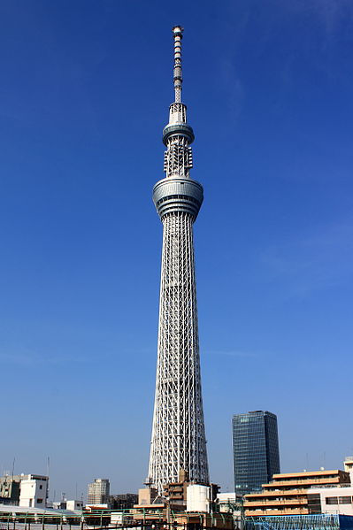
Tokyo Sky Tree
for Takaaki

Slide 52
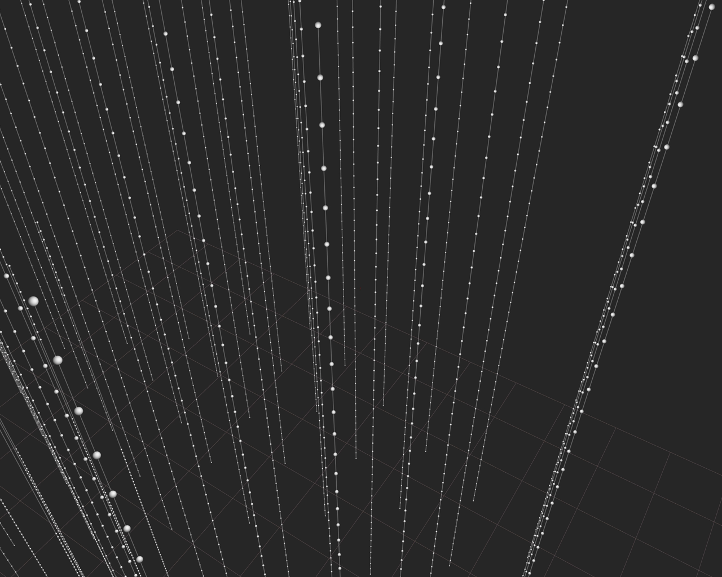

Slide 53


Slide 54
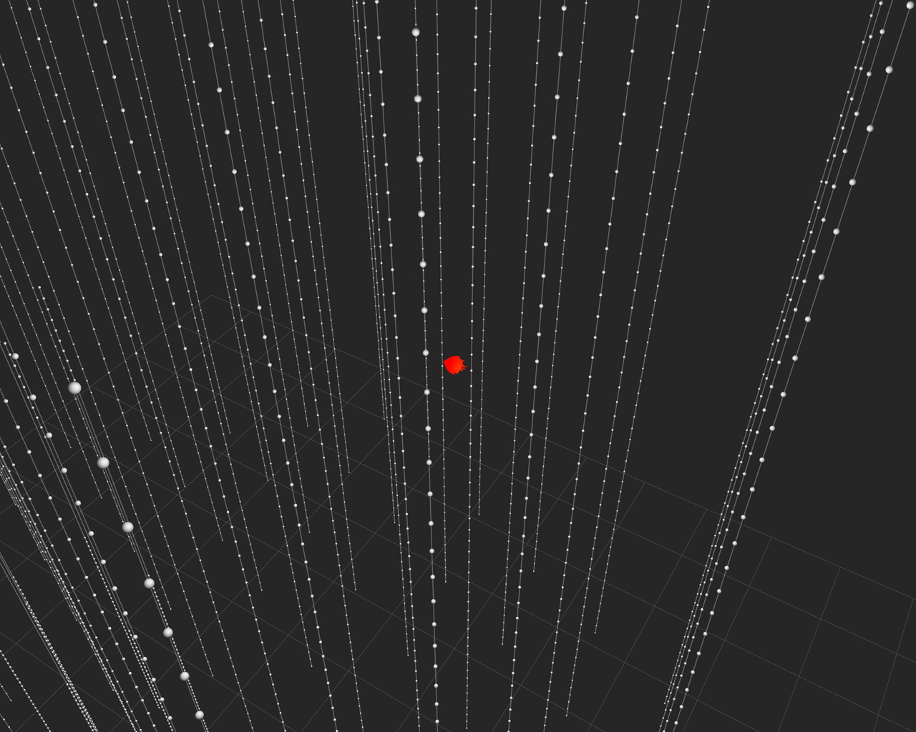

Slide 55
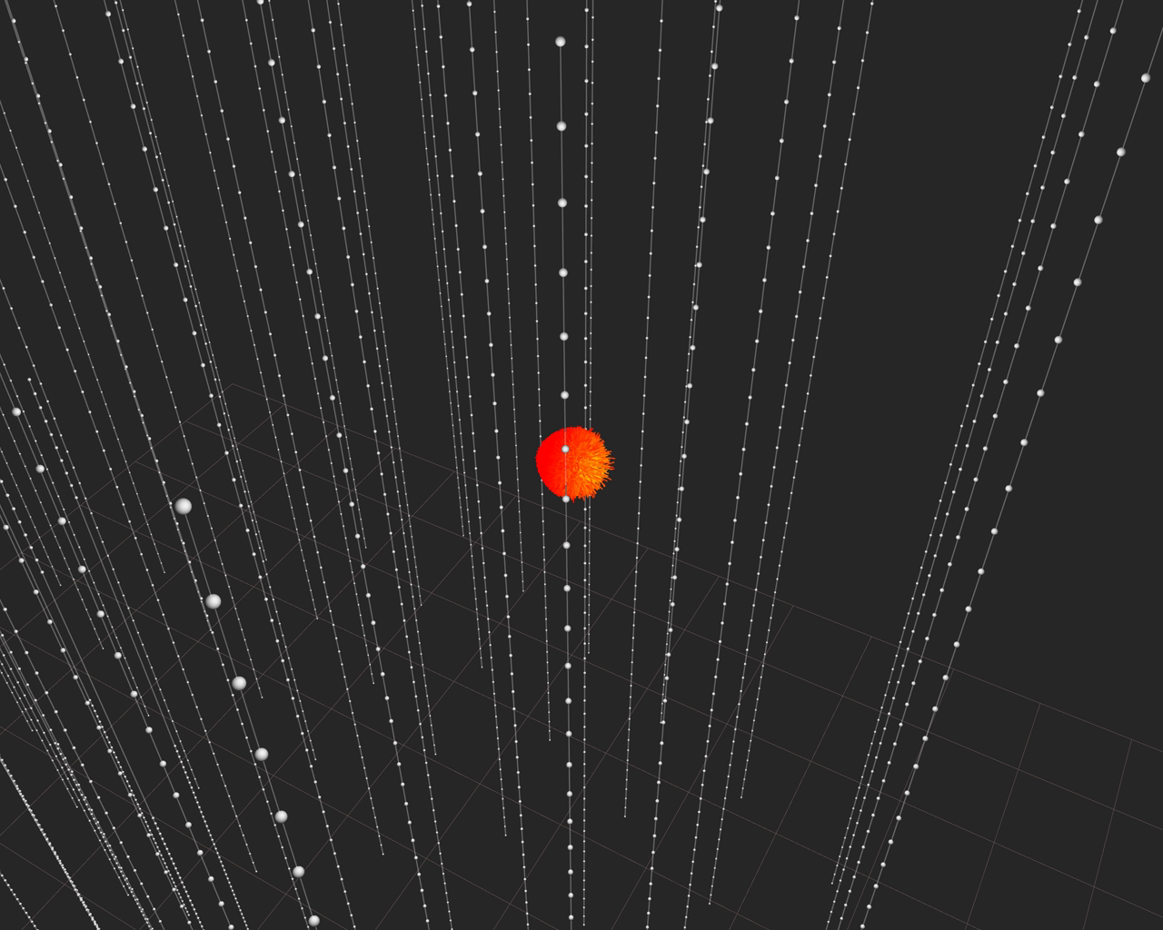

Slide 56
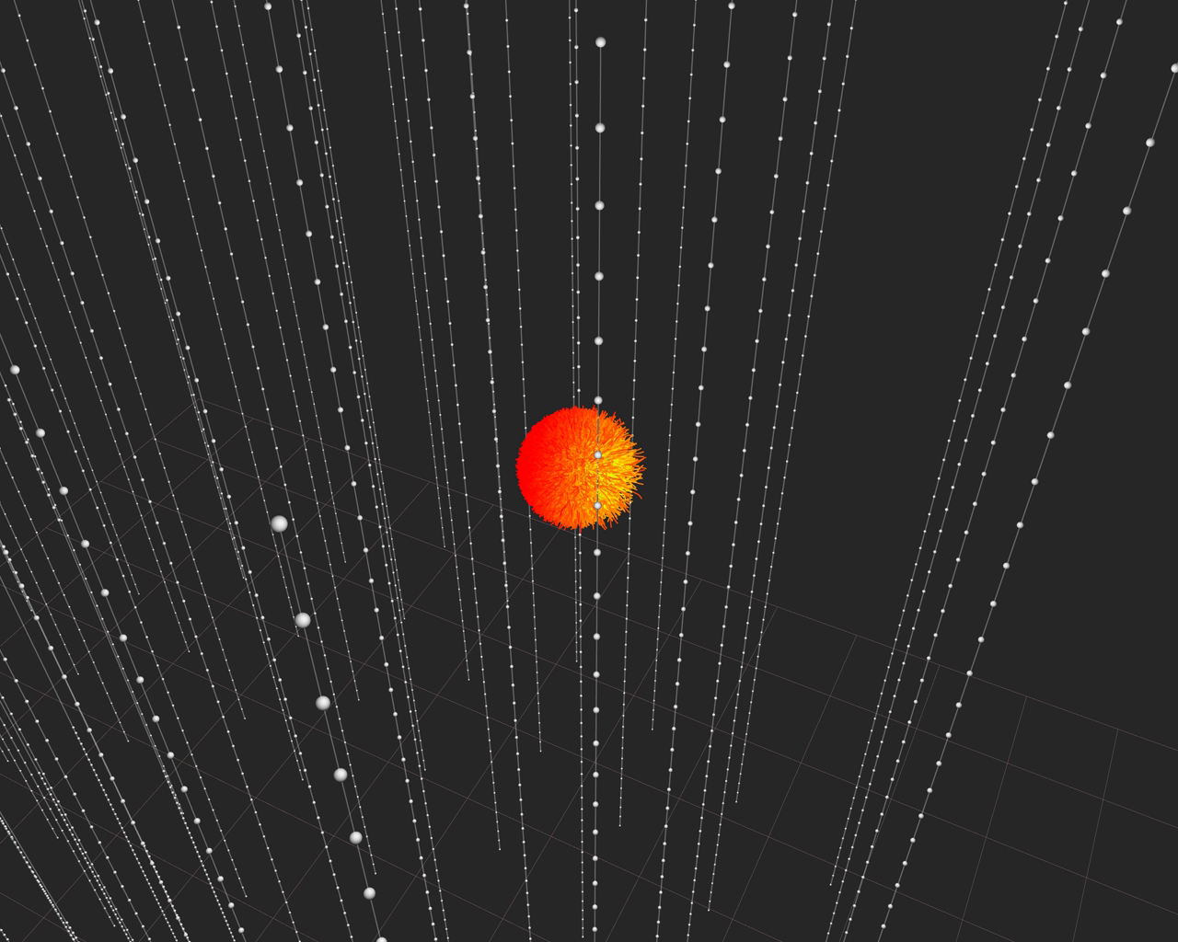

Slide 57
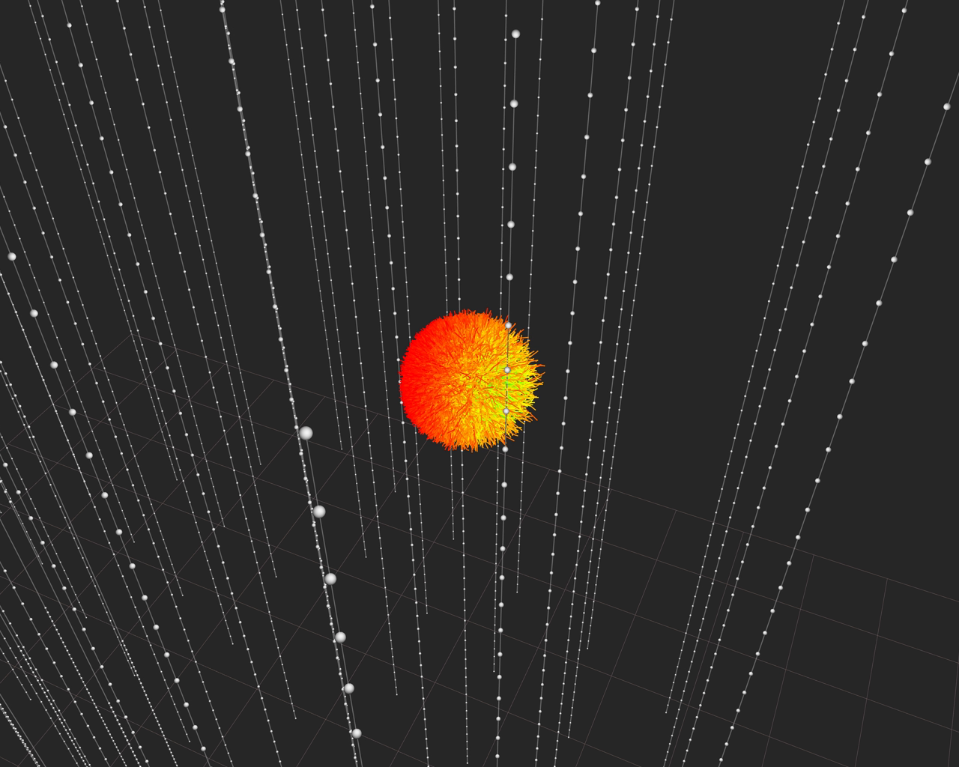

Slide 58
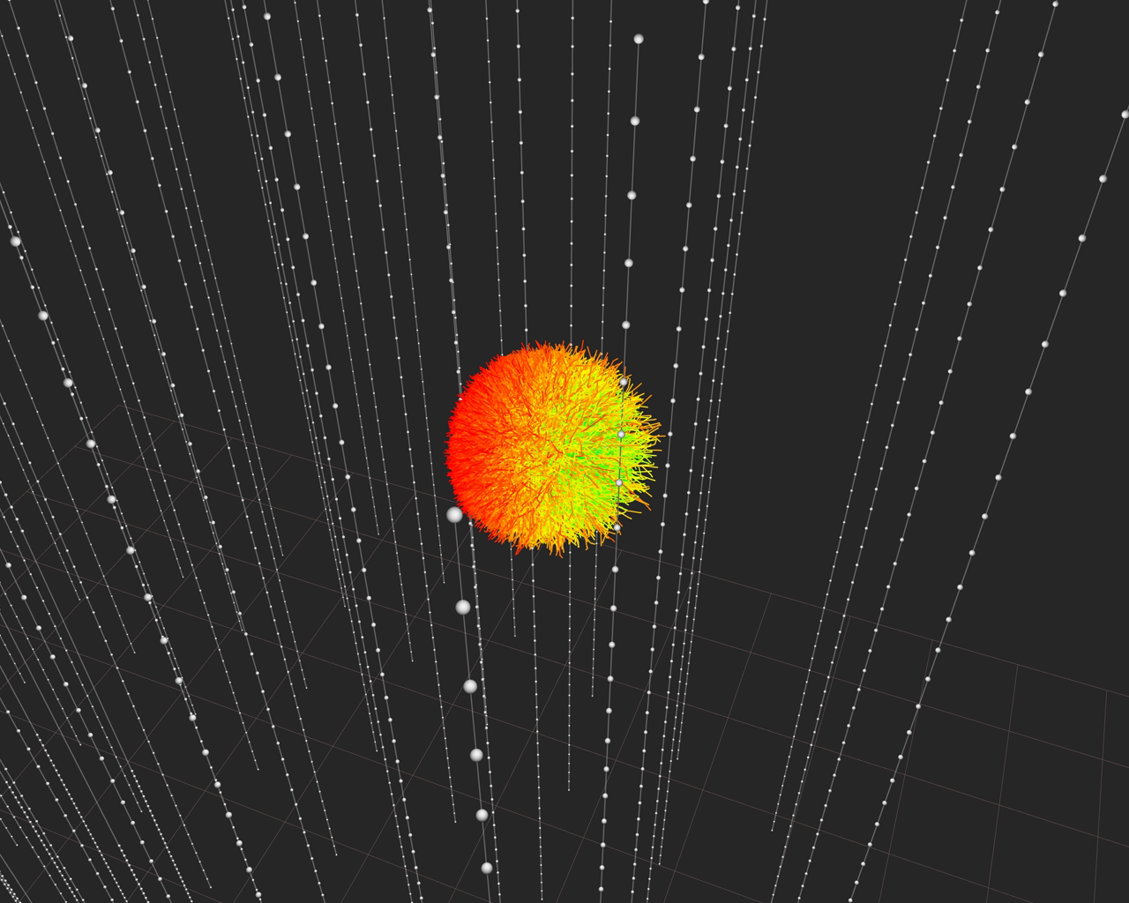

Slide 59


Slide 60


Slide 61


Slide 62


Slide 63


Slide 64


Slide 65


Slide 66


Slide 67


Slide 68


Slide 69


Slide 70


Slide 71


Slide 72


Slide 73


Slide 74


Slide 75


Follow-up Analysis: HESE published in SCIENCE
High Energy Starting Event Analysis
Muon Veto
Q_{tot} > 6000 photoelectrons
400 Mton eff. Volume
Sensitive to all flavors above 60 TeV
100 TeV 1 PeV

Slide 76

HESE Results: Ernie & Bert + 26 additional events
Significance of all 28 events: 4.1 σ
Background 10.6^{+5.0}_{-3.6}
Best fit for E⁻² spectrum:
E²Φ = 1.2 × 10⁻⁸ GeV cm² s-¹ sr⁻¹
Cut-off at 1.5-2 PeV
Ernie and Bert

Slide 77


Cover Pictures:

Slide 78


Slide 79

HESE Skyplot: Nothing significant (yet?)
Northern Sky
Southern Sky

Slide 80
HESE Skyplot: Nothing significant (yet?)
Northern Sky
Southern Sky

Slide 81


Slide 82


Slide 83


Slide 84


Slide 85
Diffuse Neutrino Flux from Cosmic Ray Interactions in the Milky Way | Joshi, Winter, Gupta | 1310.5123 | CR interactions
GeV - PeV Neutrino Production and Oscillation in hidden jets from GRBs | Fraija | 1310.7061 | Extragalactic (GRB)
Detection of ultra high energy neutrinos by IceCube: Sterile neutrino scenario | Rajpoot, Sahu, Wang | 1310.7075 | Exotic (sterile neutrinos)
Reevaluation of the Prospect of Observing Neutrinos from Galactic Sources in the Light of Recent Results in Gamma Ray and Neutrino Astronomy | Gonzalez-Garcia, Halzen, Niro | 1310.7194 | Galactic
Self-consistent neutrino and UHE cosmic ray spectra from Mrk 421 | Dimitrakoudis, Petropoulou, Mastichiadis | 1310.7923 | Extragalactic (Blazar, Mrk421)
The energy production rate density of cosmic rays in the local universe is ∼10^44−45 erg Mpc^−3 yr^−1 at all particle energies | Katz, Waxman, Thompson, Loeb | 1311.0287 | Extragalactic
Geometric Compatibility of IceCube TeV-PeV Neutrino Excess and its Galactic Dark Matter Origin | Bai, Lu, Salvado | 1311.5864 | Exotic (dark matter)
Neutrino Events at IceCube and the Fermi Bubbles | Lunardini, Razzaque, Theodoseau, Yang | 1311.7188 | Galactic (Fermi Bubbles)
IceCube's Neutrinos: The beginning of extra-Galactic neutrino astrophysics? | Waxman | 1312.0558 | Extragalactic
Cosmic-Ray Neutrinos from the Decay of Long-Lived Particle and the Recent IceCube Result | Ema, Jinno, Moroi | 1312.3501 | Exotic (heavy particle decay)

Slide 86

Looking Ahead: The future has started !
One very high-energy event in the 10% „burn sample“ of 2012 data: BigBird
2012 HESE results known but not public (confirm 2010/11 data)
Also:
upgoing muon analysis IC79 (2010)
Cascade analysis IC79
We have >5σ !
BigBird

Slide 87
Future projects

Slide 88
GVD – KM3NeT – PINGU/DecaCube
GVD
KM3NeT
PINGU or/and DecaCube

Slide 89
GNO: The Global Neutrino Network
GVD
Antares
KM3NeT
GNN
IceCube

Slide 90


KM3NeT
Distributed infrastructure
- KM3NeT-France (Toulon) ~2500m
- KM3NeT-Italy (Capo Passero) ~3400m
- KM3NeT-Greece (Pylos) ~4500m
Until 2015: construction of KM3NeT phase I detectors in France and Italy (~40 M€)

Slide 91

KM3NeT
6 building blocks, 2 per site. Overall volume ~ 5 km³
115 strings at 90 m distance
18 OMs per string, 36 m vertical distance
1 km

Slide 92


Gigaton Volume Detector, Lake Baikal
Stage 1: volume ~0.5 km³
Stage 2: volume ~ 1.5 km³
Stage 2
27 clusters with 8 strings each
Height 700 m (depth 600 m– 1300 m)
48 OMs per string
PMT
Hamamatsu
R7081-HQE
∅ = 10”
QE ~ 35%

Slide 93
South Pole infrastructure for neutrino (astro-)physics
Device Volume Threshold Primary Goal
PINGU few Mton 2-3 GeV ν mass hierarchy
DecaCube* 7-12 km³ ~10 TeV ν astronomy
cosmogenic neutrinos
Surface veto ~120 km² veto for IceCube
CR physics
ARA ~120 km² ~50 PeV cosmogenic neutrinos
* including IceCube (1 km³ with 100 GeV threshold)

Slide 94


PINGU: determine nu mass hierarchy
P(νμ → νμ) for θ=130º
1
IH
NH
0.5
P (νx → νμ)
νμ
νe
0
1
5
10
Eν [GeV]
Maximum difference NH ↔ IH for θ = 130° at 7 GeV
For anti-ν, NH and IH are approximately swapped → effect cancels if detector cannot distinguish μ⁺ and μ⁻
However: flux of atm.ν ~ 1.3 × flux of atm. anti -ν
and σ(ν) ~ 2 × σ(anti-ν) at low energies
→ Count N_{μ}(θ, E) from ν_{μ} + N →μ + X and compare with NH/IH predictions
~40 additional strings
Proposal to be submitted to P5 process in December
Cost 40-50 M$ (European Counting)

Slide 95

DecaCube Version with 240 m spacing
100 strings
~ 7 km³ volume
Muons: 3 times IC
Cascades: 7 times IC
Threshold ~ 10 TeV
Fiducial region | Volume Gton | #events >60TeV | #events > 1PeV
HESE | 0.4 | 8 | 1
IC+1ring | 1.6 | 32 | 4
IC+3rings | 4 | 80 | 10

Slide 96

A surface veto (also studied: several small Cherenkov telescopes)
943 stations on surface
Radius 6.7 km
Efficient down to 72°
Efficiency > 99.99% for > 4000 PE in IceCube

Slide 97

ARA Askaryan Radio Array
Shallow radio antennas
~ 120 km²
Threshold ~ 50 PeV

Slide 98
Summary
Exotics: Record limits on exotic particles (MM), exotic physics (LVI), WIMP DM
Cosmic rays: Best measurement spectrum, anisotropies
Atmospheric neutrinos: - entered the field of oscillation physics
- PINGU may be able to determine mass hierarchy
Astrophysical Neutrinos: Factor of 1000 improvement over last 12 years
No indications of point sources yet
  Further factor 3 in sensitivity will bring us to the level of optimistic predictions for some SNR
  KM3NeT and GVD look to central part of the Galaxy and could eventually find point sources
  Another (better!) option: DecaCube
  IceCube constrains models for GRB
IceCube finds first strong indications for a diffuse flux of extraterrestrial high-energy neutrinos
After 40 years: we are entering a new era!

Slide 99


Slide 100


Slide 101
End

