Slide 1
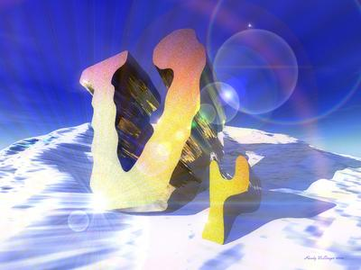

A walk through history
From the first neutrino underground to the first neutrino underwater
Christian Spiering

Slide 2
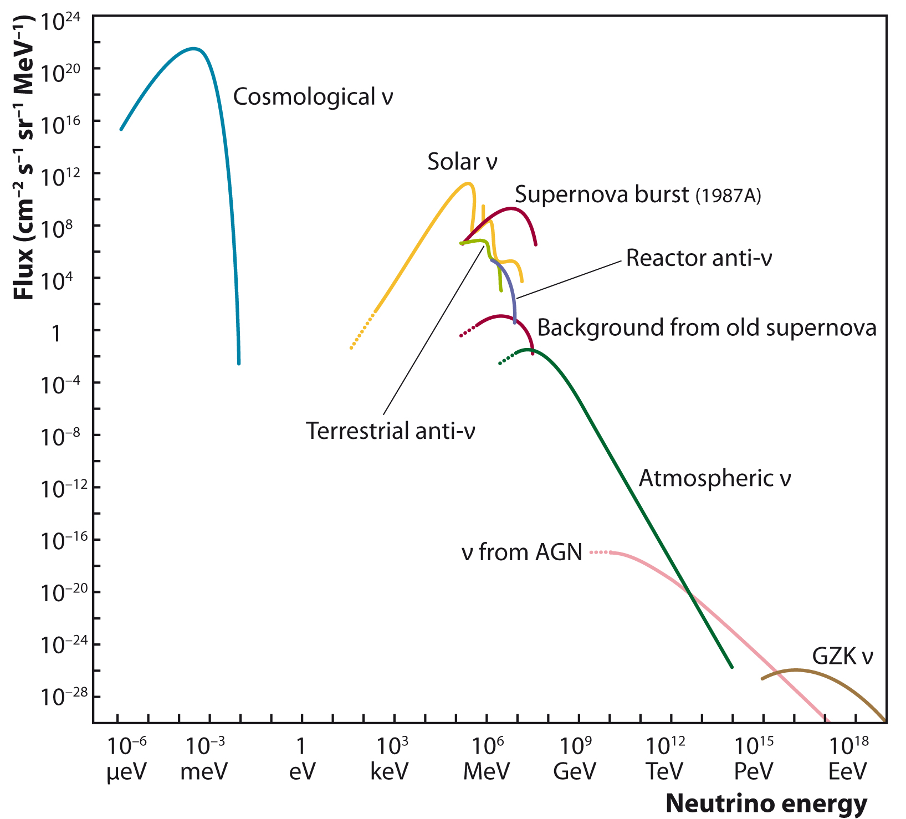
under-
ground
optical:
- deep water
- deep ice
air showers
radio
acoustics

Slide 3
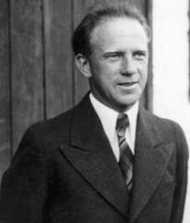
Heisenberg 1936
Instead (of protons and neutrons, C.S.) Pauli's hypothetical 'neutrinos' should contribute substantially to the penetrating radiation. This is because in each shower ... neutrinos should be generated which then would lead to the generation of small secondary showers. The cross section for the generation of these secondary showers would likely not be much smaller than 10⁻²⁶ cm². Contrary to the low-energy neutrinos from β decay one should be able to detect the energetic neutrinos from cosmic rays via their interactions.
Werner Heisenberg
Zur Theorie der Schauerbildung in der Höhenstrahlung
Zeitschr. f. Physik 101 (1936) 533

Slide 4
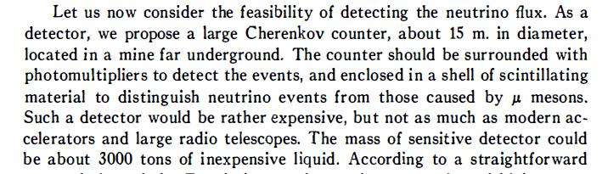

Ann.Rev.Nucl.Sci
10 (1960) 63

Slide 5
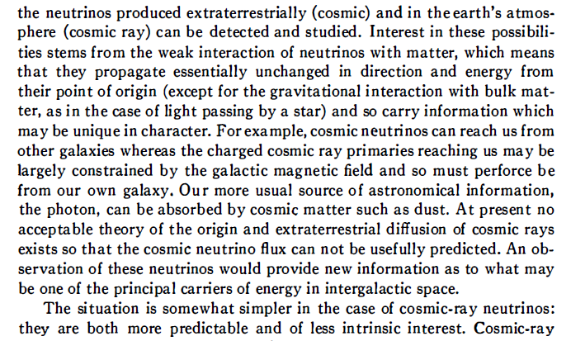
Ann.Rev.Nucl.Sci
10 (1960) 1

Slide 6

Estimates of the atmospheric neutrino flux
Zhelesnykh 1958
Markov and Zhelesnykh 1961
Zatsepin & Kuzmin 1961
      “We have been kindly informed by Professor G. Zatsepin that the contribution of neutrinos originating in µ-decay may be essential for neutrinos of the order of several GeV.”
Coswik 1963
Osborne 1965
Volkova & Zatsepin 1965

Slide 7
Detection of atmospheric neutrinos
1962: F. Reines asks M. Markov in Geneva about tunnels, caverns, mines in USSR which are suitable for underground experiments
Markov charges A. Pomanski to survey the case → no locations found → problem solved in the seventies by digging a special . tunnel in the Baksan Valley, Caucasus
1963: Reines finds a mine in South Africa (8800 mwe) → CWI Collaboration (Chase-Witwatersrand-Irvine)
Japan-India-UK group uses Kolar Gold Field mine in India (7500 mwe) → KGF Collaboration

Slide 8
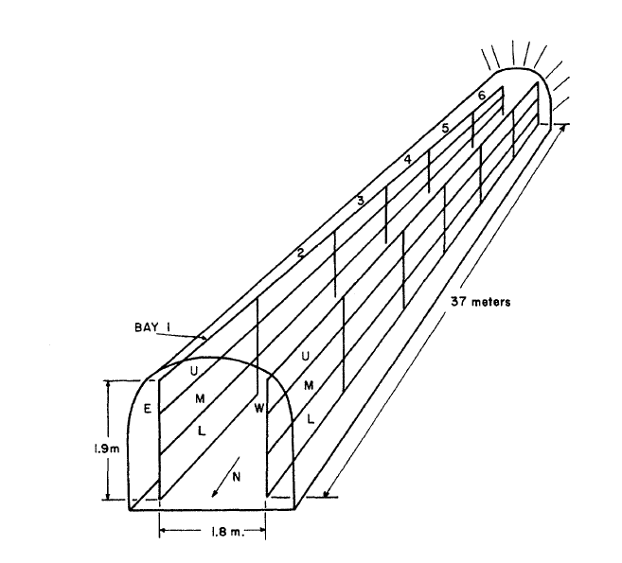
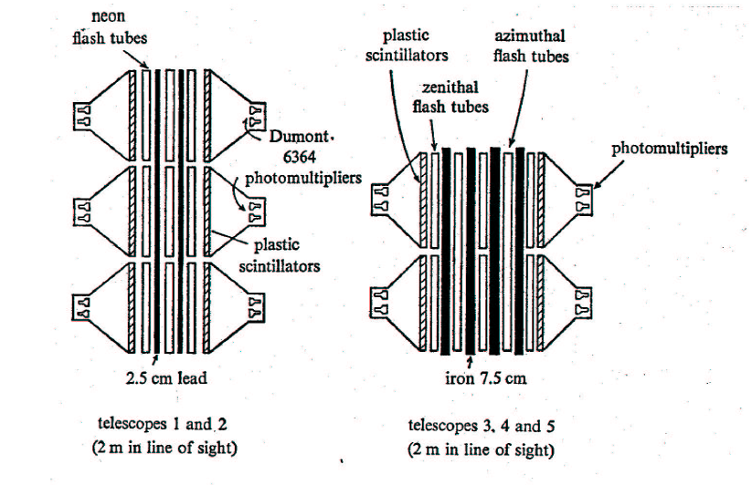
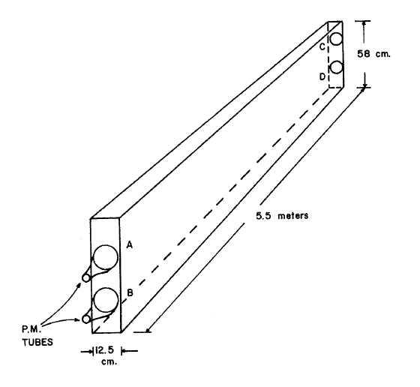
The two detectors
CWI
Liquid Scintillator
Horizontal tracks
KGF
Plastic Scintillators
Flash Tubes

Slide 9
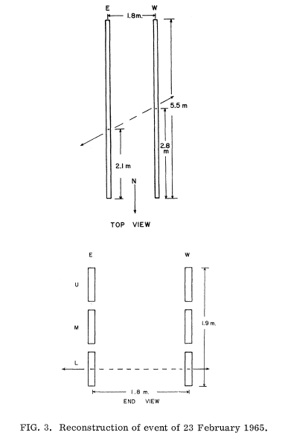
The race
The first neutrino underground (CW, 23/2/1965) – out of seven recorded between February and July.
KGF group started data taking some months after the CW group.
KGF sees its first of three neutrino candidates two months later than Reines (20/4/1965).
KGF publishes two weeks earlier than the CW group:
  KGF at August 15, 1965 (submitted 12/7/1965)
  CW at August 30, 1965 (submitted 26/7/1965)
Reines recorded the first cosmic neutrino ever, but the formal priority is with the KGF group.

Slide 10
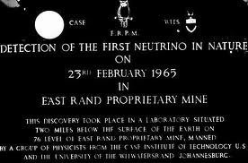
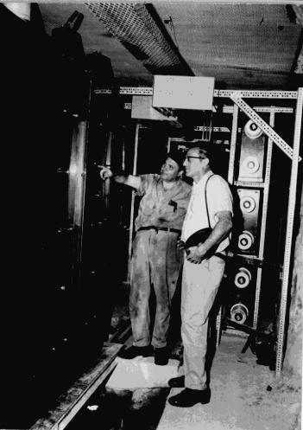
In the East Rand Proprietary Mine/South Africa

Slide 11
The first neutrino skymap
The first neutrino sky map with the celestial coordinates of 18 KGF neutrino events
(Krishnaswamy et al. 1971)
Due to uncertainties in the azimuth, the coordinates for some events are arcs rather than points. The labels reflect the numbers and registration mode of the events (e.g. "S" for spectrograph). Only for the ringed events the sense of the direction of the registered muon is known.

Slide 12
Central interest: cross sections, W-mass
… one of the main motivations for Reines‘ South Africa detector, the Kolar Gold Field Detector and the Baksan scintillation detector. Early sixties: does the neutrino cross section saturate beyond 1 GeV (i.e. one would never measure atm. neutrinos with energies higher than a few GeV). The question was closed in the mid seventies by KGF and Utah:
The mass of W must be > 10 GeV.

Slide 13
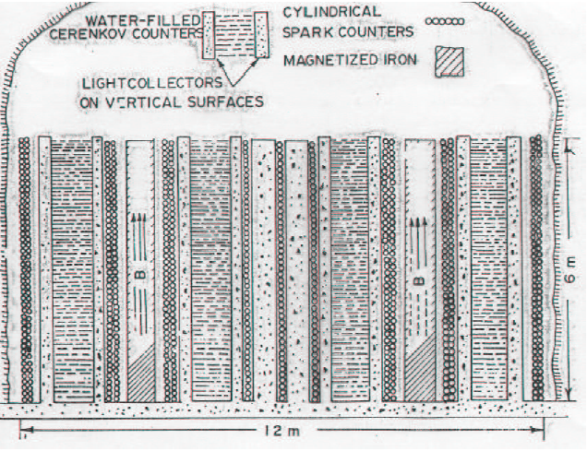
Number 3: Detector in Utah Salt mines
Utah detector plus KGF: W-mass must be >> a few GeV
Utah: downgoing muon flux behaves strange („Keuffel effect“) → one of the motivations for DUMAND

Slide 14
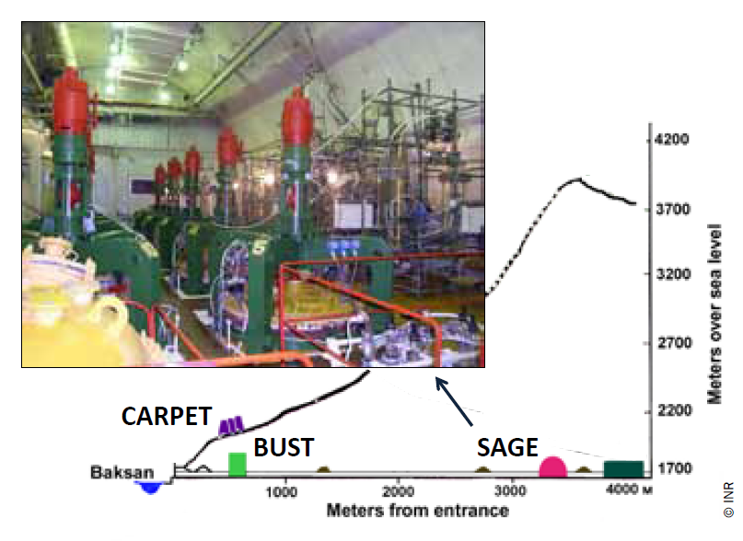
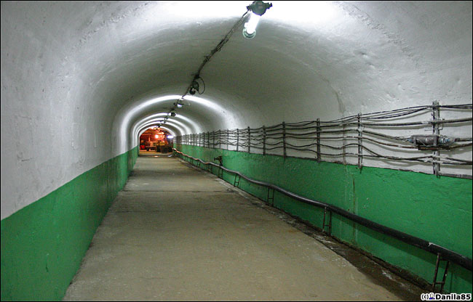
Number 4: The Baksan Laboratory
See the talk of
Vladimir Gavrin

Slide 15
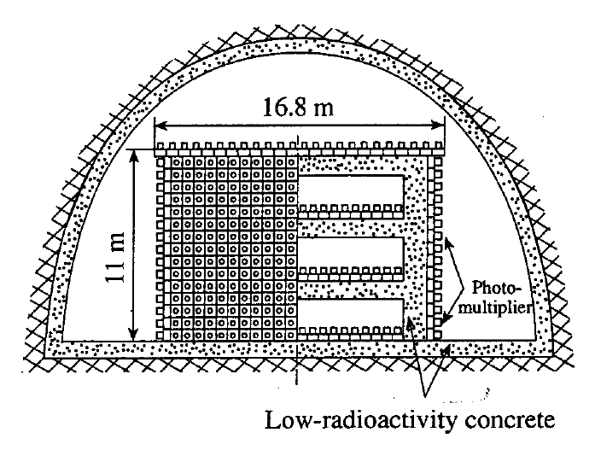
BUST (Baksan Scintillation Underground Telescope)
μ area: 250 m²
3000 tanks with 330 tons liquid scintillator
Completed 1979
Threshold for upward moving muons 2 GeV

Slide 16
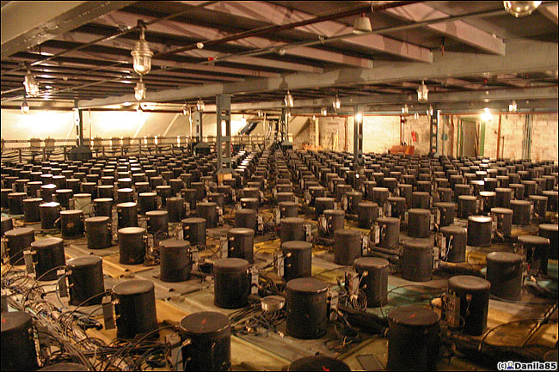

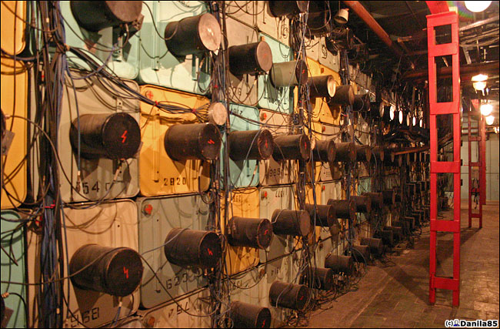
BUST (Baksan Scintillation Underground Telescope)

Slide 17
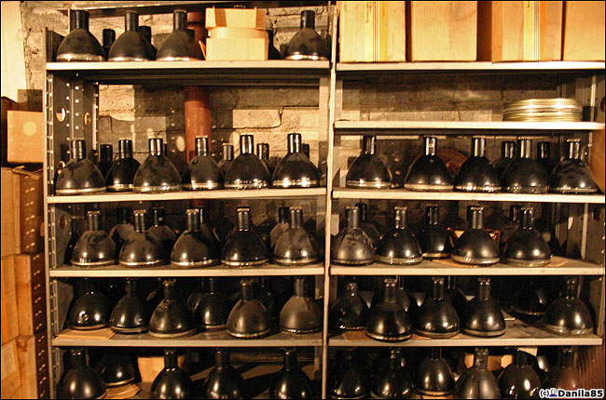

Slide 18
Baksan: early results on oscillations
1981: 19 upward moving events (±50° around opposite zenith)
upper limit on Δm² < 6×10⁻³ eV² (2-neutrino mixing scheme, maximum mixing)
This was in slight conflict with the region some years later suggested by Kamiokande, but well compatible with the present value of about 2×10⁻³ eV².

Slide 19
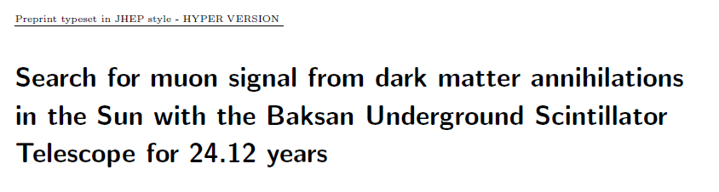
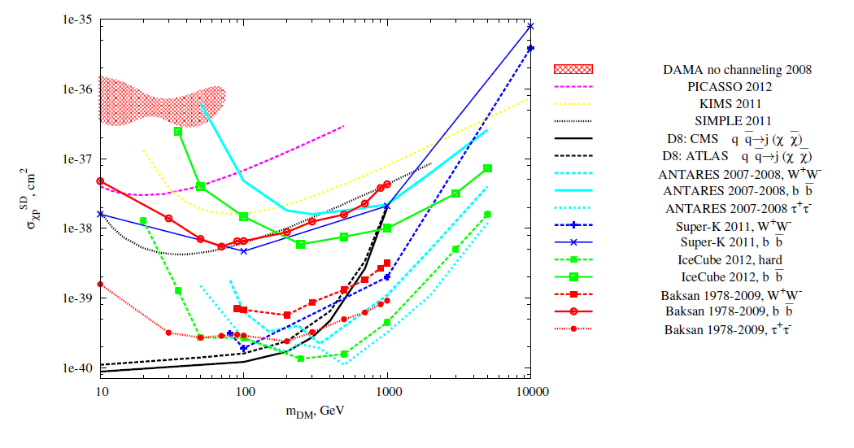
Baksan: latest results on indirect dark matter detection
arXiv, 7 January 2013

Slide 20
Water Cherenkov Detectors

Slide 21
Water Cherenkov Detectors
Primary mission: proton decay

Slide 22
Water Cherenkov Detectors
Primary mission: proton decay

Slide 23
Water Cherenkov Detectors
Primary mission: proton decay

Slide 24
Water Cherenkov Detectors
Primary mission: proton decay
γ
γ
e⁺

Slide 25
Water Cherenkov Detectors
Primary mission: proton decay
Plus:
  Supernova neutrinos
  Atmospheric neutrinos
  Solar neutrinos
KAMIOKANDE
3 / 1 kton water
(total/fiducial vol. for p decay)
Kamioka Mine (Japan)

Slide 26
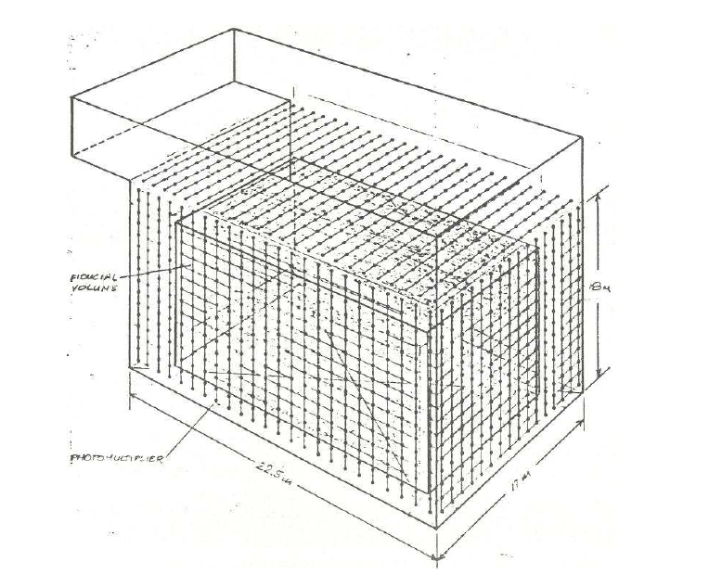
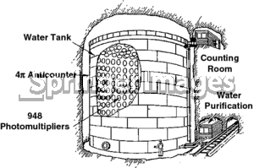
Water Cherenkov Detectors
KAMIOKA IMB
Japan, 3 kt Ohio, 8 kt
area = 120 m²
      area = 400 m²

Slide 27
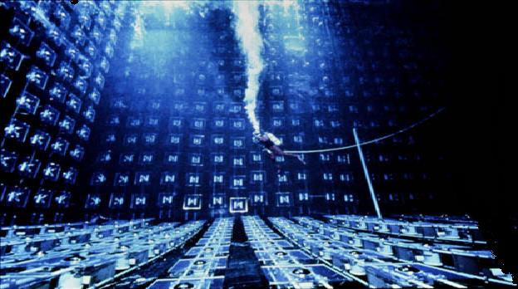
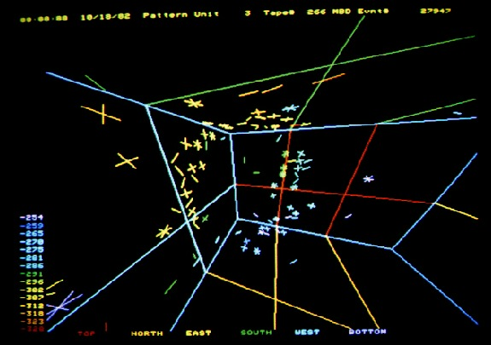
Water Cherenkov Detectors
KAMIOKA IMB
Japan, 3 kt Ohio, 8 kt

Slide 28
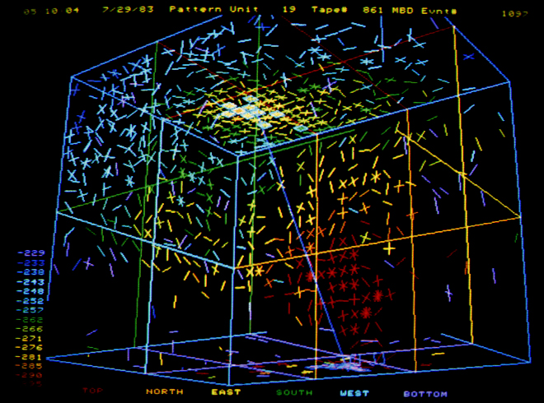
Water Cherenkov Detectors
KAMIOKA IMB
Japan, 3 kt Ohio, 8 kt

Slide 29
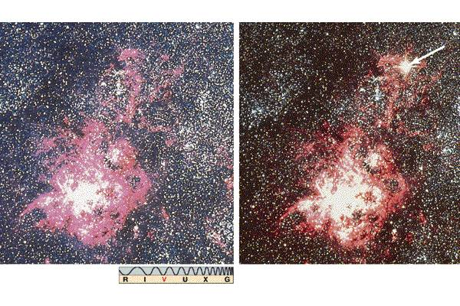
These 3 detectors have detected
coinciding neutrinos from SN1987A
Remember
the date?
23.2.1987

Slide 30

These 3 detectors have detected
coinciding neutrinos from SN1987A
23.2.1987

Slide 31
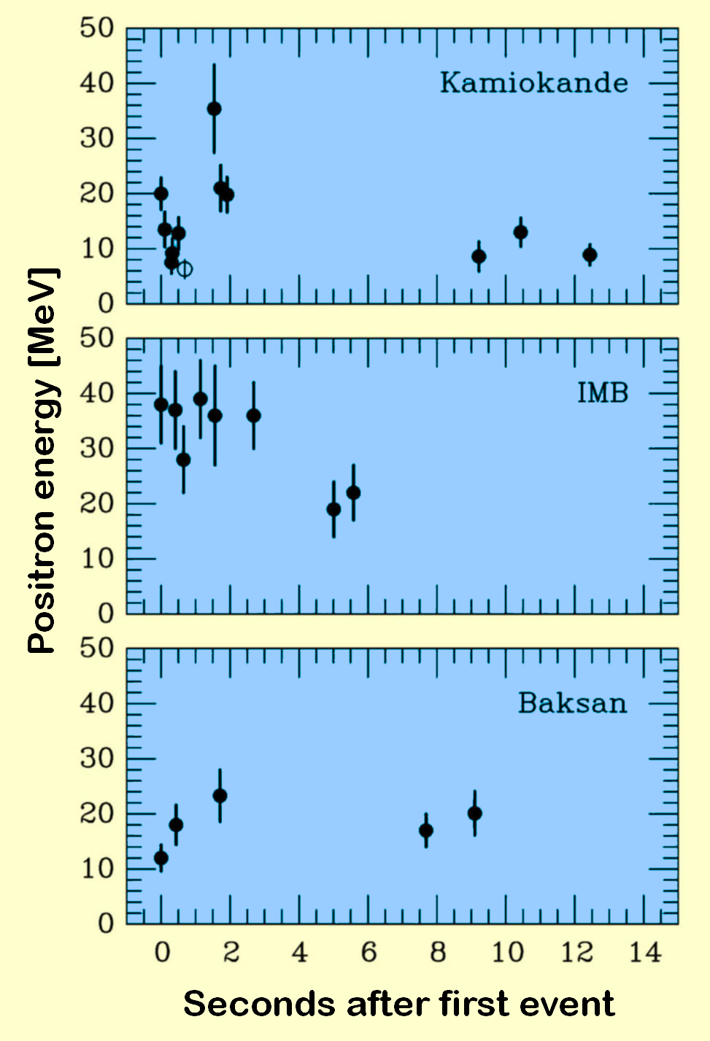
Kamiokande (Japan)
Irvine-Michigan-Brookhaven
(USA)
Baksan Scintillator Telescope
(Soviet Union)
A signal ~4 hours earlier was reported
by the LSD detector (Mont Blanc)
Compilation G.Raffelt

Slide 32
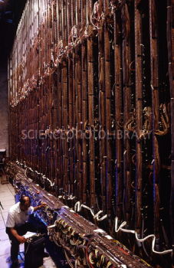
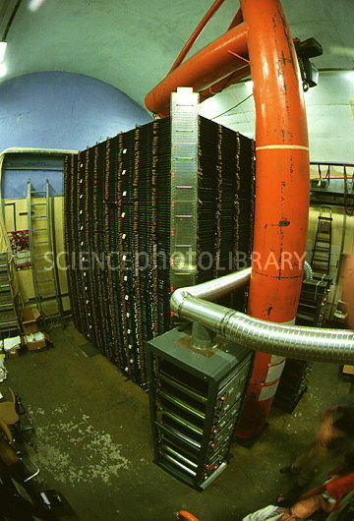
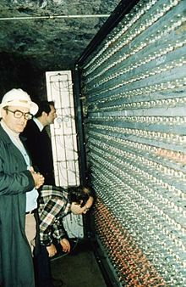
Iron-Sandwich detectors
Fréjus NUSEX Soudan-I/II
(France 1984-88) (France 1982-88) (USA 1981-90-2001)
700t Fe/flash chambers 130t Fe/streamer tubes 770t Fe/drift tubes
90 m² 10m² 10/100 m²
Plus new KGF (20 m²)
Masses are fiducial masses for p-decay

Slide 33
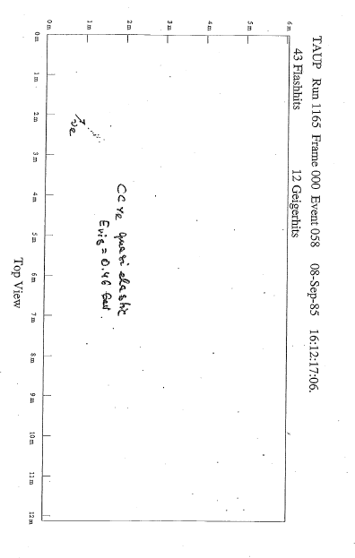
Fréjus event

Slide 34
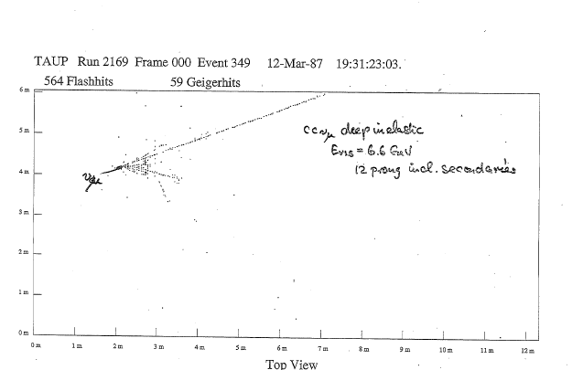
Fréjus event

Slide 35
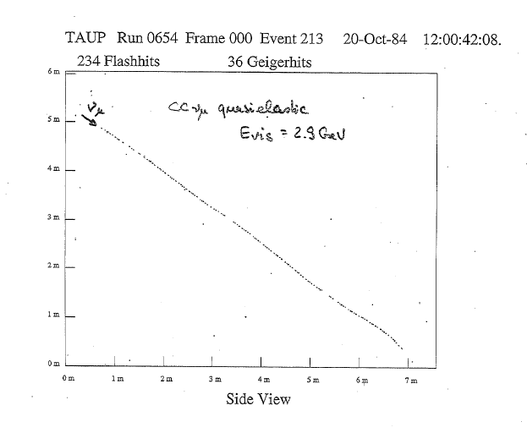
Fréjus event

Slide 36
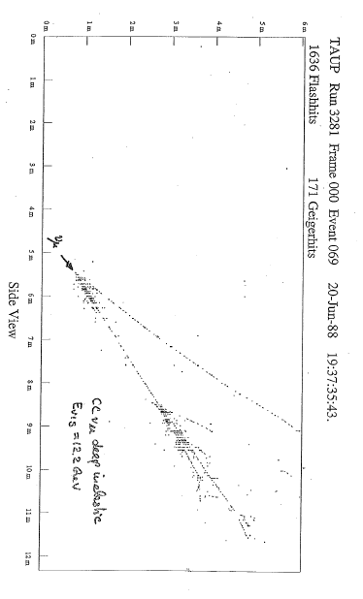
Fréjus event

Slide 37
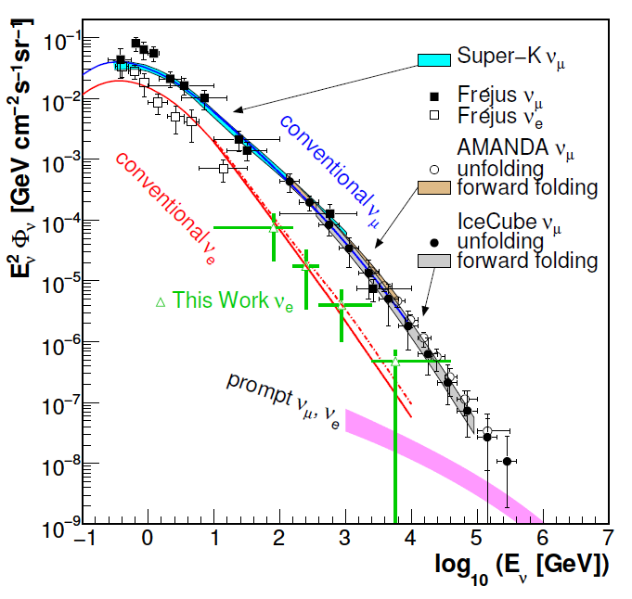
IceCube
Fréjus appearance
on plots with latest
IceCube results

Slide 38
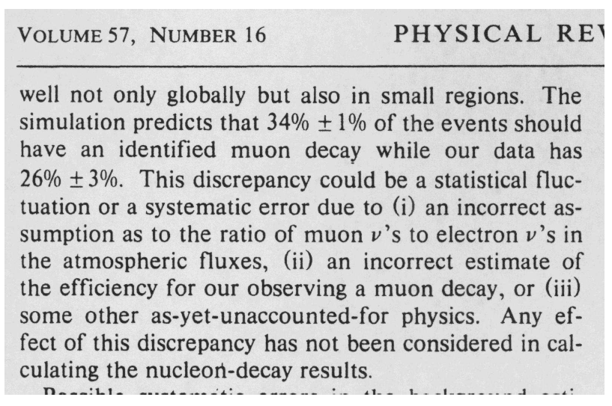
ν_{μ} Deficit seen in water but not in iron?
Excerpt from a 1986 IMB publication

Slide 39
The two behemots of the nineties:
MACRO and Super-K

Slide 40
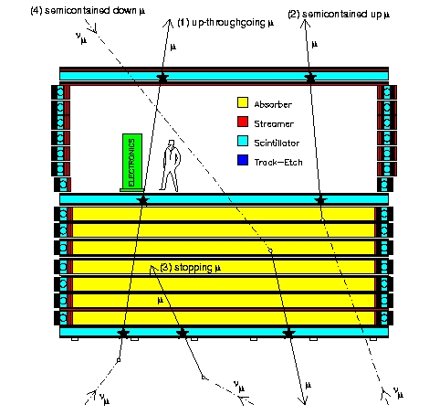
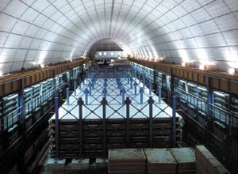
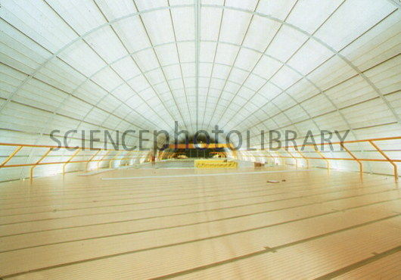
MACRO in the Gran Sasso Lab. ~1100 m²

Slide 41
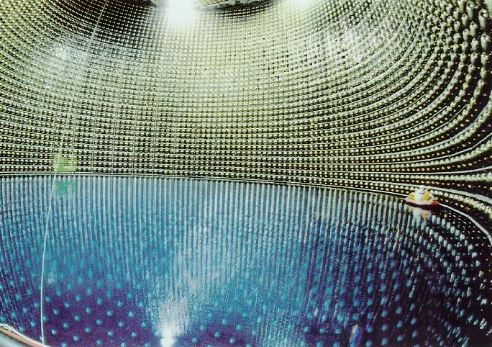
Super-Kamiokande, Japan ~1000 m²

Slide 42
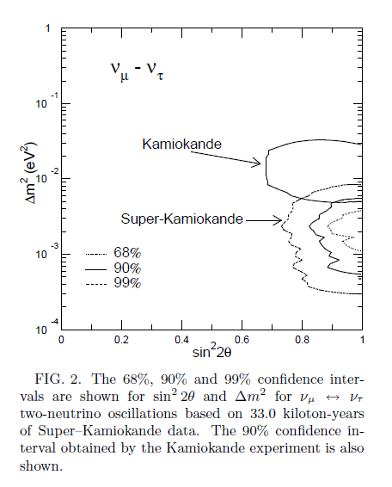
MACRO and Super-K
1990s: Deficit in muon neutrinos seen consistently in Super-K and MACRO
1998: Super-Kamiokande announces detection of atmospheric neutrino oscillations in a press release.

Slide 43
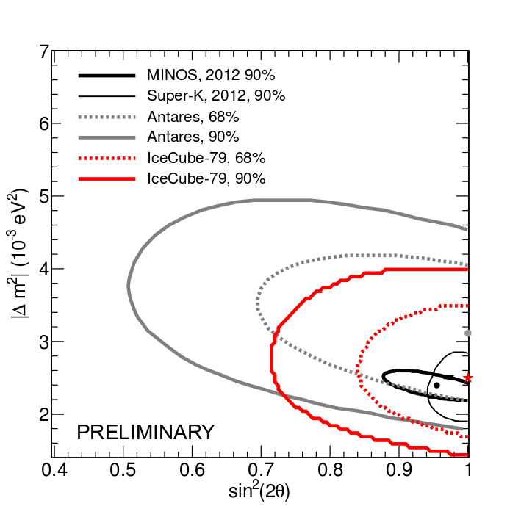
Δm²: 15 years ago and today

Slide 44
Δm²: 15 years ago and today

Slide 45
Δm²: 15 years ago and today

Slide 46
MACRO 2002: largest-statistics skymap underground
1356 upgoing events

Slide 47
Need for bigger detectors: go to open water

Slide 48
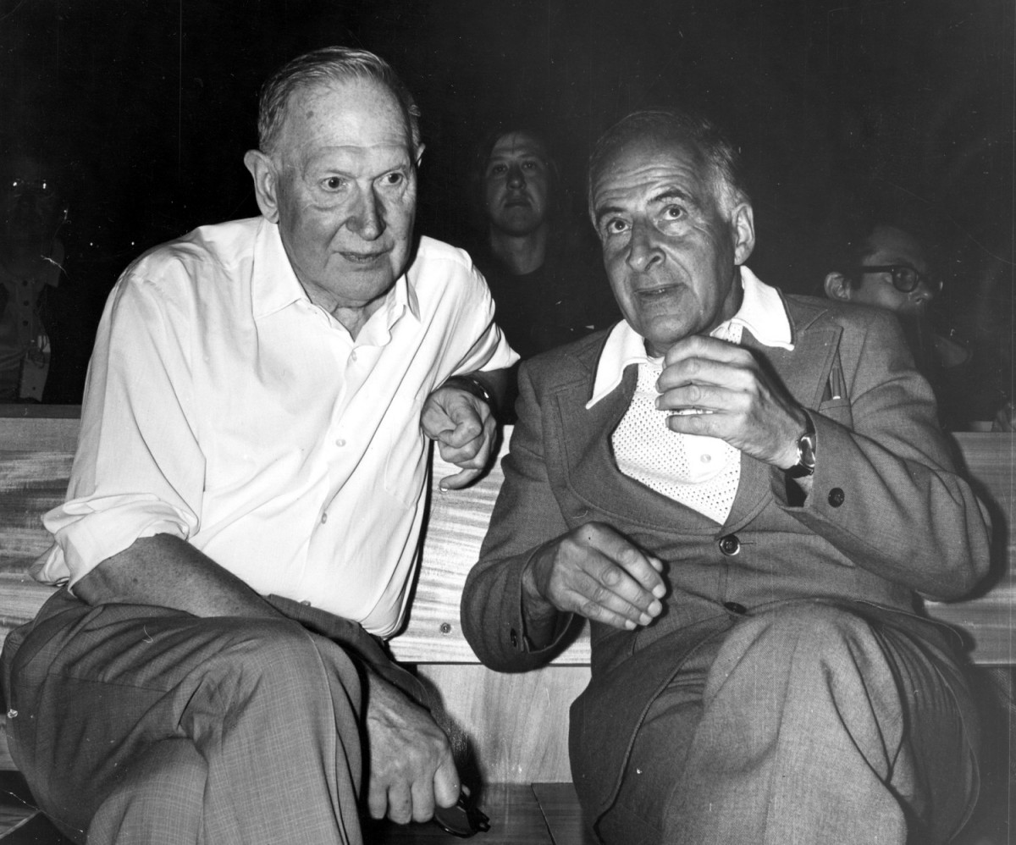
Moisej Markov
Bruno Pontecorvo
M.Markov,1960:
„We propose to install detectors deep in a lake or in the sea and
to determine the direction of charged particles with the help
of Cherenkov radiation“ Proc. 1960 ICHEP, Rochester, p. 578.

Slide 49
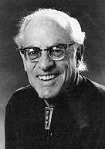


DUMAND
See also: A.Roberts: The birth of high-energy neutrino
astronomy: a personal history of the DUMAND project,
Rev. Mod. Phys. 64 (1992) 259.
1973 ICRC, Reines, Learned, Shapiro, Zatsepin, Miyake: a deep water detector to clarify puzzles in muon depth-intensity curves („Keuffel effect“ from Utah detector)
Puzzles faded away, but there remained the awareness that such a detector could also work as neutrino detector
The name: DUMAND (Deep Underwater Muon And Neutrino Detector), proposed by Fred Reines
1975: First DUMAND Workshop in Washington State College
DUMAND Steering Committee, chaired by F.Reines, J. Learned, . A.Roberts

Slide 50
1978: 1.26 km³
22,698 OMs

Slide 51
Financial and technological reality!

Slide 52
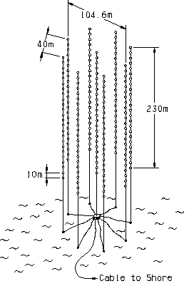
1978: 1.26 km³
22,698 OMs
1980: 0.60 km³
6,615 OMs
1982: 0.015 km³
756 OMs
1988:
0.002 km³
216 OMs
DUMAND-II

Slide 53
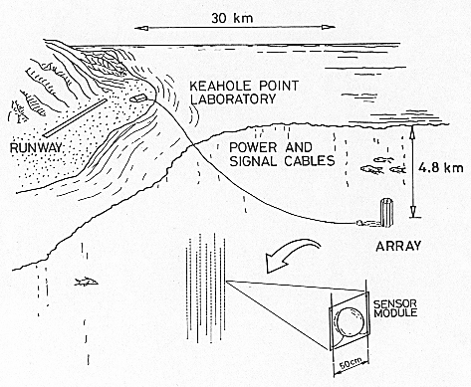
DUMAND-II (The Octagon)
9 strings
216 OMs
100 diameter, 240 m height
Depth of bottom: 4.8 km
Lowest OM 100 m above bottom

Slide 54
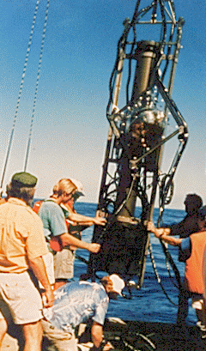
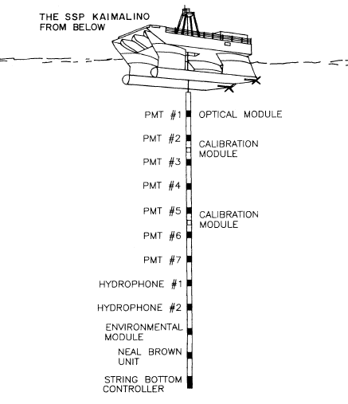
1987: The SPS
„Short Prototype String“
1982-87: a series of 14 cruises, with two lost strings
1987: success !
  depth-intensity curve
  angular distributions
  attenuation length (47±22 m)

Slide 55

DUMAND after the SPS
1989: HEPAP supports DUMAND-II
1990: DOE allocates funds for DUMAND-II
Further financial cuts → TRIAD (3 strings)
1993: shore cable laid
December 1993: deployment of first string and connection to junction box. Failure after several hours
1995: DUMAND project is terminated

Slide 56

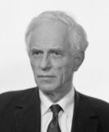
Russia
Very active during early DUMAND workshops
Kicked out of DUMAND after Russian Afghanistan invasion
A. Roberts:
1980: Chudakov proposes exploration of Lake Baikal as possible site for a neutrino telescope
1981: start of site investigations at Lake Baikal (Domogatksy, Bezrukov)
Exploration of Atlantic, Black Sea, Indian Ocean, Pacific and Mediterranean sites (Zheleznyk, Petrukhin)

Slide 57

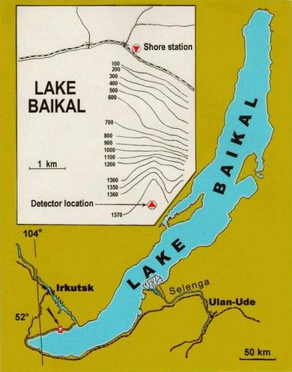


The Lake BAIKAL experiment
Bezrukov, Domogatsky, Berezinsky, Zatsepin
Leonid Bezrukov Grigorij Domogatsky
Largest fresh water reservoir in the world
Deepest Lake (1.7 km)
Choosen site 3.6 km from shore, 1.3 km depth

Slide 58

The Lake BAIKAL experiment
1988
Wolfgang Lange (Zeuthen)
Leonid Bezrukov (Moscow)

Slide 59

Ice as a natural deployment platform

Slide 60
… and its mis-interpretation:
A. Roberts:

Slide 61


Lake Baikal: the eighties
1984: first stationary string
  Muon flux measurement
1986: second stationary string (Girlyanda 86)
  Limits on GUT magnetic monopoles
All that with 15-cm flat-window PMT FEU-49
Development of a Russian smart phototube (Quasar)

Slide 62




Slide 63


Slide 64
Towards NT-200
1988: Germany joins
1989/90: design of NT-200
1993 + 1994: NT-36
  - 18 channels at 3 strings
  - first underwater array
  - first 2 neutrino candidates
1995: NT-72
  - 38 channels at 4 strings
1996: NT-96
  - 48 channels at 4 strings
  - clear neutrinos
1998: NT-200
  - 96 channels at 8 strings
J. Learned to C.Spiering:
„Congratulations for winning
the 3-string race!“
(NT-36 vs TRIAD vs AMANDA)
4-string stage (1996)

Slide 65
Towards NT-200
1988: Germany joins
1989/90: design of NT-200
1993 + 1994: NT-36
  - 18 channels at 3 strings
  - first underwater array
  first 2 neutrino candidates
  (identified 1996)
J. Learned to C.Spiering:
„Congratulations for winning
the 3-string race!“
(NT-36 vs TRIAD vs AMANDA)
Telegram G.V.Domogatsky to C. Spiering:
„ Дорогой Кристиан, сначала самое интересное: При анализе данных 1994ого года одно событие категорически сoпротивляeтcя всем тестам, и кажется это нейтрино. Естественно, я не хотел бы решать, декларируем ли мы это событие как первое ясное нейтрино в подводном детекторе. Но это можно называть очень на нейтрино похожем событием, и мне кажется, что очень желательно сообщить об этом через 2 или 3 недели достаточно широкой общественности.“

Slide 66
Towards NT-200
1988: Germany joins
1989/90: design of NT-200
1993 + 1994: NT-36
  - 18 channels at 3 strings
  - first underwater array
  first 2 neutrino candidates
  (identified 1996)
J. Learned to C.Spiering:
„Congratulations for winning
the 3-string race!“
(NT-36 vs TRIAD vs AMANDA)

Slide 67
Towards NT-200
1988: Germany joins
1989/90: design of NT-200
1993 + 1994: NT-36
  - 18 channels at 3 strings
  - first underwater array
  - first 2 neutrino candidates
1995: NT-72
  - 38 channels at 4 strings
1996: NT-96
  - 48 channels at 4 strings
  - clear neutrinos
1998: NT-200
  - 96 channels at 8 strings
J. Learned to C.Spiering:
„Congratulations for winning
the 3-string race!“
(NT-36 vs TRIAD vs AMANDA)
4-string stage (1996)

Slide 68



NT-200
2 PMTs in coincidence
to surpress background
3600 m
1366 m
NT-200

Slide 69


NT200 results
396 ν candidates
Atmospheric neutrinos
WIMP search
Diffuse neutrino fluxes
Skymap
GRB coincidences
Magnetic monopoles
Amanda 4 years
Baikal 5 years

Slide 70


Slide 71



DESY contributions:
Transputer system for shore station
Laser calibration system
Thomas Mikolajski with the underwater laser
Ralf Wischnewski
in the shore station

Slide 72


Slide 73


AMANDA
neutrinos
in icecap?
John Learned Francis Halzen

Slide 74


Slide 75


Slide 77



Slide 78


Nature
Sept 91

Slide 79


Slide 80



South Pole 1991/92 first small PMTs deployed
Results consistent with 25 m absorption length

Slide 81
93/94
40 m
1 km
2 km

Slide 82

93/94
40 m
Catastrophal delay of light between strings 20 m away!
(µsec instead of 100 nsec)
1 km
2 km

Slide 83



BUBBLES !
Vostok Data
Venice 1994

Slide 85


93/94
40 m
1 km
But the photomultipliers are ticking like Swiss watches !
2 km

Slide 86

Mikolajski Streicher Thon Spiering Wischnewski
Hundertmark Karle
DESY 1995
1995: DESY and Stockholm build
~100 modules, 86 deployed in
the season 95/96 at 1450-1950 m depth

Slide 87

The first 2 neutrinos
in AMANDA (1996)

Slide 88



Slide 89


Skyplot of the very first 17 neutrino candidates in B10
B10 skyplot
published
in Nature 2001
The Eva Event

Slide 90

AMANDA 7 years
6595 neutrinos up to record energy of 200 TeV

Slide 91

See talk of
Olga Botner
IceCube

Slide 92


Slide 94
Last 12 years: a factor of 1000 !
Amanda
2000
Antares 800 days
IceCube 40+59+79
IceCube
2012

Slide 95



Ernie Bert
~1.1 PeV ~ 1.3 PeV
PLUS excesses in the 100-200 TeV range (left muon with ~ 200 TeV)
Atmospheric neutrinos from charm decay („prompt neutrinos“) or extraterrestrial neutrinos ??
More sophisticated analyses underway, more data: stay tuned!

Slide 96

... and now up for a beer!

Slide 97
×
... and now up for a beer!
down

Slide 98
×
... and now up for a beer!
down
C. Spiering
„Towards High-Energy Neutrino Astronomy -
A Historical Review“
European Journal of Physics –H 37, 3 (2012) 515.
arXiv:1207.4952

Slide 99
The DUMAND Workshops
An unbelievable source of basic ideas (including crazy ones which are sometimes the most exciting)
1976 Honolulu
1978 Scripps
1979 Khabarovsk/Baikal
1978 Honolulu
Plus dedicated workshops on deployment, acoustic detection, signal procressing and ocean engineering

Slide 100
Which physics?
UNDINE: UNderwater Detection of Interstellar Neutrino Emission
  i.e. Supernova → too rarely to optimize an ocean detector for it (→ IMB)
ATHENE: ATmospheric High-Energy Neutrino Experiment
  Better with underground experiments
UNICORN: UNderwater Interstellar COsmic Ray Neutrinos
  The high energy option
  preferred option, but: how large are the fluxes ?
  → think as big as possible !
A. Roberts:

Slide 101

Point sources, DUMAND-II (0.002 km³) expectations in the eighties
!!!
Note: in 1989, the only proven TeV γ source was the Crab SNR!
With these assumptions, a km³ detector would have discovered 5-50 (worst scenario)
up to several ten thousand events (best scenario) per source

Slide 102


Technology boosts
Optical fibers with < 12 db attenuation over 40-km length and data rates of hundreds of MBaud (Nobel prize 2009!)
Appearance of 16“ Hamamatsu PMT
Appearance of 14“ „smart“ Philips PMT
JOM
Japanese Optical Module
EOM
European Optical Module

Slide 103

One legacy of
DUMAND for AMANDA:
The optical
feed-through

Slide 104
AMANDA 10string (1996/97) IceCube will work !
NATURE 2001

