Slide 1
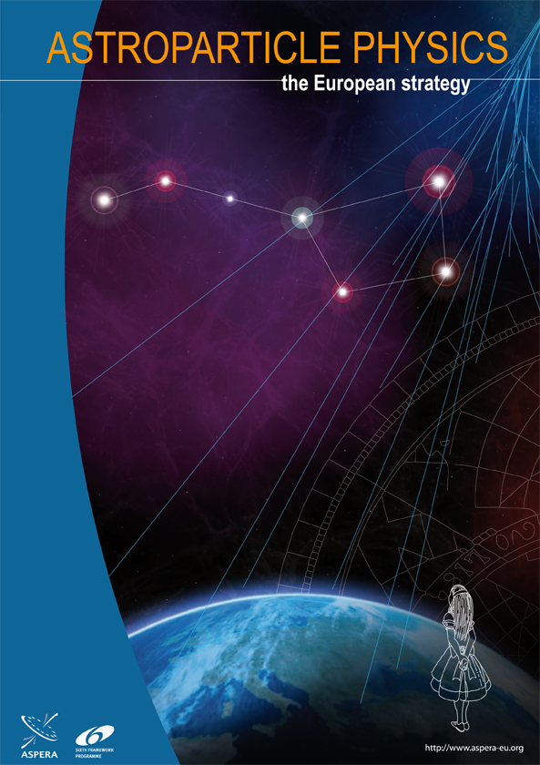
Astroparticle Physics
The Grand Picture
Christian Spiering, DESY
Buenos Aires, Nov.19, 2012

Slide 2
The Questions
of Astroparticle Physics

Slide 3
Cosmic Inventory Dark Matter (+Antimatter),
Dark Energy
Lifetime of protons GUTs & cosmology
Neutrinos as particles properties, role in cosmic evolution
Neutrinos as messengers Sun, Earth, Supernova explosions
Non-thermal Universe origin of cosmic rays,
cosmic landscape at high energies
Gravitational waves violent cosmic processes,
nature of gravity

Slide 4
Particle
Physics
Astro
Physics
Astroparticle
Physics
Cosmology

Slide 5
Dark Matter

Slide 6
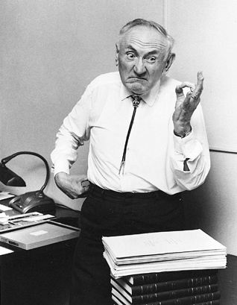
Fritz Zwicky
1933

Slide 7
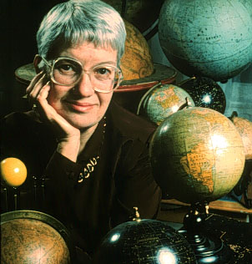
Vera Rubin
1970s

Slide 8
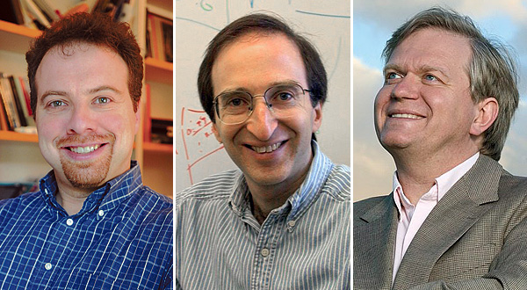
A. Riess, S. Perlmutter, B. Schmidt
1998

Slide 9
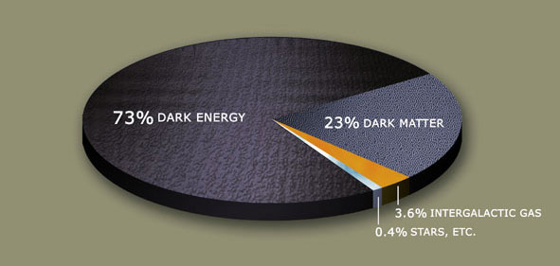

Slide 10
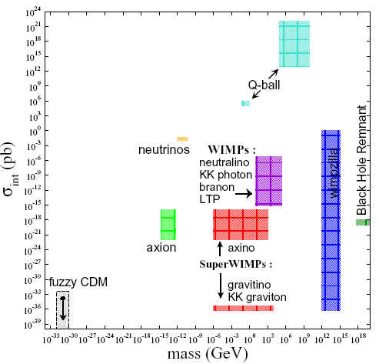

Slide 11
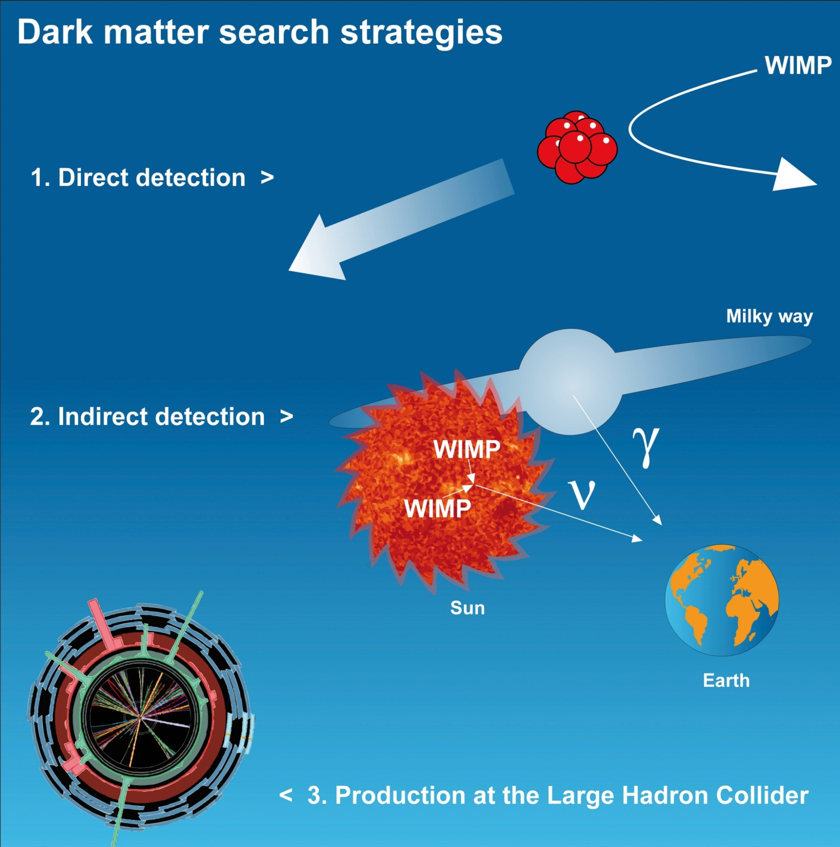
e⁺/p
ν IceCube, Antares,
Baikal , Super-K.
γ HESS/MAGIC/VERITAS
Agile, Fermi
e/p balloon exp.s
Pamela
Fermi, AMS

Slide 12
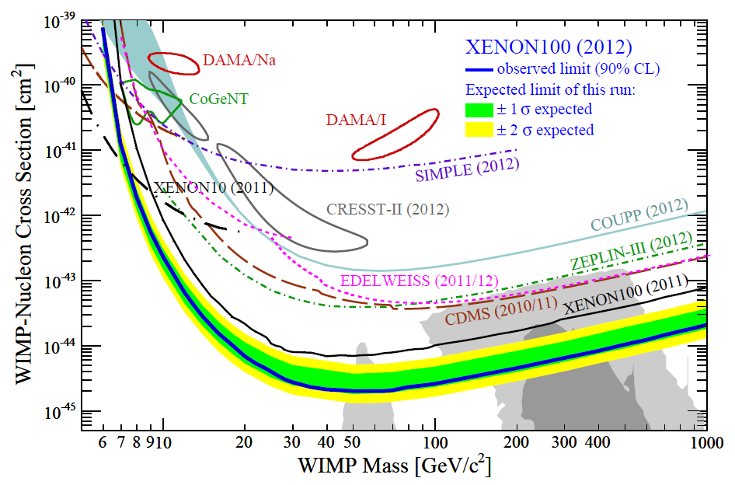
Snapshot Summer 2012

Slide 13
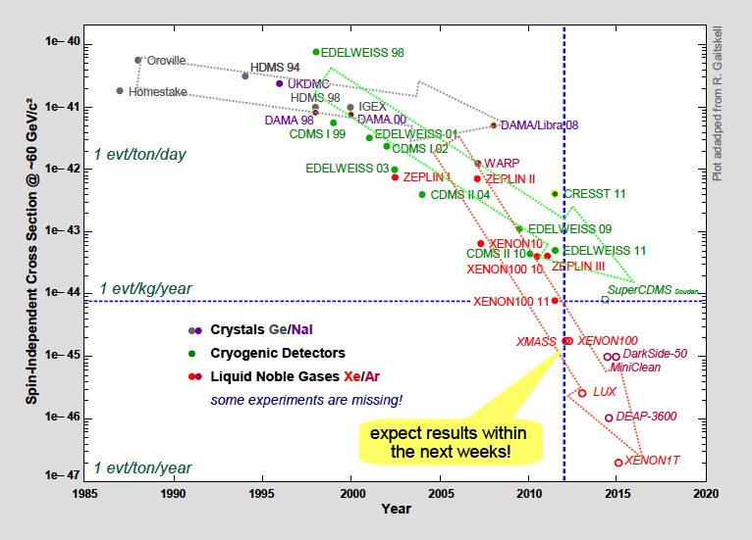
Perspectives 2017-20
Direct searches: factor of 100
Indirect searches: factor 10-30
LHC 7 → LHC 14: factor 300-1000
EURECA/SCDMS
EURECA/SCDMS

Slide 14
WIMP Dark Matter
  SUSY -WIMP DM hypothesis will be proven/disproven within the next 5-10 years.
  Stormy progress of LXe technology. XENON100 → XENON1T. XMASS. LUX.
  LAr technology: new interest using argon depleted in ³⁹Ar. Demonstration: Demonstration: DarkSide-50 (50 kt, LNGS).
  DARWIN (target mass of noble liquids up to 10-20 tons)
  Bolometric approach: EDELWEISS Ge), CRESST (CaWO₄ ). CDMS in US.
  EURECA & SCDMS (~1 ton sensitive mass)
  R&D on directional detection (confirmation of the galactic character of potential positive detection by high-density target detectors)
  DAMA/LIBRA: Need fully independent experiment of same/similar technology.

Slide 15
Neutrino Properties
m_{ν} → direct measurements
→ neutrinoless double beta decay, 0νββ
Majorana vs. Dirac
→ neutrinoless double beta decay
Mixing parameters
→ oscillation experiments

Slide 16
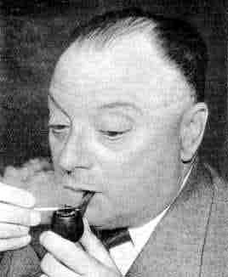
Wolfgang Pauli
1930

Slide 17
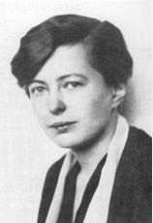
Maria Göppert-Mayer
1935

Slide 18
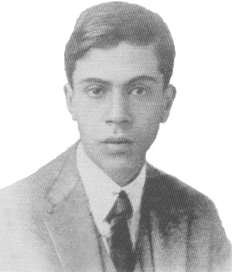
Ettore Majorana
1937

Slide 19
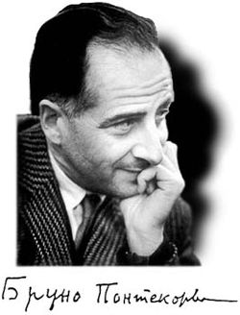
Bruno Pontecorvo
1957-67

Slide 20
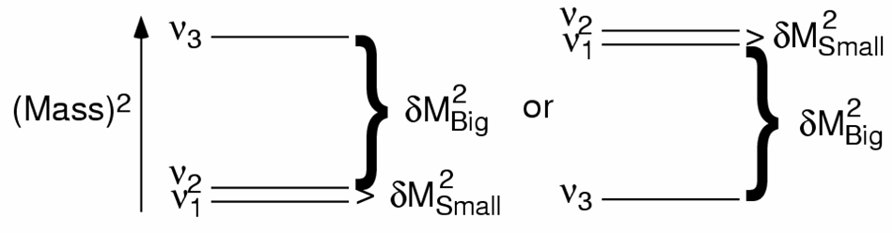
We do not yet know:
Absolute neutrino mass scale
Mass hierarchy
Nature: Dirac or Majorana
CP violating phase
Are there sterile neutrinos?
direct
inverted
ν ≠ ν
ν ≡ ν

Slide 21
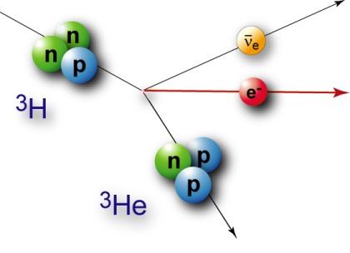
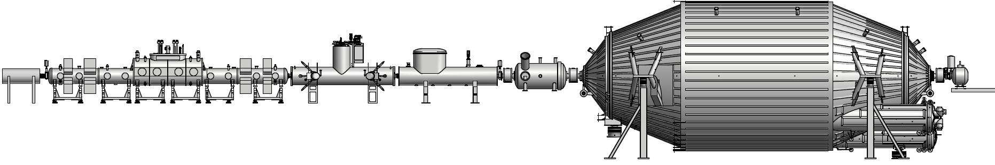
KATRIN
Karlsruhe Tritium Neutrino Experiment

Slide 22
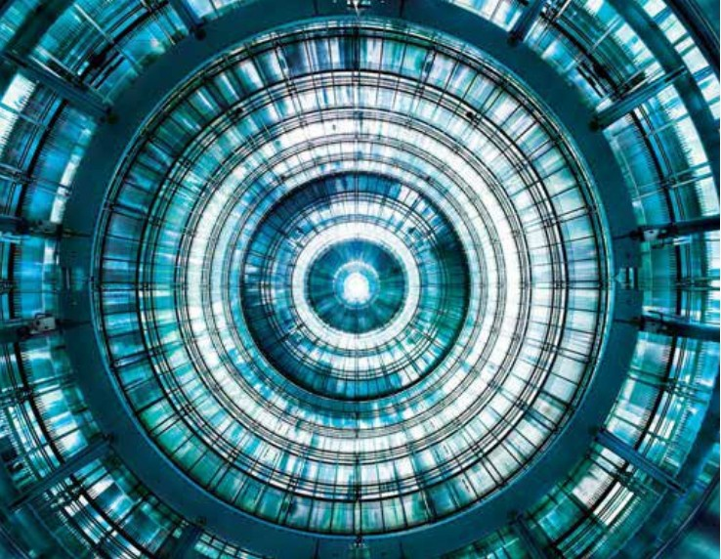
KATRIN main spectrometer electrode system installed

Slide 23
0νββ
Neutrinoless Double Beta Decay
e⁻
e⁻
n
~m_{ν}²
n
ν
ν
p
p

Slide 24
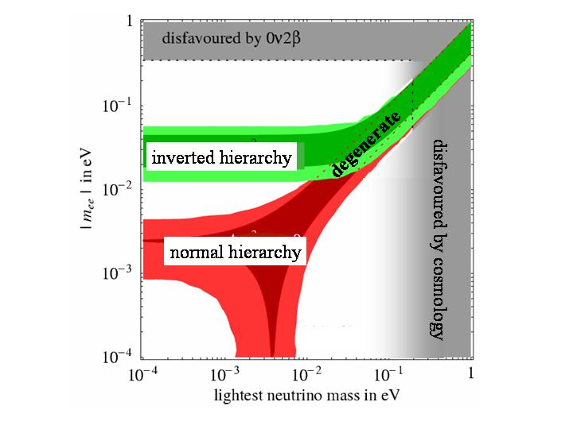
0νββ
KKGH claim
GERDA, EXO200, SNO+
CUORE, SuperNEMO
Ton-scale

Slide 25
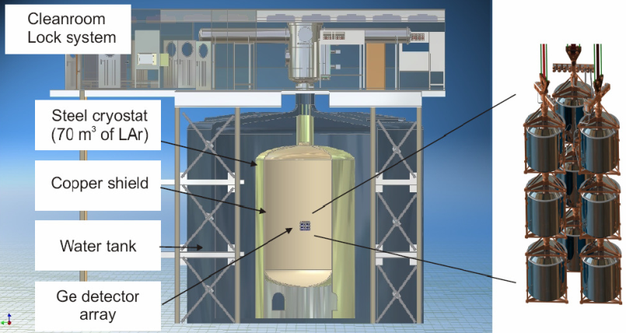
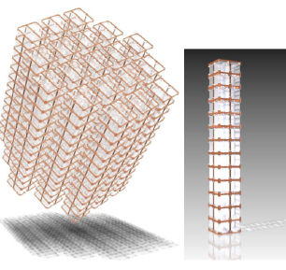
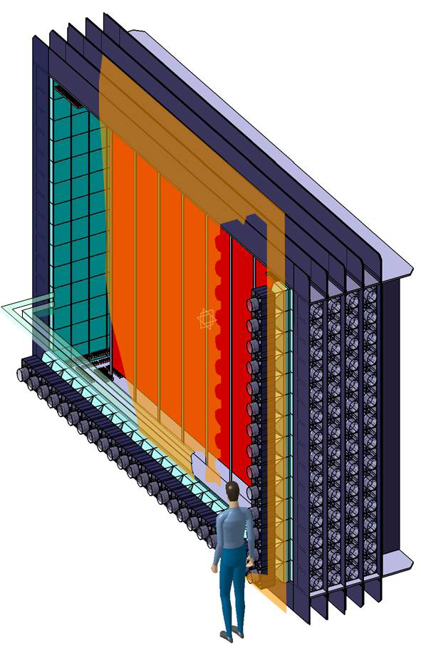
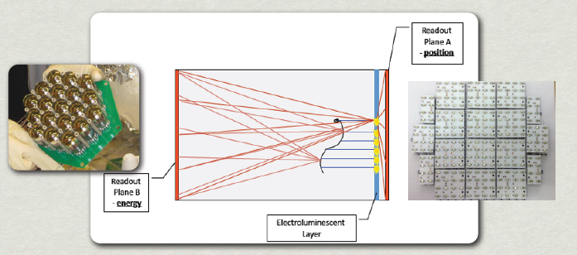
0νββ in Europe
GERDA
CUORE
Super-NEMO
NEXT
plus EXO-200, SNO+, COBRA, LUCIFER

Slide 26
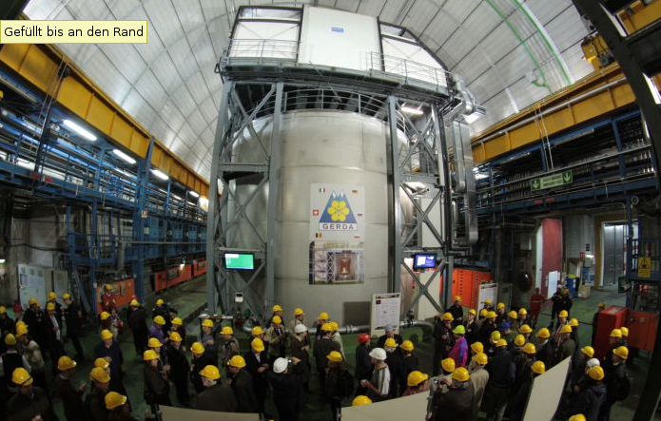
GERDA – phase 1
GERDA Phase 2: 70 – 130 meV
GERDA Phase 3 (together with Majorana): 20- 40 meV
GERDA Inauguration Nov 2010
Now data taking. Unblinding spring 2013

Slide 27
Summary 0νββ decay
Phased experimental approach towards ton-scale masses with a sensitivity exploring fully the mass range predicted by oscillation experiments for the Inverted Hierarchy.
R&D on new techniques for isotope separation.
High cost of ton-scale → realisation within worldwide collaborations as e.g. pursued by GERDA and MAJORANA.

Slide 28
The
High-Energy
Universe

Slide 29
Charged
Cosmic
Rays
Gamma
Rays
Sources of
Cosmic Rays
Neutrinos

Slide 30
Charged
Cosmic
Rays
Sources of
Cosmic Rays

Slide 31
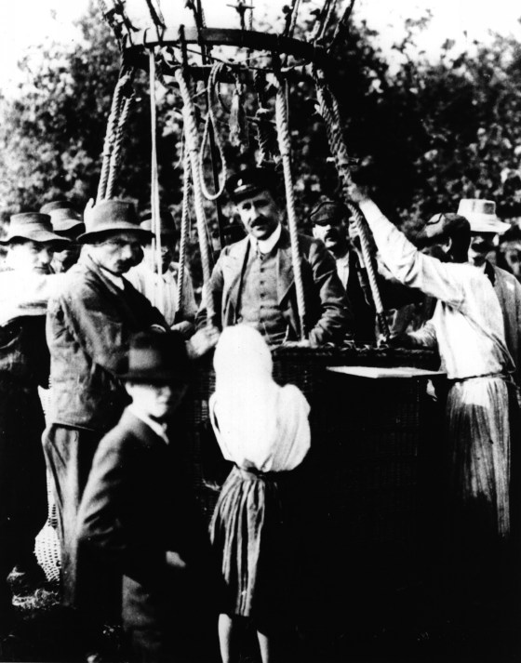
Viktor Hess
1912

Slide 32
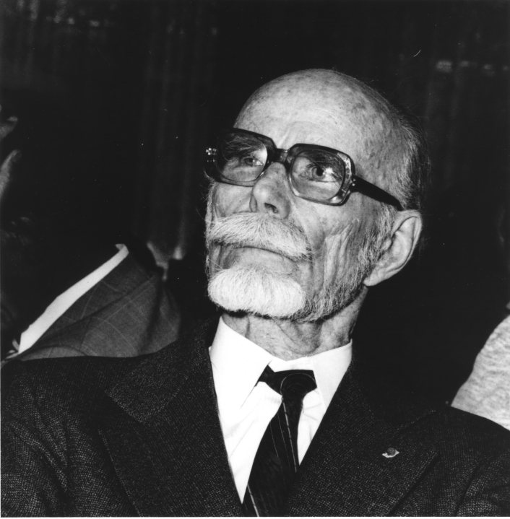
Pierre Auger
1939

Slide 33
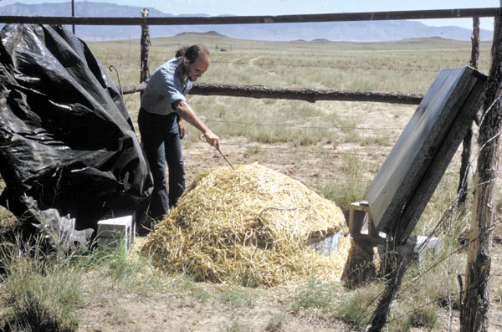
John Linsley
1961

Slide 34
The Pierre Auger Observatory

Slide 35
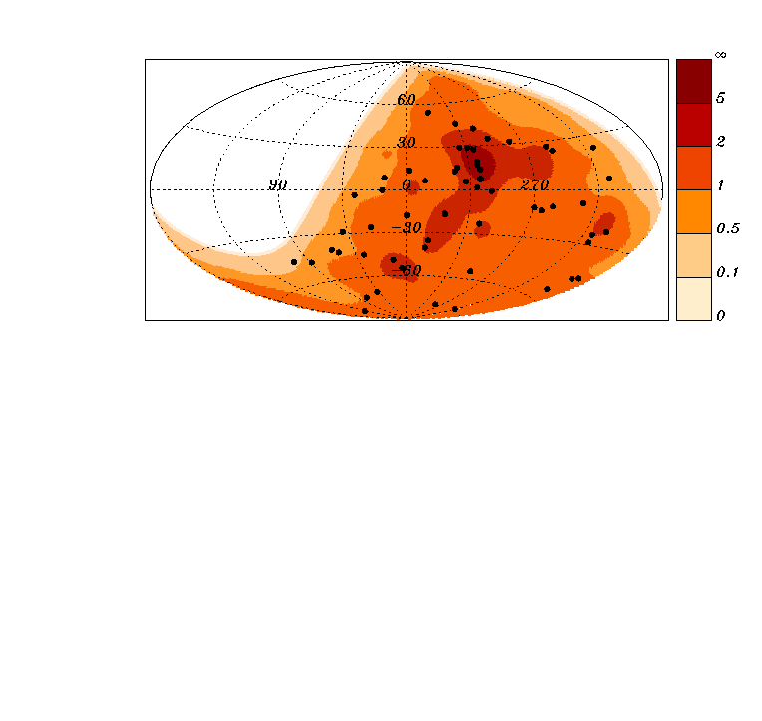

Slide 36
Cosmic Rays and LHC

Slide 37
Perspective for cosmic rays at highest Energies
Exposure
(km² sr year)
10⁷
Auger Upgrades
Lower threshold
Muon counters
Radio detection
JEM-EUSO
(space)
30,000 km²
10⁶
10⁵
Auger-South
10⁴
HiRes
AGASa
Fly‘s eye
Telescope Array
10³
10²
1985 1990 1995 2000 2005 2010 2015 2020 2025 2030
year

Slide 38
Gamma
Rays
Sources of
Cosmic Rays

Slide 39
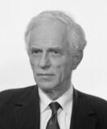
Alexander Chudakov
1965

Slide 40
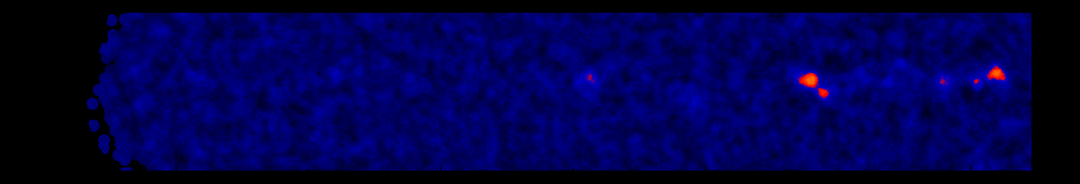
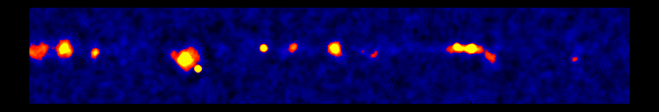
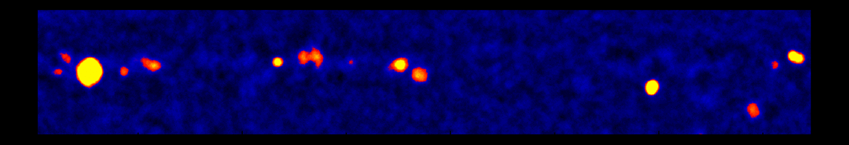
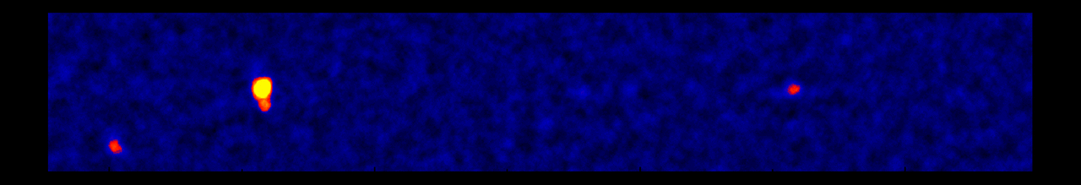
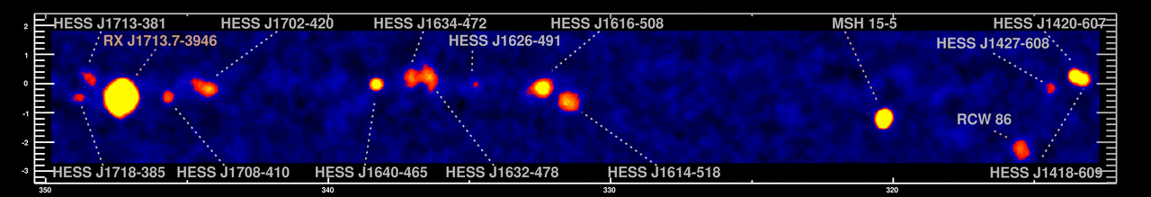
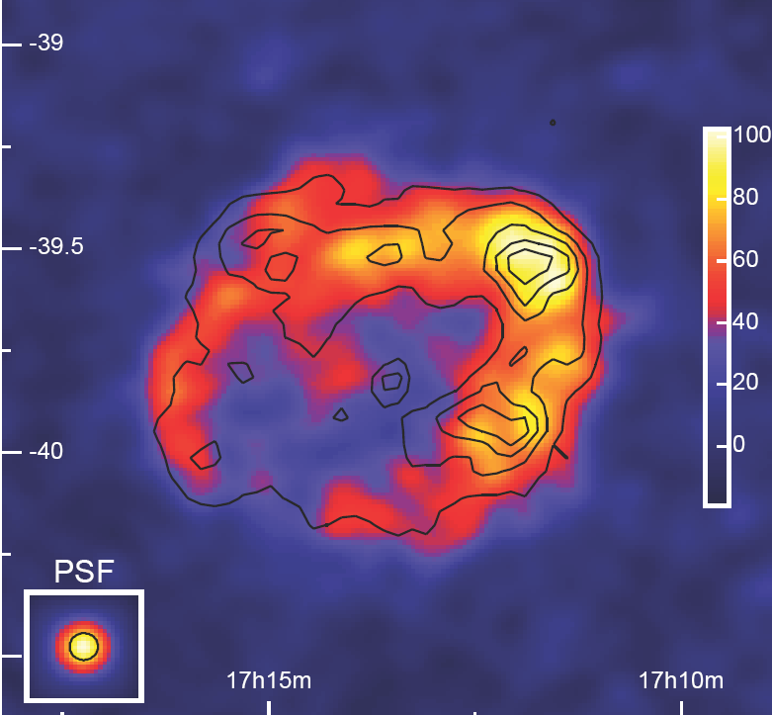
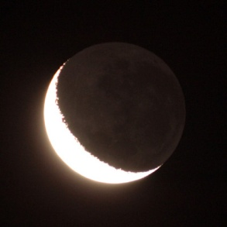
The Sky at TeV-Energies
H.E.S.S.-Scan of the galactic plane
0.5°
RX J1713.7-3946
1989: 1 Source
1996: 3 Sources
2005: 80 Sources
2012: 150 Sources
Moon

Slide 41
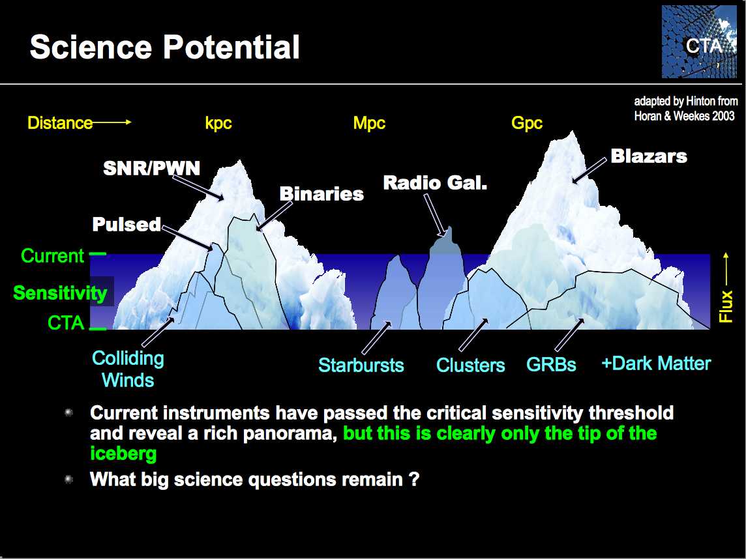

Slide 42
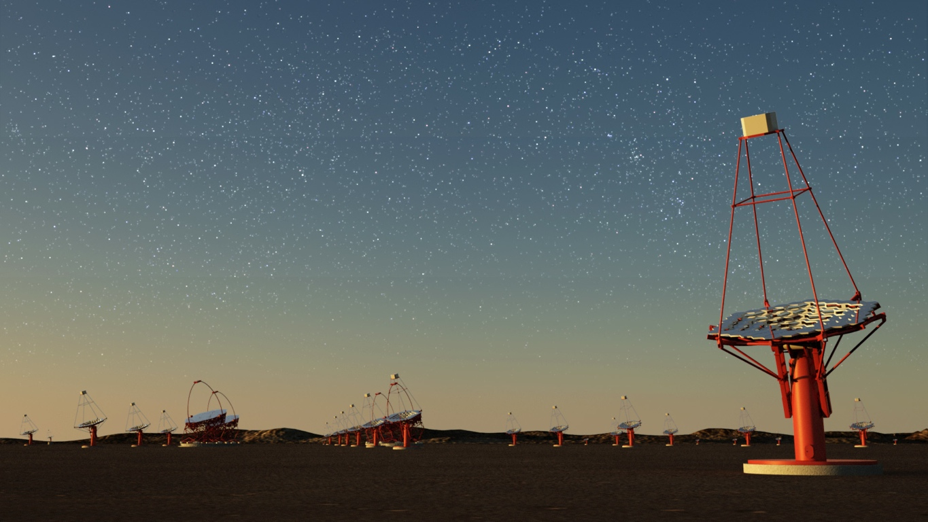


Slide 43
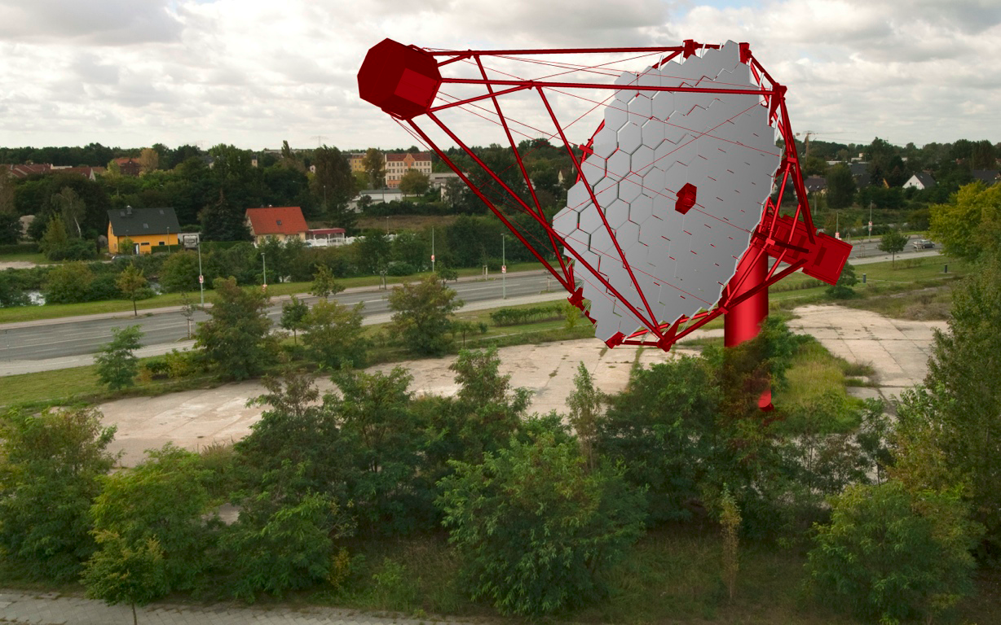
Prototyp of Mid-Size Telescope CTA, Berlin (photoshop version)

Slide 44
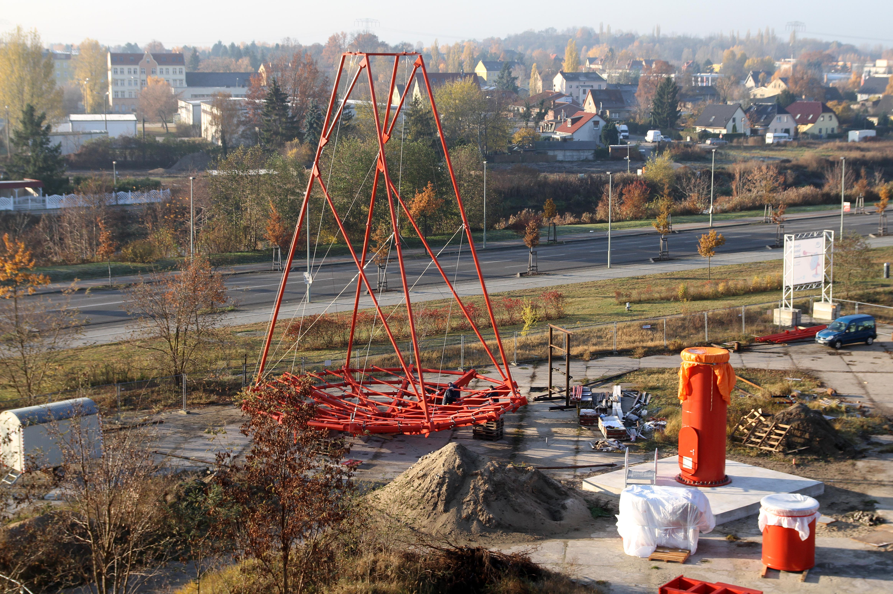

Slide 45
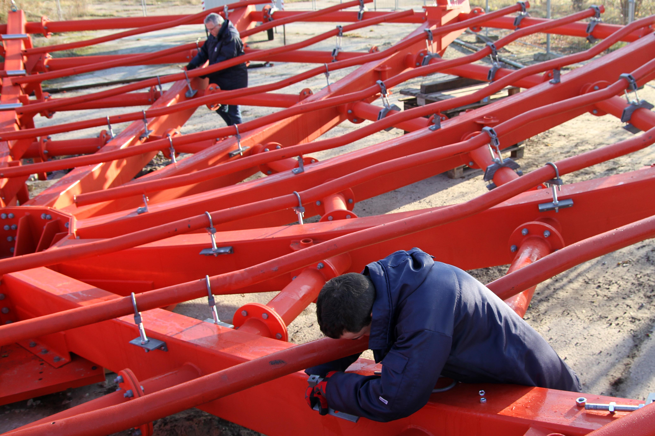

Slide 46
Plus:
MACE (India)
HAWC (Mexico)
HiSCORE (Siberia)
LHAASO (Tibet)
Fermi (space, USA-led)
GAMMA-400 (space, Russia-led)

Slide 47
Sources of
Cosmic Rays
Neutrinos

Slide 48
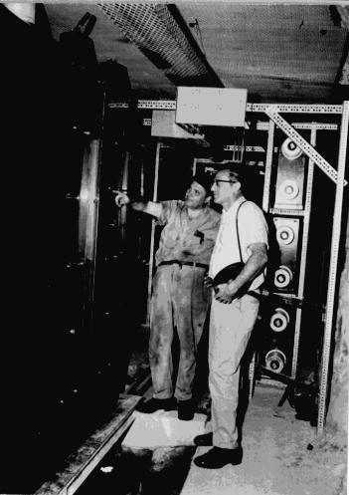
Fred Reines
1965

Slide 49
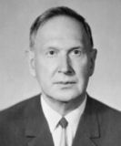
Moisej Markov
1960

Slide 50
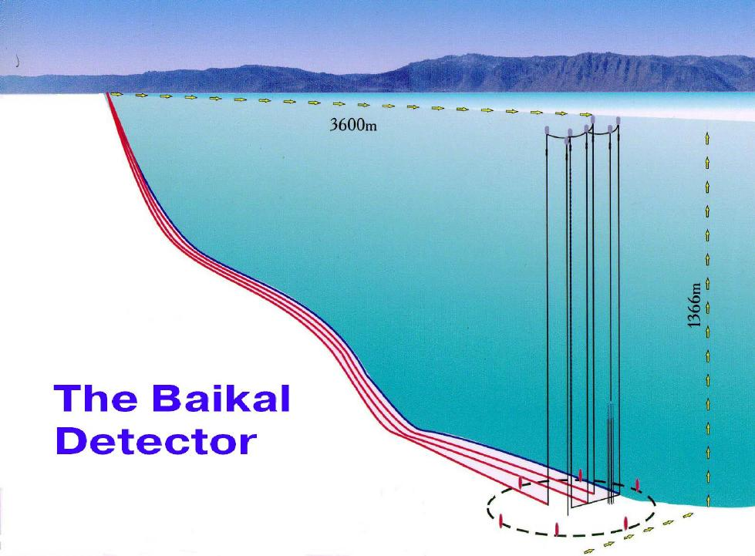
The Baikal Neutrino Telescope
- start of the project 1981, DESY 1988-2008
3600 m
1366 m
4-string stage (1996)

Slide 51
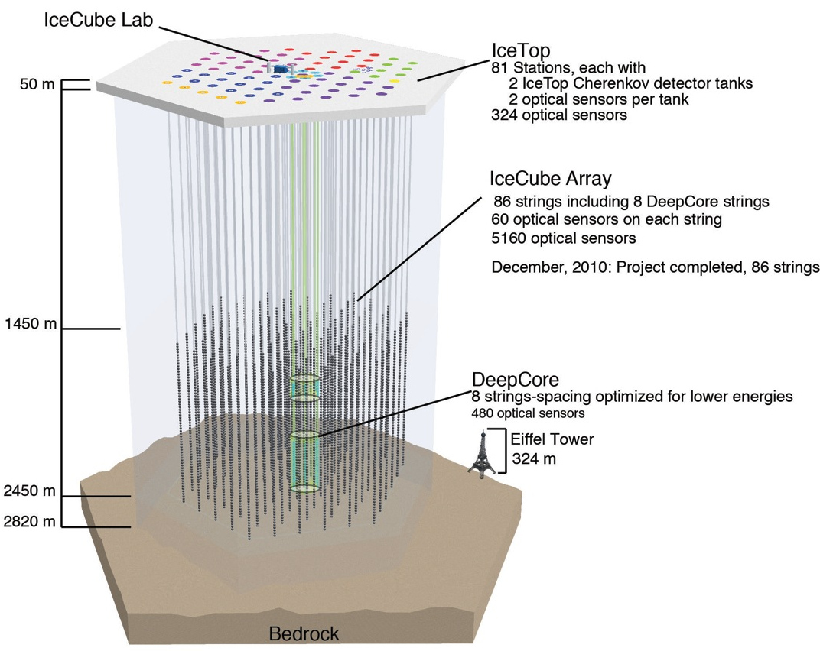

Slide 52
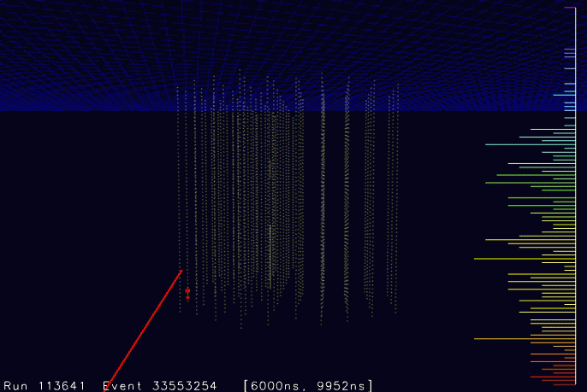

Slide 53
Last 12 years: a factor of 1000 !
Amanda
2000
Antares 800 days
IceCube 40+59+79
IceCube
2012

Slide 54

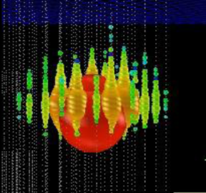
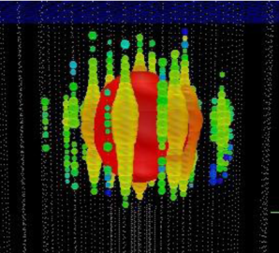
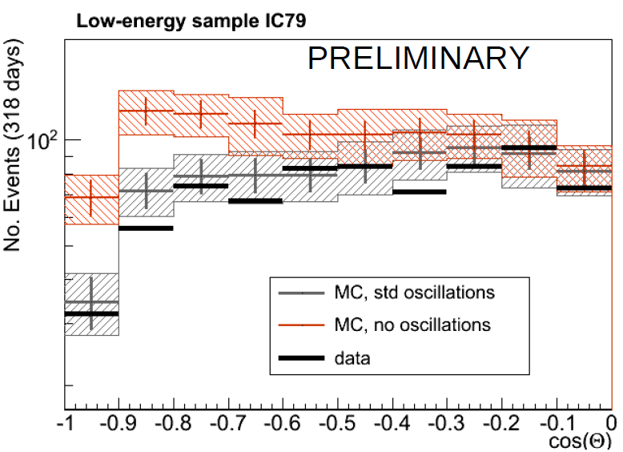
Ernie Bert
~1.1 PeV ~ 1.3 PeV
excess at high energies ?
neutrino oscillations in DeepCore
→ PINGU (mass hierarchy)?

Slide 55
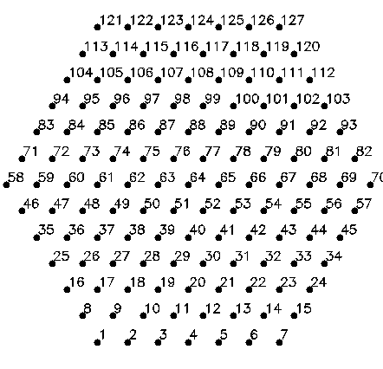
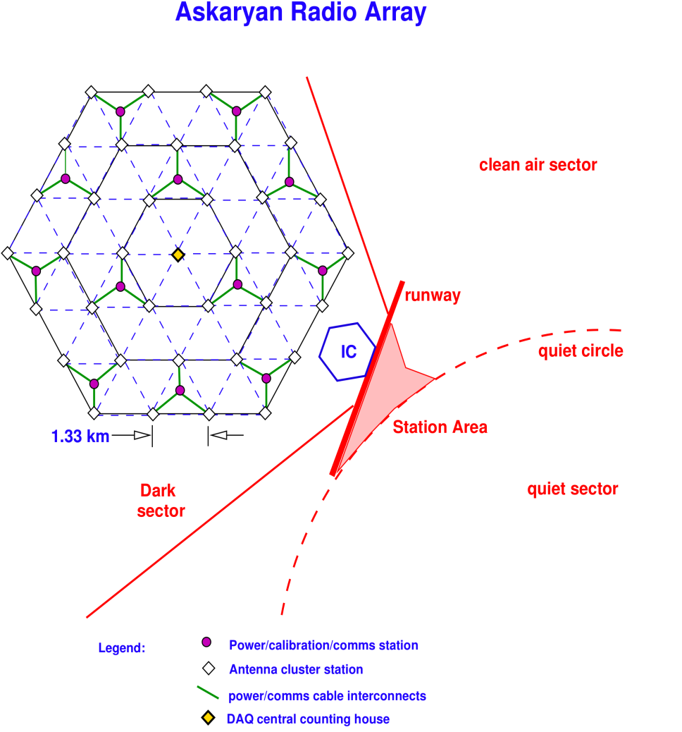

H.E. Neutrino Telescopes: The Future
KM3NeT,
Mediterranean Sea,
2 x 3 km³,
sensitive above 1 TeV
GVD, Lake Baikal, 0.5 km³,
sensitive above 3 TeV
ARA, South Pole
radio array, 160 km³,
sensitive
above 100 PeV
IceCube

Slide 56




Options for IceCube Extensions
IceCube
DeepCore
Height 300 m
DeepCore
DeepCore + PINGU
9.3 GeV event
12,6 km³
Threshold for muons ~ 50 TeV,
gain eff. area for muons ~ factor 4,
gain for cascades ~ factor 10

Slide 57
Detectors for
low-energy neutrinos
and proton decay
- SAGE, BNT (Baksan)
- LVD, Borexino (Italy)
- Super-K, KamLAND (Japan)
- soon: SNO+ (Canada)

Slide 58

Hans Bethe
1939

Slide 59

John Bahcall
1960s

Slide 60

Raymond Davis
~1970

Slide 61

Masatoshi Koshiba
1987

Slide 62



Andrei Sacharow Howard Georgi Sheldon Glashow
1965 1974

Slide 63


Borexino
solar ν: ⁷Be, pep geoneutrinos

Slide 64
Science on the Megaton scale
Proton decay: improve sensitivity by > factor 10 and test a new class of Supersymmetry models
Galactic Supernova: 10⁴- 10⁵ events Incredibly detailed information on the early SN phase
Diffuse flux from past SN: probe cosmological star formation rate
Solar neutrinos: details of the Standard Solar Model determined with percent accuracy. CNO cycle. Time variations.
Atmospheric neutrinos: high statistics would improve knowledge neutrino mixing and provide information on the neutrino mass hierarchy
Geo-neutrinos: improve understanding of the Earth interior
Indirect WIMP search
Neutrinos from accelerators: neutrino properties !

Slide 65
Projects on the Megaton scale
Europe: Laguna-LBNO
Japan: Hyper-K
USA: LBNE

Slide 66

LAGUNA
MEMPHYS
600 kton water
LENA
50 kt scintillator
50 m
GLACIER
100 kton liquid argon

Slide 67
Science on the Megaton scale
Proton decay: improve sensitivity by > factor 10 and test a new class of Supersymmetry models
Galactic Supernova: 10⁴- 10⁵ events Incredibly detailed information on the early SN phase
Diffuse flux from past SN: probe cosmological star formation rate LSc
Solar neutrinos: details of the Standard Solar Model determined with percent accuracy. Time variations. CNO cycle LSc
Atmospheric neutrinos: high statistics would improve knowledge neutrino mixing and provide unique information on the neutrino mass hierarchy
Geo-neutrinos: improve understanding of the Earth interior LSc
Indirect WIMP search
Neutrinos from accelerators: neutrino properties ! LAr, H₂0

Slide 68
Summary on large underground detectors
Exciting symbiosis of
  tackling fundamental questions of particle physics,
  accessing new cosmic landscapes,
  high-precision measurement of known cosmic phenomena.
Common program on
  accelerator based neutrino physics
  astroparticle physics
  will have more impact than the sum of its parts.
Impact of PINGU?
Needs coherent international strategy

Slide 69
Gravitational
Waves

Slide 70

Albert Einstein
1918

Slide 71

Joseph Weber
1958

Slide 72



Merging Neutron Stars

Slide 73

GEO-600
Hannover/Germany

Slide 74










The current GW Network
GEO, Hannover, 600 m
LIGO Hanford, 4 km: 2 ITF on the same site!
INDIGO
TAMA, Tokyo, 300 m
(LCGT 3km
being started)
Virgo, Cascina, 3 km
LIGO Livingston, 4 km
Notes:
The first generation of GW detectors forms a world wide network that jointly takes data and analyzes them in a common effort.
Three detectors in the US: Washington 4km & 2km
Louisiana 4km. Negotiations to move one of the Washington ones to India. Decision next summer
three kilometer long one in Italy: Virgo
German British GEO600 Germany.
LCGT a 3km cryogenic interferometer is being constructed in Japan in the Kamioka mine.

Slide 75
Gravitational Waves
A few to several tens of sources per year
Adv Virgo/ Adv LIGO
Virgo/LIGO

Slide 76

1000 to 100 000 sources per year

Slide 77

L I S A

Slide 78
The Grand Picture
Conclusions

Slide 79
Rapidly growing, dynamical field
Break-throughs:
  neutrinos from Sun and Supernova
  neutrino oscillations
  gamma-ray astronomy
Many fields approaching sensitivity with high discovery potential for fundamental questions:
  gravitational waves
  dark matter
  neutrino mass & double beta decay
Tantalizing hints:
  UHE cosmic rays
  high energy neutrinos
  sterile neutrinos ???

Slide 80

We‘ve got a lot
of work to do !

Slide 81
The best is yet
to come !

