Slide 1
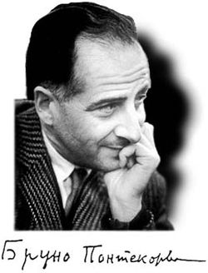


High-Energy Neutrino Astrophysics
A first glimpse to the promised land?
Session of the R.A.S. dedicated to Bruno Pontecorvo Dubna, September 2, 2013
Christian Spiering

Slide 2
Marching since fourty years ...
1973, International Cosmic Ray Conference (ICRC)
F. Reines, J. Learned, H. Davis, P. Kotzer, M. Shapiro (all USA), G. Zatsepin (USSR) and S. Miyake (Japan) discuss a deep-water detector to clarify puzzles in muon depth-intensity curves.
1978: DUMAND
First design of a cubic kilometer detector close to Hawaii

Slide 3
... but even that was not the beginning
1960
K. Greisen F. Reines M. Markov
(with I. Zheleznykh)
… discuss ways to detect cosmic high-energy neutrinos deep underground or underwater.

Slide 4
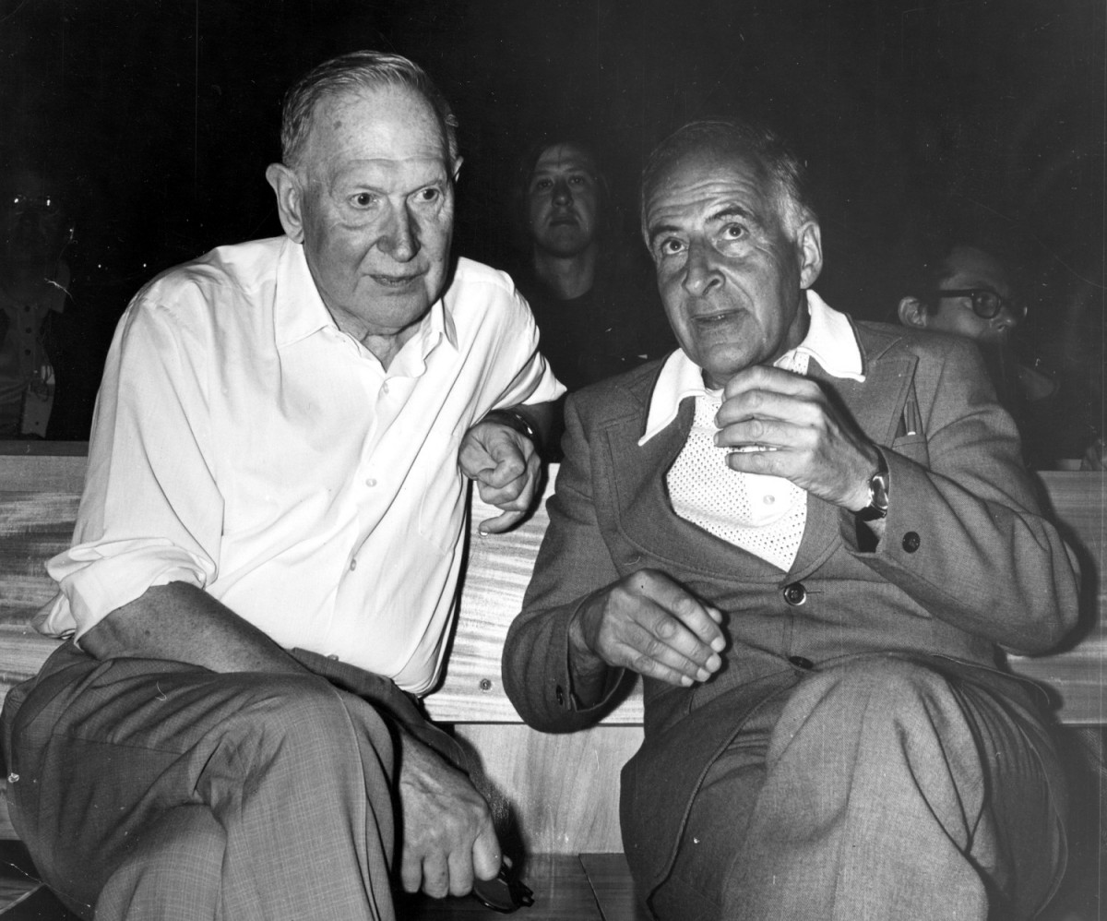
Moisej Markov
Bruno Pontecorvo
M.Markov,1960:
„We propose to install detectors deep in a lake or in the sea and
to determine the direction of charged particles with the help
of Cherenkov radiation“ Proc. 1960 ICHEP, Rochester, p. 578.

Slide 5
Physics Goals

Slide 6
Physics with neutrino telescopes
Search for the sources of high-energy cosmic rays
Dark Matter and Exotic Physics
  WIMPs
  Magnetic Monopoles and other superheavies
  Violation of Lorentz invariance
Neutrino and Particle Physics
  Neutrino oscillations (incl. mass hierachy)
  Charm physics
  Cross sections at highest energies
Supernova Collapse Physics
  MeV neutrinos in bursts → early SN phase, neutrino hierarchy, ...
Cosmic Ray Physics
  Spectrum, composition and anisotropies

Slide 7
Physics with neutrino telescopes
Search for the sources of high-energy cosmic rays
Dark Matter and Exotic Physics
  WIMPs
  Magnetic Monopoles and other superheavies
  Violation of Lorentz invariance
Neutrino and Particle Physics
  Neutrino oscillations (incl. mass hierachy)
  Charm physics
  Cross sections at highest energies
Supernova Collapse Physics
  MeV neutrinos in bursts → early SN phase, neutrino hierarchy, ...
Cosmic Ray Physics
  Spectrum, composition and anisotropies

Slide 8
p + target → π + …..
→ μ + ν_{μ}
p
π
μ
ν_{μ}
target
μ-absorber
π-decay:
π → μ ν_{μ}
accelerator
neutrino-beam

Slide 9
p + target → π + …..
→ μ + ν_{μ}
ν_{e} : ν_{μ} : ν_{τ} = 1 : 2 : 0
at source
oscillations
at Earth:
ν_{e} : ν_{μ} : ν_{τ} = 1 : 1 : 1 !

Slide 10
Detection principle

Slide 11
Signal and Background

Slide 12
Detection Modes
Muon track from CC muon neutrino interactions
  Angular resolution < 1°
  dE/dx resolution factor 2-3
Cascade from CC electron/tau and NC all flavor interactions
  Angular resolution 10° at 100 TeV
  Energy resolution ~ 15%

Slide 13
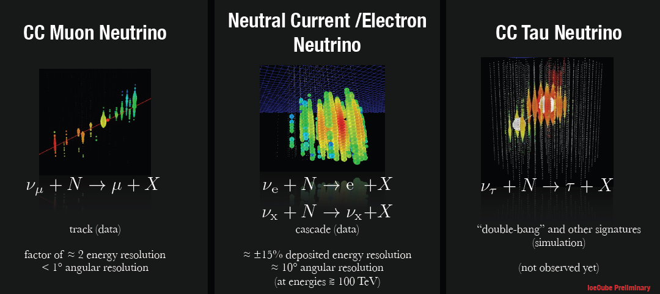
Detection Modes
Muon track from CC muon neutrino interactions
  Angular resolution < 1°
  dE/dx resolution factor 2-3
Cascade from CC electron and NC all flavor interactions
  Angular resolution 10° at 100 TeV
  Energy resolution ~ 15%

Slide 14
Present Devices

Slide 15

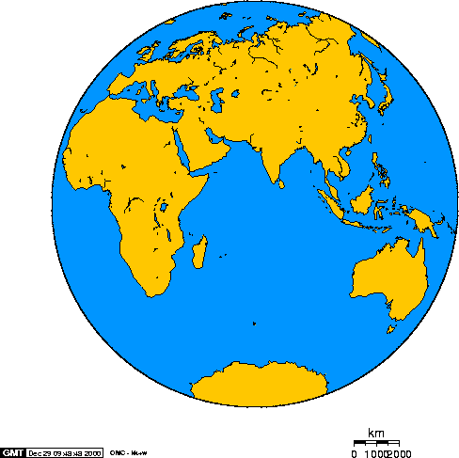
Baikal – Antares - IceCube
Baikal
Antares
AMANDA
IceCube

Slide 16
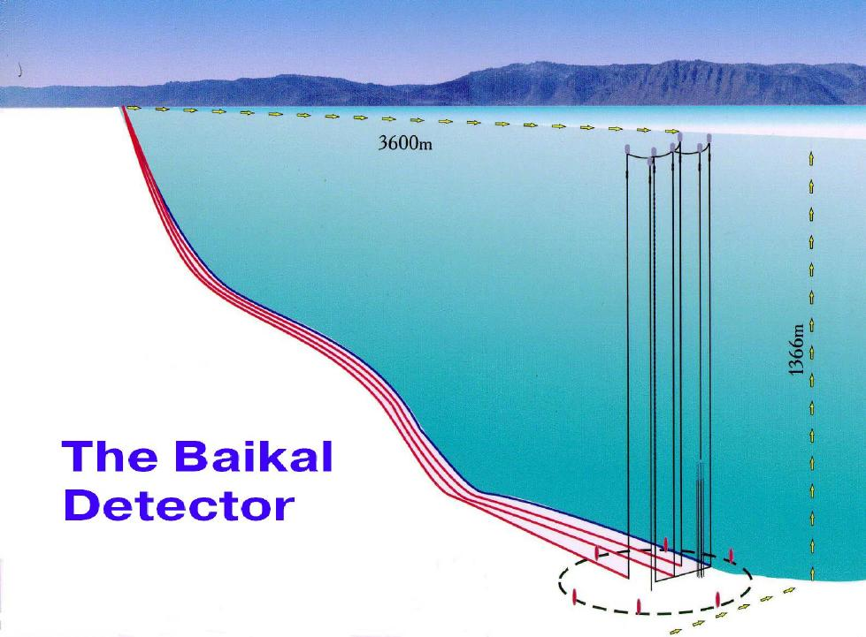
3600 m
Lake Baikal
1366 m
NT200

Slide 17
NT200+
3600 m
NT200
1366 m

Slide 18
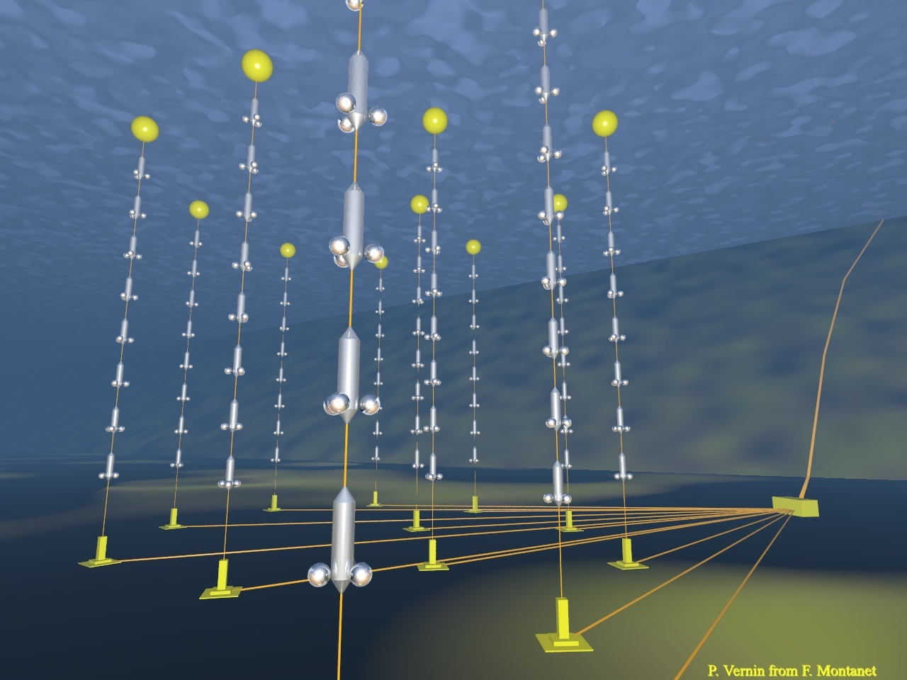
ANTARES
2500m
885 PMTs
12 strings
Operating in final
configuration
since 2008
450 m
70 m

Slide 19
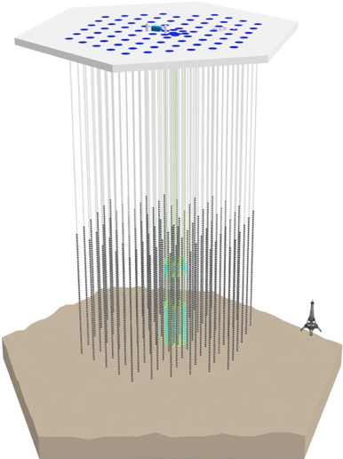
IceCube Neutrino Observatory
IceTop air shower detector
81 pairs of water Cherenkov tanks
IceCube
86 strings including 8 Deep Core strings
60 PMT per string
DeepCore
8 closely spaced strings
1450m
~220 ν/day
Threshold
- IceCube ~ 100 GeV
- DeepCore ~10 GeV
2450m
2820m

Slide 20
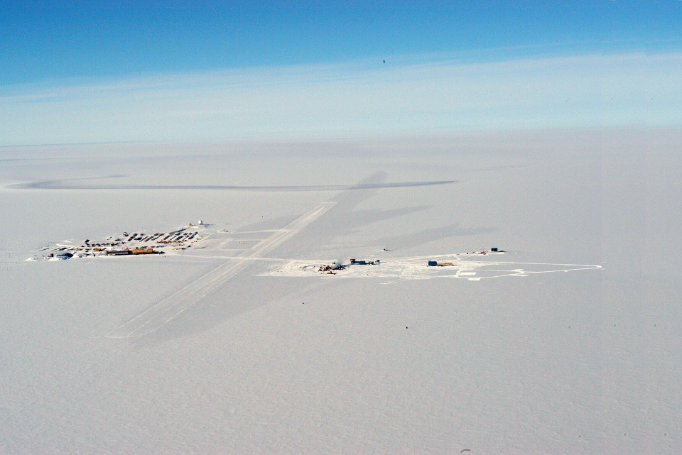
The Amundsen-Scott Station
South Pole Station Building Astronomy Sector
IceCube
AMANDA
skiway

Slide 21
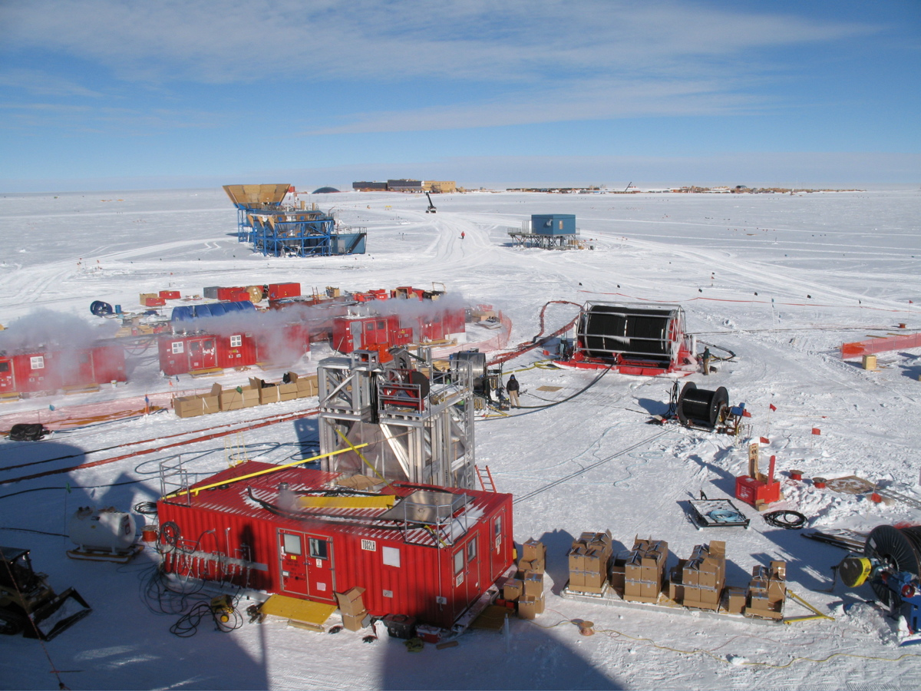
Drill Camp
- 5 MW Power
- 16 m³ Cerosin
per hole

Slide 22
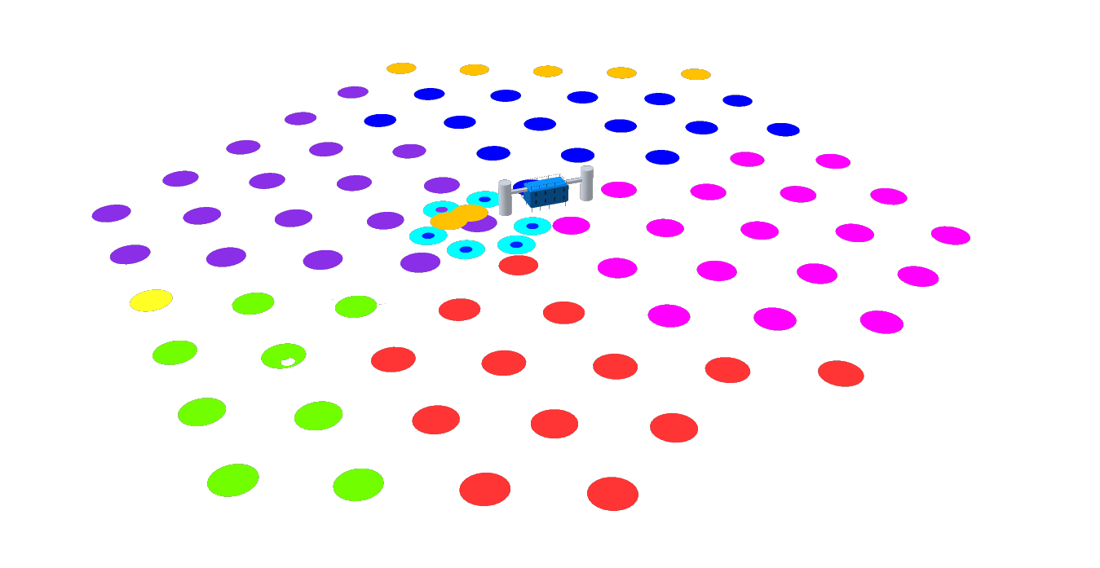
Completed December 18, 2010
IC-86
10-11 Season
IC-79
09-10 Season
IC-59
08-09 Season
IC-40
07-08 Season
IC-1
04-05 Season
IC-9
05-06 Season
IC-22
06-07 Season

Slide 23
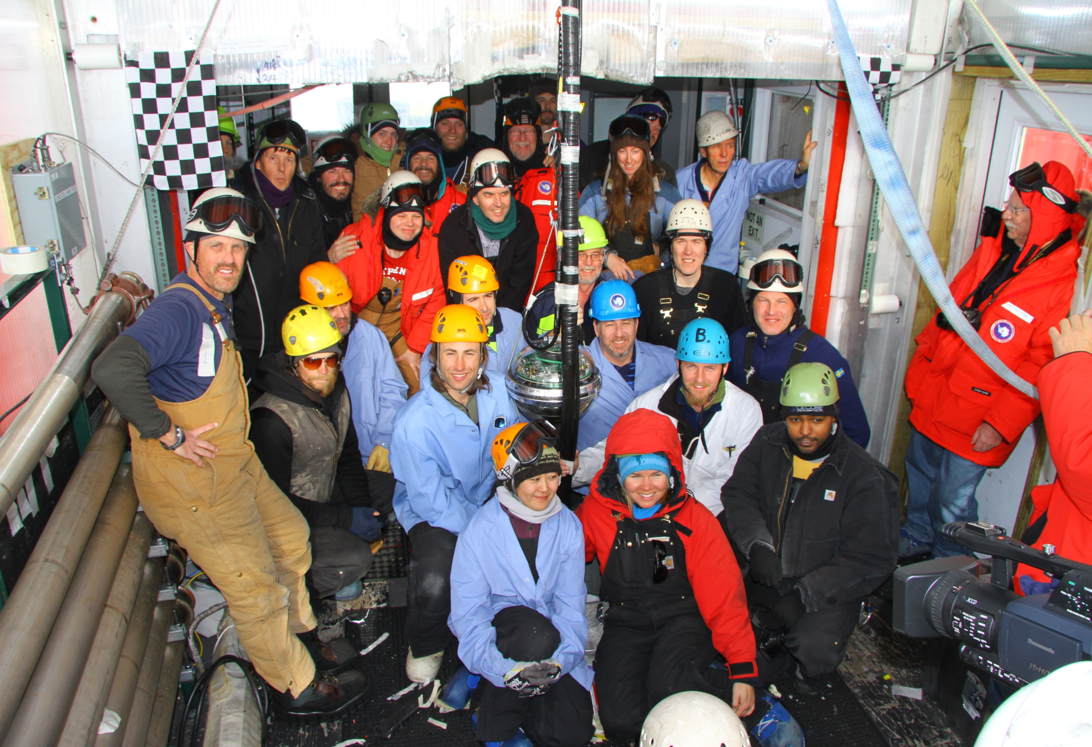
Besseres Bild
The last string

Slide 24
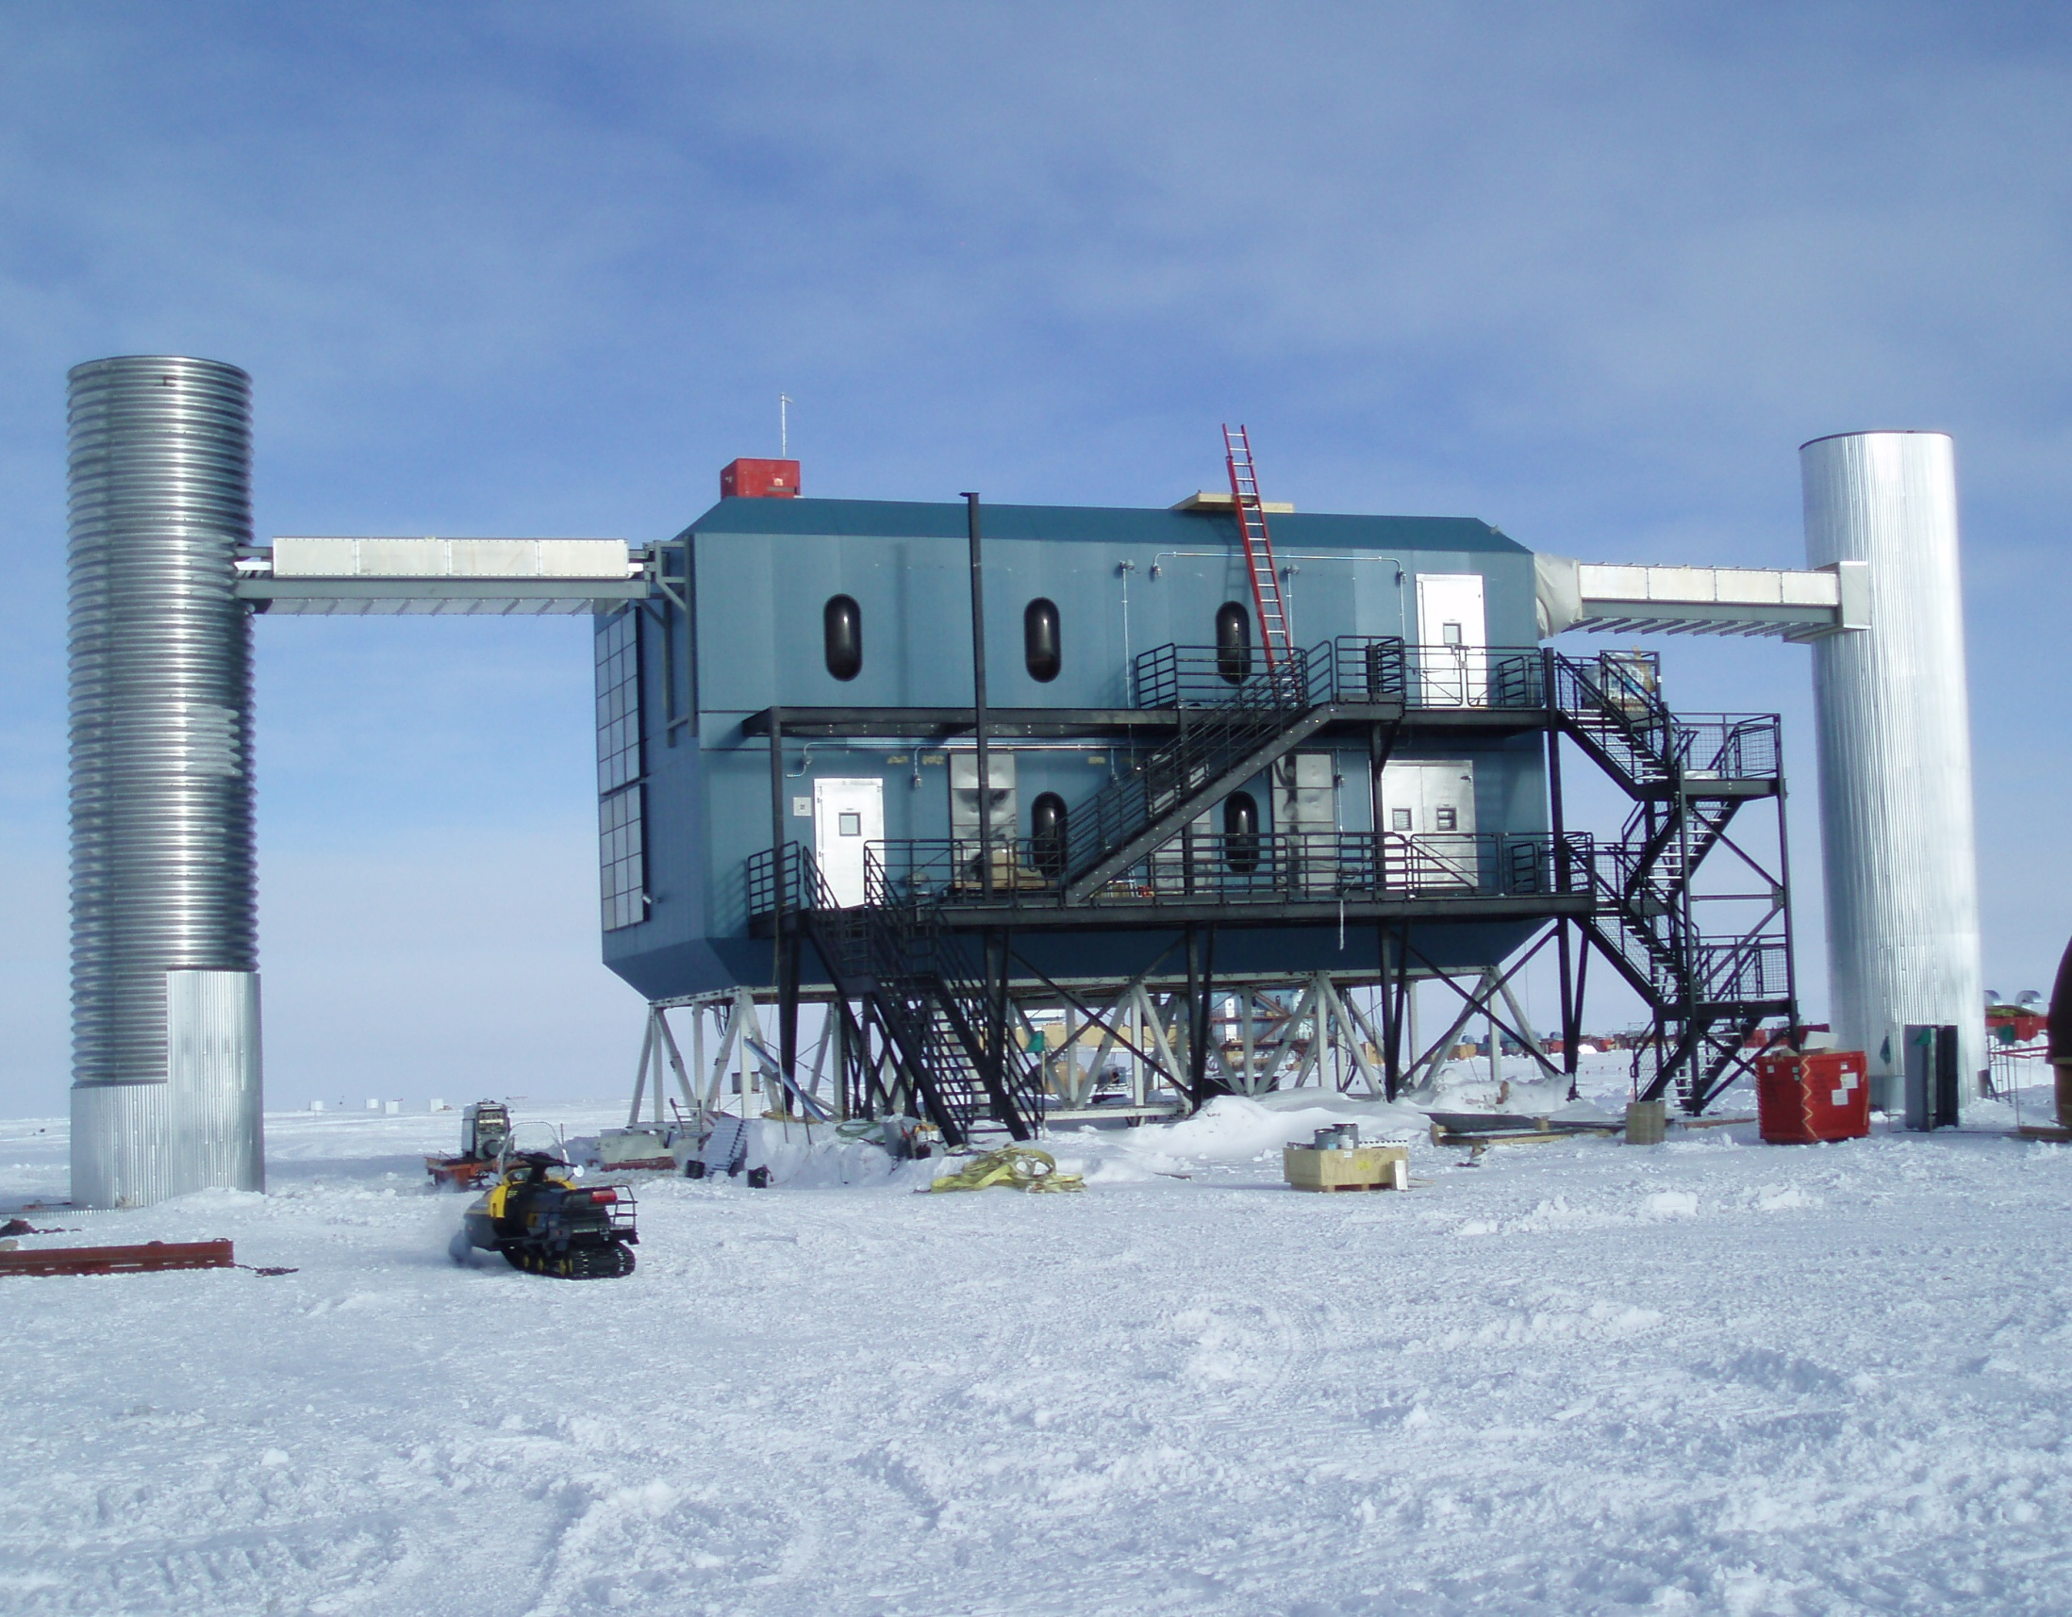
IceCube Laboratory and Data Center

Slide 25
Study of atmospheric neutrinos
Baikal 1996
4-string stage (1996)

Slide 26
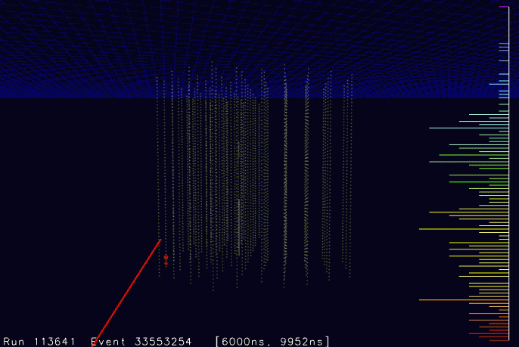
NT-96

Slide 27
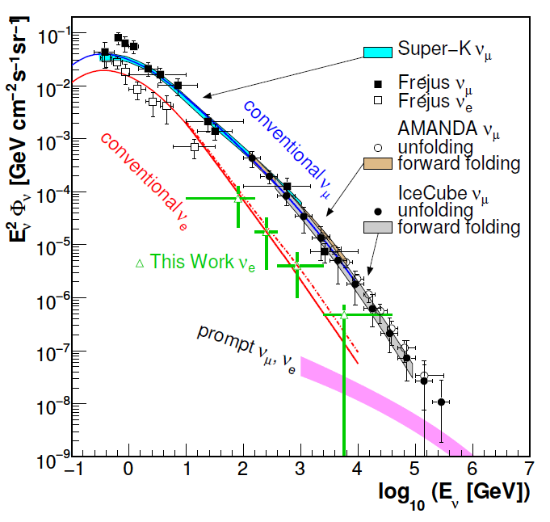
Atmospheric neutrinos in IceCube
proton
c,(b)
prompt
e,μ
νe,μ
π
μ
νμ
e
νμ
νe
conventional

Slide 28
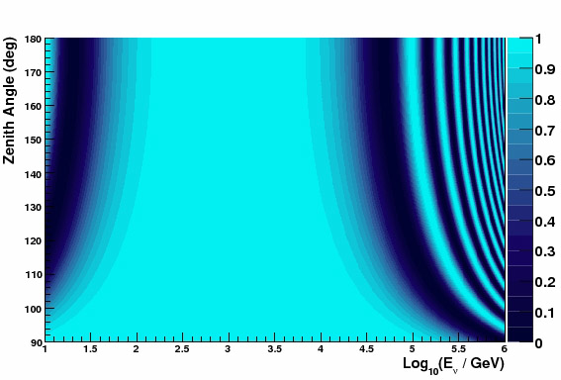
Oscillations of atmospheric neutrinos
Muon neutrino survival probability
Vertically upward
cosmic
ray
ANTARES/DeepCore
ν
Earth
L
θ
Horizontal

Slide 29
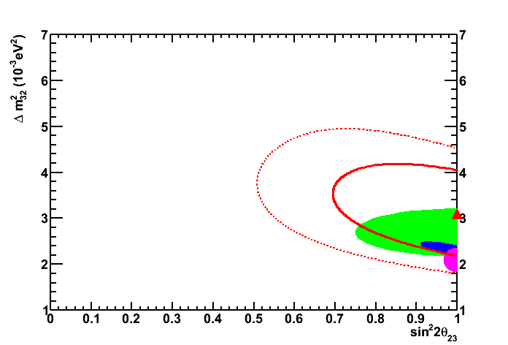
Oscillations of atmospheric neutrinos
Muon neutrino survival probability
Vertically upward
ANTARES
PL B714 (2012)
cosmic
ray
ANTARES/DeepCore
2σ
ν
Earth
1σ
ANTARES
K2K
MINOS
SuperK
L
θ
Horizontal

Slide 30
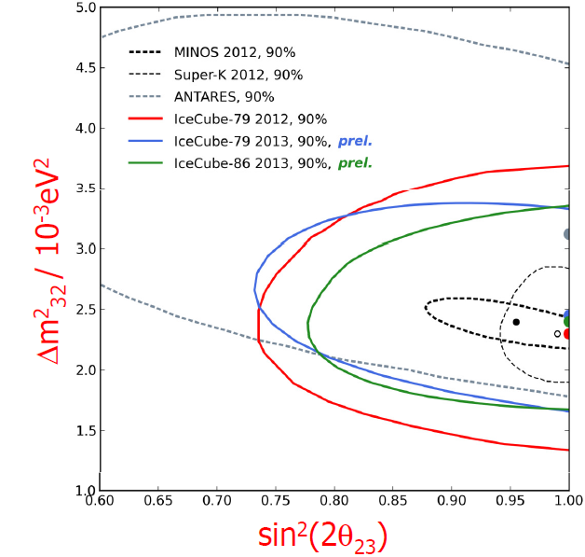
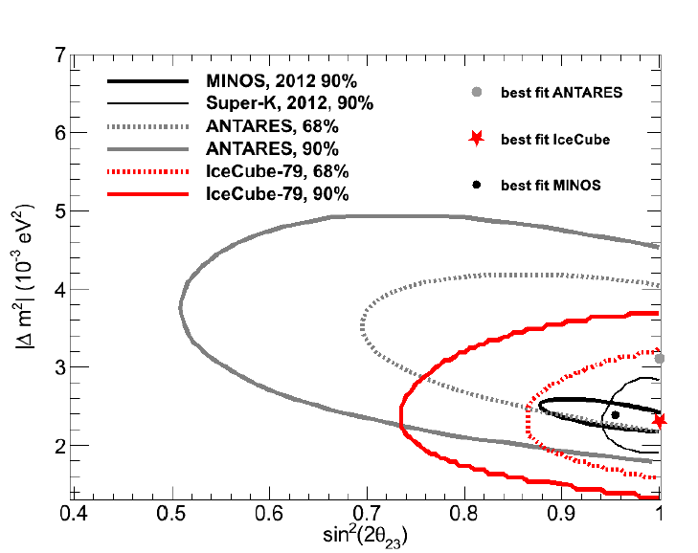
Oscillations of atmospheric neutrinos
Muon neutrino survival probability
Vertically upward
cosmic
ray
ANTARES/DeepCore
ν
Earth
L
θ
Horizontal

Slide 31
Oscillations of atmospheric neutrinos
Muon neutrino survival probability
Vertically upward
Oscillations
to sterile ν
Non-standard
oscillations due
to VLI
ANTARES/DeepCore
Standard
oscillations
Horizontal

Slide 32
Search for extra-terrestrial neutrinos
• Steady point sources
• Transient sources: GRB
• Diffuse flux

Slide 33
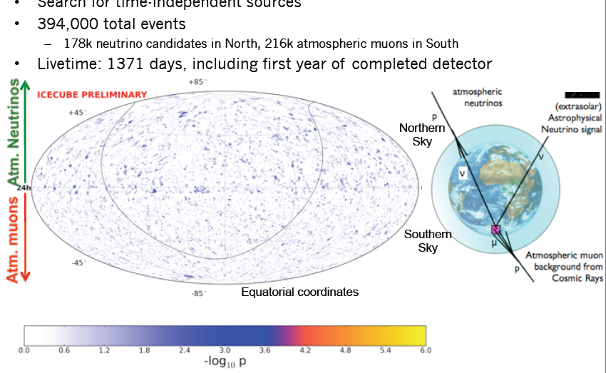
Point Source IceCube 4 years IC40/59/79/86
April 2011-March 2012
N o r t h
S o u t h

Slide 34
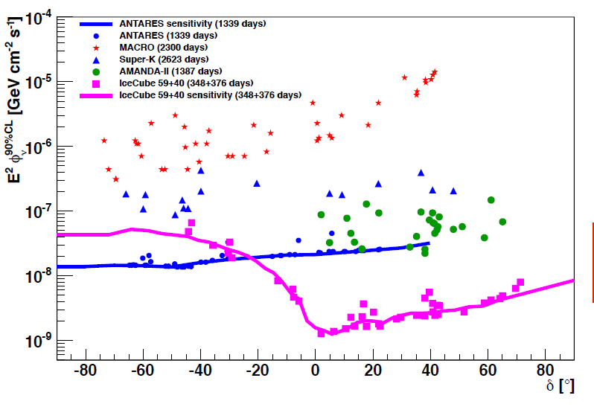
Limits for steady point sources
Factor 1000 in 12 years
No detections yet
ANTARES is best at Southern Sky IceCube sensitivity at Southern sky only for cut-off at >> PeV
Expect another factor 3 for IceCube in 2016
KM3NeT/GVD would give ~ factor 50 w.r.t. Antares
early Amanda limit
IceCube 4 years
preliminary
Southern Sky | Northern Sky

Slide 35
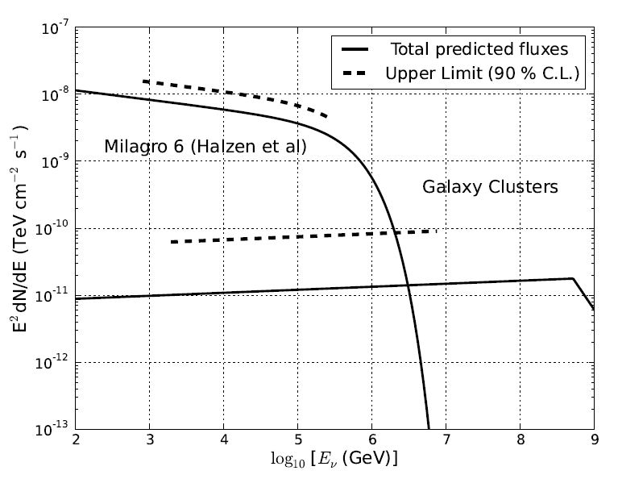
IceCube 3 years: upper limits and predictions

Slide 36
Transient Sources
GRB (second to minute scale)
AGN (Flares on hours to week scale)
Binary systems (periodic behaviour)
IceCube: SN burst trigger

Slide 37
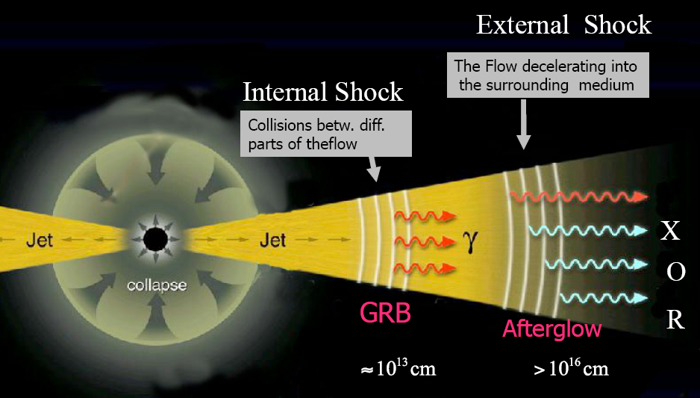
Transient Sources
GRB (second to minute scale)
AGN (Flares on hours to week scale)
Binary systems (periodic behaviour)
IceCube: SN burst trigger

Slide 38
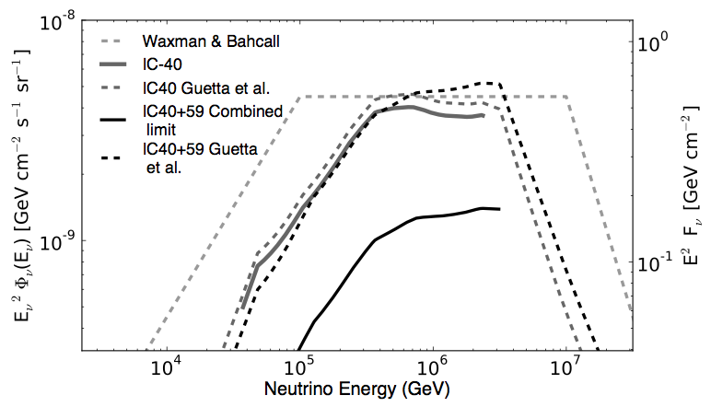
GRB Coincidence Search: IceCube
225 GRB at Northern sky (IC40 + IC59)
No IceCube event in time and direction coincidence
8.4 coincidences expected (Guetta et. al)
Standard fireball model à la Waxman or Guetta excluded with > 3σ (Nature 484 (2012) 351)
Winter et al. have modeled the fireball numerically, using more realistical particle energy distributions, and got fluences less by nearly one order of magnitude !

Slide 39
Diffuse extraterrestrial neutrino fluxes
ANTARES, Amanda, IceCube: Upward going muons
Amanda, IceCube: contained cascades
Baikal, IceCube: Extremely high energies
IceCube: galactic plane
ANTARES: Fermi bubbles

Slide 40
Diffuse extraterrestrial neutrino fluxes
IceCube:
Upward going muons
Contained cascades
Extremely high energies

Slide 41
Search for an extraterrestrial diffuse ν flux
proton
c,(b)
prompt
e,μ
νe,μ
π
μ
νμ
e
Extra-terrestrial
νμ
νe
conventional

Slide 42
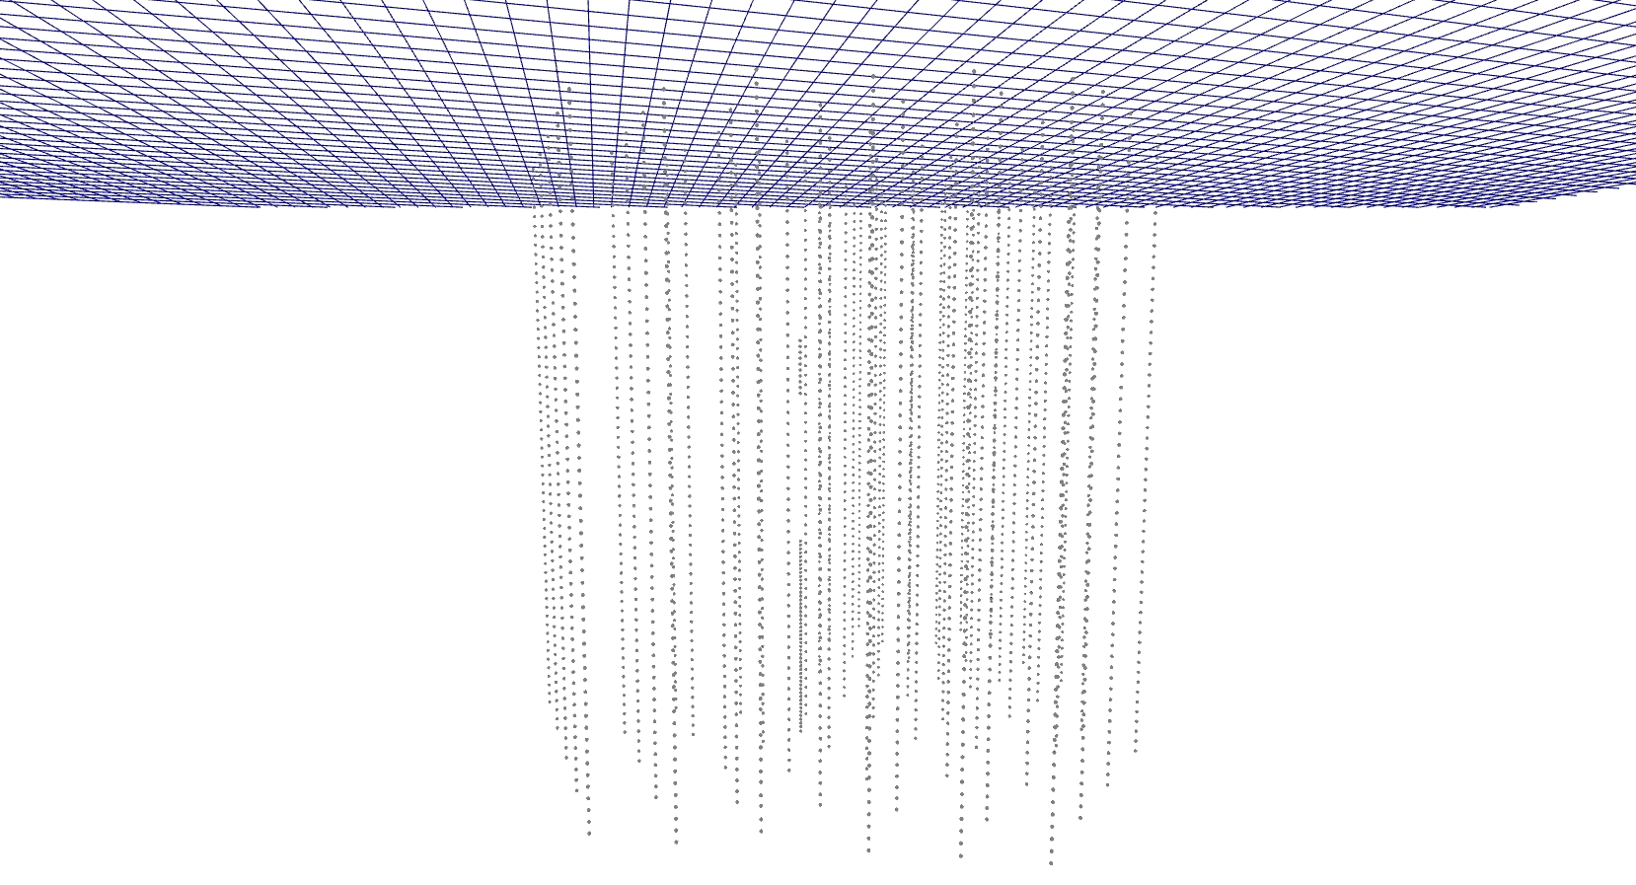
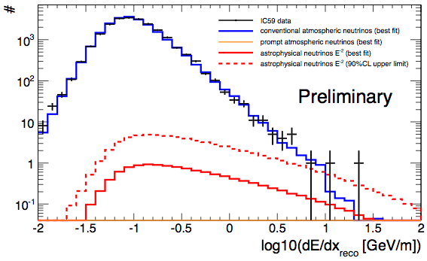
IceCube-59: upward muons
A 200 TeV muon crossing IceCube
The higest energy muon we have detected
1.8σ excess
IC-79 data coming soon !

Slide 43
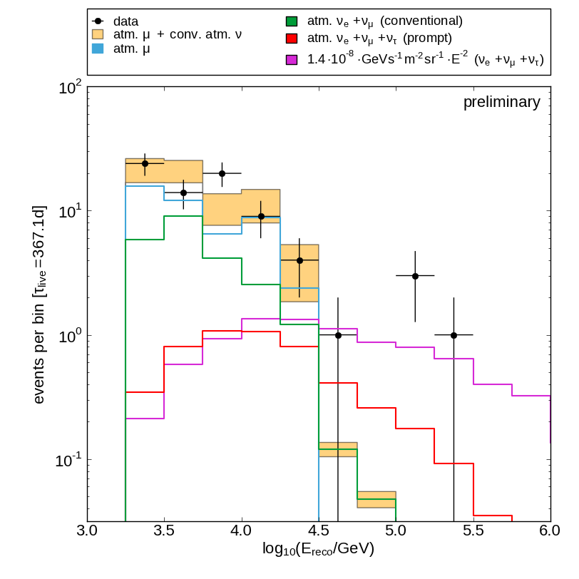
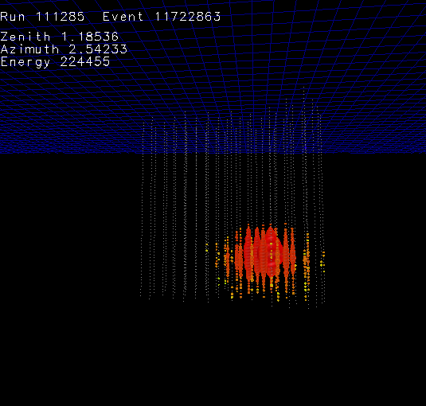
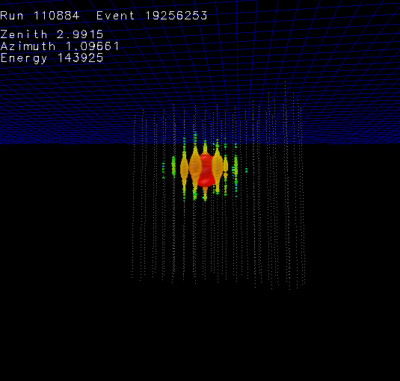
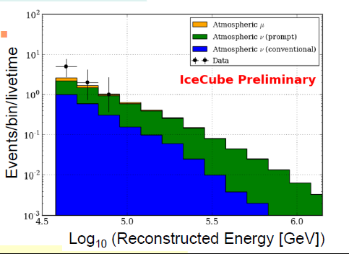
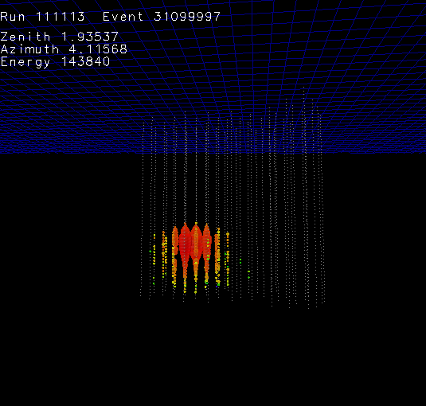
IceCube contained cascades
IceCube-40
3 cascade events 2.7 σ excess
IceCube-59
Mild excess over conventional atm. neutrinos
~ 220 TeV
~ 140 TeV
~ 140 TeV

Slide 44
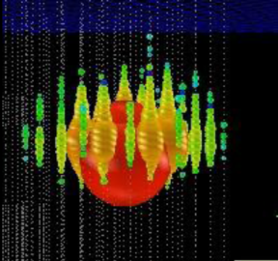
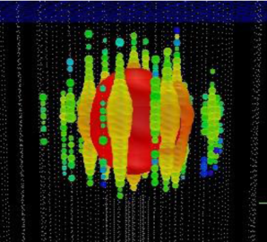
Special Search for cosmogenic ν (Berezinsky Zatsepin)
Ernie Bert
~1.2 PeV ~ 1.1 PeV
IC79/IC86
2.8 σ
Both downgoing
Unbroken E⁻² would have made 8-9 events at higher energy → cut-off

Slide 45
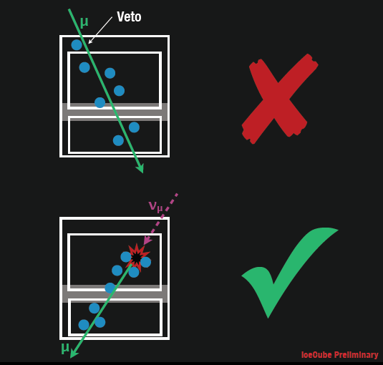
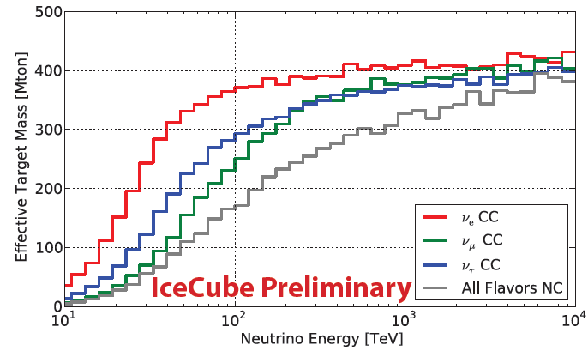
Follow-up Analysis: HESE accepted by SCIENCE
HHigh Energy Starting Event Analysis
Muon Veto
Q_{tot} > 6000 photoelectrons
400 Mton eff. Volume
Sensitive to all flavors above 60 TeV
100 TeV 1 PeV

Slide 46
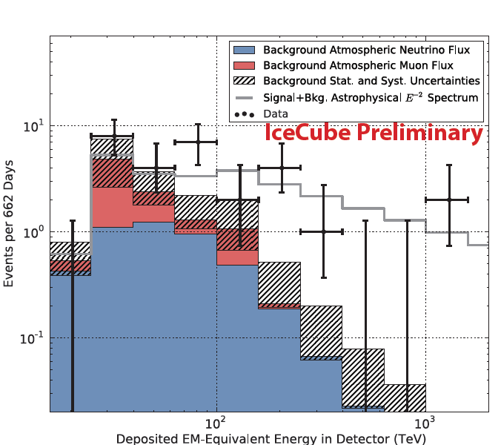
HESE Results: Ernie & Bert + 26 additional events
Significance of all 28 events: 4.1 σ
Background 10.6^{+5.0}_{-3.6}
Best fit for E⁻² spectrum:
E²Φ = 1.2 × 10⁻⁸ GeV cm² s-¹ sr⁻¹
Cut-off at 1.5-2 PeV
Results are consistent
with previous analyses
Ernie and Bert

Slide 47
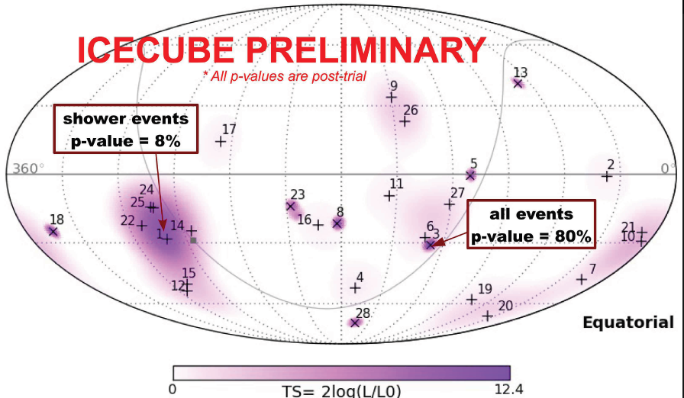
HESE Skyplot: Nothing significant (yet?)
Northern Sky
Southern Sky

Slide 48
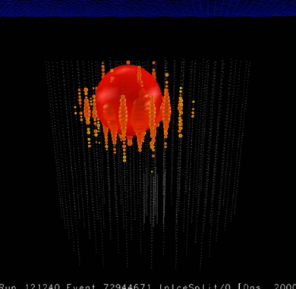
Looking Ahead: The future may start tomorrow!
One very high-energy event in the 10% „burn sample“ of 2012 data: BigBird
Expect 2012 HESE results in fall 2013
Also:
upgoing muon analysis IC79 (2010)
Cascade analysis IC79
Get the 5σ soon. (Do we understand systemactic well enough?)
BigBird

Slide 49
Future projects

Slide 50
GVD – KM3NeT – PINGU or IceCube++
GVD
KM3NeT
PINGU or/and IceCube++

Slide 51
GNO: The Global Neutrino Observatory
GVD
KM3NeT
GNO
IceCube

Slide 52
North and South
> 25%
> 75%
Figure courtesy A. Kappes

Slide 53
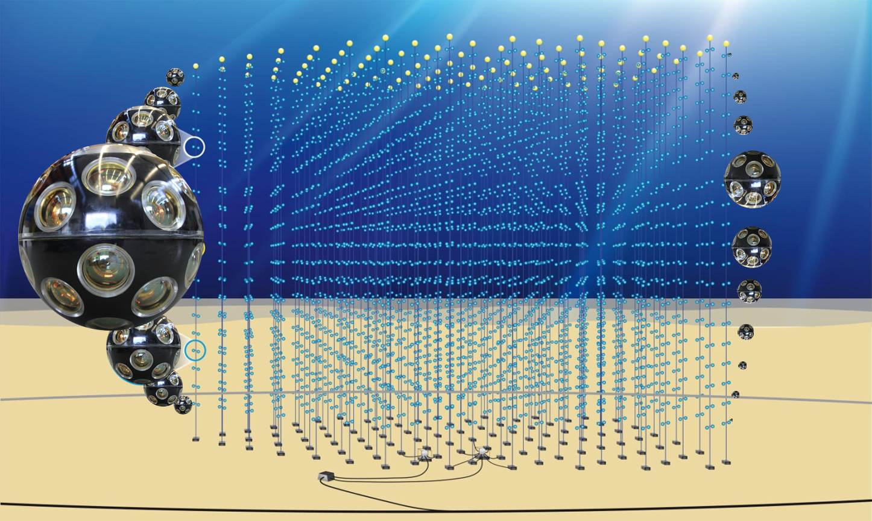

KM3NeT
Distributed infrastructure
- KM3NeT-France (Toulon) ~2500m
- KM3NeT-Italy (Capo Passero) ~3400m
- KM3NeT-Greece (Pylos) ~4500m
Centrally managed
Common hardware, software, data handling
Until 2015: construction of KM3NeT phase I detectors in France and Italy (~40 M€)

Slide 54
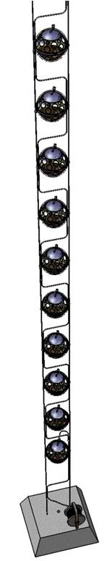
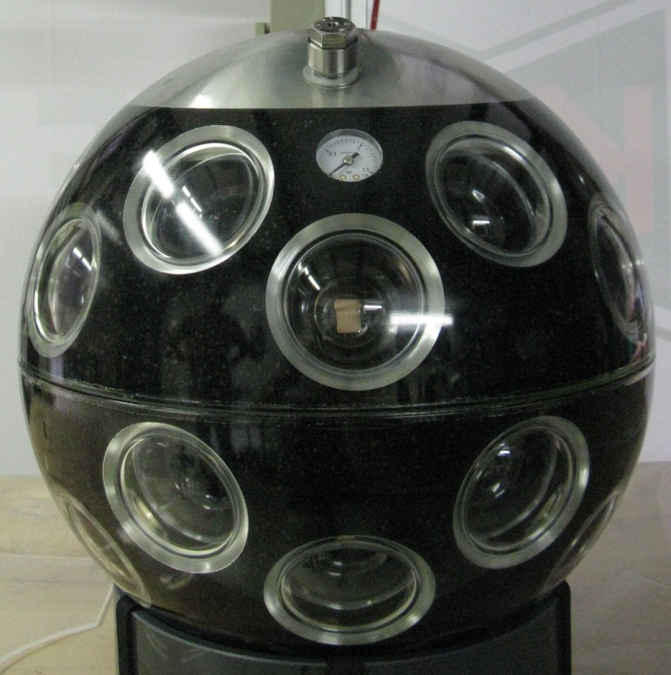
KM3NeT
6 building blocks, 2 per site
115 strings at 90 m distance
18 OMs per string, 36 m vertical distance
31 small PMTs per OM
  3 times more cathode area per OM
  Better background suppression
  Some directional sensitivity
1 km

Slide 55
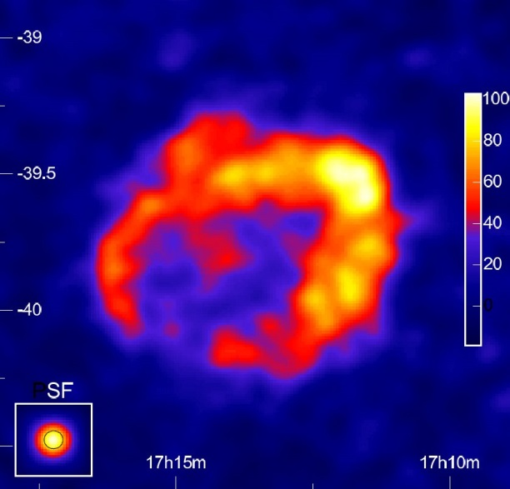
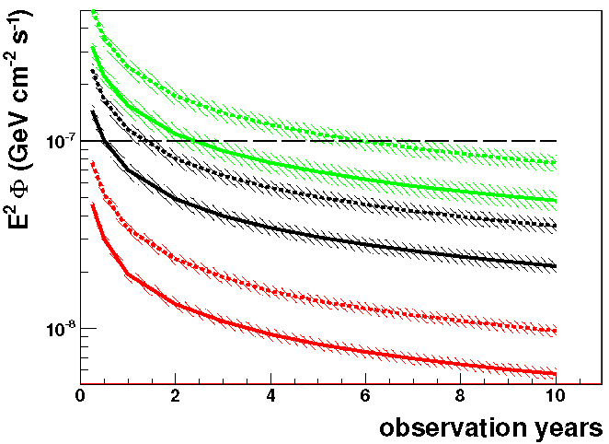
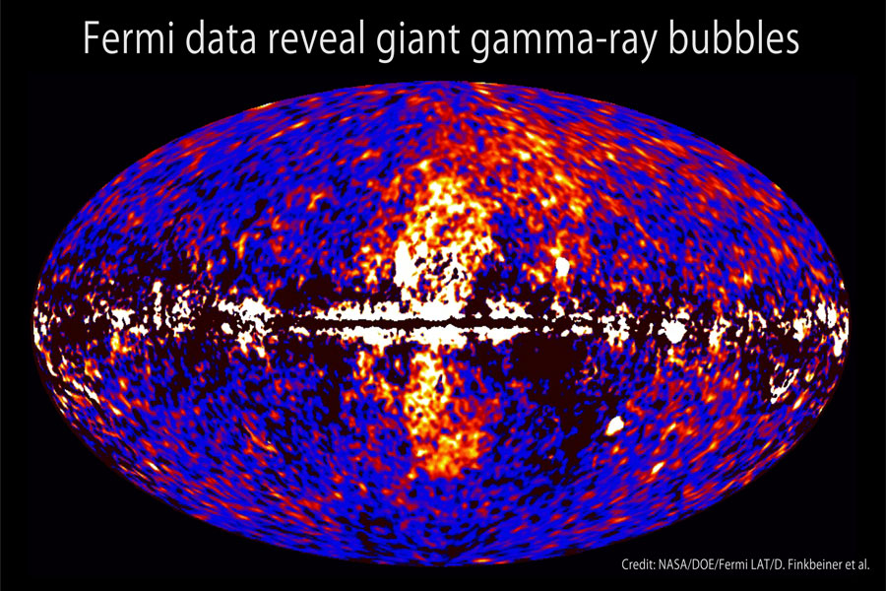
KM3NeT Sensitivity
x
RXJ 1713.7-3946 →
  Simulation results for 2 x 310 strings
  5σ discovery in less than 5 years
Even higher sensitivity for Vela X
Fermi-Bubbles
Astropart.Phys.42(2013)7
E⁻², 30 TeV cut-off
expected flux
E⁻², 100 TeV cut-off
E⁻², no cut-off
3σ @ 50%
5σ @ 50%

Slide 56
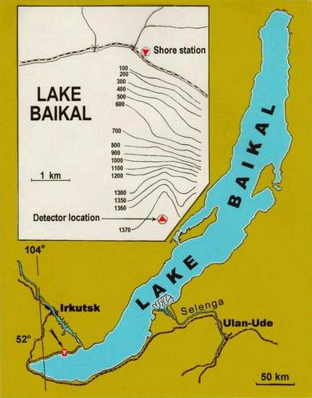
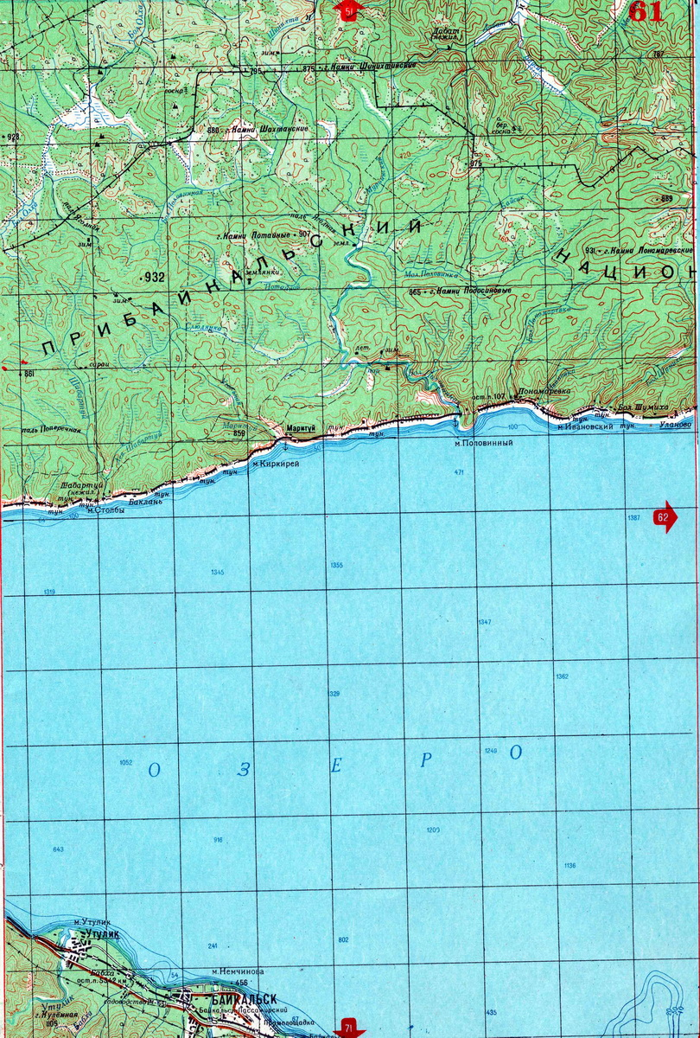
Gigaton Volume Detector GVD
>250 km³
0.5 to 1.5 km³ Detector in Lake Baikal

Slide 57
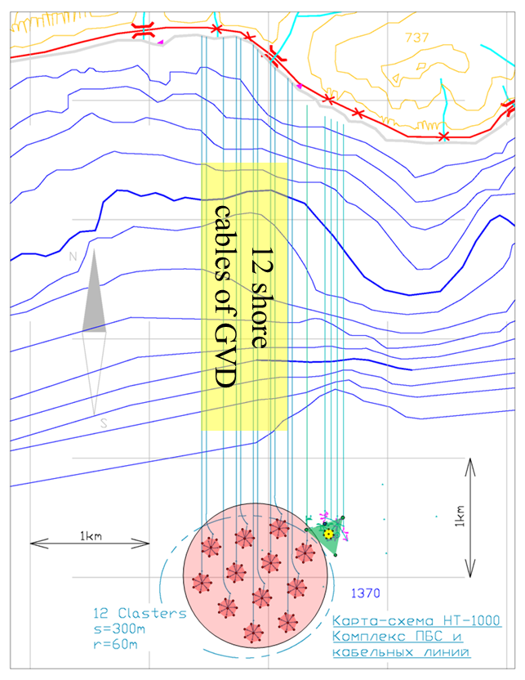
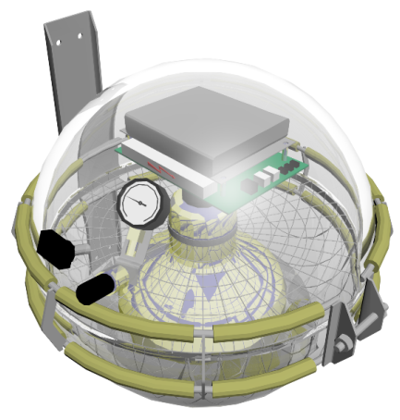
Gigaton Volume Detector GVD
Stage 1
12 clusters with 8 strings each
Cluster diameter 60 m
Height 300 m
Volume ~ 0.3 km³
48 OMs per string
PMT
Hamamatsu
R7081-HQE
∅ = 10”
QE ~ 0.35%

Slide 58
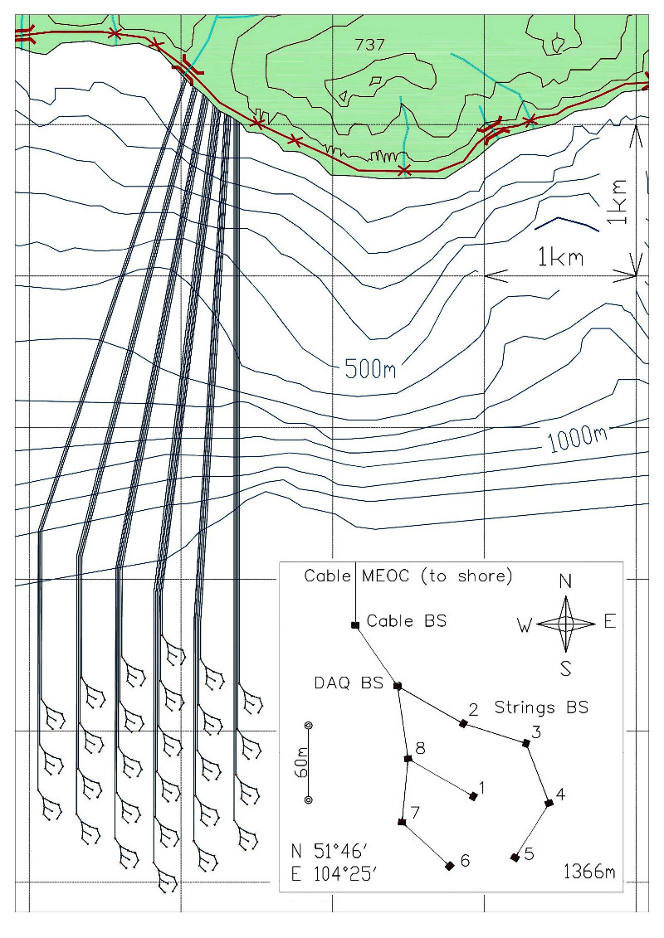
Gigaton Volume Detector GVD
Stage 2
27 clusters with 8 strings each
Cluster diameter 60 m
Height 700 m (depth 600 m– 1300 m)
Volume ~ 1.5 km³
48 OMs per string
PMT
Hamamatsu
R7081-HQE
∅ = 10”
QE ~ 0.35%

Slide 59
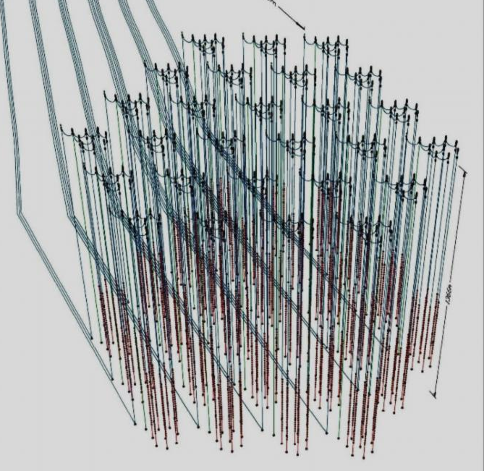
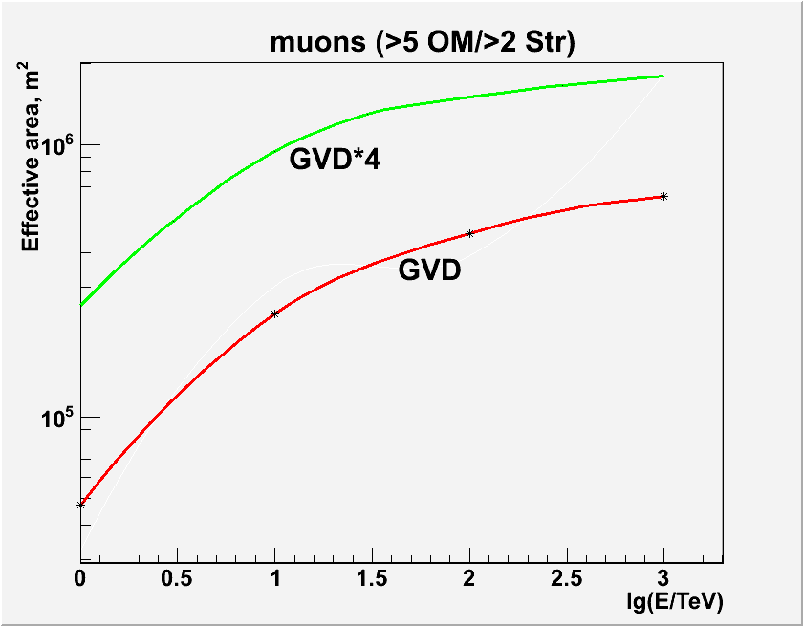
Gigaton Volume Detector GVD
Stage 2
27 clusters with 8 strings each
Cluster diameter 60 m
Height 700 m (depth 600 m– 1300 m)
Volume ~ 1.5 km³

Slide 60



From Engineering Arrays to first Cluster
2012
3 strings, first full-scale
GVD string (24 ОМs)
Data taking
from 4/2012
2013
3 full-scale strings (72 OMs),
upgrade of section electronics
Data taking from 4/2013
2014-2015
First Cluster (8 strings)
345 m
60 m
∼4×10⁶ m³ instrumented volume

Slide 61


Options for IceCube Extensions
IceCube
DeepCore
PINGU: low energy extension of DeepCore
Aim: Measure ν Mass Hierarchy
Plan: deploy 2016/17 – 2019/20
12,6 km³
Threshold for muons ~ 50 TeV,
gain eff. area for muons ~ factor 4,
gain for cascades ~ factor 10

Slide 62
Mass Hierarchy
Known:
  Mixing angles
  Absolute mass differences, ordering of ν₁ and ν₂
Unknown:
  Complex phase δ
  Mass ordering: is ν₃ the lightest or the heaviest mass state?

Slide 63

Matter Oscillations and Mass Hierarchy
P(νμ → νμ) for θ=130º
1
Akhmedov et al., arXiv:1205.7071
IH
NH
0.5
P (νx → νμ)
νμ
νe
0
1
5
10
Eν [GeV]
Maximum difference NH ↔ IH for θ = 130° at 7 GeV
For anti-ν, NH and IH are approximately swapped → effect cancels if ν and anti-ν have equal fluxes and cross sections and if the detector cannot distinguish μ⁺ and μ⁻
However: flux of atm.ν ~ 1.3 × flux of atm. anti -ν
and σ(ν) ~ 2 × σ(anti-ν) at low energies
→ Count N_{μ}(θ, E) from ν_{μ} + N →μ + X and compare with NH/IH predictions

Slide 64

Pattern from matter oscillations
ΔN(IH‑NH) / √N(NH) [PINGU 1 yr, 10% sys.]
Perfect resolution
Akhmedov et al., arXiv:1205.7071

Slide 65



Importance of resolution and systematics
ΔN(IH‑NH) / √N(NH) [PINGU 1 yr, 10% sys.]
σθ = 11º σE = 2 GeV → Σ=7σ
σθ = 23º σE = 4 GeV → Σ=3σ
σθ = 15º σE = 3 GeV → Σ=5σ
Perfect resolution
Feasibility depends on
  Angular resolution
  Energy resolution
  Particle ID
  Systematic effects
Akhmedov et al., arXiv:1205.7071

Slide 66

Sensitivity of PINGU
Impacts of uncertainties in CP phase and θ₁₃/θ₂₃ not yet included !

Slide 67
SUMMARY

Slide 68
Factor of 1000 improvement over last 12 years
No indications of point sources yet
Further factor 3 in sensitivity will bring us to the level of optimistic predictions for some SNR
KM3NeT and GVD look to central part of the Galaxy and could eventually find point sources!
Another option: IceCube++
IceCube constrains models for GRB
IceCube finds first strong indications for a diffuse flux of extraterrestrial high-energy neutrinos
Have we already entered a new era ?
The next months will give the answer!

Slide 69

... and last but not least
Under-ice/underwater telescopes are becoming relevant players in oscillation physics, the legacy of
Bruno Pontecorvo

