Slide 1
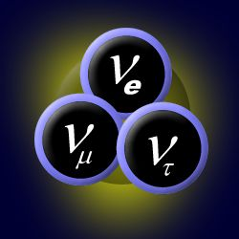
CAPTURING COSMIC NEUTRINOS Neutrinos as Messengers
C. Spiering
Boston, 15.2. 2013

Slide 2
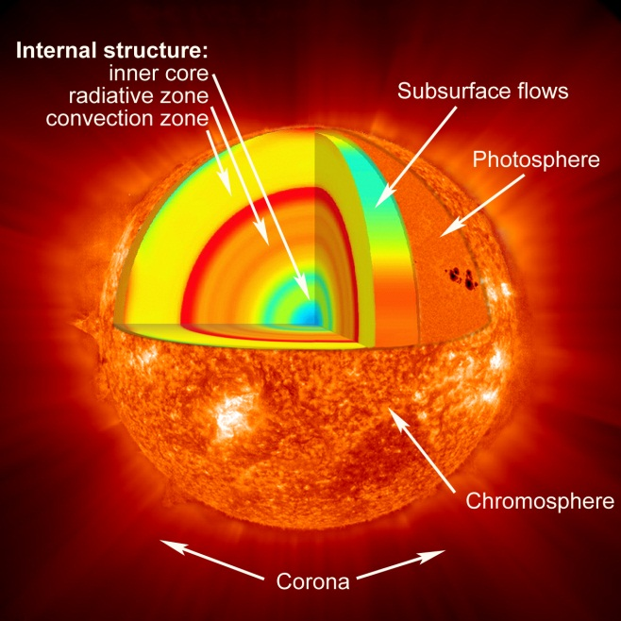
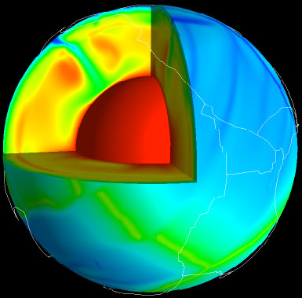
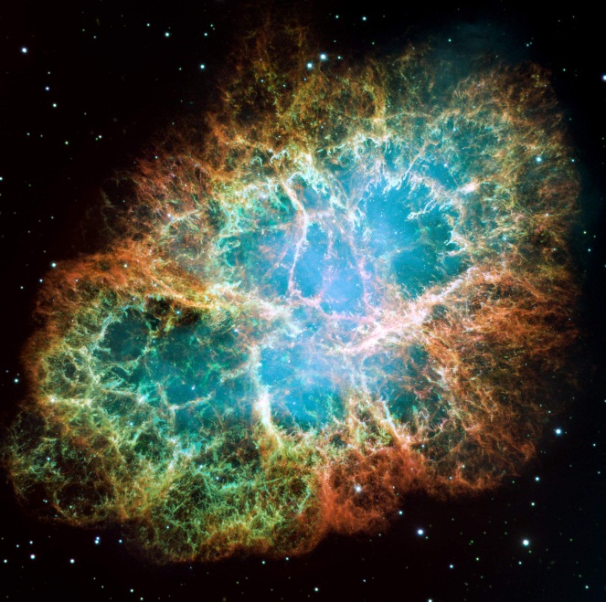
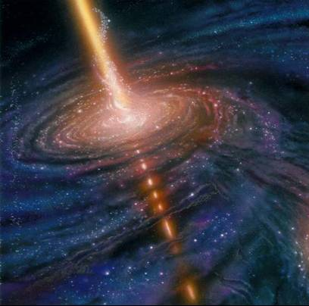
Looking
deep into …
… the Sun
… the Earth
… a Supernova
… environment
of black holes
Crust
Mantle
Core

Slide 3
neutrinos as messengers challenges and benefits

Slide 4
The benefits
Neutrinos ...
... can escape dense celestial bodies
the Sun
fresh neutrons star
dense regions close to black holes
interior of the Earth
core of nuclear reactors
... are not absorbed on their journey
... travel straight

Slide 5
The challenge
Neutrinos rarely interact with other matter
How often they interact depends on energy:
Interaction probability when crossing the full Earth
solar neutrinos (keV range): ~ 10⁻¹⁰
1 TeV neutrinos: ~ 10⁻²
100 TeV neutrinos: ~ 0.8
Need huge detectors!

Slide 6
Cosmic Neutrinos a synoptic view

Slide 7
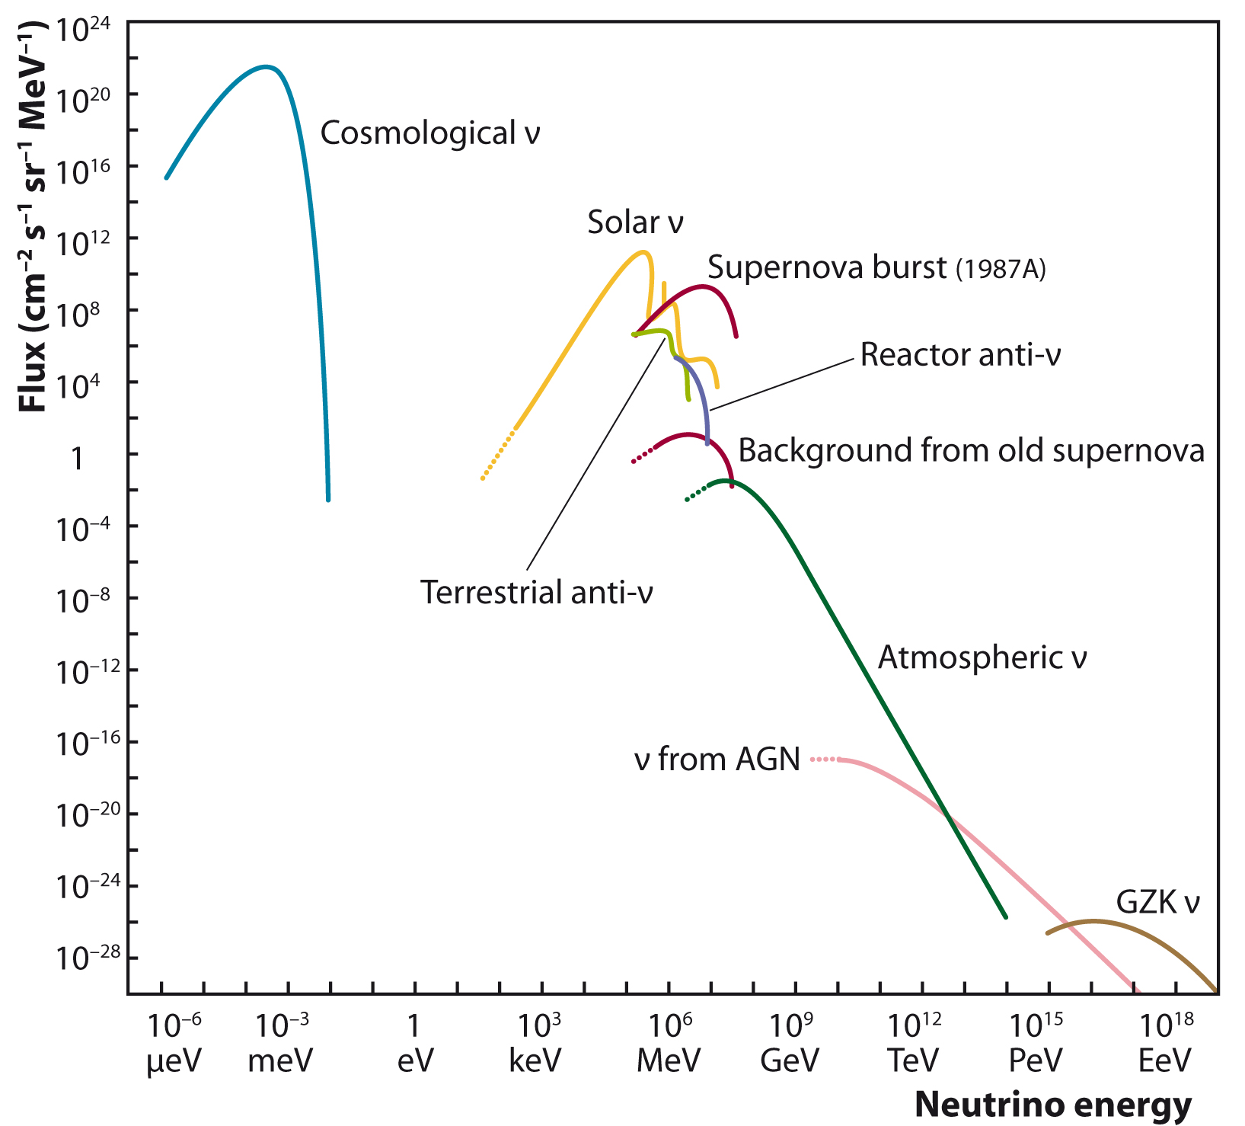
Neutrinos are everywhere

Slide 8
Supernova 1987A The birth of neutrino astronomy

Slide 9
Supernova 1987A
in the Large Magellanic Cloud
23.2.1987

Slide 10
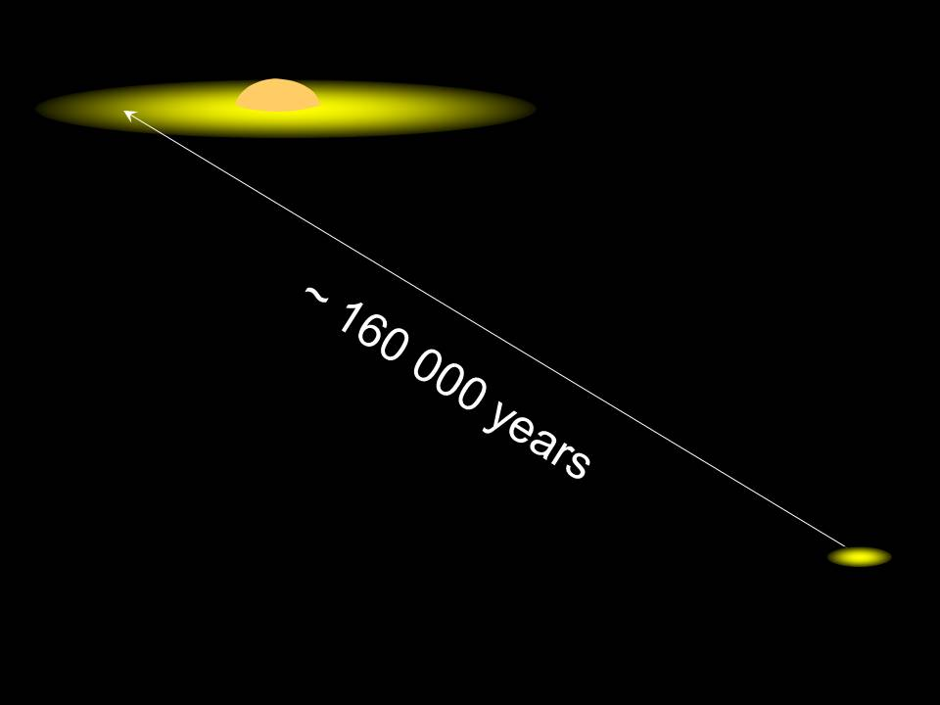

Slide 11
What happened?
Star exhausts its nuclear fission power and collapses to a neutron star, ∅ ~ 30 km
proton + e⁻ → neutron + ν_{e}
Short pulse of electron neutrinos (~ 10 msec)
Neutron star cools down over ~10 sec (99% of the energy emission via neutrinos!)

Slide 12
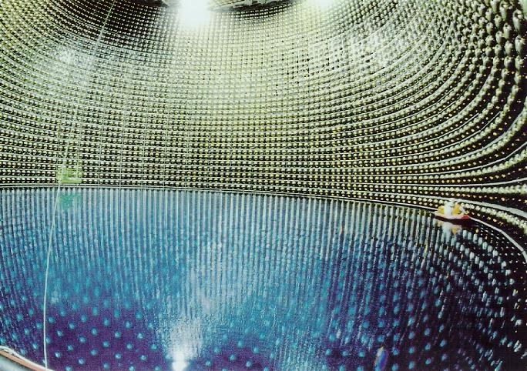
Super-Kamiokande
Japan

Slide 13
Neutrinos in Kamiokande
ν_{e}
e⁺

Slide 14
Neutrino Signal from SN-1987A
in Kamiokande
SN 1987A
Noise

Slide 15
What have we learned?
12 events in Kamiokande, 8 in IMB (Ohio), 3 in Baksan (Russia)
Temperature in the fresh neutron star: 30-50 billion Kelvin
Mass of neutrinos < 20 eV
... plus many other conclusions
SN 1987A
Noise

Slide 16
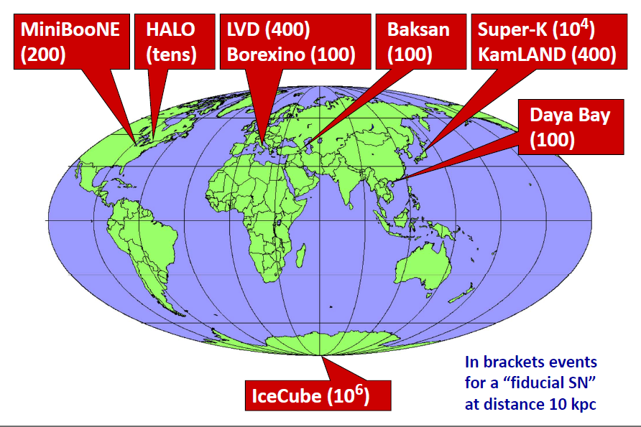
Experiments ready to detect a Supernova today
SNO+
(800)
commissioning
phase

Slide 17
... and „tomorrow“
Several projects for huge detectors:
USA: LBNE detector at Homestake mine 10-34 kt liquid argon
Japan: Hyper-Kamiokande up to 500 kt water
Europe: LBNO 25-70 kt liquid argon
LENA 25-50 kt scintillator
- China: DayaBay 2 20 kt liquid scintillator
~10⁵ ν-events from SN in center of our Galaxy
Bonanza for particle physics and astroparticle physics !

Slide 18
Solar neutrinos what fuels the Sun?

Slide 19
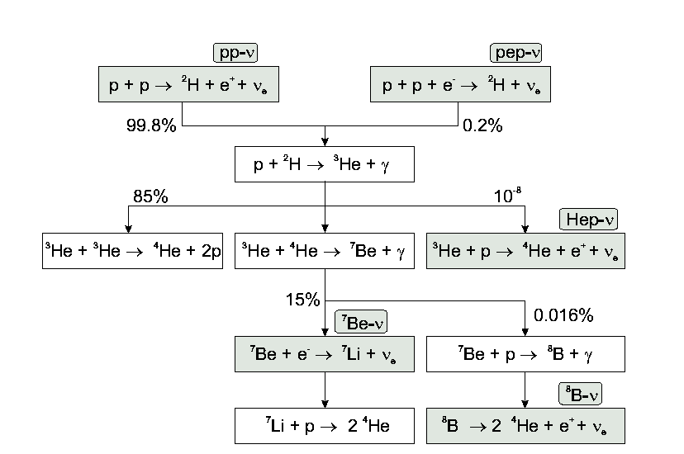
The proton-proton chain

Slide 20
The proton-proton chain

Slide 21
The proton-proton chain
1991
2012
2009
1969

Slide 22
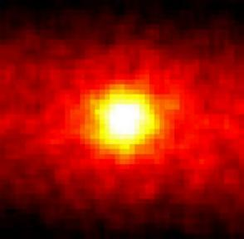
The Sun in Neutrinos

Slide 23
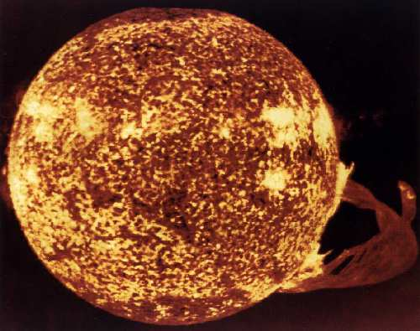
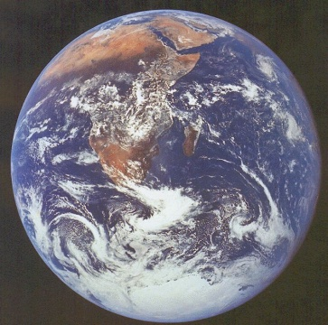
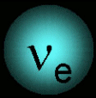
What have we learned?
The basic mechanism of the Sun is confirmed with a few percent accuracy
Neutrinos change their identity on their way to Earth („oscillations“)
neutrinos change
their identity on
their way to Earth
→ neutrinos have a mass

Slide 24
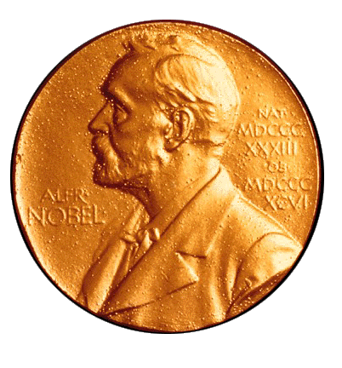
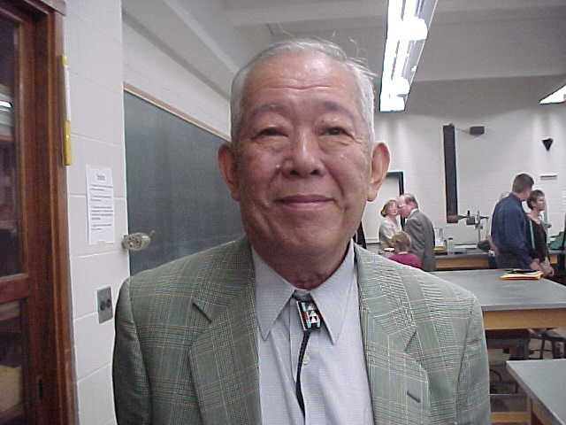
Solar and Supernova Neutrinos:
2002
„… for opening a new observational window
to the Universe“
Raymond Davis jr. Masatoshi Koshiba

Slide 25
What do we not know yet?
Why do we see less „metals“ at the solar surface than suggested by the solar model („metallicity puzzle“)?
→ measure CNO neutrinos
Are there tiny time modulations of the neutrino flux?
Hints from satellite experiment SOHO
Present limits : < 10%. Could be ~1% or less.
→ build larger detectors which
collect larger statistics!

Slide 26
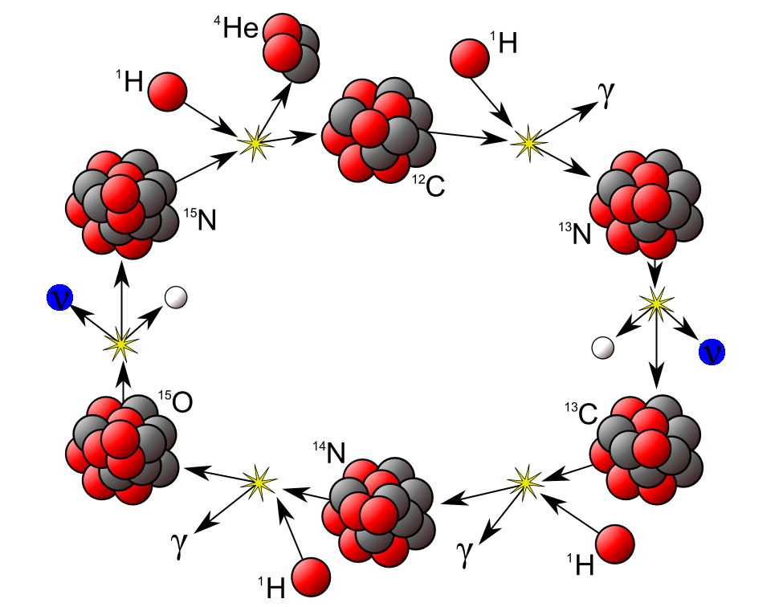
Key for discovery: the CNO cycle
Dominant in heavy stars
Contributes only 0.5% in the Sun
CNO neutrinos not yet detected
But:
Solar CNO neutrinos provide key information about heavy elements in the Sun („metallicity puzzle“) !

Slide 27
Geo-neutrinos understanding the interior of the earth

Slide 28
Structure of the Earth
Crust
Mantle
Core

Slide 29
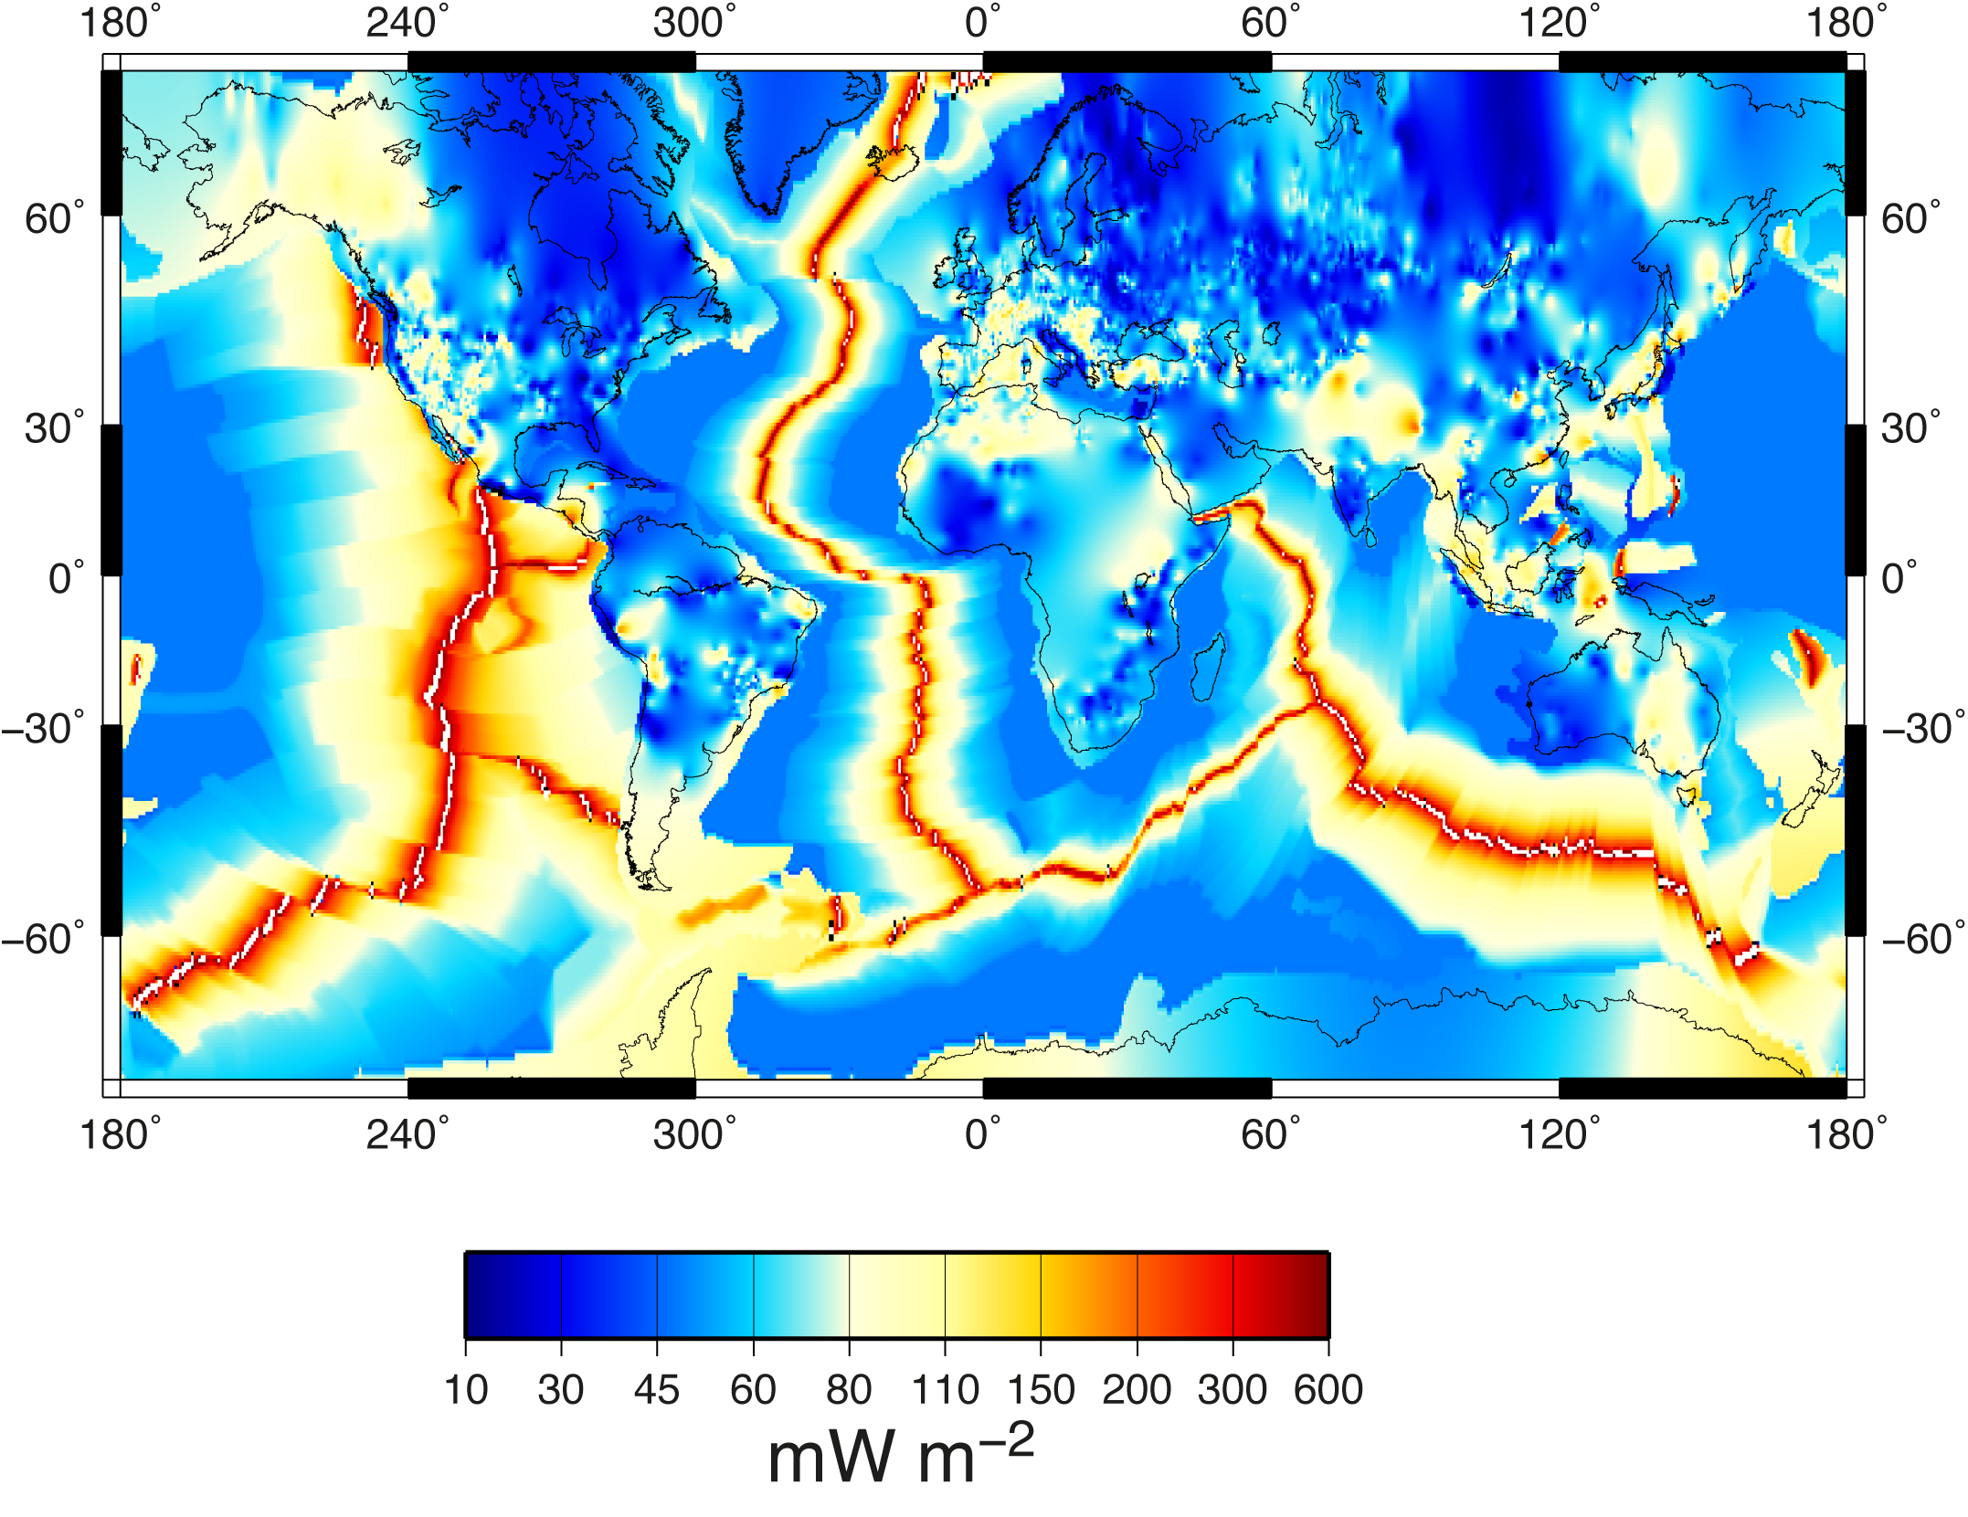
Heat loss of the Earth: 42-48 TW

Slide 30
Contributions to heat loss
Expect 14-24 TW due to radioactive decay in crust and mantle
Missing
Measure anti-neutrinos from U and Th decays in order to determine, at least, the heat production in mantel and crust

Slide 31
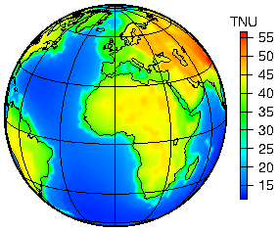
Expected fluxes of geoneutrinos

Slide 32
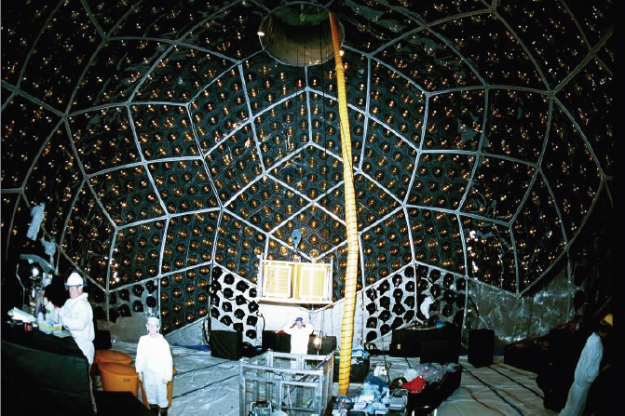
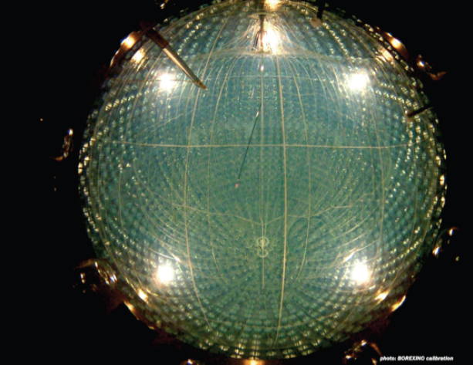
First detection and future needs
Kamland (liquid scintillation detector in Japan): 2005
Borexino (liquid scintillation detector in Italy): 2010
Heat production by U and Th decays 20±9 TW
Need to distinguish U and Th separately, pushing the error below ±2 TW and scrutinizing Earth models
→ DayaBay-2 China 20 kt
→ LENA Europe 25-50 kt

Slide 33
Icecube and the high-energy universe

Slide 34
A century ago: discovery of cosmic rays
Victor Hess 1912
Nobel Prize 1936

Slide 35
What do we know about cosmic rays?
What do we know?
Composition: Protons and light and heavy nuclei
Spectrum: Energies up to 10 million of that of the Large Hadron Collider (LHC) in Geneva !
Contribute substantially to the energy budget of our Galaxy.
What don‘t we know?
What are the sources? How do they work?
Suspected sources: shock fronts of Supernova remnants, environment of black holes, ...

Slide 36
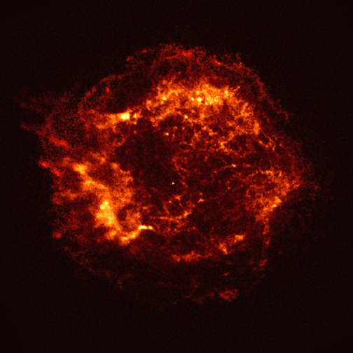
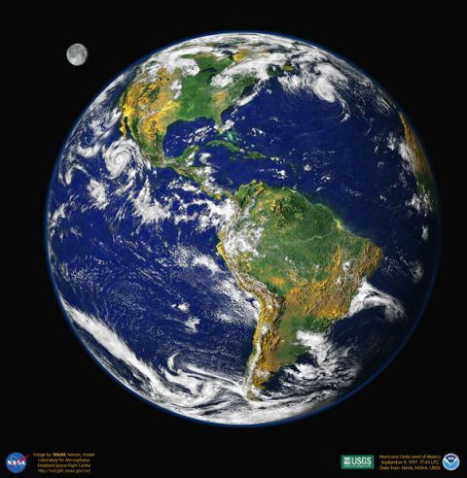
Charged cosmic rays vs. gamma rays vs. neutrinos
Charged particles
γ,ν
ν

Slide 37
How to detect high energy neutrinos
μ
ν_{μ}

Slide 38
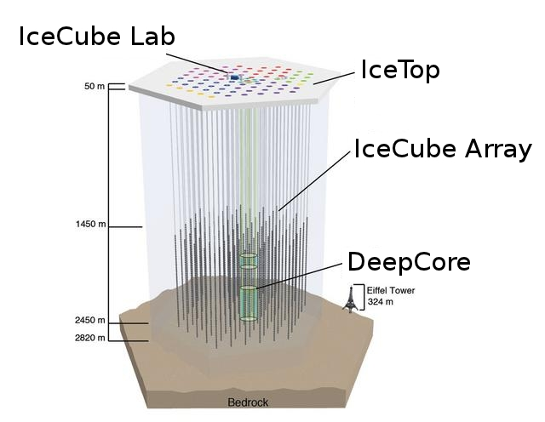
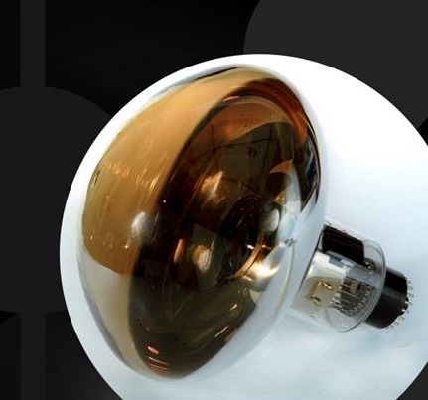
The IceCube Neutrino Observatory
5160 optical sensors
buried deep in the
Antarctic ice
A full km³ of ice
instrumented!
10´´ photo-multiplier

Slide 39
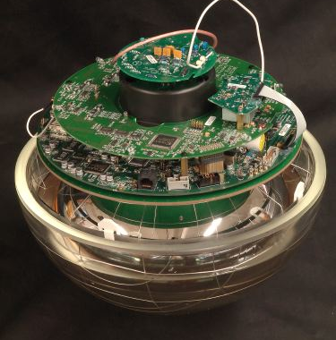
The IceCube Neutrino Observatory
5160 optical sensors
buried deep in the
Antarctic ice
A full km³ of ice
instrumented!

Slide 40
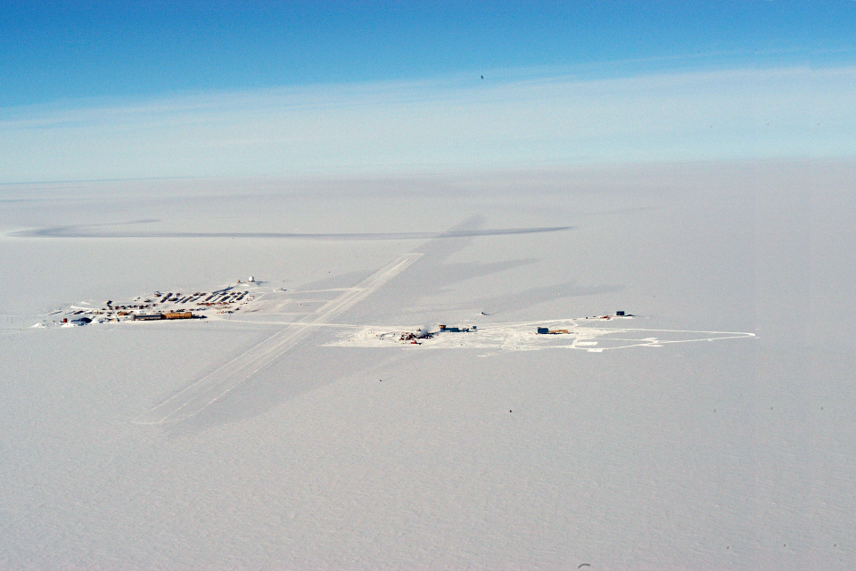
The Amundsen-Scott Station
South Pole Station Building Astronomy Sector
IceCube
AMANDA
skiway

Slide 41
Drill Camp
- 5 MW power
- 16 m³ Kerosine
per hole

Slide 42
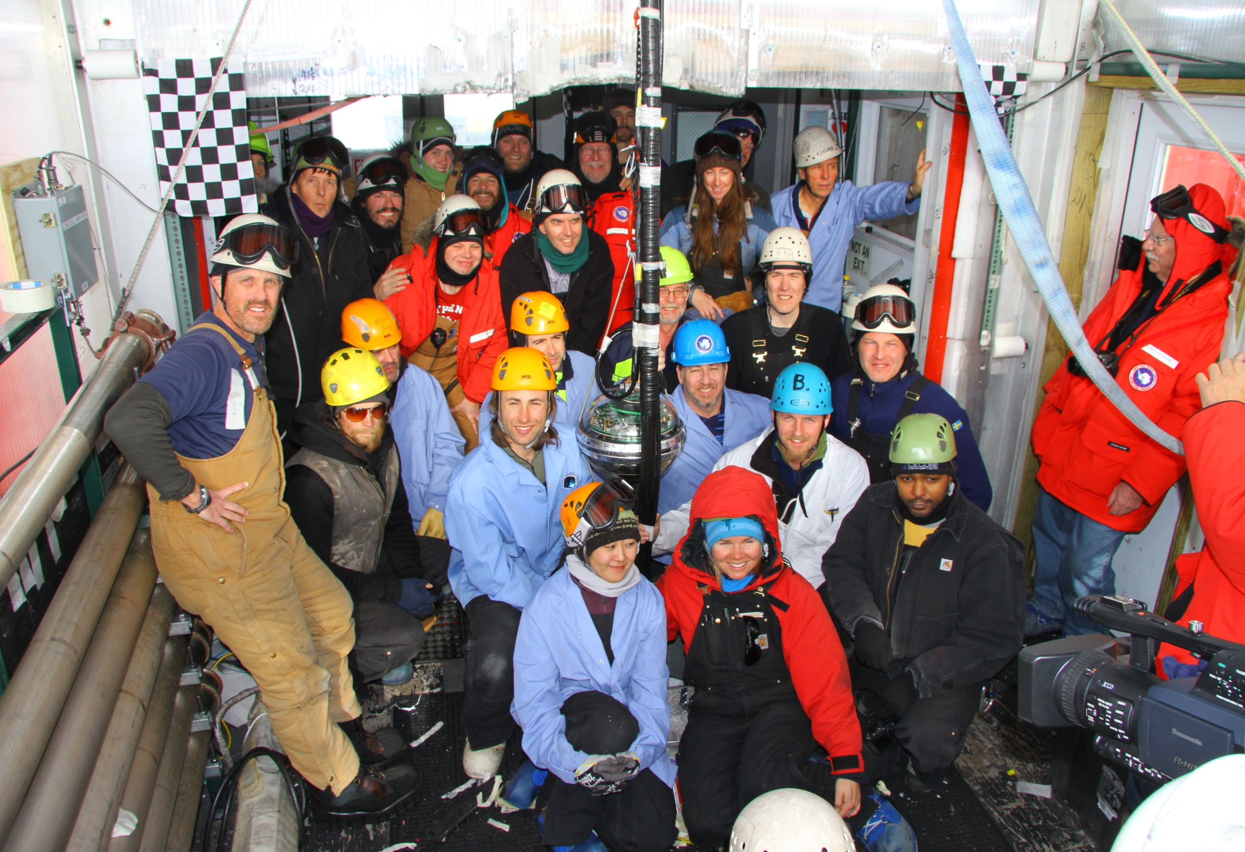
Besseres Bild
Dec.18, 2010: the last string

Slide 43
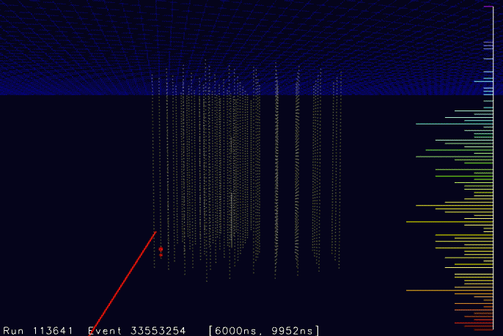

Slide 44
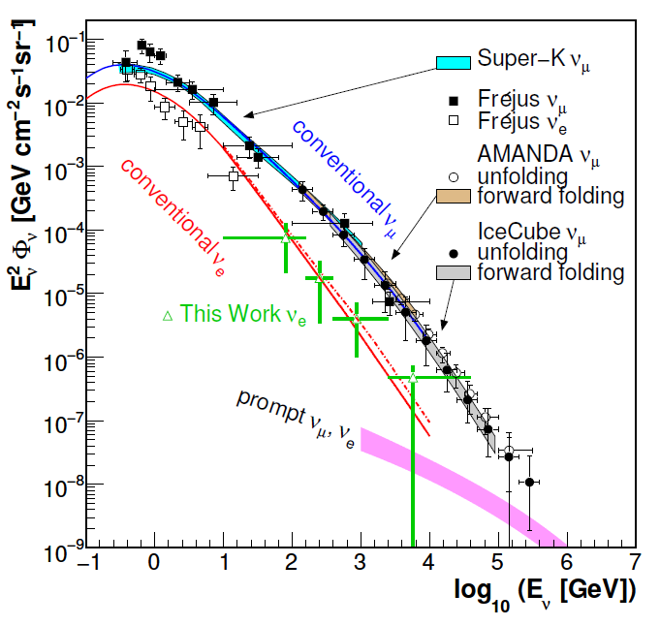
Atmospheric Neutrinos
proton
c,(b)
prompt
e,μ
νe,μ
π
μ
νμ
e
νμ
νe
conventional

Slide 45
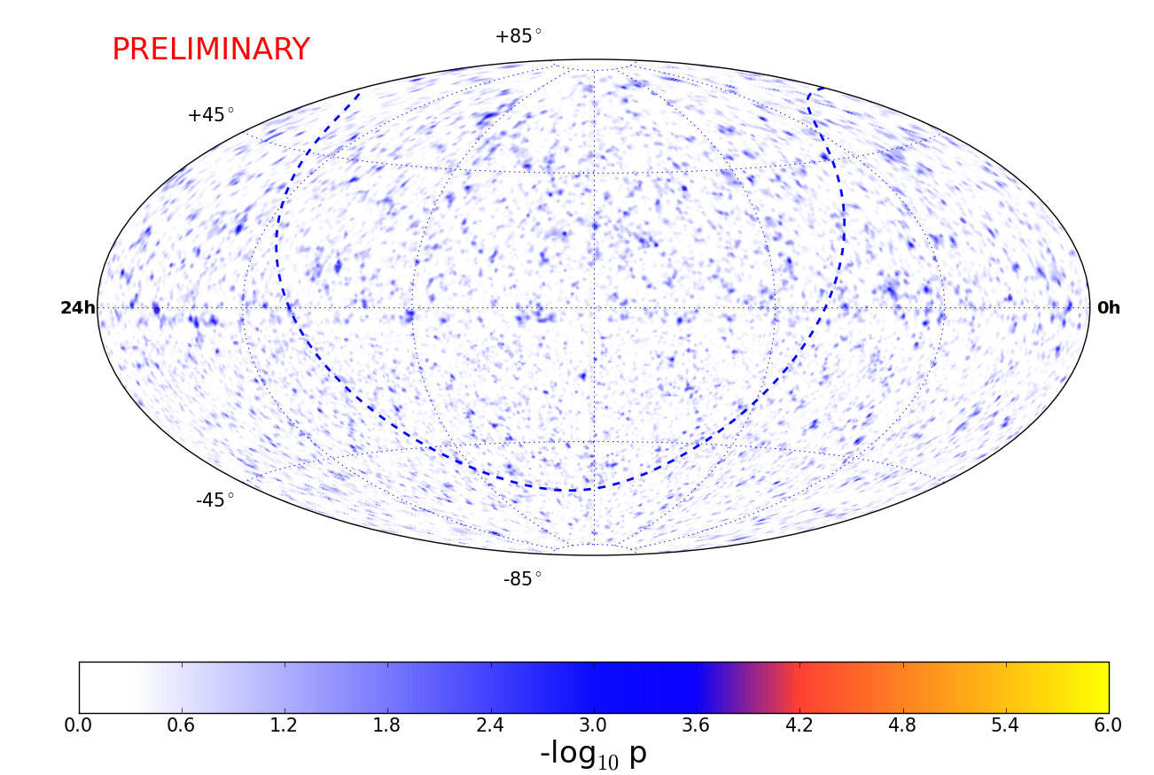
IceCube Neutrino Sky-Map

Slide 46
Point Source Summary
Giant leap: have improved the sensitivity to point sources by a factor 1000 compared to 12 years ago
No point sources (yet) identified
Another factor 10 to come within the next few years.
Entering region with very high discovery potential

Slide 47
However ...

Slide 48
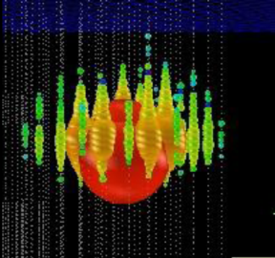
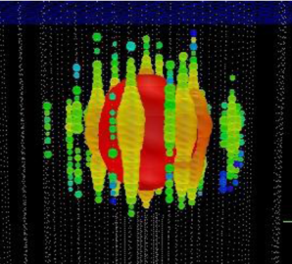
Tantalizing excesses at high energies
Ernie Bert
~1.1 PeV ~ 1.3 PeV
Atmospheric neutrinos from charm decay („prompt neutrinos“) or extraterrestrial neutrinos ??
More sophisticated analyses underway, more data.

Slide 49
Tantalizing excesses at high energies
A 200 TeV muon crossing IceCube
(the highest energy muon we have detected)
Atmospheric neutrinos from charm decay („prompt neutrinos“) or extraterrestrial neutrinos ??
More sophisticated analyses underway, more data.
Stay tuned: 2013 will be interesting!

Slide 50
Future mega-projects

Slide 51
LENA, GLACIER Europe
LBNE USA, Hyper-K Japan
Daya-Bay2 China , Hano-Hano, USA
KM3NeT Med-Terr. Sea
GVD Lake Baikal
IceCube++ South Pole
PINGU
South Pole
ARA, ARIANNA
Antarctica

Slide 52
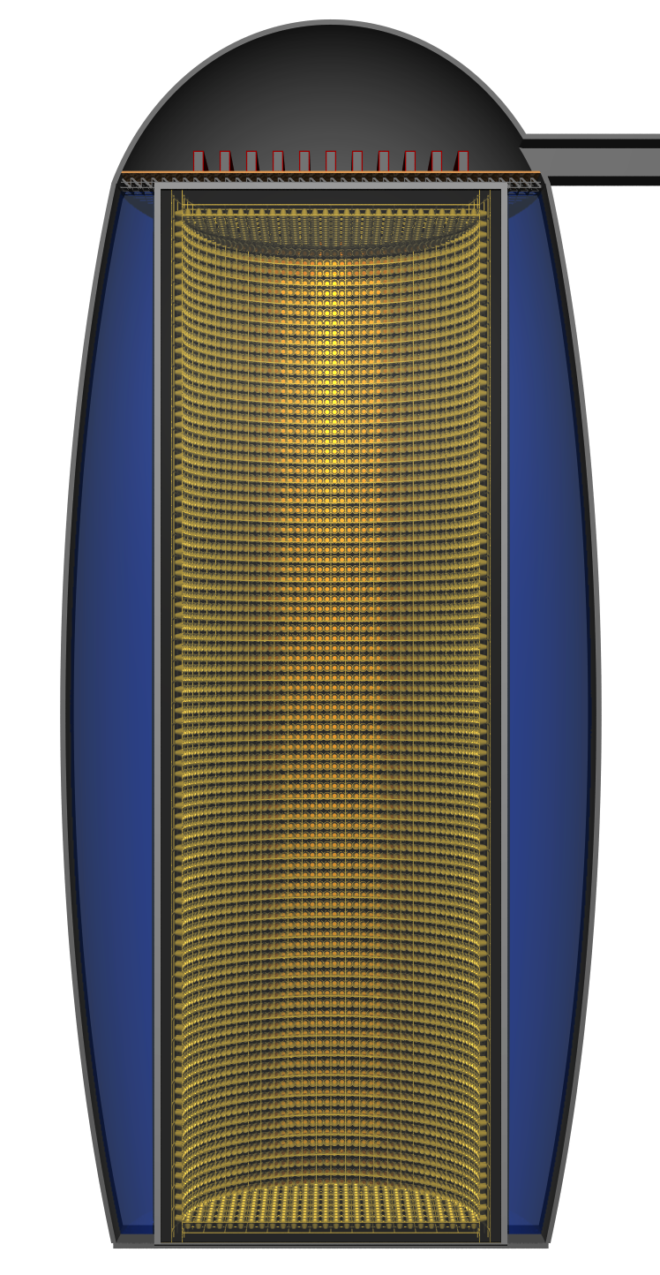
Example: LENA
Electronics Hall dome of 15m height
Top Muon Veto
Water Cherenkov Veto 2000 PMTs
Egg-Shaped Cavern
Concrete Tank
32,000 12‘‘-PMTs coverage: 30%
Active volume 50kt of scintillator
Depth:
4 km water equivalent
Finnish mine

Slide 53
LENA Science Potential
Proton decay sensitivity 10 years p →νK 4×10³⁴ y
SN at 10 kpc ~16,000 events
Diffuse SN signal/background 10 years 60/10
Solar neutrinos events/years
⁷Be 3,600,000
pep 100,000
⁸B 30,000
CNO 70,000
Geoneutrinos events/year 1500
Test new class of SUSY models
Bonanza for astro- and particle physics
Understand past supernovas
Test Sun with % accuracy
Resolve remaining puzzles
(Will there be more?)
Understand the energy budget of our planet

Slide 54
summary

Slide 55
Neutrinos are unique cosmic messengers.
Rich legacy of gold-plated discoveries: solar, supernova and geo-neutrinos.
Neutrino oscillations have been discovered using solar and atmospheric neutrinos (see the other two talks).
IceCube with tantalizing indications. Light at the end of the tunnel?
Much more powerful detectors promise deep understanding of Sun, Earth interior, Supernovae and the origin of cosmic rays.
There is a fascinating decade ahead!

Slide 56
end

