Slide 1
Ivan Bereziuk (group: LC)
supervisor: S. Riemann, F. Staufenbiel
the project ILC
The positron production target
Material science
Dynamical and static stress calculations
Temperature distribution in a test target

Slide 2
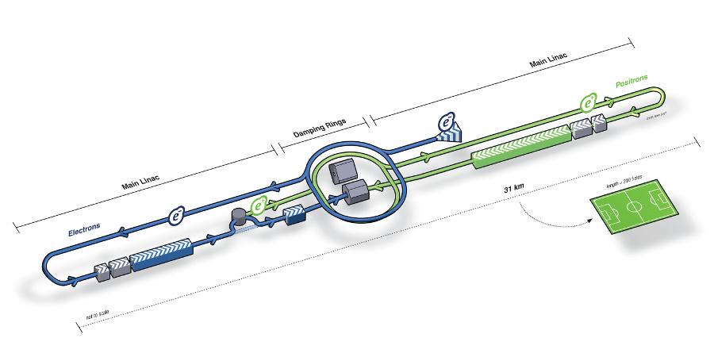
We work for the project ILC:

Slide 3
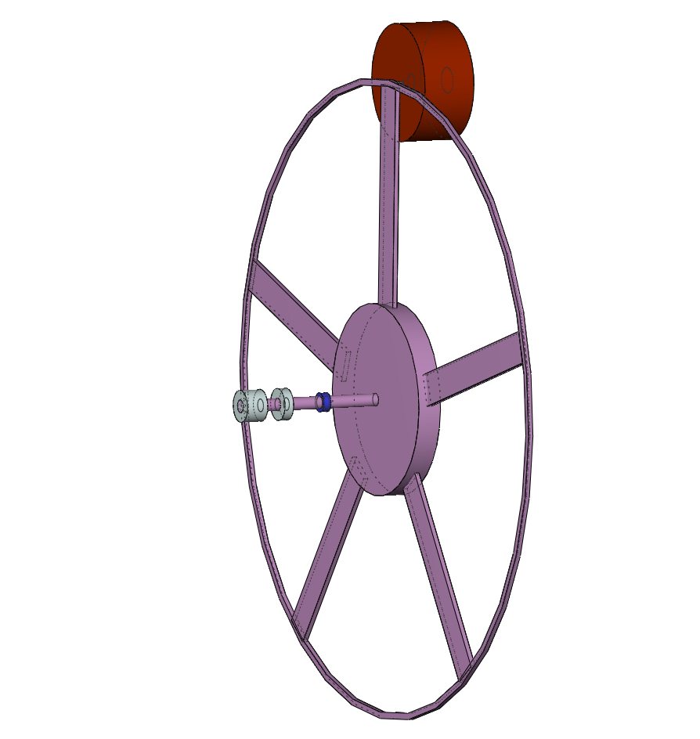
The positron production target
2*10¹⁰ e⁻ / bunch = 3.2 nC / bunch
2625 bunch / train (0.97ms)
5 train / s
-> 4.6*10¹⁵ photon / train
Titan target for polarised positron production
~ 14.4 MeV e⁺
250 GeV e⁻
~ 28.8 MeV photon beam
helical undulator
distribution of
heat load !!
v_{rim} = 100 m/s
r
r = 1 m

Slide 4
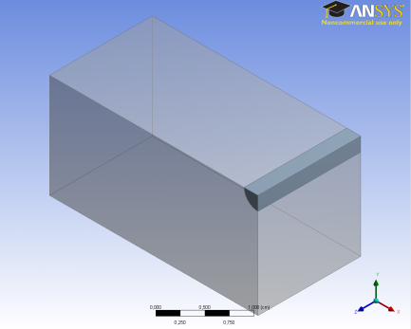
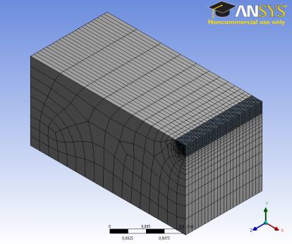
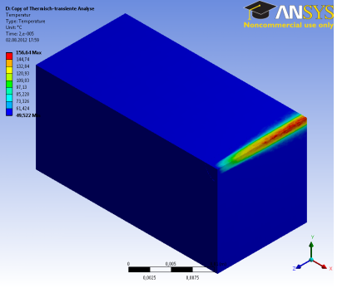
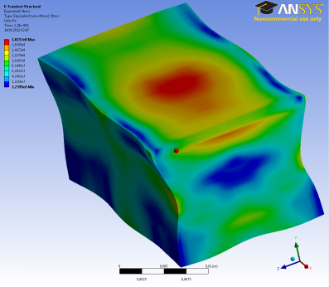
The question and method of solving
This simple geometry of this test target is fixed. The dynamical evolution is studied by rapidly pulsed heating. The original target is a rotating wheel and it`s modeling is the next step of the research.
Оur goal: to check target properties and the limits for break down by using ANSYS - software. That is used to solve the problems of time dependent stress (velocity) evolution , deformation ...
Basic research in ANSYS scheme is as follows:
Geometry Meshing Heating Stress analysis

Slide 5
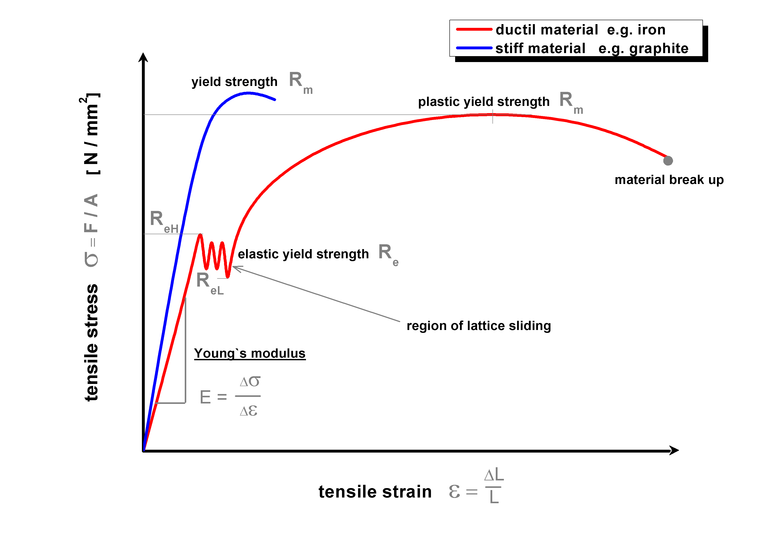
Material science
Robert Hooke (* 1635 +1703)
Thomas Young (* 1773 +1829)
Δσ
Δε
E =

Slide 6
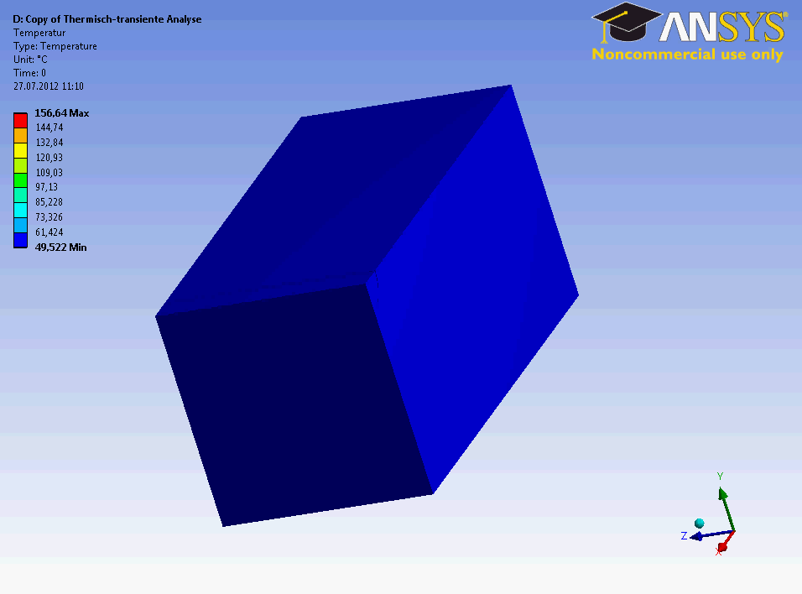
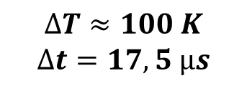
- fixed titanium rectangular target for dynamical studies
- gamma rays penetrates it`s and electron-positron pairs are produced
- the heat loads is simulated via FLUKA Monte Carlo code
Temperature distribution in a test target
28.8 MeV photon beam
$$∆T≈100 K$$
$$∆t=17,5 µs$$

Slide 7
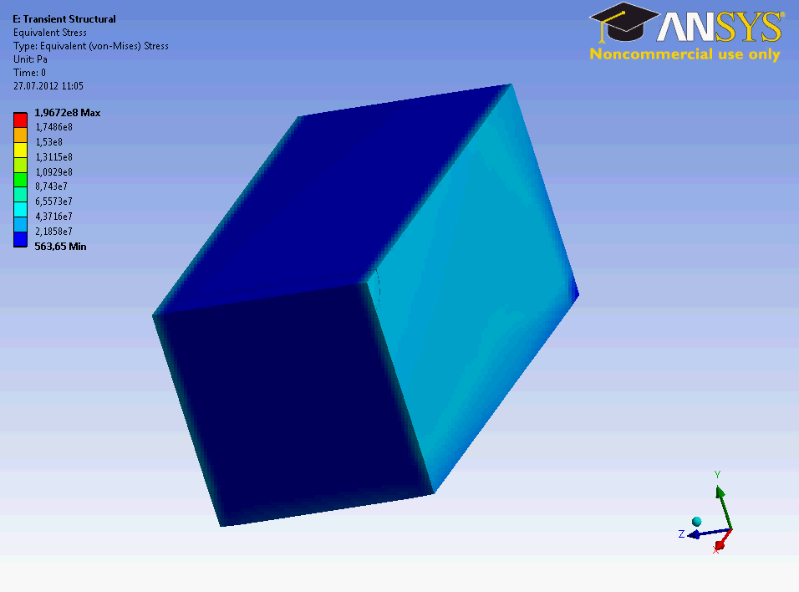
Dynamical stress evolution in a test target
upper limit of renewable strain(elastic) = 800 MPa
Fatigue stress (Ti) < 400 MPa

Slide 8

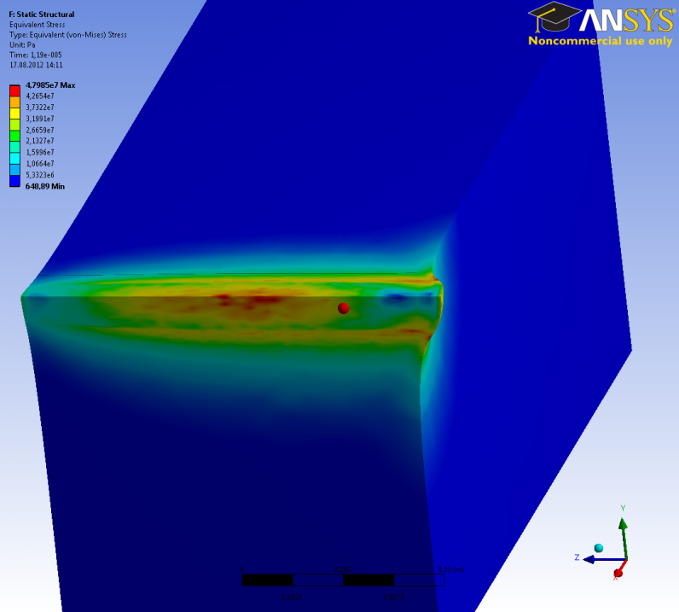
Dynamical and static stress calculations
Dynamic
Static
The stress maximum is induced by wave superposition. The maximum of the stress area is close to the center of body but not on in the maximal heated area of the target. The static stress value is about 50 MPa. This is a factor of 4 less than in the case of the dynamic stress evolution with value of about 200 MPa for 50 bunches at the same place.

Slide 9
Conclusion
The solid Ti target hitted by an intense photon beam with ILC time structure behaves like liquid material.
It seems that depending on the geometry and target material properties, the periodic heat load due to an intense beam can produce strong stress waves which easily exceed the elastic limit. It could be possible that these waves build up further and could destroy the target.

Slide 10
Thanks for your attention!

