Slide 1
DESY Summer Student 2010
Test of the Stefan-Boltzmann behavior for T>0 at tree-level of perturbation theory on the lattice
Carmen Ka Ki Li
Imperial College london
Supervised by Karl Jansen and Xu Feng
John von Neumann-Institut für Computing
09.09.2010

Slide 2
Introduction
Image source: http://www-alice.gsi.de/fsp201/qgp/hist_univ.gif
Phase Transition
Need lattice QCD to calculate the critical temperature
Deviation from continuum
Cost of simulation ~ lattice spacing a ⁻⁶
Need fermion action that gives quick convergence to the continuum limit
Wilson Fermion
Ginsparg Wilson (GW) Fermion

Slide 3
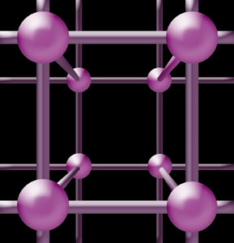
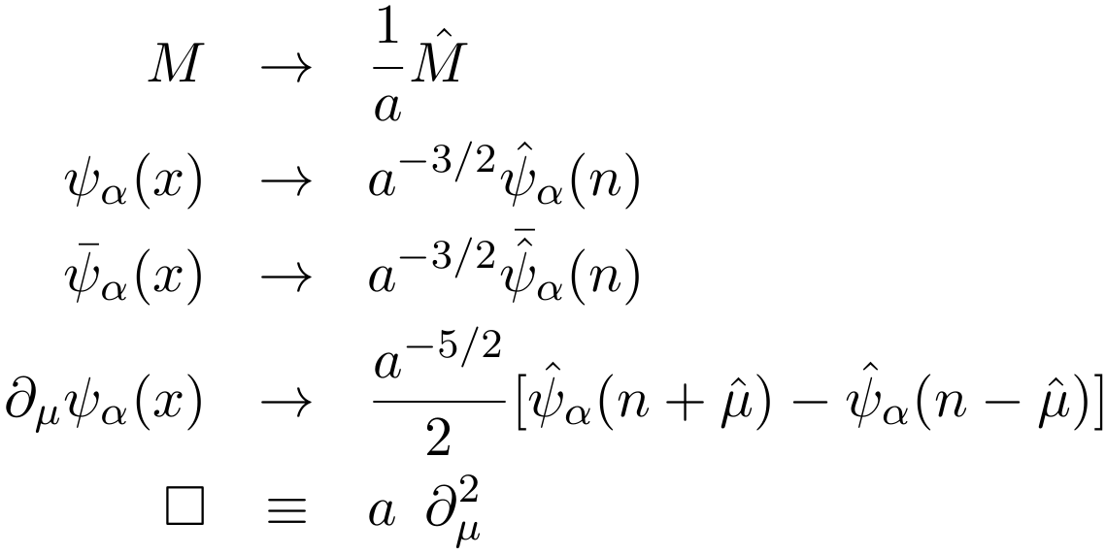
Naïve Discretization
The simplest action for the Dirac equation in Euclidean time
Discretization by substitution with dimensionless variables
The action becomes
a
with
,

Slide 4
Naïve Discretization – Poles
Fermions obey Grassmann Algebra → propagator is given by
Take the Fourier transform and a → 0 we recover the familiar form
Poles on the lattice satisfy
Setting p_{i} = 0 for i = 1, 2, 3 ;
In the limit a → 0 we recover the stationary quark solution
But is also a solution
Similarly we could have set
16 poles = 16 quarks in the continuum limit!
for

Slide 5
Wilson Fermions
Wilson Fermion Action ;
Recover Dirac action in continuum since extra term vanishes linearly with a
Fermion matrix in momentum space
Take the inverse and a → 0 then again recover continuum propagator
Poles:
A pole exists at
π phase shift → poles satisfy
Taking the limit a → 0 RHS diverges
So is no longer a solution in continuum
Same for

Slide 6
Ginsparg Wilson Fermions
Wilson term gets rid of doublers but breaks chiral symmetry
Chiral symmetry – Lagrangian remains invariant under the transformation from a left handed massless fermion to a right handed one
Nielsen – Ninomiya theorem: cannot have no doublers without breaking chiral symmetry for zero mass quark
GW Fermion Action
Lattice chiral symmetry for any a > 0 such that in continuum limit standard chiral symmetry is restored
To eliminate the unphysical poles it requires
For calculation we use
1

Slide 7
Partition Function
In classical mechanics the partition function Z is given by
In quantum mechanics it can be written as
Path Integral
The relation between time and temperature
Wick Rotation t = -iτ
Substitute time interval T = -iβ
Impose anti-periodic boundary condition (APBC) in time because fermions anti-commute
Can evaluate partition function Z using path integral:
Z ( Temp )

Slide 8
Partition Function on the Lattice
To evaluate Z numerically we need to discretize it
Time extent of lattice = ; spatial extent =
The integral S becomes a matrix multiplication
Fermions represented by Grassmann numbers
Use the relation Z = det K
Fourier Transform – K is in block diagonal form in momentum space
Wilson Fermions
GW Fermions

Slide 9
Free Energy Density
The free energy density f is defined by
For T >0 choose ; T =0 when
Fix big enough g such that for finite size effects are negligible
Stefan – Boltzmann Law
Calculate the ratio
See how fast R converges to 1 as increases
Use as

Slide 10
Massless Quark

Slide 11
Massless Quark – Finite Size Effect

Slide 12
Non-zero Quark Mass
Free energy density
R converges to instead of 1
Use
Compute the new ratio
Can also look at how cut-off effect changes with quark mass

Slide 13
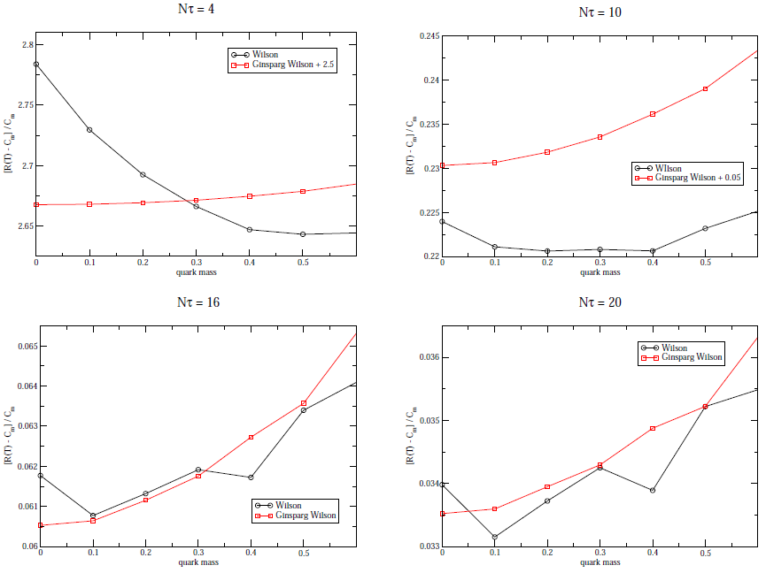
Non-zero Quark Mass

Slide 14
Conclusion
For the error from the Wilson formulation is 280% whereas for the GW formulation it is just 18%
So for small GW is much better
But if you have both are equally good (as far as cut-off effects are concerned)
Wilson is much simpler therefore saves computation time and hence cost
GW preserves chiral symmetry

Slide 15
Questions?

Slide 16
Erratum
Page 3 equation 2
Page 3 equation 3
Page 3 second last line
Page 4 equation 14
Page 6 top line “The GW propagator kernel is”

Slide 17
References
[1] H. J. Rothe, “Lattice gauge theories: An Introduction” World Sci. Lect. Notes Phys. 74
(2005)
[2] K. G. Wilson, “New Phenomena in Subnuclear Physics” Erice Lecture Notes (1975), ed. A.
Zichichi, Plenum Press (1977)
[3] H. B. Nielsen and M. Ninomiya, “Absence of Neutrinos on a Lattice. 1. Proof by Homotopy
Theory” Nucl. Phys. B185, 20 (1981)
[4] P. Ginsparg and K. G. Wilson, Phys. Rev. D25 (1982), p. 2649
[5] A. Zee, “Quantum Field Theory in a Nutshell” Princeton University Press (2003)
[6] C. Gattringer and C. B. Lang, “Quantum Chromodynamics on the Lattice: An Introductory
Presentation (Lecture Notes in Physics)” Springer (2009)
[7] U. M. Heller, F. Karsch and B. Sturm, “Improved Staggered Fermion Actions for QCD
Thermodynamics” Phys.Rev. D60 (1999) 114502 [arXiv:hep-lat/9901010v1]

Slide 18
Thank you! =)

Slide 19
Ginsparg Wilson Fermions
Choose the positive root of
Then for any poles to exist it requires that
Since
By squaring the pole equation and keeping leading terms we recover the physical pole
To eliminate the π/a shifted solutions in the continuum we need
At least one =1
So we need
Hence it requires to eliminate the unphysical poles in the continuum limit

